Slide 1
Line List Editor

Slide 2
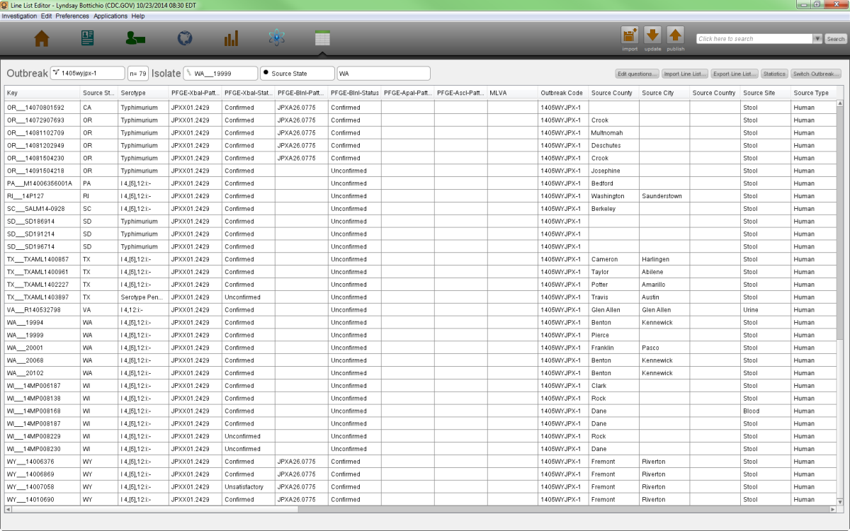
Line List Editor (LLE)
Manage line lists for outbreaks
Identify isolates belong within outbreaks
Quickly analyze yes/no variables
Important Helpers: None

Slide 3
Three Ways to Edit a Line List
Edit Isolate Pop-Out Box
Type directly in the line list
Export a line list and re-import when completed

Slide 4
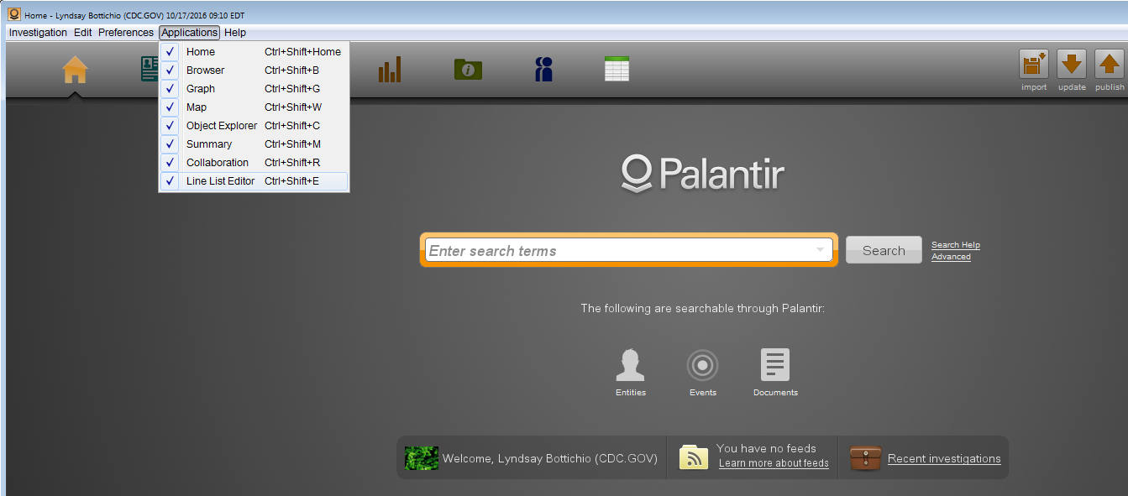
But first – let’s make sure you have LLE turned on!
In your top application icon list, you should see an icon that looks like an excel spreadsheet. If you do, you are good to go to the next slide!
If you do not see the LLE icon, go to Applications and select the LLE application. If it does not automatically open, click the icon to now open it.
Step 1
Step 2

Slide 5
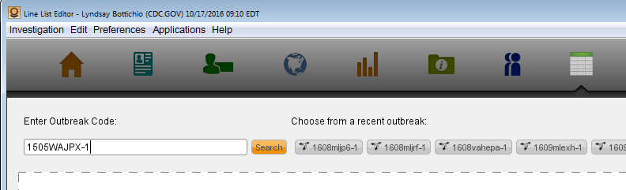
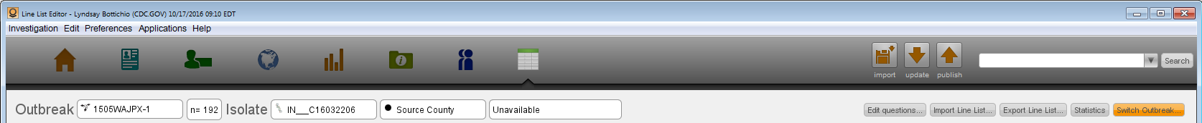
Finding an Outbreak in LLE
Once LLE is open, enter the outbreak code into the search box and then click “Search”. Note: This search bar is NOT case sensitive.
If you want to change the line list you are viewing, click “Switch Outbreak”, and repeat Step 1.

Slide 6
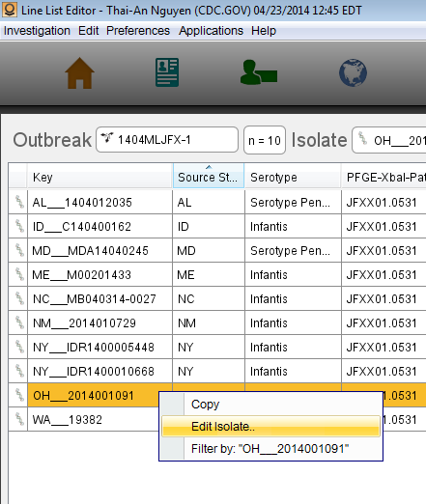
Method One: Edit Isolate Pop-Out Box
Scroll through the isolates on the line list you have selected until you find the isolate you want to edit. Right click on the isolate and select “Edit Isolate”.

Slide 7
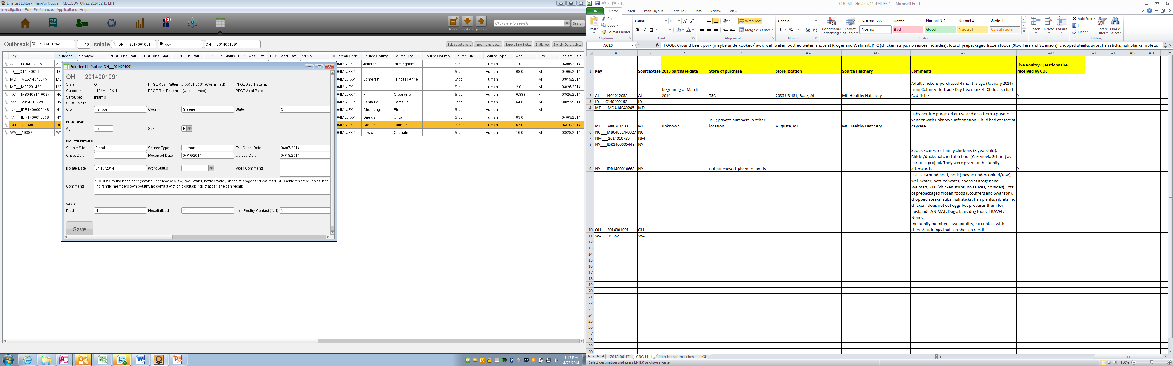
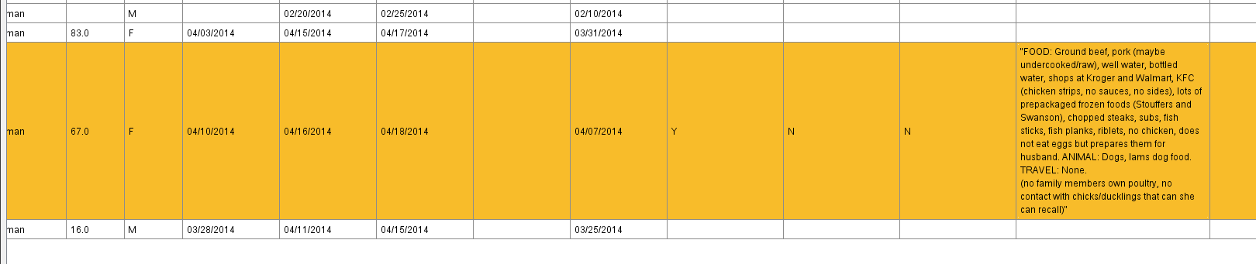
Method One cont.
A pop-out box will appear where you can
fill and update information into the line
list. Click save when done entering data
and you can see it in the line list.

Slide 8
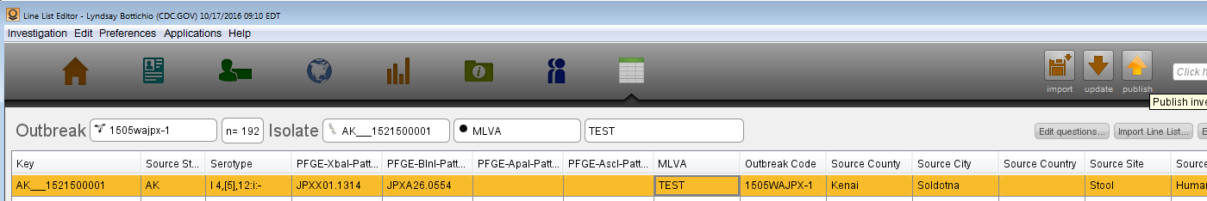
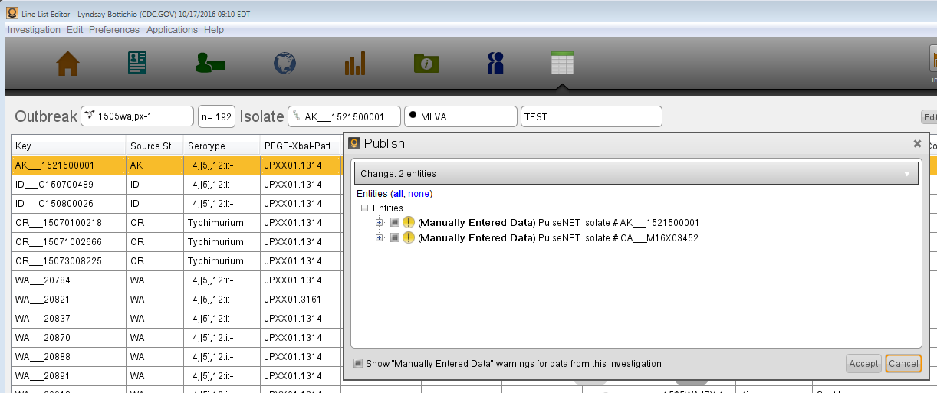
Method One Cont. 2
MOST IMPORTANT STEP! Once you have finished making updates, you MUST publish your changes in order for others to see your updates.
Select all updates to publish and then click accept.

Slide 9
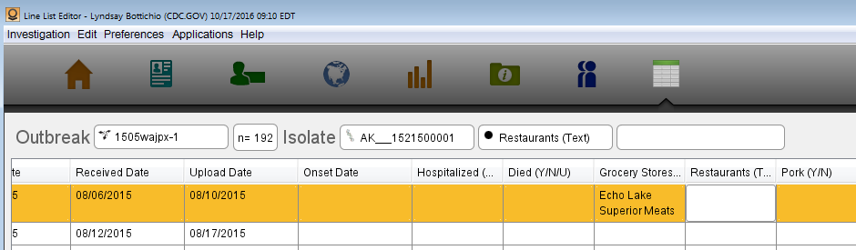

Method Two: Directly in the Line List
As before, find the isolate you wish to edit. Scroll to the right and then double click in the field you want to edit. Type as you would in an excel spreadsheet.

Slide 10
Method 2 cont.
MOST IMPORTANT STEP! Once you have finished making updates, you MUST publish your changes in order for others to see your updates.
Select all updates to publish and then click accept.

Slide 11
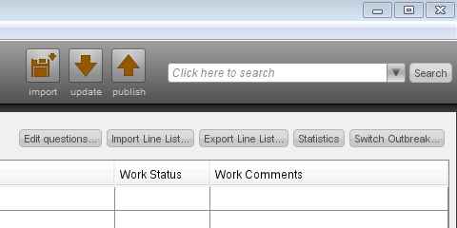
Method Three: Exporting and Importing
For outbreaks where a state may need to update many isolates at once, you can export to Excel, make updates, and upload these changes. States can copy and paste from their own state database, but cannot add new variables or new isolates.
Click Export Line List (near the upper right corner) and follow the prompts:
  Which state do you want to edit?
  Where do you want the file saved? (I usually recommend your desktop.)

Slide 12
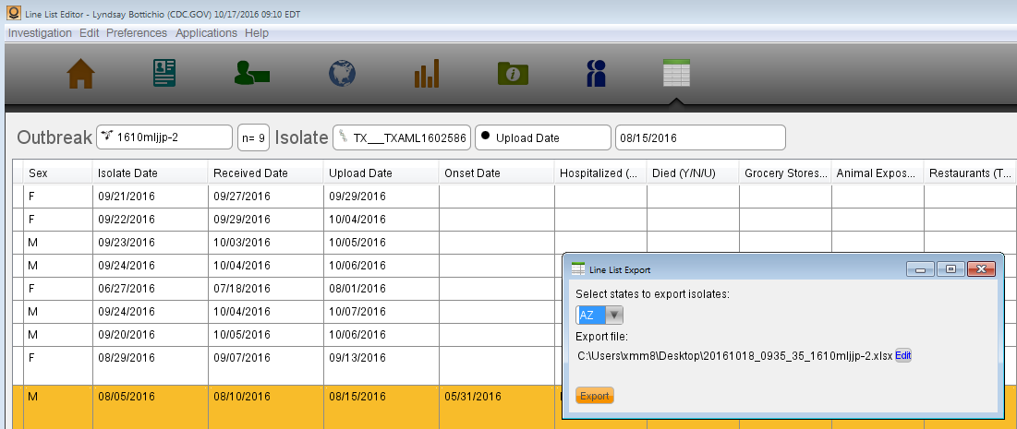
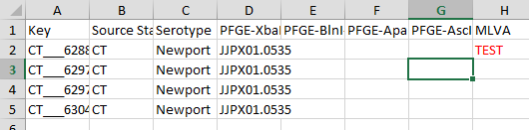
Method 3 cont.
Hit Export. The file should automatically open, but you may need to open it from your saved location.
Make your updates in the excel sheet, then save.

Slide 13
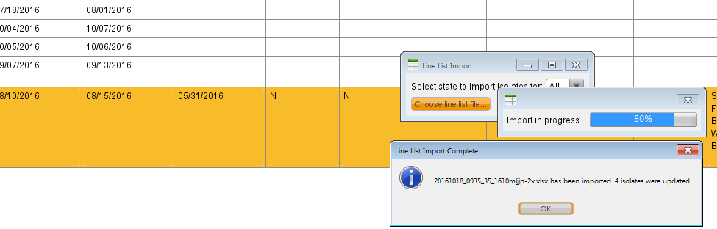
Method 3 cont. 2
To upload your changes, click Import Line List and follow the same prompts (which state, location of the file).
A message will appear to indicate that information was uploaded to the line list. Check to make sure your updates loaded correctly (dates can be tricky!).

Slide 14
Method 3 cont. 3
MOST IMPORTANT STEP! Once you have finished making updates, you MUST publish your changes in order for others to see your updates.
Select all updates to publish and then click accept.

Slide 15
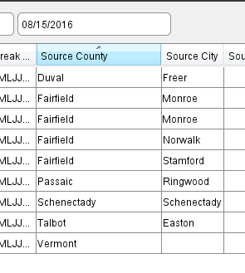
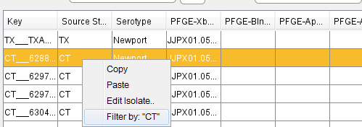
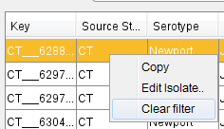
LLE Tips and Tricks
You can sort by any of the column names by clicking on the header. One click will sort A-Z (or oldest to newest) and two clicks will reverse the order.
2. You can filter by right clicking on any piece of information and selecting “Filter by” that piece of information. Right click and select “Clear Filter” to undo it.

Slide 16
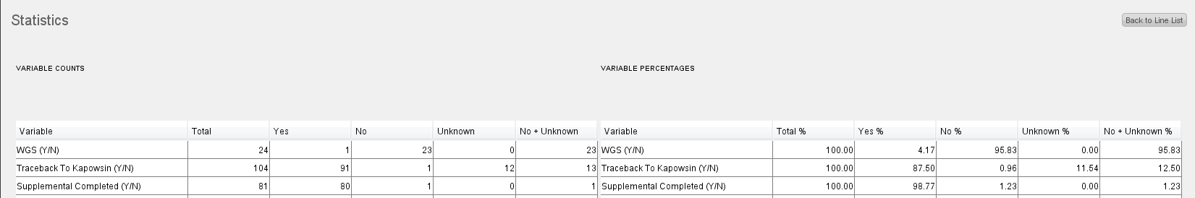
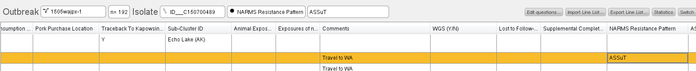
LLE Tips and Tricks cont.
To get a quick count of variables that are Y/N/U (not including standard variables like hospitalized and died), click Statistics.
To leave the statistics page, click “Back to Line List”
If an isolate has been tested for antimicrobial susceptibility, the results will be near the end of the line list for that isolate.

Slide 17
Important Notes about LLE
Everyone can view all the data in the line list
Rules are set in place to limit who can edit the data
  Each state user can edit their own state’s data
  Each state user cannot edit any other state’s data
  If a local user has access, they can edit the state’s data and not just their own jurisdiction
All changes are tracked in history, so changes can be reversed or nullified (contact Lyndsay for this)
Please enter as many exposures as you have data on in the “Exposures of Note, Grocery Stores, Restaurants, and Animals” variables, as these are free-text fields that can be analyzed with Text Cloud (will learn this later)
Note if you have attached a questionnaire to an individual isolate in the “Comments” variable (will learn this later)
Note if this isolate is a duplicate or secondary case in the “Comments” variable

Slide 18
Closing slide
For more information, contact:
Lyndsay Bottichio (xmm8@cdc.gov)
404-639-0570
https://sedric.cdc.gov
The findings and conclusions in this report are those of the authors and do not necessarily represent the
official position of the Centers for Disease Control and Prevention.

