Slide 1
Age-Adjusted Prevalence of Diagnosed Diabetes and Obesity Among Adults, by County, United States (2004, 2009, 2014, 2019)

Slide 2
Methods
Data from CDC's Behavioral Risk Factor Surveillance System (BRFSS) and from the US Census Bureau's Population Estimates Program were used for county-level estimates of diagnosed diabetes and obesity.
Prevalence Definitions
Diagnosed diabetes: response of “yes" to the question, "Has a doctor ever told you that you have diabetes?" Women who indicated that they only had diabetes during pregnancy were excluded.
Obesity: body mass index of ≥30 derived from self-report of height and weight.
Estimates were restricted to adults aged ≥20 years.
Estimates were based on the power prior log-weights (PLOW) approach*.
Rates were age adjusted to the 2000 US standard population using age groups 20-44, 45-64, and ≥65 years.
* Xie H, Barker LE, Rolka DB. Incorporating design weights and historical data into model based small area estimation. J Data Sci. 2020;18:115-131.

Slide 3
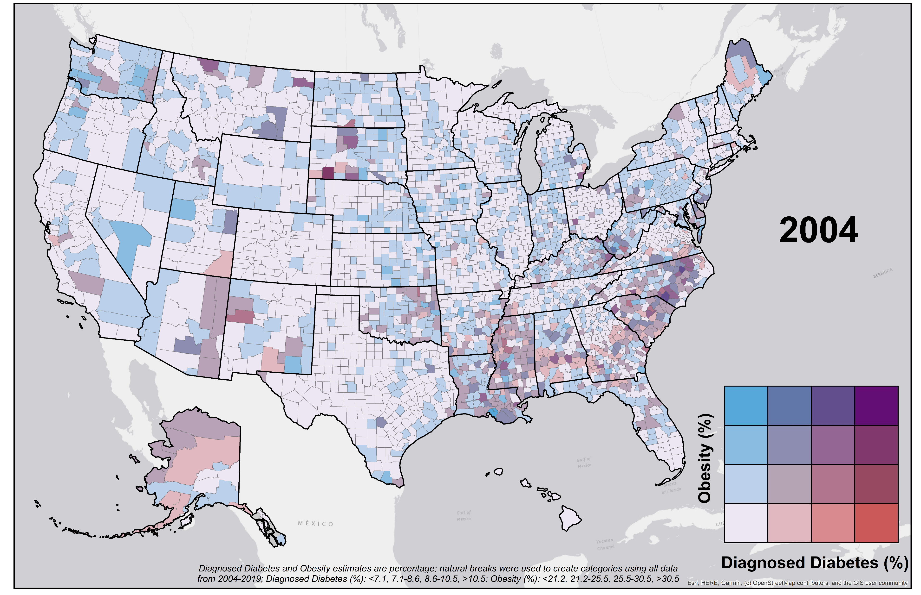
Map of diagnosed diabetes vs obesity by county among US adults, 2004.

Slide 4
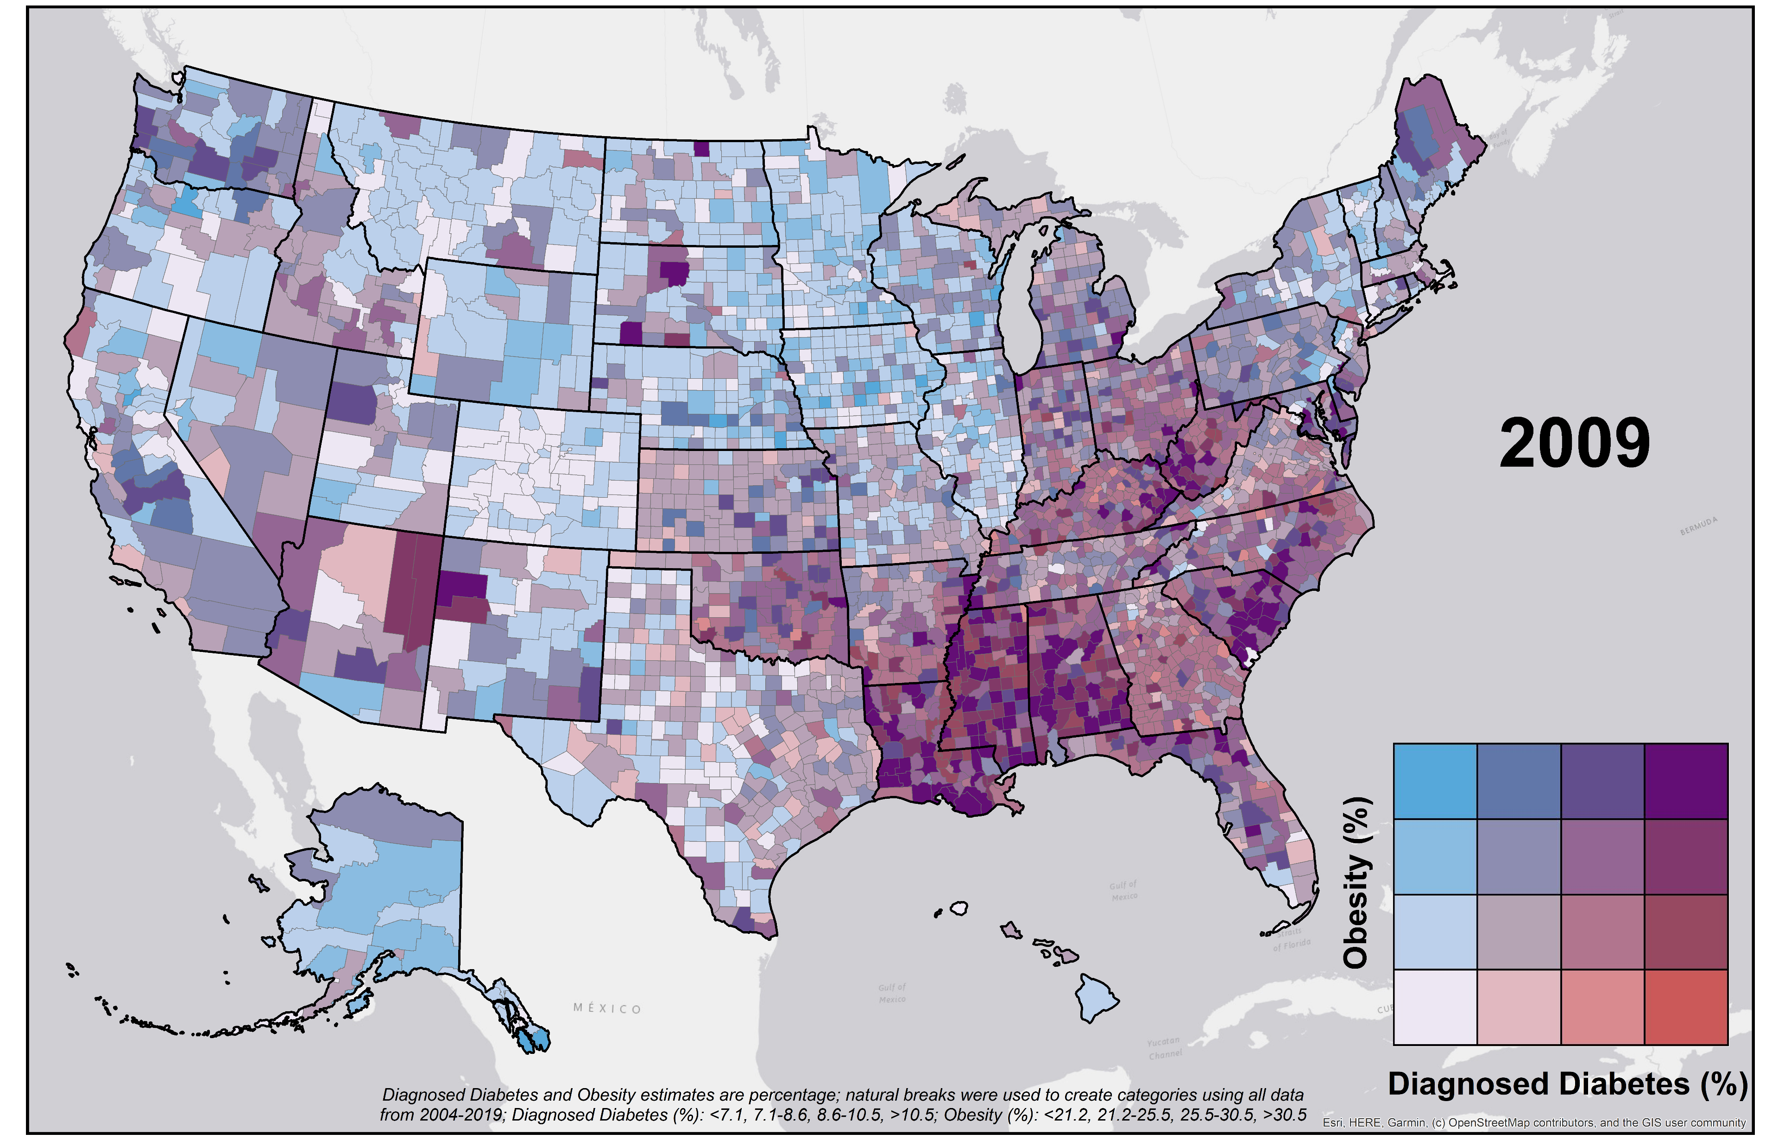
Map of diagnosed diabetes vs obesity by county among US adults, 2009

Slide 5
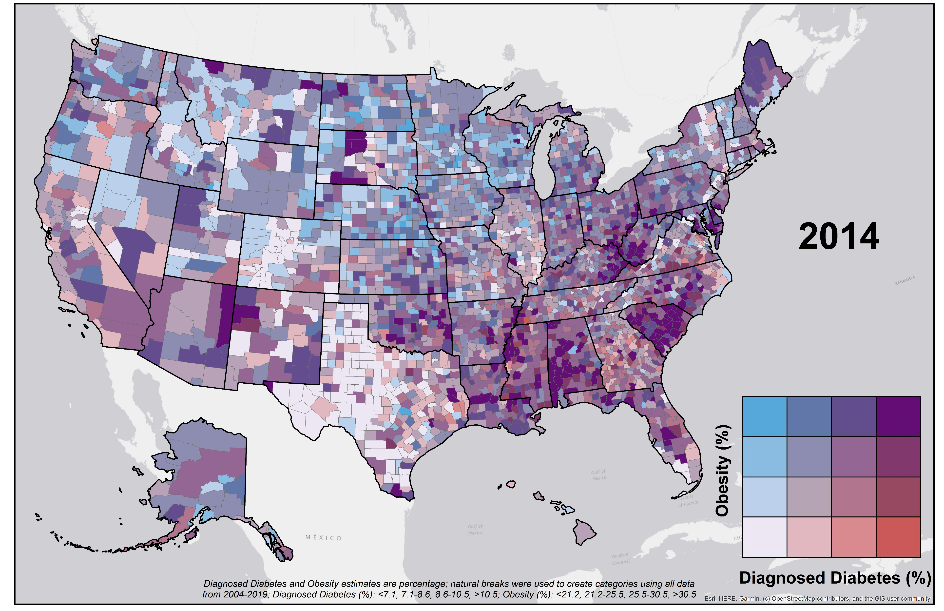
Map of diagnosed diabetes vs obesity by county among US adults, 2014

Slide 6
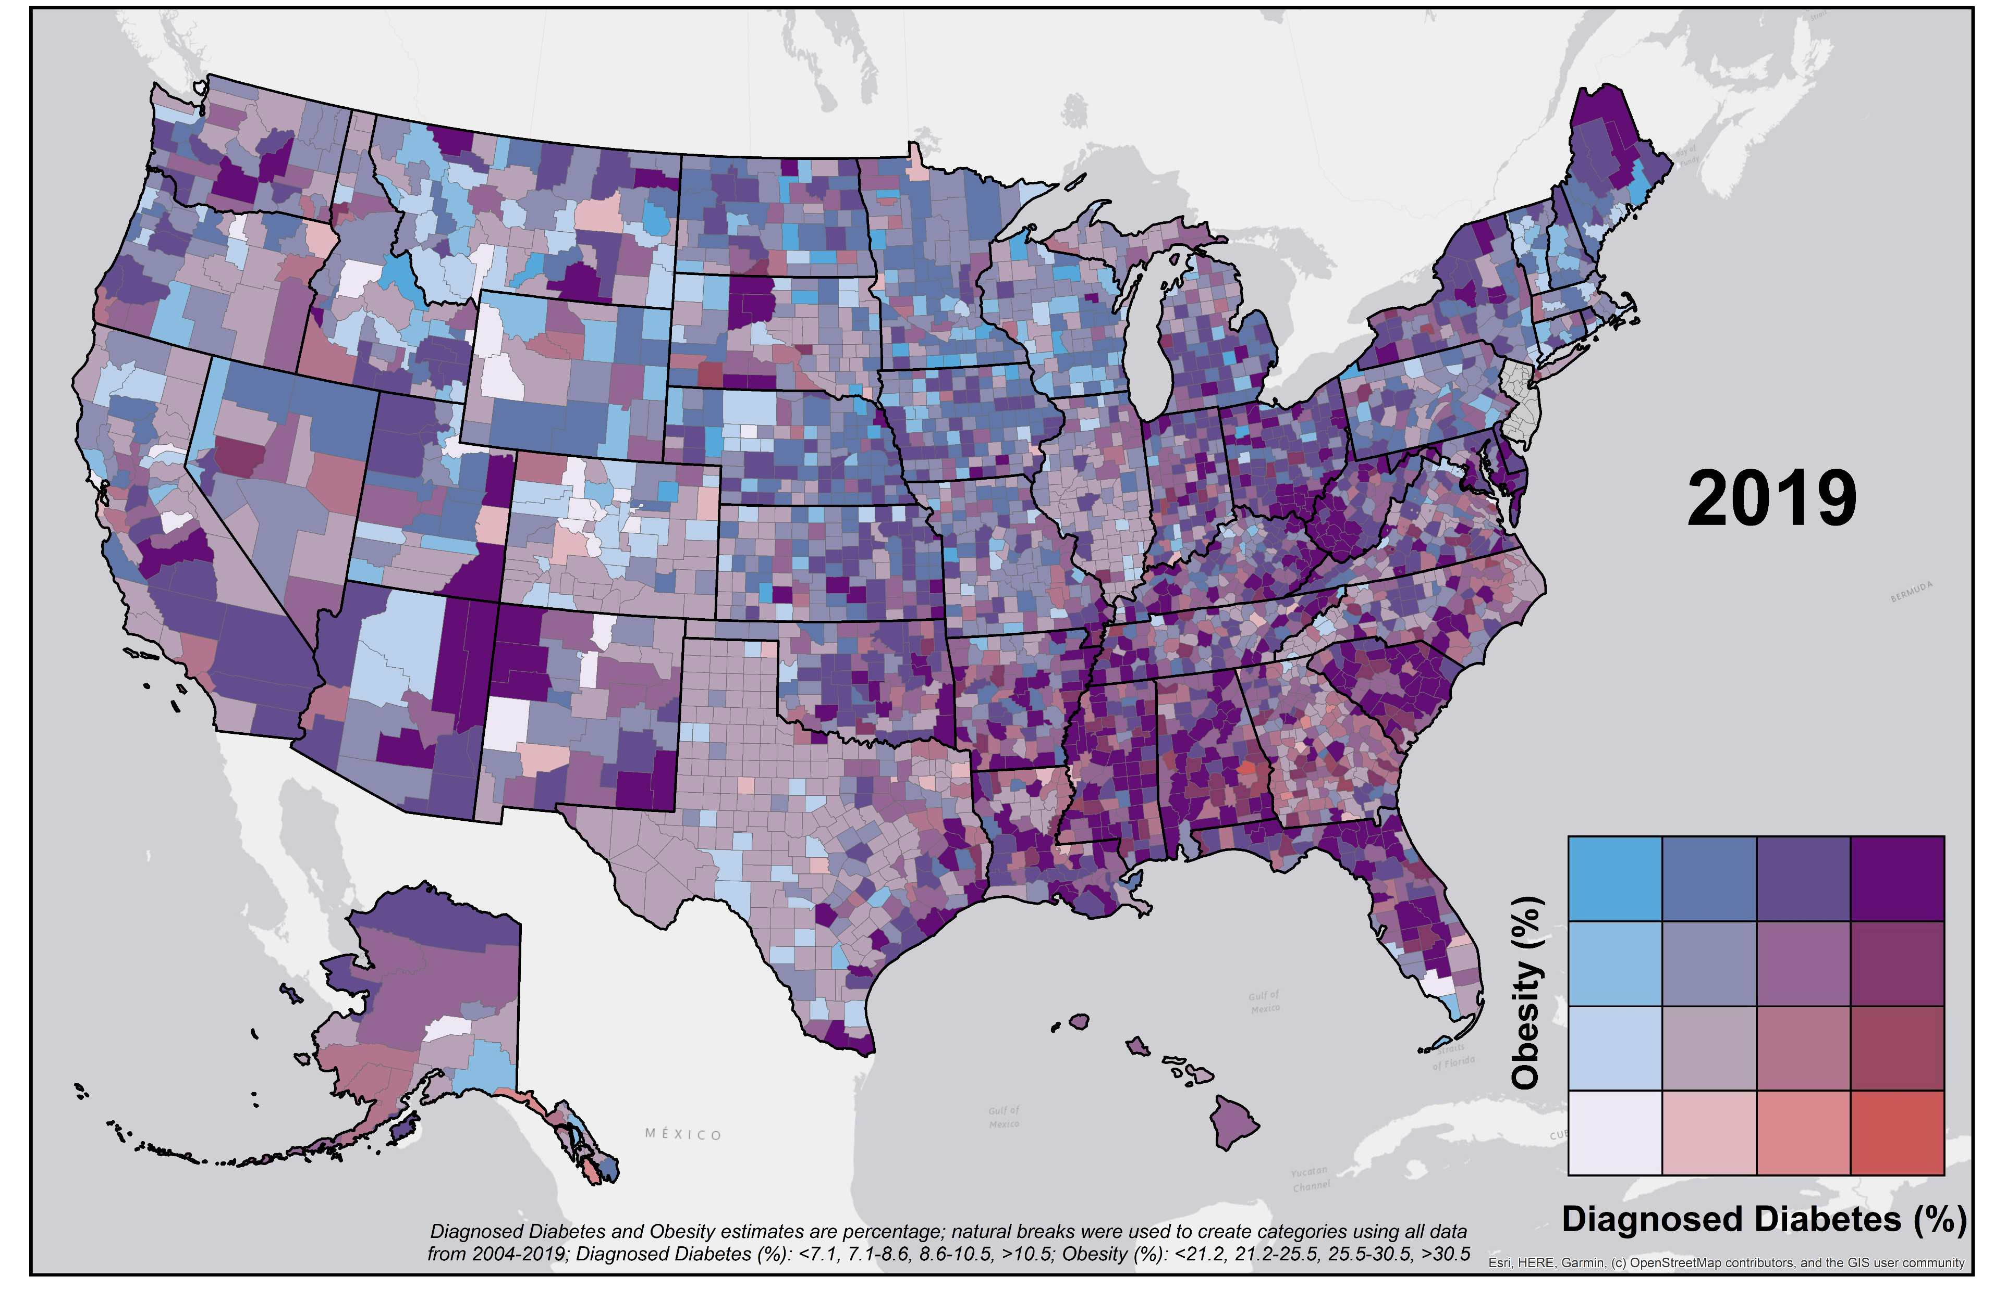
Map of diagnosed diabetes vs obesity by county among US adults, 2019

