Slide 1
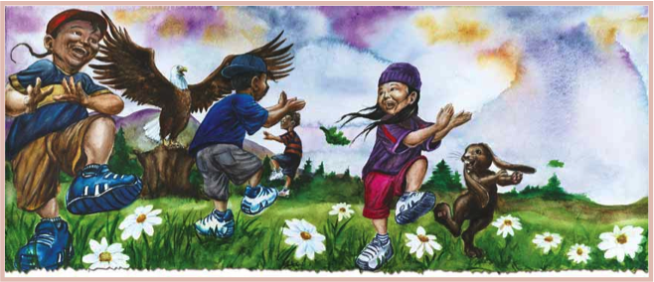
Creating Eagle Books Events

Slide 2
What is an Eagle Books Event?
A half-day health fair?
A school assembly?
A week-long series of activities?
A culture camp or retreat theme?
A daily or weekly classroom activity?
Other? It is an occasion—created by your own community— that uses the characters and messages of Eagle Books to bring people together for fun, learning, and motivation to exercise and eat more healthy foods.
Notes:
An Eagle Books event may take any form:
a half-day health fair
a school assembly
a retreat
a daily/weekly classroom activity
a party or culture camp theme
a week-long series of activities
Essentially, an Eagle Books event incorporates the characters and messages of Eagle Books to promote healthy eating and exercise particularly in reference to combating diabetes.

Slide 3
Strength in Numbers
Enlist lots of people to help plan your event.
health clinics and programs
teachers and coaches
school boards
tribal leaders
businesses
youth programs
parents and grandparents
When embraced by the entire community, lasting healthy lifestyle changes become much more possible.

Slide 4
Your Resources
Eagle Books events can be simple and easy to plan.
http://www.cdc.gov/diabetes/pubs/eagle.htm hosts free planning, activity, educational, publicity, and incentive materials.
Check them out!
Notes:
Eagle Books events may be relatively simple and can be inexpensive to conduct. The scale of your event is up to you. Planning, activity, educational, publicity, and incentive materials are available for print, free of charge, at http://www.cdc.gov/diabetes/pubs/eagle.htm.
Information on ordering single and multiple copies of the Eagle Books is available at this site.
Become familiar with the materials and information posted online early in your planning to get ideas and options for event.

Slide 5
To Begin…
Become familiar with resources posted at http://www.cdc.gov/diabetes/pubs/eagle.htm
Confirm participants and sponsorships
Select a date and location
Plan publicity
Develop event activities
Notes:
Become familiar with resources posted online. This will help you determine, early on, what is already available for your event.
Confirm participants and sponsorships
Select a date and location
Plan publicity
Develop event activities
Strive to get Eagle Books in the hands of children, parents, and educators well before your event, if possible, to increase familiarity and build anticipation

Slide 6
Activity Suggestions
Diabetes bingo
Seed planting
Traditional food tasting
Drum and dance performance
Explore how many servings are contained in a package or container and the number of calories per serving
Visits by safety, health, and sports mascots
Storytelling by Elders
Diabetes talking circle
Exercise and heart rate charting
Examine fat, sugar, and nutritional content of various foods
Physical challenges
Notes:
Consider these as activities at your event:
Diabetes bingo
Art exploration
Explore how many servings are actually contained in a package or container and the number of calories per serving
Examine fat, sugar, and nutritional content of various foods
Seed planting
Physical challenges
Visits by safety, health, and sports mascots
Storytelling by Elders
Diabetes talking circle
Eagle books plays
Exercise and heart rate charting
Traditional food tasting
Drum and dance performance

Slide 7
FYI: IHS Best Practices
Eagle Books activities can be used to support 11 of the Best Practices adopted in 2009 by the Indian Health Service (IHS) for diabetes programs.
Community Advocacy
Community Screening
Diabetes and Pregnancy
Diabetes Systems of Care
Diabetes Self-Management Education
Nutrition
Oral Health
Physical Activity
School Health & Diabetes
Youth & Type 2 Diabetes
Adult Weight Management

Slide 8
Stage Your Event
Notes:
This Eagle Books Game Plan is one example of how to choreograph your event. In this plan, children are divided into groups, each group starting at a different activity. After a specified time allowance, groups rotate from one activity to the next until each group has participated at each stop. The Eagle Books Game Plan is posted online.

Slide 9
Samples of Event Staging
Divide children into groups and rotate groups from one activity to the next.
Have the entire group of participants experience one activity at a time.
Allow each participant to choose the order of activities.
Materials are posted online to support whatever staging works best.
Notes:
The number and ages of attendees will determine how best to move them through the activities planned and how much time to allow at each stop.
Some activities may work as “walk-ins welcome,” where others—Elder storytelling or dance lessons, for example—will work best with official start/stop times.
Have Eagle Books read; show the video animated stories; supply crayons, paper, and Eagle Books materials; or have another plan for early/late arrivals or children who may have to wait briefly before beginning an organized activity.

Slide 10
To Conclude…
Wrap up and clean up
Thank all supporters
Encourage feedback to determine what worked best and what can be improved
Plan for next year’s event
Notes:
Be certain your event ends at the specified time. Clean the facility, take out trash and recycling, return keys, etc. and any other closing tasks as appropriate. Thank all those who helped orchestrate and support your event by sending written correspondence. Eagle Books materials are available for that use. You may wish to call and thank assistants and sponsors as well.
Plan for next year’s event

Slide 11
For further information email: cdcinfo@cdc.gov
or call 800-CDC-INFO (800-232-4636)

