Slide 1
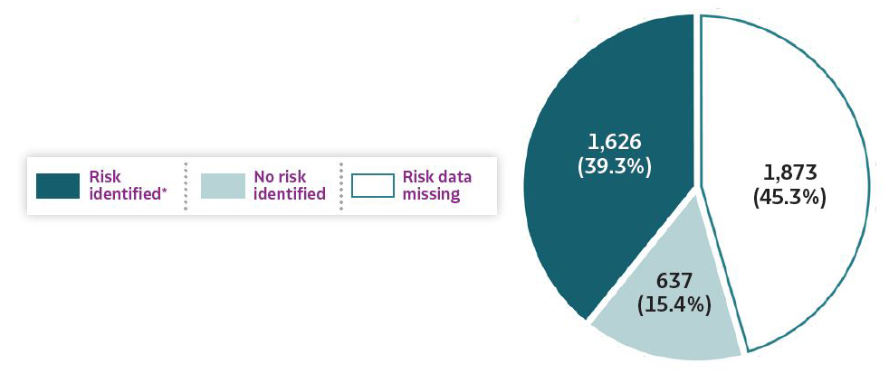
2019 VIRAL HEPATITIS
SURVEILLANCE REPORT
Figure 3.7. Availability of information regarding risk behaviors or exposures*† associated with reported cases of acute hepatitis C virus infection — United States, 2019
Source: CDC, Nationally Notifiable Diseases Surveillance System.
* Case reports with at least one of the following risk behaviors/exposures reported 6 weeks to 6 months prior to symptom onset or documented seroconversion if asymptomatic: 1) injection drug use; 2) multiple sexual partners; 3) underwent surgery; 4) men who have sex with men; 5) sexual contact with suspected/confirmed hepatitis C case; 6) sustained a percutaneous injury; 7) household contact with suspected/confirmed hepatitis C case; 8) occupational exposure to blood; 9) dialysis; and 10) transfusion. Reported cases may include more than one risk behavior/exposure.
† Risk behaviors/exposures data from one state was classified as ‘missing’ because of errors in reporting.

