Slide 1
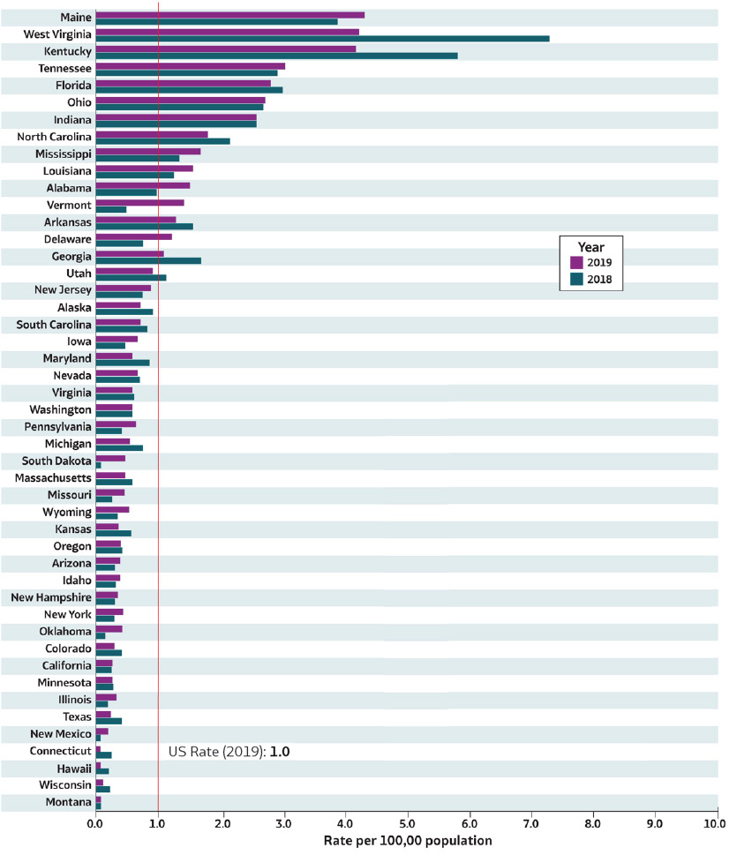
2019 VIRAL HEPATITIS
SURVEILLANCE REPORT
Figure 2.2. Rates* of reported acute hepatitis B† virus infection, by state — United States, 2018–2019
Source: CDC, National Notifiable Diseases Surveillance System.
* Rates per 100,000
population.
† Reported cases that met the classification criteria for a confirmed case. For the case definition, see https:// ndc.services.cdc.gov/conditions/hepatitis-b-acute/.
Only states with rates for 2018 and 2019 are shown. State/ jurisdiction and year for no reported cases: Nebraska (2019), North Dakota (2019); for unavailable data: District of Columbia (2018, 2019), Rhode Island (2018, 2019).

