Slide 1
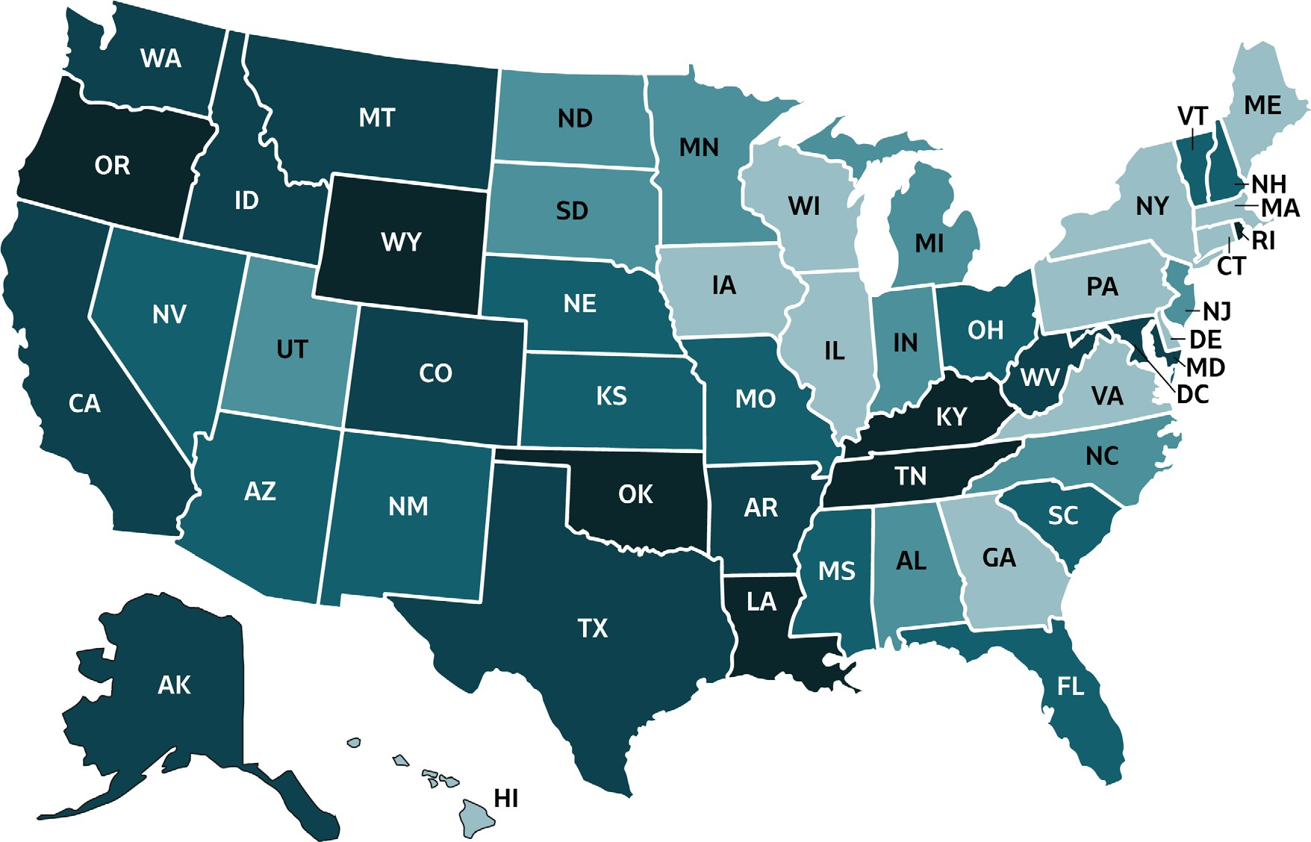
VIRAL HEPATITIS
SURVEILLANCE
Figure 3.9. Rate of deaths with hepatitis C listed as a cause of death among US residents, by jurisdiction and year — United States, 2018
 | Cases/100,000 Population | States
 | 0-2.49 | CT, DE, GA, HI, IL, IA, ME, MA, NY, PA, VA, WI
 | >2.49-3.12 | AL, IN, MI, MN, MO, NJ, NC, ND, SD, UT
 | >3.12-3.85 | AZ, FL, KS, MS, NE, NV, NH, OH, SC, VT
 | >3.85-5.49 | AK, AR, CA, CO, ID, MD, MT, TX, WA, WV
 | >5.49-11.00 | DC, KY, LA, NM, OK, OR, RI, TN, WY
Source: CDC, National Center for Health Statistics, Multiple Cause of Death 2018 on CDC WONDER Online Database.

