Slide 1
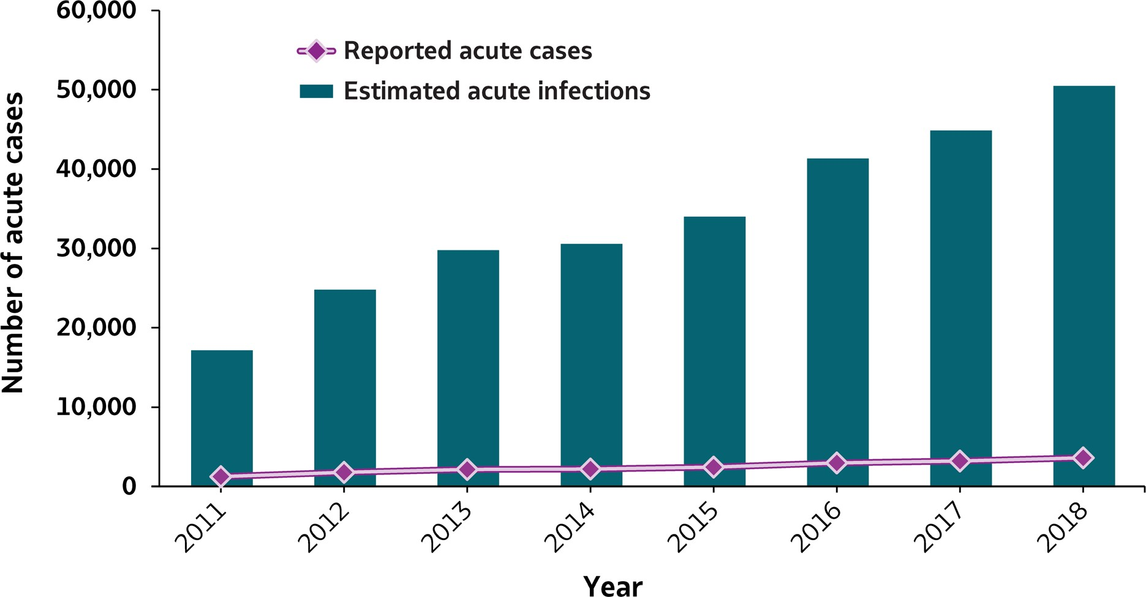
VIRAL HEPATITIS
SURVEILLANCE
Figure 3.1. Number of reported acute hepatitis C cases and estimated infections* — United States, 2011–2018
Source: CDC, National Notifiable Diseases Surveillance System.
* The number of estimated viral hepatitis infections was determined by multiplying the number of reported cases by a factor that adjusted for under-ascertainment and under-reporting⁽⁷⁾. The 95% bootstrap confidence intervals for the estimated number of infections are shown in the Appendix.

Slide 2
VIRAL HEPATITIS
SURVEILLANCE
Figure 3.1. Number of reported acute hepatitis C cases and estimated infections* — United States, 2011–2018
Hepatitis C | 2011 | 2012 | 2013 | 2014 | 2015 | 2016 | 2017 | 2018
Reported cases | 1,232 | 1,778 | 2,138 | 2,194 | 2,436 | 2,967 | 3,216 | 3,621
Estimated cases | 17,100 | 24,700 | 29,700 | 30,500 | 33,900 | 41,200 | 44,700 | 50,300
Source: CDC, National Notifiable Diseases Surveillance System
* The number of estimated viral hepatitis infections was determined by multiplying the number of reported cases by a factor that adjusted for under-ascertainment and under-reporting⁽¹⁰⁾. The 95% bootstrap confidence intervals for the estimated number of infections are shown in the Appendix.

