Slide 1
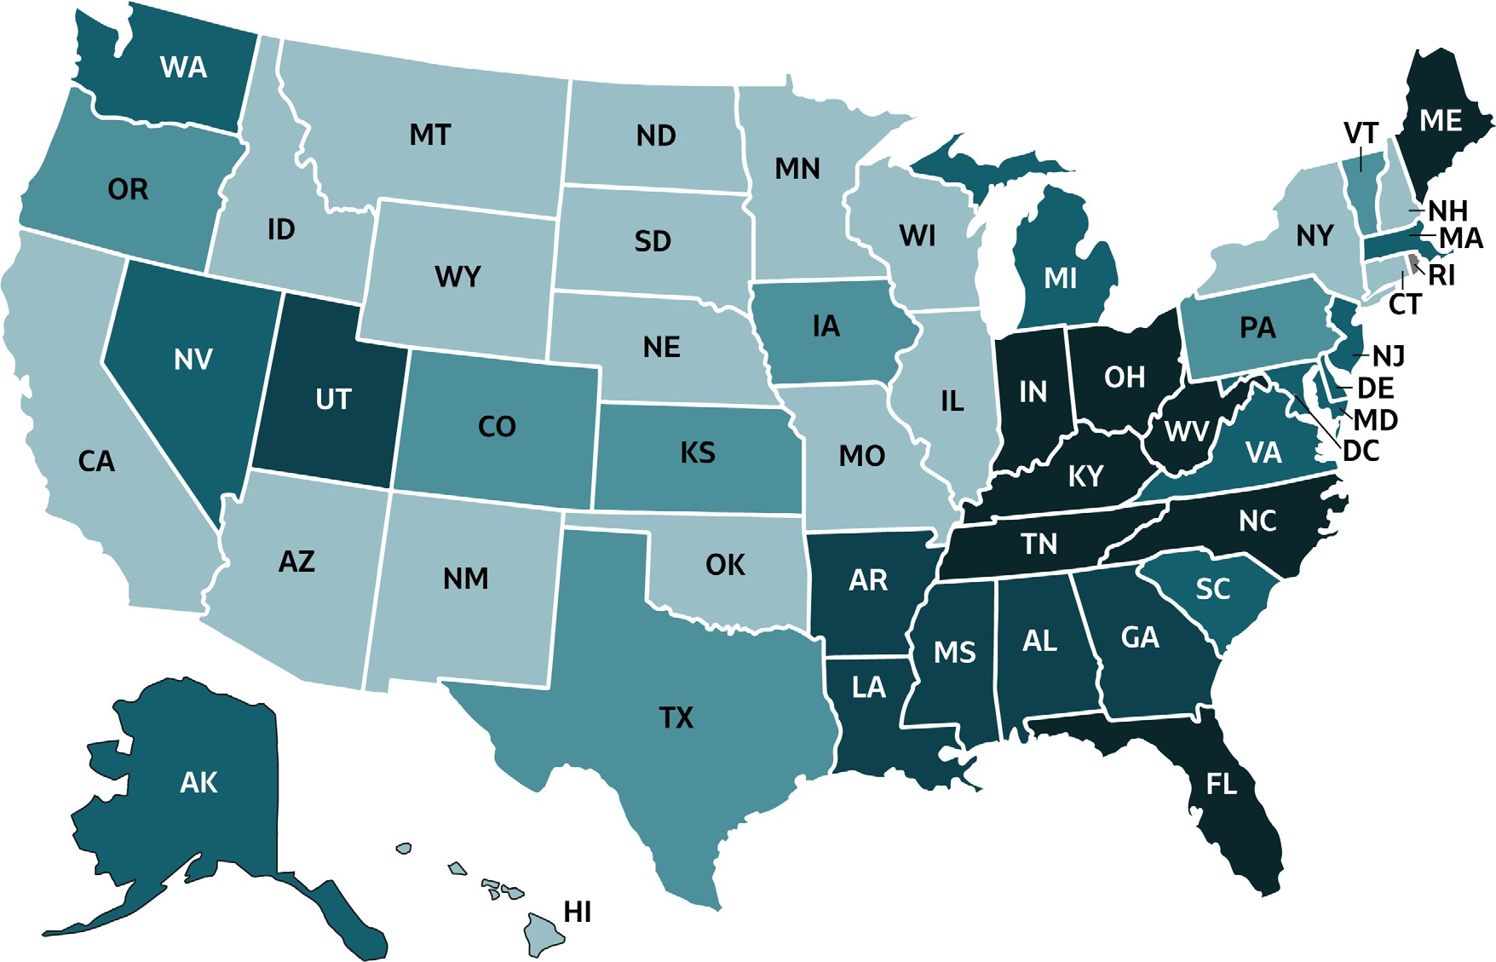
VIRAL HEPATITIS
SURVEILLANCE
Figure 2.3. Rates of reported acute hepatitis B, by state or jurisdiction — United States, 2018
Source: CDC, National Notifiable Diseases Surveillance System.

Slide 2
VIRAL HEPATITIS
SURVEILLANCE
Figure 2.3. Rates of reported hepatitis B, by state or jurisdiction — United States, 2018
Color Key | Cases/100,000 Population | States
 | 0-0.3 | AZ, CA, CT, HI, ID, IL, MN, MO, MT, NE, NH, NM, NY, ND, OK, SD, WI, WY
 | >0.3-0.6 | CO, IA, KS, OR, PA, TX, VT
 | >0.6-0.9 | AK, DE, MD, MA, MI, NV, NJ, SC, VA, WA
 | >0.9-2.0 | AL, AR, GA, LA, MS, UT
 | >2.0-7.3 | FL, IN, KY, ME, NC, OH, TN, WV
 | Data Not Available | DC, RI
Source: CDC, National Notifiable Diseases Surveillance System.

