Slide 1
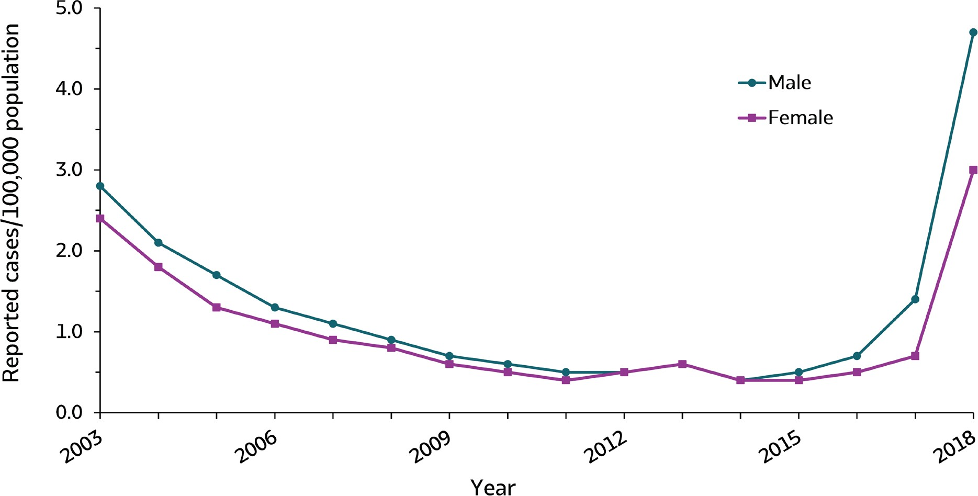
VIRAL HEPATITIS
SURVEILLANCE
Figure 1.5. Rates of reported hepatitis A, by sex — United States, 2003–2018
Source: CDC, National Notifiable Diseases Surveillance System.

Slide 2
VIRAL HEPATITIS
SURVEILLANCE
Figure 1.5. Rates of reported hepatitis A, by sex — United States, 2003–2018
Sex | 2003 | 2004 | 2005 | 2006 | 2007 | 2008 | 2009 | 2010 | 2011 | 2012 | 2013 | 2014 | 2015 | 2016 | 2017 | 2018
Male | 2.8 | 2.1 | 1.7 | 1.3 | 1.1 | 0.9 | 0.7 | 0.6 | 0.5 | 0.5 | 0.6 | 0.4 | 0.5 | 0.7 | 1.4 | 4.7
Female | 2.4 | 1.8 | 1.3 | 1.1 | 0.9 | 0.8 | 0.6 | 0.5 | 0.4 | 0.5 | 0.6 | 0.4 | 0.4 | 0.5 | 0.7 | 3.0
Source: CDC, National Notifiable Diseases Surveillance System.

