Slide 1
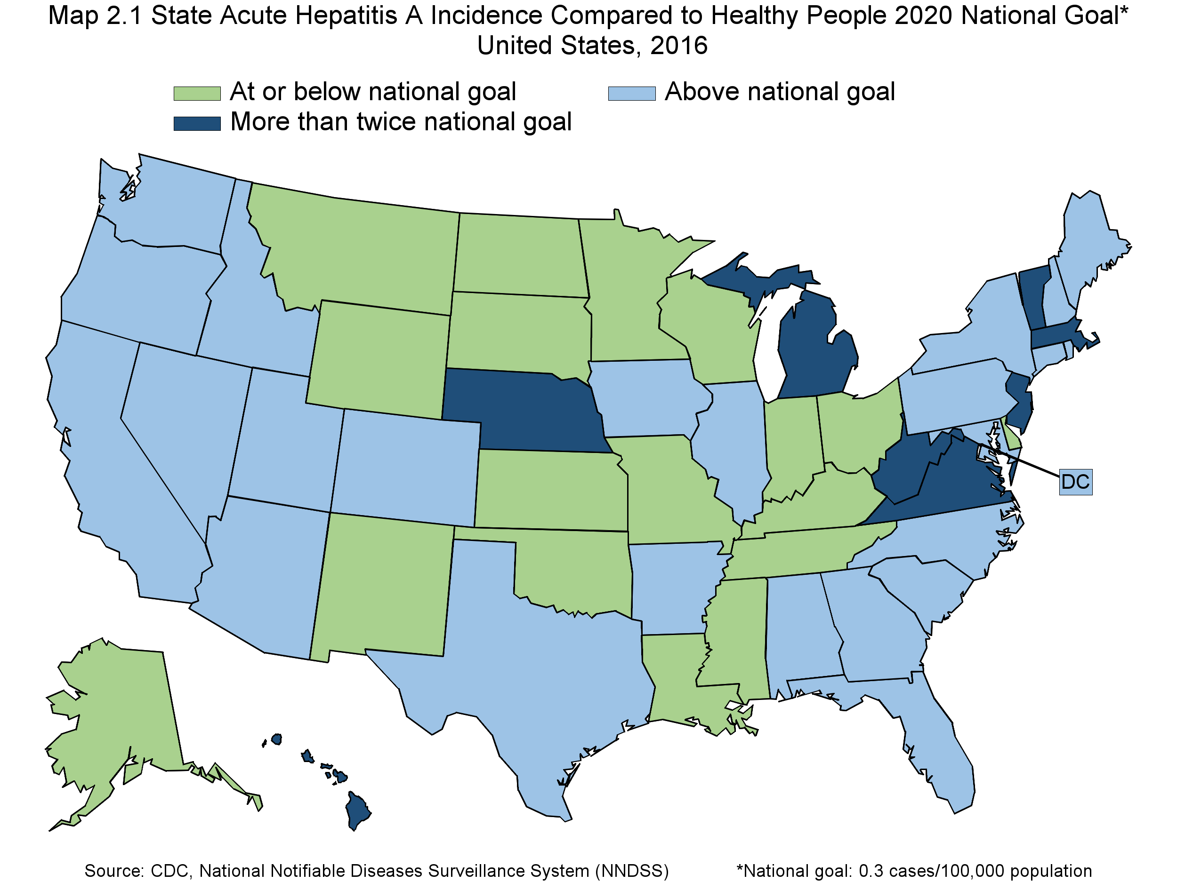
Notes:
Map 2.1 State Acute Hepatitis A Incidence Compared to Healthy People 2020 National Goal of 0.2 cases/100,000 population / United States, 2016.
Three categories: 1. At or below national goal. 2. Above national goal. 3. More than twice national goal. Source: CDC, National Notifiable Diseases Surveillance System (NNDSS)

