Slide 1
Introduction to Contact Investigation Process
Notes:
Explain that this session will be an overview of the contact investigation (CI) process
Reiterate that this session has a lot of didactic information and participants are encouraged to ask questions to keep it engaging
Note to facilitator: Assess participant’s knowledge level regarding the concepts presented in this session and skip or discuss concepts more in-depth as needed. Additionally, you can engage the more experienced participants by having them help explain concepts to participants with less experience.

Slide 2
Learning Objectives
After this session, participants will be able to
Explain the purpose of a TB contact investigation
Describe core concepts and skills that are required to conduct a TB contact investigation
Determine when to initiate a TB contact investigation
Describe the systematic approach to conducting a TB contact investigation
Notes:
Review objectives

Slide 3
Priority TB Control Activities
Identify and treat persons who have active TB disease
Find and evaluate persons who have been in contact with TB cases and provide appropriate latent TB infection (LTBI) or TB disease treatment as needed
Use targeted testing strategies to identify and treat persons with LTBI at risk for developing TB disease
Identify settings at high risk for transmission of M. tuberculosis and apply effective infection-control measures
Notes:
Review the four priority TB control activities
Mention that #2 (contact investigation) is the focus of this course

Slide 4
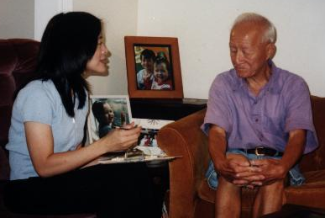
Contact Investigations:
A Priority TB Control Activity
Conducting contact investigations (CIs) is one of the highest priorities for TB programs in the United States
  Second in importance only to
  detection and treatment of TB disease
Notes:
4
Emphasize that CIs are one of the highest priorities for controlling TB

Slide 5
What is a Contact Investigation?
A systematic process to:
  Identify persons (contacts) exposed to cases of infectious TB disease
  Assess contacts for infection with M. tuberculosis and TB disease
  Provide appropriate treatment for contacts with LTBI or TB disease
Case
Contact
Notes:
Emphasize that a CI is not simply identifying contacts; it also entails assessing contacts for LTBI or TB disease, and following them through completion of treatment, as necessary

Slide 6
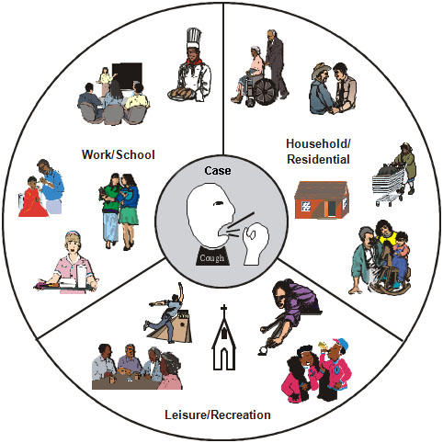
Who are TB Contacts?
Contacts are persons who
have shared airspace with a
person with infectious TB disease. This might include
  Household members
  Friends
  Co-workers
  Others (e.g., cellmates, shelter residents)
Notes:
Review slide content
Ask participants if they can think of other people who may be potential contacts that are not listed on this slide
Additional examples could include: schools, churches, bars, and senior centers

Slide 7
Why is it Important to Conduct TB Contact Investigations? (1)
CIs help to:
  Interrupt spread of TB
  Prevent outbreaks of TB
  Ensure appropriate treatment for LTBI or TB disease
Notes:
Review slide content

Slide 8
Why is it Important to Conduct TB Contact Investigations? (2)
On average, 10 contacts are identified for each case
  20% to 30% of household contacts have LTBI
  1% of contacts have TB disease
Notes:
Review slide content
Emphasize that 1% of contacts are diagnosed at initial visit

Slide 9
Who is Responsible for TB
Contact Investigations?
State and local health departments have legal responsibility to
  Investigate TB cases reported in their jurisdiction
  Evaluate effectiveness of TB investigations
Although the health department maintains legal responsibility, some CI steps may be delegated
  For example, with worksite exposures, occupational health offices are often involved
Notes:
Review slide content
Explain that when steps are delegated, the health department needs to ensure that the jurisdiction’s standard CI policies and procedures are being followed
Additional information: another example of delegating CI steps would be if transmission of TB is suspected at a healthcare facility, the CI would often include hospital epidemiologists and infection control professionals

Slide 10
Group Discussion
Share a few examples from your CI experience when you successfully identified active TB cases.
What are some barriers to conducting CIs in your area?
Notes:
Ask participants to share their successful CI examples and any barriers they have faced conducting CIs
Time: 5 -10 minutes

Slide 11
Core Concepts and Skills Required for Conducting
TB Contact Investigations
Notes:
Explain that this section will cover the basic core concepts and skills required for conducting CIs

Slide 12
What Core Concepts and Skills are Required to Conduct TB Contact Investigations?
Knowledge of TB transmission
Knowledge of TB pathogenesis
  Difference between LTBI and TB disease
  Risk factors for progressing to TB disease
Effective interviewing skills
Data management and analysis skills
Notes:
Review slide content
Explain that effective interviewing skills will be the focus of the rest of the training; however, it is important to ensure that participants understand the basic core TB concepts before working on a CI

Slide 13
Contact Investigation
Core Concepts
TB Transmission

Slide 14
Every TB case Began as a
TB contact
Remember: TB is Transmitted
Person to Person!
TB case
TB case
TB Contacts
TB cases
TB Contacts
Notes:
Emphasize that TB is transmitted person-to-person, and every person with TB disease was at some point a contact of someone else who had TB disease

Slide 15
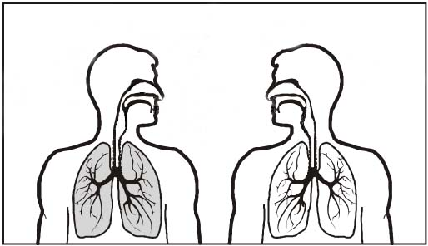
TB Transmission
The dots in the air represent droplet nuclei
When a person with infectious TB disease coughs, sneezes, speaks, or sings, tiny particles containing M. tuberculosis (droplet nuclei) may be expelled into the air.
If another person inhales droplet nuclei, transmission may occur; however, not everyone who is exposed to TB becomes infected with TB.
Notes:
Review slide content

Slide 16
What Factors Influence
TB Transmission?
The probability that TB will be transmitted depends on the following factors:
  Infectiousness of person with TB disease
  Duration and frequency of exposure
  Environment in which exposure occurred
Notes:
**Animated slide**
Ask participants what factors influence transmission
Click to display slide content
Note to facilitator: slides 17-19 discuss each of these factors in depth

Slide 17

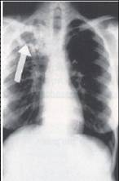
  1. Infectiousness of Person with TB Disease
Characteristics associated with infectiousness:
  TB of the lungs, airway, or larynx
  Presence of cough
  Positive sputum smear
  Cavity on chest x-ray
  Positive cultures
  Not covering mouth when coughing
  Not receiving adequate treatment
  Undergoing cough inducing procedures
Notes:
Review slide content
Emphasize the presence of a cough

Slide 18

2. Duration and Frequency of Exposure
Contacts at higher risk for TB
infection are those who:
  Frequently spend
  a lot of time* with
  the case
  Have been physically
  close to the case
* “A lot of time” is difficult to define, but may be determined locally based on experience
Notes:
Review slide content

Slide 19

3. Environment in Which Exposure Occurred
Environmental characteristics that
increase chances of TB transmission:
  Small or crowded rooms
  Areas that are poorly ventilated
  Rooms without air-filtering systems
Notes:
Review slide content

Slide 20

STOP the Chain of Transmission
The BEST way to stop transmission is to
  Identify and isolate infectious persons
  Start infectious persons on effective treatment for TB disease
Notes:
**Animated slide**
Review slide content

Slide 21
Contact Investigation
Core Concepts
TB Pathogenesis

Slide 22
What Happens Once Someone is Exposed To TB?
Not every person who is exposed to TB becomes infected
Persons who become infected will generally have a positive
  Tuberculin skin test (TST)
  Or
  Blood test (interferon gamma release assay [IGRA])
Persons who become infected can have either:
  LTBI
  Active TB disease
Notes:
Review slide content

Slide 23
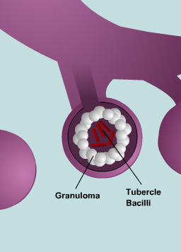
Latent TB Infection (LTBI)
LTBI - immune system keeps tubercle bacilli under control
LTBI characteristics
  Usually positive TST or IGRA
  Not infectious
  No symptoms
  Normal chest x-ray
  Sputum smears and cultures are negative
Not a “case” of TB
Notes:
Review slide content
Explain that granuloma (white dots in picture) keep bacilli under control

Slide 24
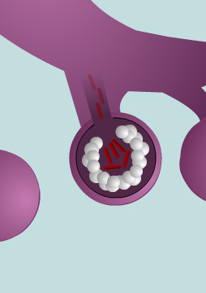
Active TB Disease
  TB disease - immune system cannot stop tubercle bacilli from multiplying leading to active TB disease
Usually affects lungs, but can affect other areas of the body
Characteristics usually include:
  Positive TST or IGRA
  Infectious (before treatment)
  Symptoms
  Abnormal chest x-ray
  Positive sputum smear and culture
Considered a “case” of TB
Notes:
Review slide content
Explain that TB of the lungs is referred to as “pulmonary TB”
Explain that TB disease that occurs in places other than the lungs, is referred to as “extrapulmonary TB.” These other areas may include lymph nodes, pleura, the brain, the kidneys, or the bones; most types of extrapulmonary TB are not infectious

Slide 25
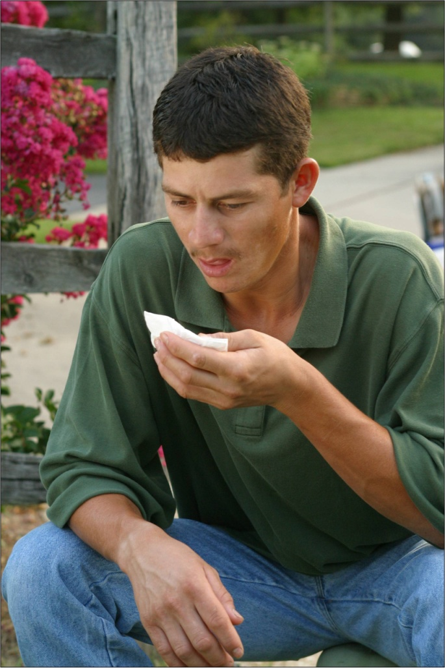
What are Symptoms of TB Disease?
Cough lasting 3 or more weeks
Coughing up sputum or blood
Fever
Chills
Night sweats
Weight loss
Appetite loss
Fatigue
Malaise
Chest pain
Notes:
Review slide content
Ask participants what symptoms they see most often in their patients

Slide 26
LTBI vs. TB Disease
LTBI | TB Disease (in the lungs)
Inactive tubercle bacilli in the body | Active tubercle bacilli in the body
TST or IGRA usually positive | TST or IGRA usually positive
Chest x-ray usually normal | Chest x-ray usually abnormal
Sputum smears and cultures negative | Sputum smears and cultures usually positive
No symptoms | Symptoms such as cough, fever, weight loss
Not infectious | Often infectious before treatment
Not a case of TB | A case of TB
Notes:
Review slide content

Slide 27
Conditions that Increase Risk of Progressing to TB Disease
Children younger than 5 years of age
Weakened immune systems
  Infection with HIV
  Diabetes mellitus
  Organ transplant
  Silicosis
  Severe kidney disease
  Certain types of cancer
  Certain intestinal conditions
  Prolonged therapy with corticosteroids and other immunosuppressive therapy, such as prednisone and tumor necrosis factor-alpha [TNF-α] antagonists
Chest x-ray findings suggestive of previous TB
Low body weight
Cigarette smokers and persons who abuse drugs and/or alcohol
Recent TB infection (within past 2 years)
Notes:
Review slide content
27

Slide 28
LTBI Progressing to TB Disease
Risk of developing TB disease is highest in the first 2 years after infection (or, if foreign-born, first 2 years after immigration)
People with LTBI can be treated to prevent development of TB disease
Detecting LTBI early and providing treatment helps prevent new cases of TB disease
Notes:
Review slide content
Emphasize that detecting LTBI early is a key goal of CIs
28

Slide 29
Contact Investigation
Core Concepts
Effective Interviewing Skills

Slide 30
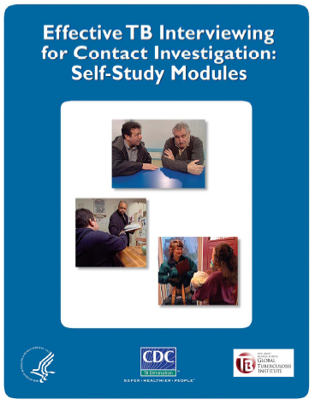
Effective Interviewing
Effective interviewing skills are essential for eliciting information from cases and their contacts
Interview skills can be taught
Interview skills improve with practice
  The focus of this course is on building these skills
Notes:
Review slide content
Mention that there are self-study modules available from the CDC regarding effective interviewing skills for CI. These materials can be accessed via the CDC website (www.cdc.gov/tb)
Mention the rest of the course will focus on building these skills

Slide 31
Contact Investigation
Core Concepts
Data Management and
Analysis Skills

Slide 32
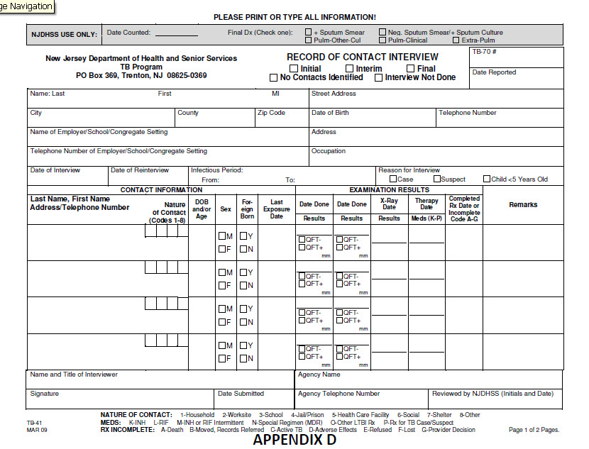
Use of Data in
TB Contact Investigations (1)
Collecting and analyzing data in a systematic way helps determine the effectiveness of CI efforts
Appendix D: Sample CI Form
Notes:
32
Review slide content
Explain that simplicity is best; information can be limited to contact priority, contact information, TST/IGRA result, treatment status, etc.
Explain that each program has its own system of collecting data
Emphasize that it is important to safeguard this information
Note to facilitator: Replace appendix D sample form with specific state/local form and briefly discuss the key elements of the CI form with participants

Slide 33
Use of Data in
TB Contact Investigations (2)
Data can be used for
Case and contact follow-up and management
Analysis of findings to help assess CI strategy
  Contacts identified
  Contacts evaluated who have TB disease
  Contacts evaluated who have LTBI
    Number who started and completed LTBI treatment
Notes:
33
Review slide content

Slide 34
Decision to Initiate a
Contact Investigation

Slide 35
When is a TB Contact Investigation Necessary? (1)
Confirmed TB Cases
A full CI is required for all confirmed cases that have infectious forms of TB disease
  Generally, TB of lungs, airway, or larynx
Notes:
Review slide content
Explain that confirmed means that the case has been confirmed by culture
Explain that a full CI means that the entire CI process should be completed (i.e., Steps 1-10)

Slide 36
When is a TB Contact Investigation Necessary? (2)
  Suspect TB Cases
  A CI should be started for persons suspected of having infectious TB disease if they have
  Positive sputum smears*
  Cavities on chest x-ray
Assessment of priority contacts can begin before case is confirmed
  If case is eventually confirmed, continue with full CI
  If person is found to NOT have infectious TB disease, stop the CI process
* Provided nucleic acid amplification (NAA) test, if conducted, is also positive
Notes:
Review slide content

Slide 37
When is a TB Contact Investigation Necessary? (3)
  Suspect TB Cases
For all other suspect cases, collect preliminary information about contacts (name, locations, and TB risk factors)
Assess contacts at high-risk for progressing to TB disease without waiting for case confirmation
  If case is eventually confirmed, continue with full CI
  If person is found to NOT have infectious TB disease, stop the CI process
Notes:
Review slide content
Explain that “all other suspect cases” may include those who are AFB negative or have non-cavitary TB disease
Explain that contacts at high-risk for progressing to TB disease includes children younger than 5 years of age and immunocompromised persons (e.g., people living with HIV/AIDS)

Slide 38
When is a TB Contact Investigation
NOT Necessary?
TB CI is generally NOT necessary if a case
  Has positive sputum smears and a negative nucleic acid amplification (NAA) test
  Has a noninfectious form of TB disease (extrapulmonary disease) with no pulmonary involvement
  Is a child under 10 years of age
    However, if case less than 5 years of age, a source case investigation may be necessary
Notes:
Explain that a positive AFB smear and a negative NAA test indicates non-TB mycobacteria (NTM). NTM do not spread person to person so a CI is not necessary
Explain that children under 10 years of age are less likely to transmit disease because they generally produce less sputum when they cough
Explain that a source case investigation is conducted to find the source of transmission
Note that source case investigations will be covered in special circumstances on Day 4

Slide 39
Prioritizing Among Contact Investigations
  If faced with multiple TB cases, health departments may have to decide which cases should be a higher priority for conducting CIs
  Decision will be influenced by:
    Likelihood of transmission (e.g., sputum smear positive*, cavity on chest x-ray, cough, and exposure environment)
    Risk of contacts rapidly progressing to TB disease (e.g., contacts in daycare, HIV care-settings, and dialysis centers)
    Resources available
* Transmission is still possible for cases with negative sputum smears
Notes:
Review slide content
Explain to participants that although cases with negative sputum smears are thought to be less infectious, transmission is still possible and CIs should still be conducted

Slide 40
Why is it Important to Promptly Start a Contact Investigation?
Some contacts may develop TB disease soon after exposure and infection, especially
  Infants and children younger than 5 years of age
  HIV-infected or other persons with weakened immune systems
All contacts need to be found and evaluated promptly
  As time increases, some contacts might be more difficult to locate (e.g., homeless or transient persons)
There could be ongoing transmission of M.tuberculosis
Notes:
**Animated slide**
Ask participants why it is important to promptly start a CI
Click to display slide text and review slide content

Slide 41
Exercise:
Decision to Initiate a Contact Investigation
Refer to Appendix E
Notes:
Have participants refer to Appendix E
Have participants work in groups at their table or individually
Review the answers as a group
Time:10 minutes

Slide 42
Systematic Approach to
TB Contact Investigations

Slide 43
How Do You Conduct a
Contact Investigation?
TB programs should use a systematic approach to conduct CIs
Using a systematic approach helps to ensure the CI is carried out effectively and efficiently
Notes:
Review slide content
Stress that this is an overview of the CI process; but that the main focus of the training course is on interviewing skills

Slide 44
Systematic Approach to
Contact Investigations (1)
The systematic approach includes 10 steps:
Review existing information about the case
Determine an initial estimate for the infectious period and estimate the degree of infectiousness
Interview the case
Review information and develop a plan for the investigation
Refine the infectious period and degree of infectiousness
Notes:
Review slide content
Emphasize that although TB contact investigations do not always follow a set sequence of steps, an effective investigation will use a systematic process that includes the following 10 steps
Note to facilitator: the rest of the presentation goes over each of these steps in-depth

Slide 45
Systematic Approach to Contact Investigations (2)
Prioritize contacts
Conduct field visits
Conduct contact assessments
Determine whether to expand or conclude an investigation
Evaluate the CI activities
These steps may not always be done in sequential order
Notes:
Review slide content

Slide 46
Systematic Approach to
TB Contact Investigations
1. Review Existing Information about the Case

Slide 47
Review Existing Information
The process of reviewing existing information is sometimes called the pre-interview phase
Reviewing information before the initial interview can ensure the right questions are being asked
Notes:
47
Review slide content

Slide 48
Information to Collect and Review Before the Initial Interview (1)
Become familiar with the case’s social history
Case name(s), aliases, date of birth, gender, all known addresses, telephone number(s), preferred language
Substance abuse, mental illness, or other issues that could affect the interview or contact investigation
Social, or behavioral risk factors increasing the risk of TB
Known contact names, particularly children or persons with weakened immune systems
History of jail or homelessness
History of immigration or travel
Notes:
48
**Animated slide**
Ask participants what kind of information they should collect before initial interview
Click to display text and review slide content
Note to facilitator: List of information to collect continues on to next slide (slide 49)

Slide 49
Information to Collect and Review Before the Initial Interview (2)
Become familiar with case’s medical history
Current site(s) of TB disease
Current TB treatment regimen
TB symptoms and estimated onset date
Chest x-rays and/or other diagnostic imaging dates and results
TST or IGRA dates and results
Sputum smear and culture dates and results
NAA test dates and results
Genotype results (if available)
Notes:
49
**Animated slide**
Display slide text and review slide content
Acknowledge that TB genotype information will not likely be available during the initial interview

Slide 50
Information to Collect and Review Before the Initial Interview (3)
Become familiar with case’s medical history (cont.)
HIV test dates and results
Details about prior diagnosis with LTBI or TB disease, and any treatment
Medical risk factors that could have increased the case’s risk for infection with M. tuberculosis or development of TB disease
Notes:
Review slide content

Slide 51
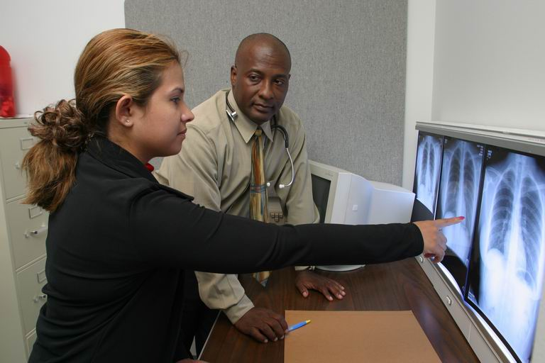
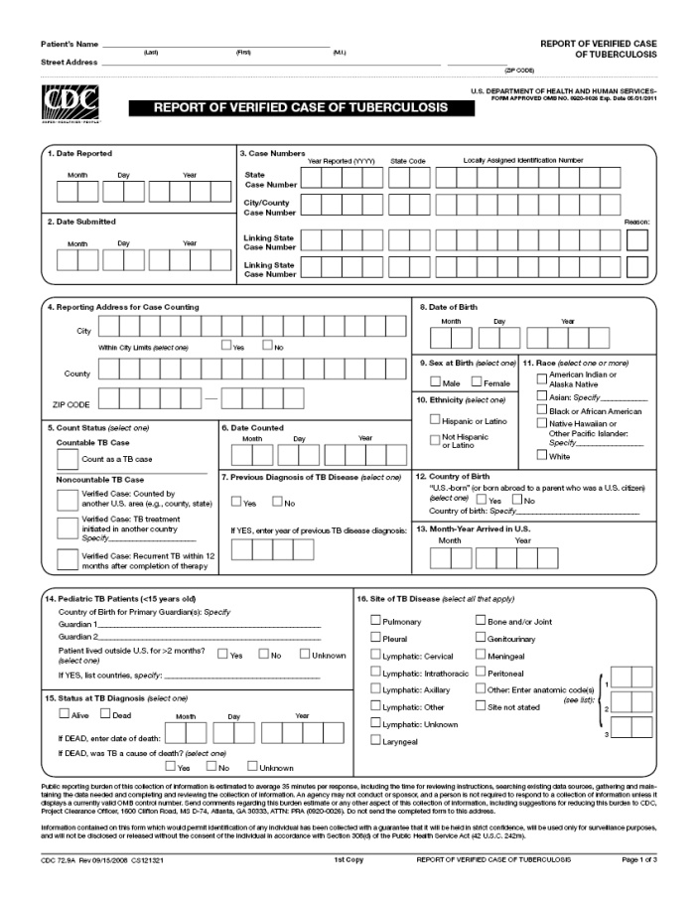
Sources of Information for TB Case
Medical records
Public health records
  Cross-check case name with local TB registries and databases to determine if previous diagnosis of LTBI or TB
  Cross-check with STD and HIV registries, if possible
Case’s clinician
Report of Verified Case of Tuberculosis (RVCT)
TB Genotyping Information Management System (TB GIMS)
Notes:
51
Review slide content
Note that the medical record should be the first thing the interviewer consults before the interview

Slide 52
Systematic Approach to
TB Contact Investigations
2. Determine an Initial Estimate for the Infectious Period and Estimate the Degree of Infectiousness

Slide 53
Estimating the Degree of Infectiousness
Factors Associated with Infectiousness | Factors Associated with Noninfectiousness
Presence of a cough | No cough
Cavity in the lung | No cavity in the lung
Acid-fast bacilli on sputum smear | No acid-fast bacilli on sputum smear
TB of the lungs, airway, or larynx | Most extrapulmonary (non-respiratory) TB
Patient not covering mouth or nose when coughing | Patient covering mouth or nose when coughing
Not receiving adequate treatment | Receiving adequate treatment for 2 weeks or longer
Undergoing cough-inducing procedures | Not undergoing cough-inducing procedures
Positive sputum cultures | Negative sputum cultures
Notes:
Review slide content

Slide 54

What is the Infectious Period?
The time period during which a TB case is able to transmit M. tuberculosis
Notes:
Review slide content
Emphasize that this is an estimate of when the case was infectious, not exact dates

Slide 55
Why is it Important to Estimate the Infectious Period?
Focuses investigation on contacts most at risk for exposure
  Especially important if the investigation involves congregate settings
Sets the time frame for contact assessment
  Contacts with an initial negative test will need a 2nd TST or IGRA at least 8 weeks after date of last exposure
Notes:
Review slide content
Explain that the need for a 2nd TST or IGRA will be discussed during the assessment and management of TB contacts section of this presentation

Slide 56
Estimating the Start of the Infectious Period
Characteristic of Case |  |  | Likely Period of Infectiousness
TB symptoms | AFB sputum smear positive | Cavitary chest x-ray
Yes | No | No | 3 months before symptom onset or first finding consistent with TB disease, whichever is longer
Yes | Yes | Yes | 3 months before symptom onset or first finding consistent with TB disease, whichever is longer
No | No | No | 1 month (4 weeks) before date of suspected diagnosis
No | Yes | Yes | 3 months before finding consistent with TB disease
Notes:
Review slide content

Slide 57
Ending the Infectious Period
Biologically, a case’s infectious period ends with:
Effective treatment for 2 weeks or more,
Diminished symptoms, and
Mycobacteriologic response*
*A case returning to a congregate setting should have 3 or more consecutive negative sputum smears
However, for CI purposes effective isolation can also end the infectious period since the case is not likely to be in contact with additional persons
Notes:
Review slide content
Point out that it is important to distinguish between the end of the infectious period biologically vs. for contact investigation purposes. If a person is effectively isolated they are not likely having physical contact with additional contacts, even if they are still biologically infectious. This is sometimes referred to as “contact break”
Ask participants what criteria they use in their jurisdiction for ending a case’s infectious period. Criteria may vary among jurisdictions

Slide 58
Exercise:
Determining the Infectious Period
Refer to Appendix F
Notes:
Have participants refer to Appendix F
Have participants work in groups at their table or individually
Review the answers as a group
Time: 10 minutes

Slide 59
Systematic Approach to
TB Contact Investigations
3. Interview the Case

Slide 60
What is the Main Goal of a
TB Interview?
The main goal of a TB interview is to
identify contacts.
Why?
So you can assess them for TB disease and infection and start them on appropriate treatment.
Notes:
**Animated slide**
Review slide content
Click to display “Why” question and answer

Slide 61
How Do You Identify Contacts?
Ask the case about the following during their infectious period:
Places WHERE they spent time
Persons with WHOM they spent time
Participation in activities and events (WHAT and WHEN)
Notes:
Review slide content
Explain that details on how to effectively identify contacts will be covered later in the course

Slide 62
What are the Other
Objectives of the TB Interview?*
Establish rapport
Educate about TB and CI process
Discuss confidentiality
Gather and confirm information
* These objectives will be discussed in more detail later in the course
Notes:
Review slide content
Explain that all of this information will be covered more in-depth during the Day 2 presentation on interviewing for TB contact investigation

Slide 63
How Many Interviews Should be Conducted?
Two interviews is the minimum (initial interview and re-interview)
  May need more interviews to develop rapport
  Often need to build on previously collected information
Additionally, every DOT encounter is an opportunity to learn about more contacts
  Especially helpful for finding children
  (e.g., toys around? photos on display?)
Notes:
Review slide content

Slide 64
When Should Interviews be Conducted?
Initial interview should be conducted
  Within 1 business day of reporting for infectious cases
  Within 3 business days for others
Second interview (re-interview) conducted
1 to 2 weeks later
Notes:
Review slide content
Stress that this an ideal situation and it may not always be possible to interview the case so quickly
Explain that re-interviews are especially important if the case is very sick when you first meet them

Slide 65
Initial Interview with the TB Case
Initial case interview should be conducted:
In-person
At a hospital, TB clinic, case’s home, or any convenient location that allows for privacy
In case’s primary language
With cultural sensitivity
Using appropriate infection control measures (e.g., respirators, masks, and ventilation)
Notes:
Review slide content
Emphasize that telephone interviews are strongly discouraged

Slide 66
Systematic Approach to
TB Contact Investigations
4. Review Information and Develop a Plan for the Investigation

Slide 67
Review Information and Develop a Plan for the Investigation
After conducting an interview with the case, the investigator should meet with his/her supervisor or the contact investigation team to
  Review all of the information obtained thus far
  Develop a plan on how to proceed
Notes:
Review slide content

Slide 68

Contact Investigation Team
CI team may include
Case managers
Public health investigators
Surveillance coordinators
Program managers
DOT workers
Disease intervention specialists (DIS)
Notes:
Review slide content
Ask participants who else is involved in the CI process in their areas

Slide 69
Developing an Investigation Plan (1)
To develop a plan for the investigation, the team should do the following activities:
Refine the infectious period and degree of infectiousness for the case as necessary
Prioritize identified contacts for assessment
Prioritize identified places to conduct field visits
Notes:
Review slide content
Note to facilitator: Each of these activities are discussed later on in this presentation

Slide 70
Developing an Investigation Plan (2)
Additional activities that are a part of developing a plan:
Establish a communication plan
Clarify any jurisdictional issues
Establish timeframes and methods for investigation activities, data collection, and management
Identify stakeholders
Determine potential media interest
Establish a schedule for meetings to review challenges and progress
Notes:
Review slide content

Slide 71
Systematic Approach to
TB Contact Investigations
5. Refine the Infectious Period and Degree of Infectiousness

Slide 72
Refining the Infectious Period and
Degree of Infectiousness
It is often necessary to refine the infectious period
Initial interview should
  Provide more information to help refine estimate of infectious period
  Help to further estimate degree of infectiousness
Refined infectious period information can be used during the re-interview to elicit more contacts if needed
Notes:
Review slide content

Slide 73
Exercise:
Refining the Infectious Period
Refer to Appendix G
Notes:
Have participants refer to Appendix G
Have participants work in groups at their table or individually
Review answers as a group
Time: 5 minutes

Slide 74
Systematic Approach to
TB Contact Investigations
6. Prioritize Contacts

Slide 75
Assigning Priority to Contacts
Once a list of contacts is obtained, the contacts should be prioritized to determine who should be immediately located and assessed for TB disease or infection.
The priority assigned to individual contacts should be based on the following:
  Likelihood of transmission from the case
  Contact’s risk for development of TB disease
Notes:
Review slide content

Slide 76
Which Contacts Should be Given
Priority for TB Assessment?
Priority should be given to contacts who
Have symptoms of TB disease
Are at risk for rapid development of TB disease
Had repeated or extended exposure to the case
Were exposed to a case in an environment where transmission was likely, such as a small, crowded, or poorly ventilated room or vehicle
Were exposed to a case undergoing medical procedures that can release substantial numbers of M. tuberculosis into the air (e.g., bronchoscopy)
Notes:
Review slide content
Emphasize likelihood of infection is linked to the intensity, frequency, and duration of exposure as well as the environment of exposure
Note that the CDC prioritization guidelines include low, medium, and high priority contacts

Slide 77
Concentric Circle Tool
The concentric circle should only be used as a secondary tool to help further prioritize contacts based on exposure (duration, frequency, and distance)
High Risk
Contacts spend a lot of time and with case
Low
Medium
High
CASE
Medium Risk
Contacts spend some amount of time with case
Low Risk
Contacts spend little amount of time with case
Notes:
Review slide content
Note to facilitator: low, medium, and high refer to exposure risk on this slide not to priority level of the contact. For example, a person has a higher risk of exposure to TB if they spent a lot of time with the case on a regular basis

Slide 78
Later (Re)Prioritization of Contacts
Re-examine priority level assigned to contacts throughout the investigation
  If evidence of significant transmission has occurred in priority contacts, CI may need to be expanded to additional contacts
However, investigation should not expand to additional contacts if doing so would compromise TB program’s ability to assess and treat the known priority contacts
Notes:
Review slide content

Slide 79
Exercise:
Prioritization of Contacts
Refer to Appendix H
Notes:
Have participants refer to Appendix H exercise
Have participants work in groups at their table
Review answers as a group
Time: 10 minutes

Slide 80
Systematic Approach to
TB Contact Investigations
7. Conduct Field Visits

Slide 81

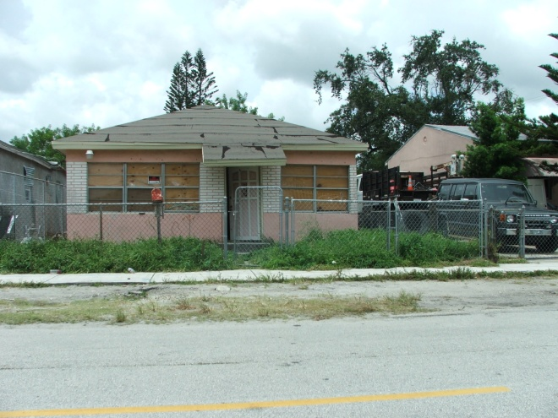
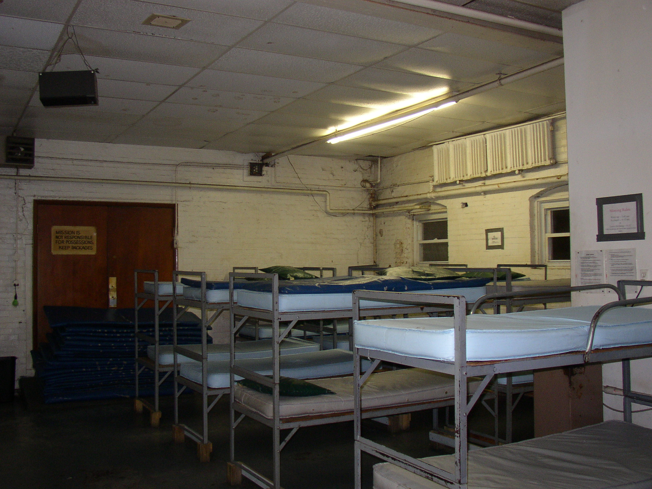
What is a Field Visit?
Field Visit
Visiting a case’s residence, congregate settings, and other places the case spent time while infectious
Complementary to interviewing
Information obtained can inform CI activities
Should be made within 3 days after initial interview
Notes:
Review slide content

Slide 82
Purpose of a Field Visit
Four main functions
  Identify additional cases of TB disease
  Identify additional contacts
  Provide additional information about environmental characteristics of places where exposure occured
  Lay a foundation for additional CI activities at those locations, if needed
Notes:
Review slide content

Slide 83
What to do During a Field Visit?
Refer persons with TB symptoms for medical assessment
Observe environmental characteristics
Look for evidence of other contacts
Obtain list of clients, employees, volunteers, and others who frequented location during infectious period
Explore possibility of offering TB testing onsite at that location
Notes:
**Animated slide**
Ask participants what should happen during a field visit
Click to display slide text
Emphasize that investigators should maintain confidentiality of cases and contacts

Slide 84

Field Visit Safety
Have identification badge
Work in pairs when visiting potentially dangerous areas
Have working cell phone
Inform coworkers of itinerary and expected return time
Practice appropriate infection control precautions as needed
Notes:
Review slide content
Note to facilitator: These are general suggestions and safety tips should be based on local information

Slide 85
Group Discussion
What safety and health concerns do you have when going out into the field?
How do you address these concerns?
Notes:
Ask participants to share any safety and health concerns they have had while conducting field visits
Ask participants for suggestions on how to address safety and health concerns and potentially dangerous situations
Time: 5 minutes

Slide 86
Systematic Approach to
TB Contact Investigations
8. Conduct Contact Assessments

Slide 87
What Happens After Contacts Have Been Identified and Prioritized?
  After contacts have been identified and prioritized:
Contacts should be located
Contact assessments should be conducted
Notes:
Review slide content
Ask participants how they notify contacts in their jurisdiction

Slide 88
Why Conduct a Contact Assessment?
Allows for
Determination of contacts’ potential TB symptoms
Gathering of social and medical information*
Referral or in-person testing for TB infection with a TST or IGRA
Provision of treatment as indicated
* Key information to collect during contact assessment will be discussed later in the course
Notes:
Review slide content

Slide 89

When and How Should a Contact Assessment be Conducted?
The initial contact assessment should be within 3 working days of the contact having been identified
Should be conducted in-person
Investigator should use effective communication skills
Notes:
Review slide content
Remind participants that initial contact meeting will be discussed in detail later in the course on Day 4

Slide 90
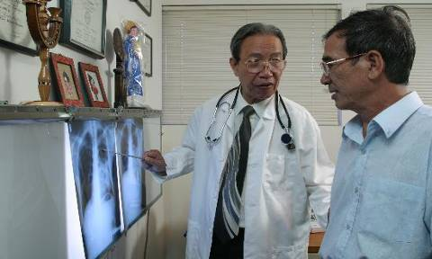
Initial Contact Assessment:
Contacts with TB Symptoms
During the initial assessment, all contacts with symptoms of TB disease should be immediately examined by a medical professional.
Notes:
Review slide content

Slide 91
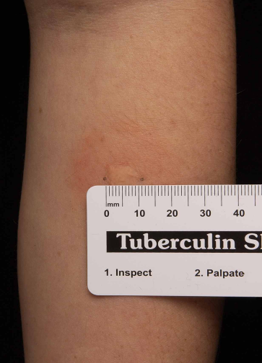
Initial Contact Assessment:
Testing for TB Infection - TST or IGRA
Contacts should receive a TST or IGRA unless a previous, documented positive result exists
A TST induration of 5 mm or larger is positive
A contact with a
  Positive TST or IGRA should be medically examined for TB disease
  Negative TST or IGRA should
  be re-tested 8 to 10 weeks after date of last exposure to the case
Notes:
Review slide content

Slide 92
Window Period
The window period is the time span between the contact’s last exposure to the case and when a TST or IGRA can reliably detect infection
It takes 2 to 10 weeks after TB infection for the body to mount an immune response that is detectable by a TST*
Therefore, it is recommended to repeat a TST or IGRA for contacts 8 to 10 weeks after date of last exposure to a TB case
* Data on the timing of IGRA conversion after a new infection are not currently available; however, it is recommended to follow TST guidelines.
Notes:
Review slide content

Slide 93
Calculating the Window Period (1)
What was the date of the contact’s last exposure to the case?
  Identify the infectious period of the case
  Identify when each contact had last exposure
Calculate 8 to 10 weeks from last exposure
  Administer a TST or IGRA for each contact who tested negative
Notes:
Review slide content

Slide 94
Calculating the Window Period (2)
Contact’s window period
is the time span between contact’s last exposure to TB case and when TST or IGRA can reliably detect infection
Only 4 weeks have passed since contact’s last exposure to TB case
Contact should have repeat TST/IGRA
8 to 10 weeks after last exposure
Contact’s last exposure to TB case
Initial TST/IGRA is negative
Jun 15
Jul 1
Jul 15
Aug 1
Aug 15
Sep 1
Sep 15
Oct 1
Oct 15
4 weeks
10 weeks
Notes:
**Animated slide**
Click to display each box

Slide 95
What if a Contact has LTBI or TB Disease?
The decision to test a contact is a commitment to offer treatment
  If TB disease is ruled out, contacts with a positive TST or IGRA should be offered LTBI treatment
  Regardless of whether they received BCG vaccine in the past
  Unless there is a compelling reason not to treat
Contacts with TB disease need to be treated under DOT
Notes:
Review slide content
Remind participants of the importance of treatment, and that a decision to test is a decision to treat
Explain that a compelling reason not to treat someone with LTBI would be if the person has hepatitis or end-stage liver disease
Note that IGRAs are not influenced by BCG

Slide 96
Assessment and Management of Children
After ruling out TB disease, contacts younger than 5 years of age should start treatment for LTBI even if they have a negative initial TST or IGRA result
LBTI treatment can be stopped if a second TST or IGRA done 8 to 10 weeks after exposure is negative
  However, if contact is under 6 months of age, LTBI treatment should be continued until contact reaches 6 months of age and a second TST/IGRA is negative
Notes:
Review slide content
Emphasize that children under 5 can rapidly progress to TB disease

Slide 97
Assessment and Management of Contacts with Weakened Immune Systems
A full medical evaluation, including a chest x-ray, should be given to contacts
  With HIV/AIDS
  On immunosuppressive therapy for organ transplant
  Taking anti-tumor necrosis factor alpha (TNF-α) agents
If both initial and follow-up TST/IGRA are negative, a full course of prophylactic LTBI treatment is recommended (after TB disease is excluded)
Expert consultation should be sought for contacts with other immunocompromising conditions
Notes:
Review slide content

Slide 98
Systematic Approach to
TB Contact Investigations
9. Determine Whether to Expand or Conclude an Investigation

Slide 99
When Can you Close a Contact Investigation?
A CI can be closed if
Identified contacts have been assessed for TB in accordance with local policy
  At some point, the TB program must decide when all reasonable investigative efforts have been exhausted
Contacts with LTBI have completed or are close to completing treatment
No additional active TB cases among contacts
Notes:
Review slide content

Slide 100
When Should a Contact Investigation be Expanded?
Sometimes a CI has to be expanded if there is evidence of recent transmission
Unexpectedly high TB disease or LTBI rates among priority contacts
Large number of contacts with change in infection status from negative to positive
TB disease in any contacts who had been assigned low priority or TB disease in those previously not identified as contacts
Infection in any contacts younger than 5 years of age
Notes:
Review slide content

Slide 101
Expanding a Contact Investigation
Decision to expand CI should be based on the investigation data
  Results should be reviewed weekly
Decision should be made by supervisory staff
In the absence of recent transmission, the investigation should not be expanded to lower-priority groups
Notes:
Review slide content

Slide 102
Other Important Considerations During a Contact Investigation
If a second TB case is found during the CI, this second case needs their own CI.
If a case is considered highly infectious and you find few contacts and/or find little evidence of transmission, you may need to go back and review your records and determine if a re-interview is needed.
Notes:
102
Review slide content
Emphasize that second case needs to be considered for CI based on policy and guidelines

Slide 103
Systematic Approach to
TB Contact Investigations
10. Evaluate the Contact Investigation Activities

Slide 104
Evaluating Contact Investigation Activities (1)
The purpose of evaluating the activities of the CI is to determine:
If an appropriate number of contacts were identified
How many contacts were identified with LTBI
How many contacts with LTBI completed treatment
How many additional cases of TB disease were identified
Notes:
Review slide content
Mention that collection and use of data is crucial for assessing and evaluation the CI activities; however this course will not go over the how to analyze and evaluate the activities

Slide 105
Evaluating Contact Investigation Activities (2)
How many contacts were not located
How many contacts were located but did not complete assessment
Timeliness of identifying and assessing contacts, and starting them on treatment
If the CI was performed in all necessary settings
If the CI was expanded appropriately
If secondary cases completed treatment for TB disease
Notes:
Review slide content
Explain that evaluating CI activities can help identify areas that need improvement and motivate people to do a better a job
Mention that TB Programs, NTIP, and cohort review activities will also inform the evaluation process

Slide 106
Review
What are the 10 steps of the systematic approach to conducting a CI?
Notes:
Ask participants for answer to the review question
Note to facilitator:
Answer to review question:
Review existing information about the case
Determine an initial estimate for the infectious period and estimate the degree of infectiousness
Interview the case
Review information and develop a plan for the investigation
Refine the infectious period and degree of infectiousness
Prioritize contacts
Conduct field visits
Conduct contact assessments
Determine whether to expand or conclude an investigation
Evaluate the contact investigation activities
Ask participants if they have any questions regarding the information that was presented

