Slide 1
Sexually Transmitted Infections
Surveillance 2022
Gonorrhea
Notes:
This slide set was prepared by the Division of STD Prevention, National Center for HIV, Viral Hepatitis, STD, and TB Prevention (NCHHSTP), Centers for Disease Control and Prevention (CDC). These slides display trends for STIs in the United States through 2022. Data presented include case notifications provided to CDC through the National Notifiable Diseases Surveillance System (NNDSS) and data collected through projects and programs that monitor STIs in various settings, including the STD Surveillance Network (SSuN), and the Gonococcal Isolate Surveillance Project (GISP).
For more information on data sources, data collection and reporting practices, and case definitions, please see the Technical Notes, available at https://www.cdc.gov/std/statistics/2022/technical-notes.htm.
All data points for figures presented in these slides are available at https://www.cdc.gov/std/statistics/2022/data.zip.
NOTE: This slide set is in the public domain. You may reproduce these slides without permission; however, citation as to source is appreciated.
Centers for Disease Control and Prevention. Sexually Transmitted Infections Surveillance 2022. Atlanta: U.S. Department of Health and Human Services; 2024.
You are also free to adapt and revise these slides; however, you must remove the CDC name and logo if changes are made.

Slide 2
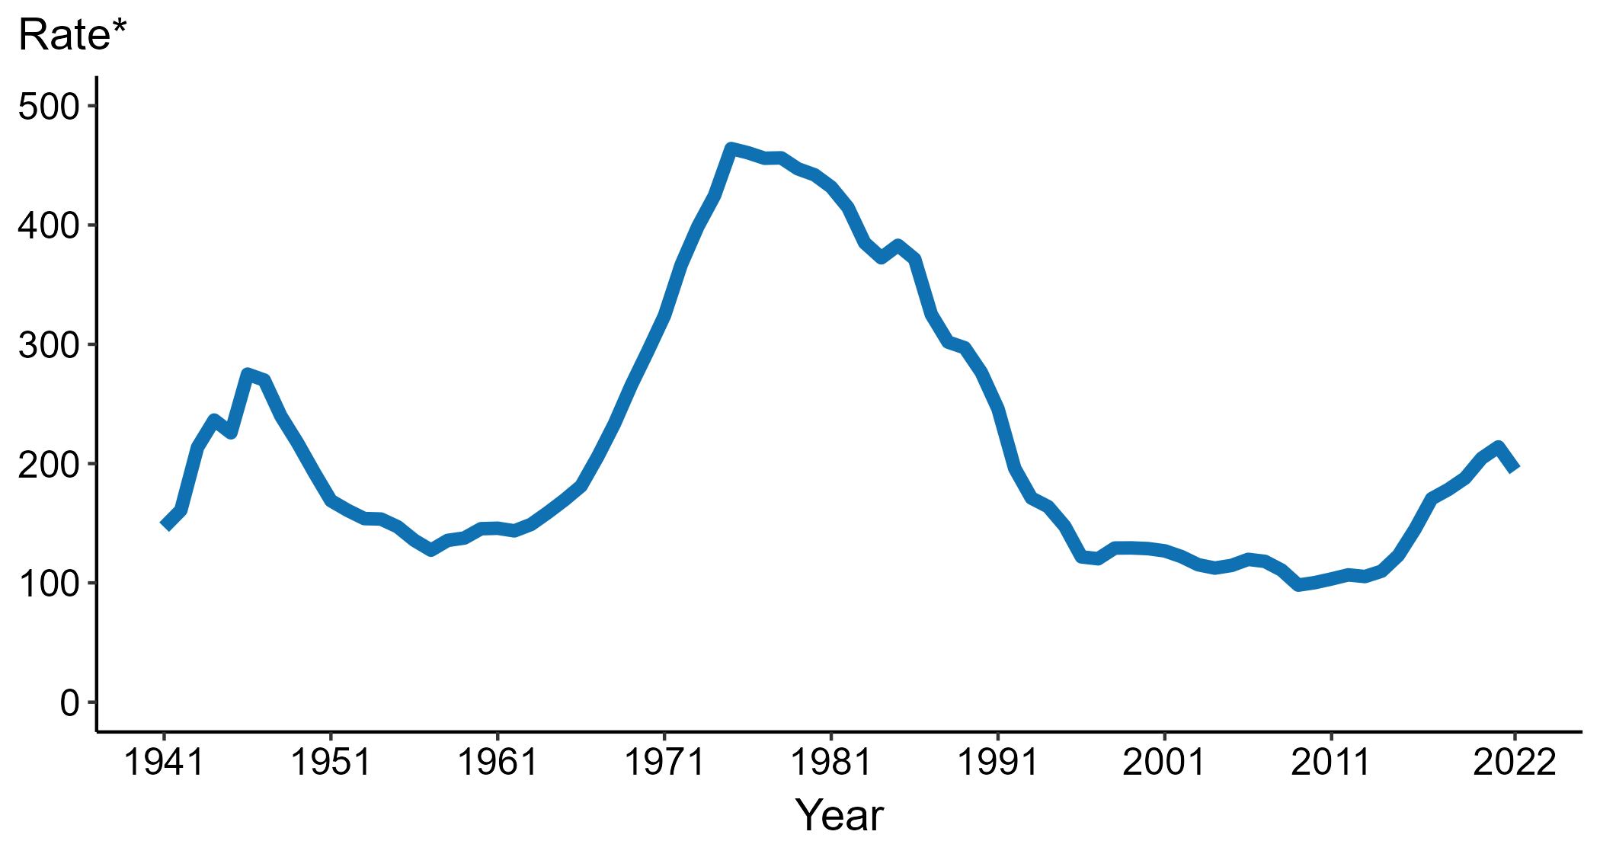
Gonorrhea — Rates of Reported Cases by Year, United States, 1941–2022
* Per 100,000
Notes:
Data collection for gonorrhea began in 1941 and gonorrhea was made a nationally notifiable condition in 1944. Steep declines in case rates in the 1940s and 1950s likely reflect expanded use of penicillin to treat infection.
In 2022, a total of 648,056 cases of gonorrhea were reported in the United States. During 2021 to 2022, the rate of reported gonorrhea decreased 9.2% (from 214.0 to 194.4 per 100,000).
This report includes data from years that coincide with the COVID-19 pandemic, which introduced uncertainty and difficulty in interpreting STI surveillance data. See Impact of COVID-19 on STIs for more information.
See Technical Notes (https://www.cdc.gov/std/statistics/2022/technical-notes.htm) for information on gonorrhea case reporting.
Data for all figures are available at https://www.cdc.gov/std/statistics/2022/data.zip. The file “GC - Rates by Year (US 1941-2022).xlsx” contains the data for the figure presented on this slide.

Slide 3
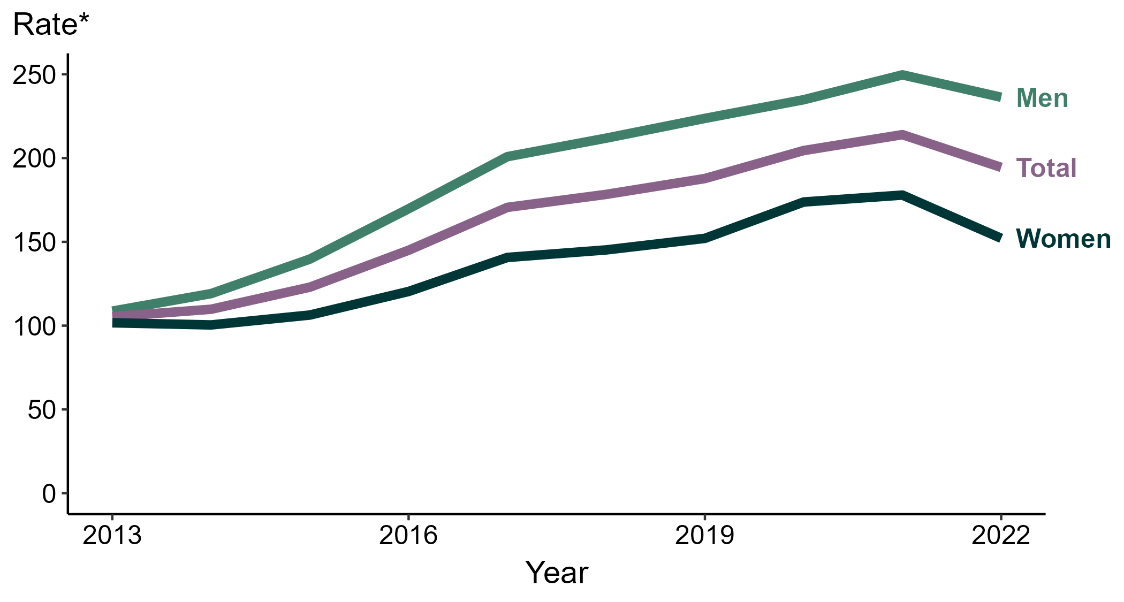
Gonorrhea — Rates of Reported Cases by Sex, United States, 2013–2022
* Per 100,000
Notes:
During 2021 to 2022, the rate of reported gonorrhea among men decreased 5.4% (from 249.7 to 236.3 per 100,000) and the rate among women decreased 14.5% (from 177.9 to 152.1 per 100,000).
Over the last five years, the rate of reported gonorrhea among men increased 11.5% (from 211.9 to 236.3 per 100,000) and the rate among women increased 4.8% (from 145.2 to 152.1 per 100,000). Over the last 10 years, the rate among men increased 117.4% (from 108.7 to 236.3 per 100,000) and the rate among women increased 49.6% (from 101.7 to 152.1 per 100,000).
This report includes data from years that coincide with the COVID-19 pandemic, which introduced uncertainty and difficulty in interpreting STI surveillance data. See Impact of COVID-19 on STIs for more information.
See Technical Notes (https://www.cdc.gov/std/statistics/2022/technical-notes.htm) for information on gonorrhea case reporting. Table A1 (https://www.cdc.gov/std/statistics/2022/tables/a1.htm) provides information on unknown, missing, or invalid values of select variables.
Data for all figures are available at https://www.cdc.gov/std/statistics/2022/data.zip. The file “GC - Rates by Sex (US 2013-2022).xlsx” contains the data for the figure presented on this slide.

Slide 4
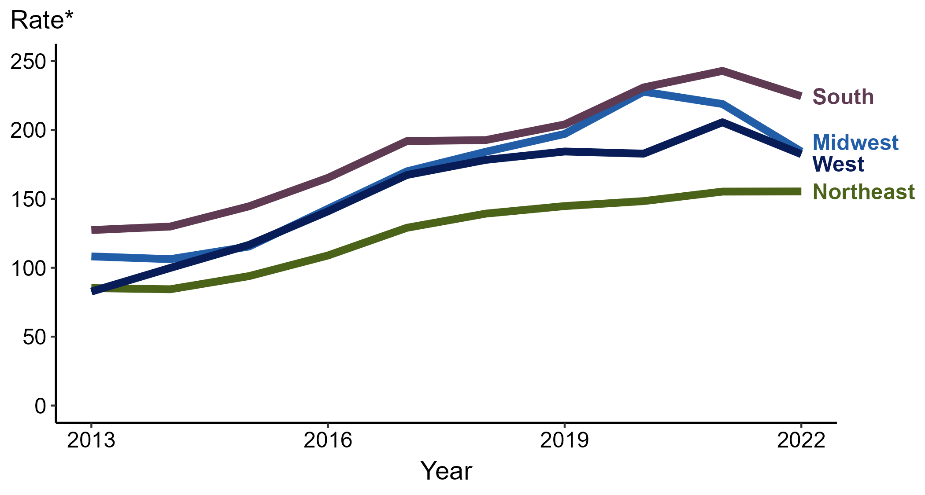
Gonorrhea — Rates of Reported Cases by Region, United States, 2013–2022
* Per 100,000
Notes:
In 2022, the South had the highest rate of reported gonorrhea (224.5 cases per 100,000; 7.6% decrease from 2021), followed by the Midwest (184.3 cases per 100,000; 15.8% decrease from 2021), the West (182.4 cases per 100,000; 11.3% decrease from 2021), and the Northeast (155.4 cases per 100,000; <1.0% change from 2021).
The South had the greatest five-year increase in rates of reported cases of gonorrhea (192.7 to 224.5 per 100,000; 16.5% increase from 2018). The West had the greatest 10-year increase in rates of reported cases of gonorrhea (82.7 to 182.4 per 100,000; 120.6% increase from 2013).
This report includes data from years that coincide with the COVID-19 pandemic, which introduced uncertainty and difficulty in interpreting STI surveillance data. See Impact of COVID-19 on STIs for more information.
See Technical Notes (https://www.cdc.gov/std/statistics/2022/technical-notes.htm) for information on gonorrhea case reporting.
Data for all figures are available at https://www.cdc.gov/std/statistics/2022/data.zip. The file “GC - Rates by Region (US 2013-2022).xlsx” contains the data for the figure presented on this slide.

Slide 5
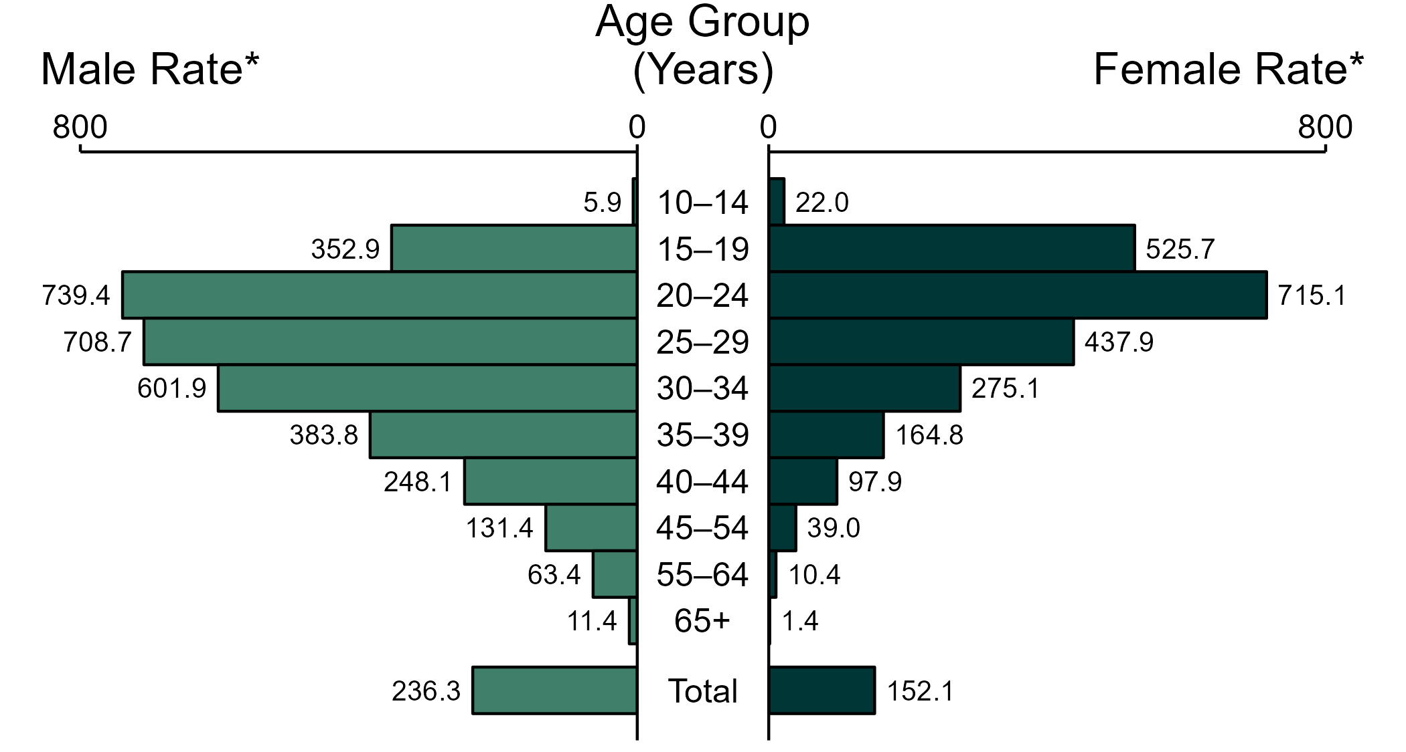
Gonorrhea — Rates of Reported Cases by Age Group and Sex, United States, 2022
* Per 100,000
NOTE: Total includes cases of all ages, including those with unknown age.
Notes:
In 2022, the rate of reported gonorrhea was higher among men (236.3 per 100,000) compared to women (152.1 per 100,000).
Among men, those aged 20 to 24 years had the highest rate of reported cases of gonorrhea (739.4 per 100,000), followed by men aged 25 to 29 years (708.7 per 100,000) and men aged 30 to 34 years (601.9 per 100,000). Among women, those aged 20 to 24 years also had the highest rate of reported cases of gonorrhea (715.1 per 100,000), followed by women aged 15 to 19 years (525.7 per 100,000) and women aged 25 to 29 years (437.9 per 100,000).
This report includes data from years that coincide with the COVID-19 pandemic, which introduced uncertainty and difficulty in interpreting STI surveillance data. See Impact of COVID-19 on STIs for more information.
See Technical Notes (https://www.cdc.gov/std/statistics/2022/technical-notes.htm) for information on gonorrhea case reporting. Table A1 (https://www.cdc.gov/std/statistics/2022/tables/a1.htm) provides information on unknown, missing, or invalid values of select variables.
Data for all figures are available at https://www.cdc.gov/std/statistics/2022/data.zip. The file “GC - Rates by Age Group and Sex (US 2022).xlsx” contains the data for the figure presented on this slide.

Slide 6
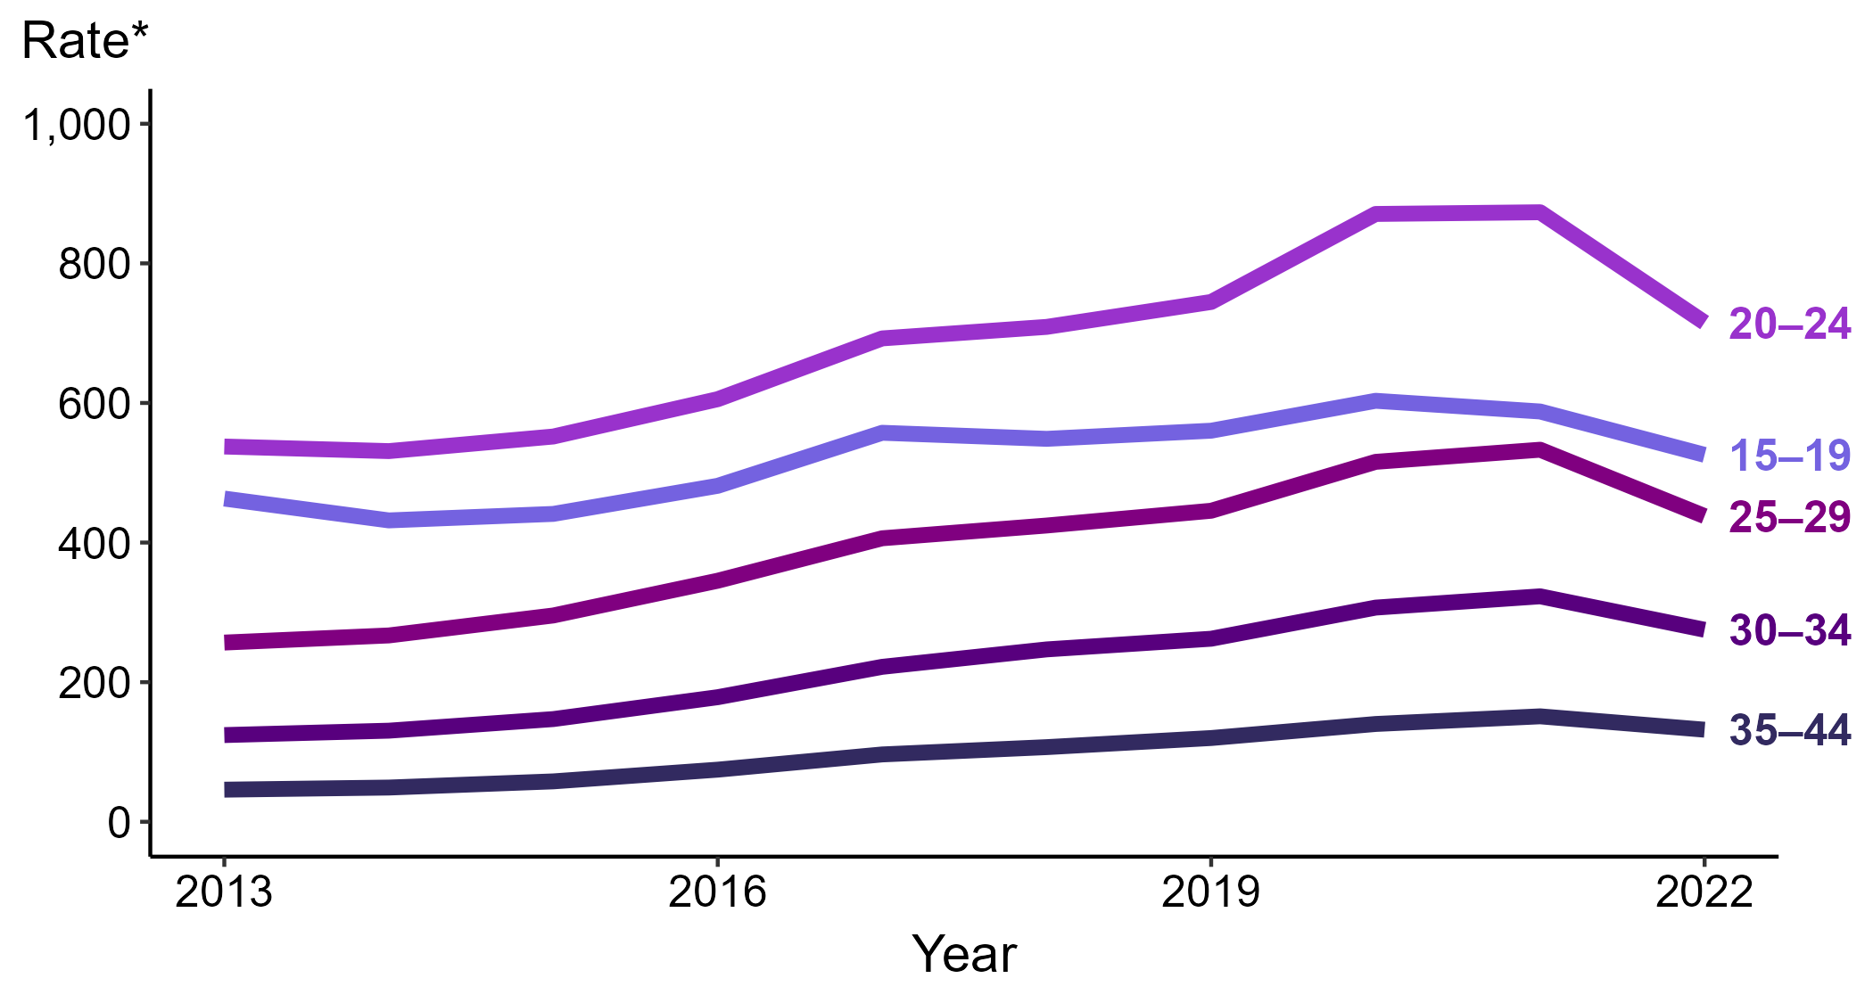
Gonorrhea — Rates of Reported Cases Among Women Aged 15–44 Years by Age Group, United States, 2013–2022
* Per 100,000
Notes:
Among women aged 15 to 44 years in 2022, those aged 20 to 24 years had the highest rate of reported cases of gonorrhea (715.1 cases per 100,000; 18.1% decrease from 2021), followed by those aged 15 to 19 years (525.7 cases per 100,000; 10.6% decrease from 2021), those aged 25 to 29 years (437.9 cases per 100,000; 17.8% decrease from 2021), those aged 30 to 34 years (275.1 cases per 100,000; 14.8% decrease from 2021), and those aged 35 to 44 years (131.9 cases per 100,000; 12.6% decrease from 2021).
This report includes data from years that coincide with the COVID-19 pandemic, which introduced uncertainty and difficulty in interpreting STI surveillance data. See Impact of COVID-19 on STIs for more information.
See Technical Notes (https://www.cdc.gov/std/statistics/2022/technical-notes.htm) for information on gonorrhea case reporting. Table A1 (https://www.cdc.gov/std/statistics/2022/tables/a1.htm) provides information on unknown, missing, or invalid values of select variables.
Data for all figures are available at https://www.cdc.gov/std/statistics/2022/data.zip. The file “GC - Rates Women 15-44 Years by Age Group (US 2012-2022).xlsx” contains the data for the figure presented on this slide.

Slide 7
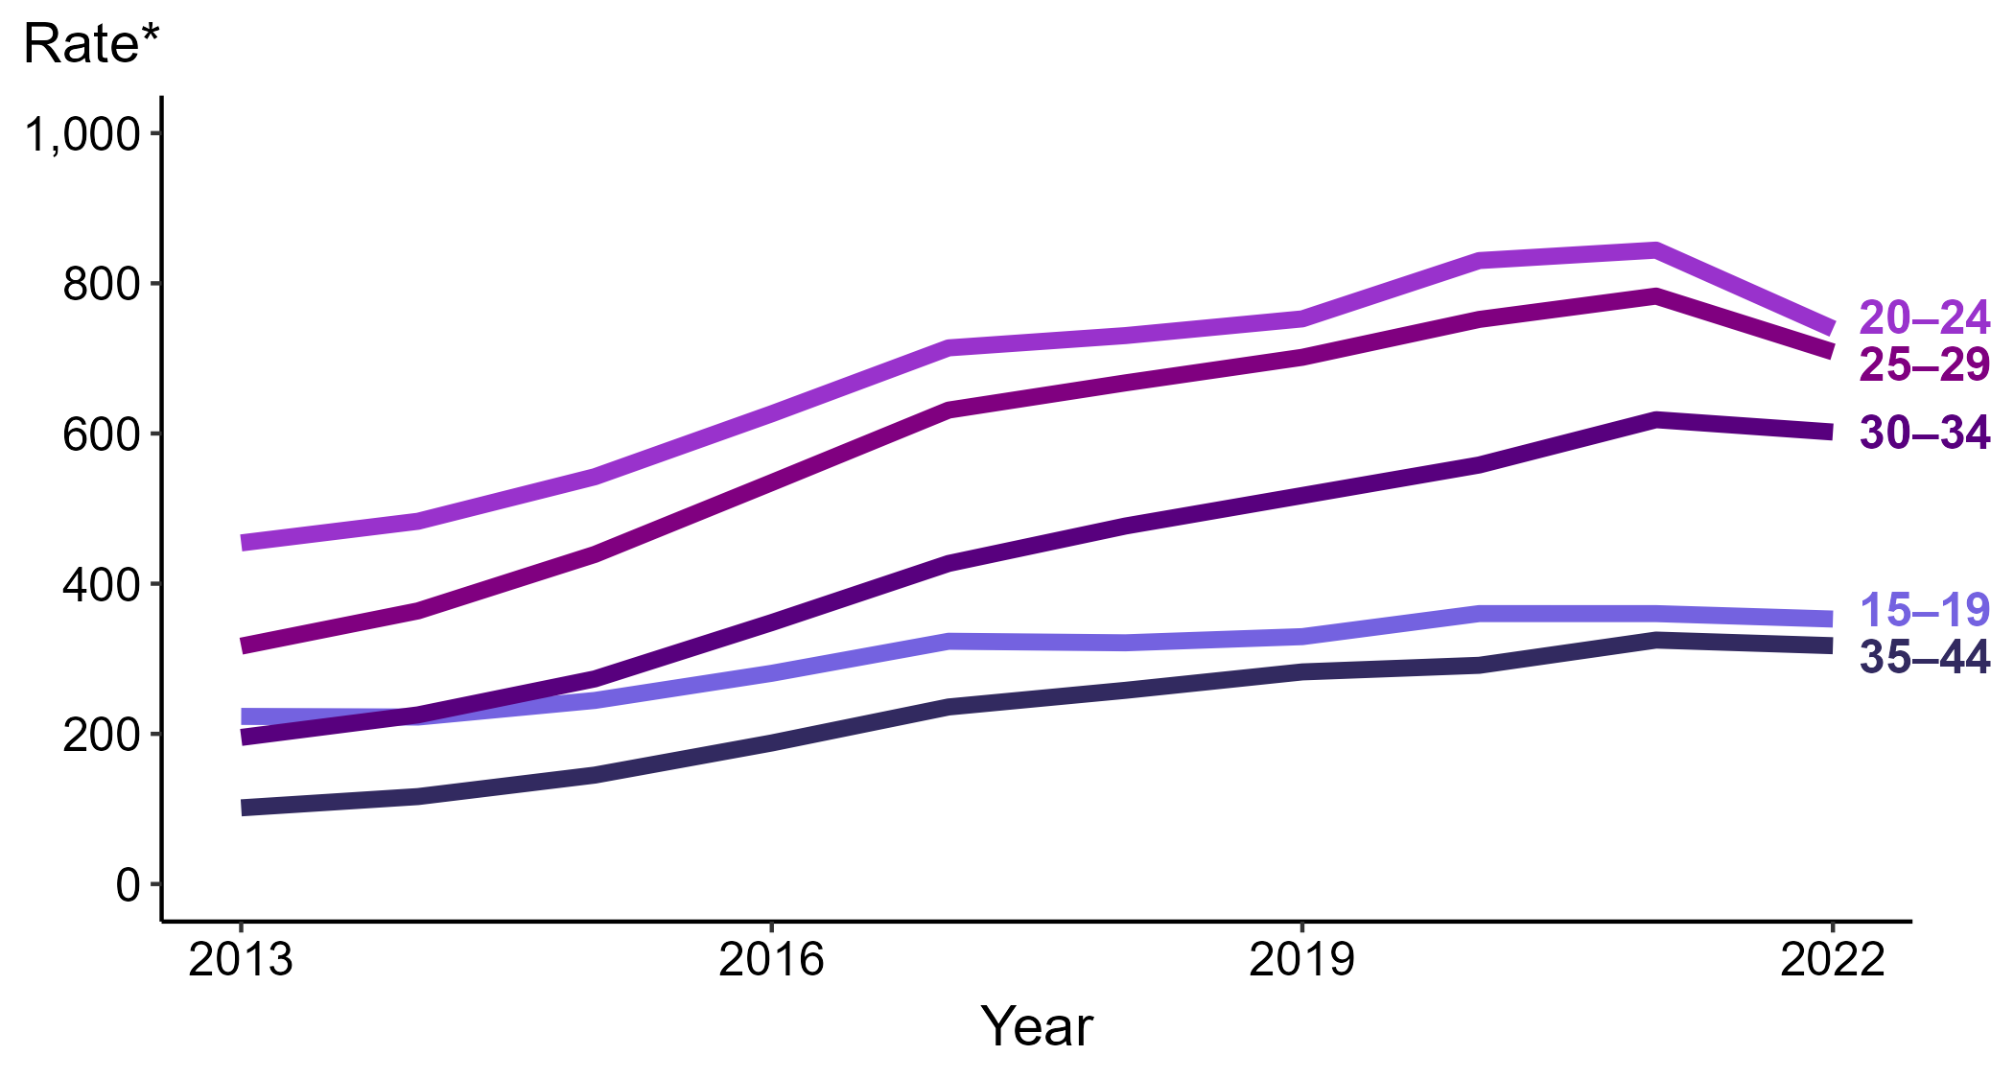
Gonorrhea — Rates of Reported Cases Among Men Aged 15–44 Years by Age Group, United States, 2013–2022
* Per 100,000
Notes:
Among men aged 15 to 44 years in 2022, those aged 20 to 24 years had the highest rate of reported cases of gonorrhea (739.4 cases per 100,000; 12.4% decrease from 2021), followed by those aged 25 to 29 years (708.7 cases per 100,000; 9.5% decrease from 2021), those aged 30 to 34 years (601.9 cases per 100,000; 2.7% decrease from 2021), those aged 15 to 19 years (352.9 cases per 100,000; 2.0% decrease from 2021), and those aged 35 to 44 years (317.4 cases per 100,000; 2.3% decrease from 2021).
This report includes data from years that coincide with the COVID-19 pandemic, which introduced uncertainty and difficulty in interpreting STI surveillance data. See Impact of COVID-19 on STIs for more information.
See Technical Notes (https://www.cdc.gov/std/statistics/2022/technical-notes.htm) for information on gonorrhea case reporting. Table A1 (https://www.cdc.gov/std/statistics/2022/tables/a1.htm) provides information on unknown, missing, or invalid values of select variables.
Data for all figures are available at https://www.cdc.gov/std/statistics/2022/data.zip. The file “GC - Rates Men 15-44 Years by Age Group (US 2012-2022).xlsx” contains the data for the figure presented on this slide.

Slide 8
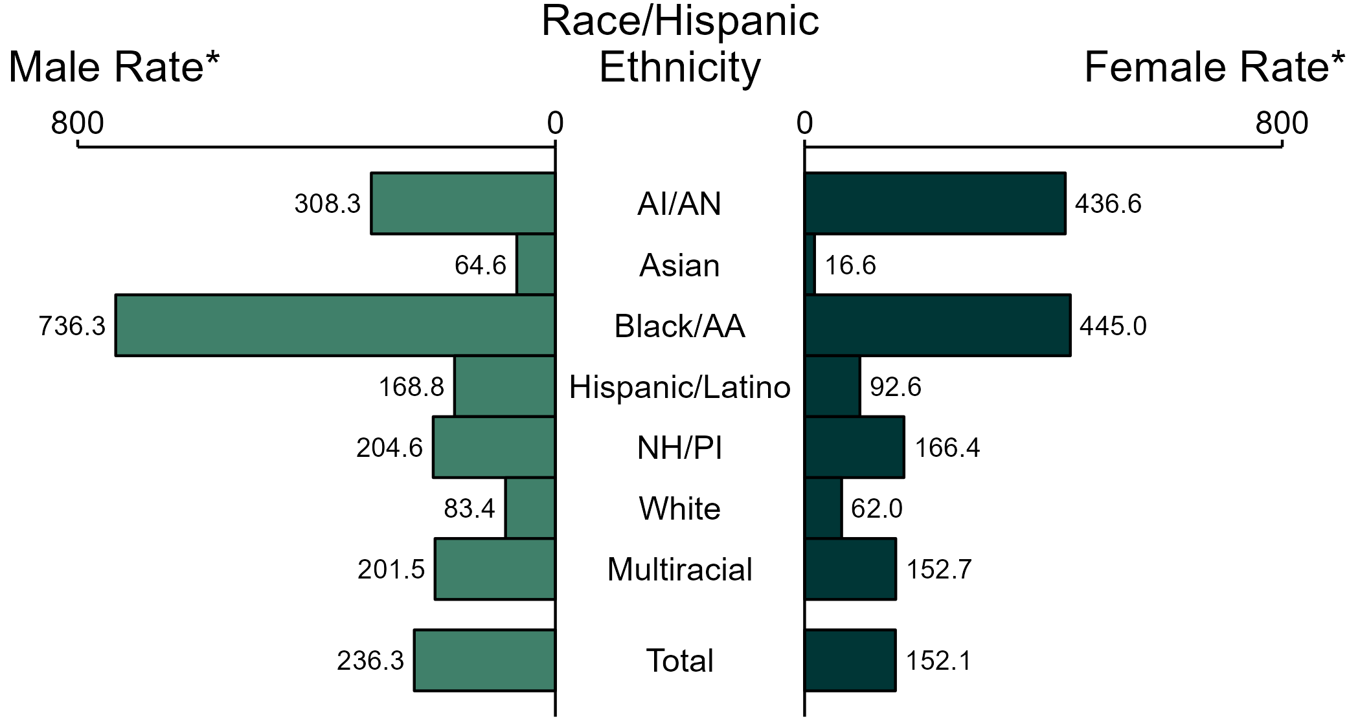
Gonorrhea — Rates of Reported Cases by Race/Hispanic Ethnicity and Sex, United States, 2022
* Per 100,000
ACRONYMS: AI/AN = American Indian or Alaska Native; Black/AA = Black or African American; NH/PI = Native Hawaiian or other Pacific Islander
NOTE: Total includes all cases including those with unknown race/Hispanic ethnicity.
Notes:
In 2022, the rate of reported gonorrhea was higher among men (236.3 per 100,000) compared to women (152.1 per 100,000).
Among men, non-Hispanic Black or African American men had the highest rate of reported cases of gonorrhea (736.3 per 100,000), followed by non-Hispanic American Indian or Alaska Native men (308.3 per 100,000) and non-Hispanic Native Hawaiian or other Pacific Islander men (204.6 per 100,000). Among women, non-Hispanic Black or African American women also had the highest rate of reported cases of gonorrhea (445.0 per 100,000), followed by non-Hispanic American Indian or Alaska Native women (436.6 per 100,000) and non-Hispanic Native Hawaiian or other Pacific Islander women (166.4 per 100,000).
Using non-Hispanic White persons as the referent category, the greatest relative racial disparity in rates of reported gonorrhea across both sexes was observed among non-Hispanic Black or African American men, with a rate ratio of 8.8 times that of non-Hispanic White men. Among women, the greatest relative disparity was observed among non-Hispanic Black or African American women as well, with a rate 7.2 times that of non-Hispanic White women.
This report includes data from years that coincide with the COVID-19 pandemic, which introduced uncertainty and difficulty in interpreting STI surveillance data. See Impact of COVID-19 on STIs for more information.
See Technical Notes (https://www.cdc.gov/std/statistics/2022/technical-notes.htm) for information on gonorrhea case reporting, race/Hispanic ethnicity categorization, and reporting of race/Hispanic ethnicity for STI cases. Table A1 (https://www.cdc.gov/std/statistics/2022/tables/a1.htm) provides information on unknown, missing, or invalid values of select variables.
Data for all figures are available at https://www.cdc.gov/std/statistics/2022/data.zip. The file “GC - Rates by Race Hispanic Ethnicity and Sex (US 2022).xlsx” contains the data for the figure presented on this slide.

Slide 9
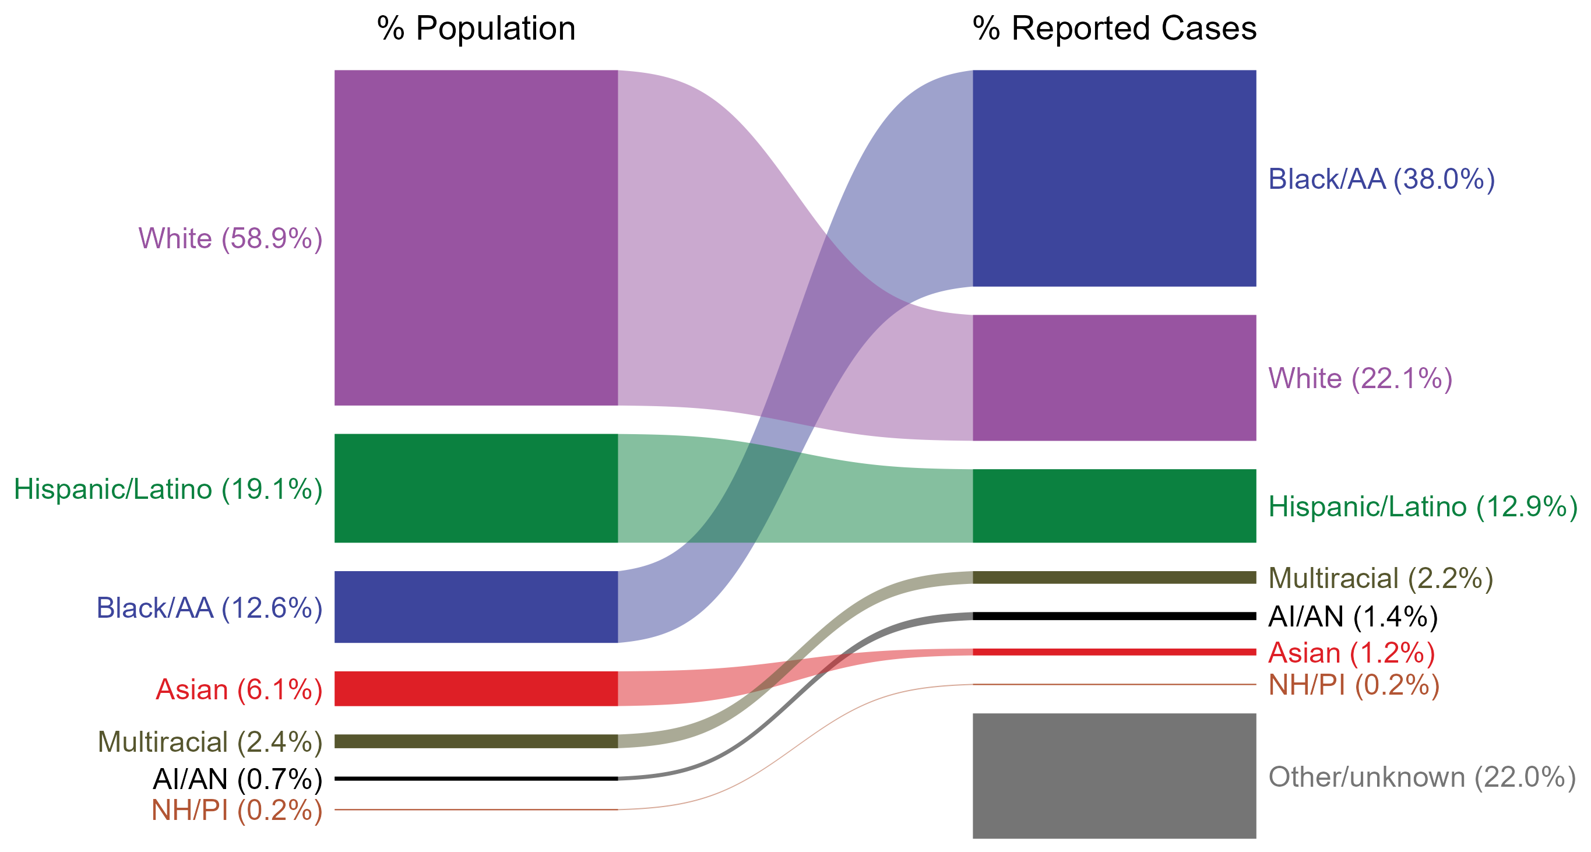
Gonorrhea — Total Population and Reported Cases by Race/Hispanic Ethnicity, United States, 2022
* Per 100,000
NOTE: In 2022, a total of 142,317 gonorrhea cases (22.0%) had missing, unknown, or other race and were not reported to be of Hispanic ethnicity. These cases are included in the “other/unknown” category.
ACRONYMS: AI/AN = American Indian or Alaska Native; Black/AA = Black or African American; NH/PI = Native Hawaiian or other Pacific Islander
Notes:
The percentages of gonorrhea cases by race/Hispanic ethnicity were disproportionate to the percentages among the total population of the United States in 2022. The greatest absolute and relative disparities were observed among non-Hispanic Black or African American persons, who represented 38.0% of reported gonorrhea cases (n = 246,480; 48.7% of gonorrhea cases with reported race or Hispanic ethnicity) despite being 12.6% of the US population. This is means that the burden of gonorrhea among non-Hispanic Black or African American persons was 25.4% greater than — or 3.0 times — what would be expected based on their proportion of the population. Additionally, non-Hispanic American Indian or Alaska Native persons were also overrepresented among gonorrhea cases relative to their proportion of the population.
This report includes data from years that coincide with the COVID-19 pandemic, which introduced uncertainty and difficulty in interpreting STI surveillance data. See Impact of COVID-19 on STIs for more information.
See Technical Notes (https://www.cdc.gov/std/statistics/2022/technical-notes.htm) for information on gonorrhea case reporting, race/Hispanic ethnicity categorization, and reporting of race/Hispanic ethnicity for STI cases.
Data for all figures are available at https://www.cdc.gov/std/statistics/2022/data.zip. The file “GC - Population and Cases by Race Hispanic Ethnicity (US 2022).xlsx” contains the data for the figure presented on this slide.

Slide 10
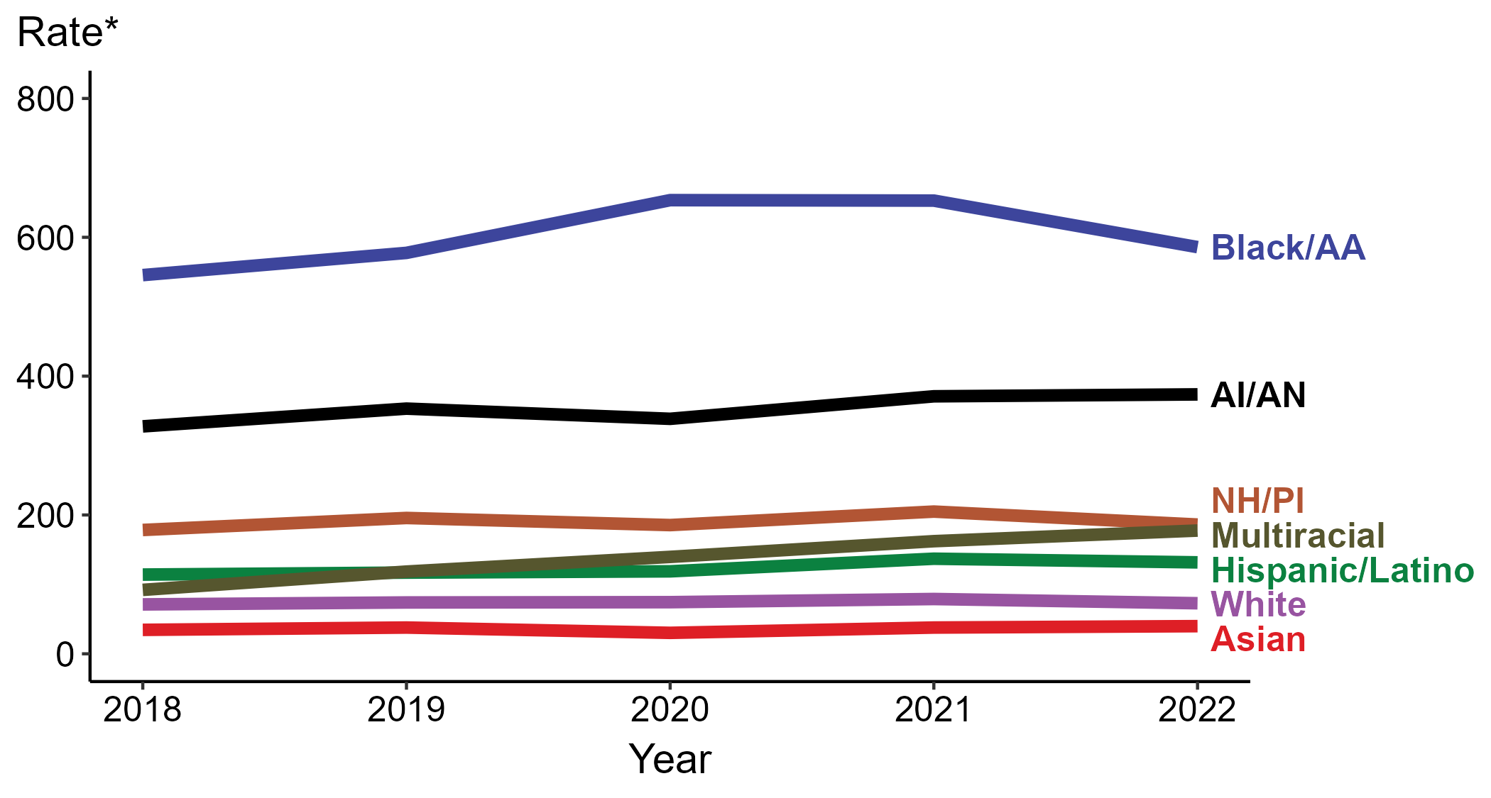
Gonorrhea — Rates of Reported Cases by Race/Hispanic Ethnicity, United States, 2018–2022
* Per 100,000
ACRONYMS: AI/AN = American Indian or Alaska Native; Black/AA = Black or African American; NH/PI = Native Hawaiian or other Pacific Islander
Notes:
In 2022, the highest rate of reported gonorrhea cases per 100,000 persons was among non-Hispanic Black or African American persons (585.9), followed by non-Hispanic American Indian or Alaska Native persons (373.7).
During 2021 to 2022, the greatest increase in rate of reported gonorrhea cases per 100,000 persons was among non-Hispanic persons of multiple races (162.2 to 177.5; 9.4% increase). Non-Hispanic persons of multiple races also had the greatest five-year increase in rate of reported gonorrhea (92.1 to 177.5; 92.7% increase from 2018).
During 2021 to 2022, the greatest decrease in rate of reported gonorrhea cases per 100,000 persons was among non-Hispanic Black or African American persons (652.9 to 585.9; 10.3% decrease). There were no decreases in the rate of reported gonorrhea among any race or Hispanic ethnicity group during 2018 to 2022.
This report includes data from years that coincide with the COVID-19 pandemic, which introduced uncertainty and difficulty in interpreting STI surveillance data. See Impact of COVID-19 on STIs for more information.
See Technical Notes (https://www.cdc.gov/std/statistics/2022/technical-notes.htm) for information on gonorrhea case reporting, race/Hispanic ethnicity categorization, and reporting of race/Hispanic ethnicity for STI cases. Table A1 (https://www.cdc.gov/std/statistics/2022/tables/a1.htm) provides information on unknown, missing, or invalid values of select variables.
Data for all figures are available at https://www.cdc.gov/std/statistics/2022/data.zip. The file “GC - Rates by Race Hispanic Ethnicity (US 2018-2022).xlsx” contains the data for the figure presented on this slide.

Slide 11
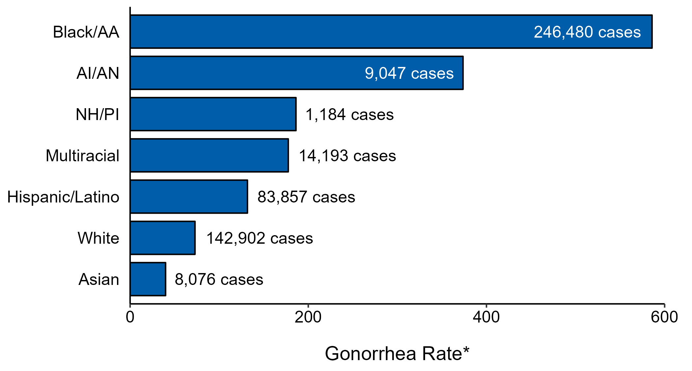
Gonorrhea — Case Counts and Rates of Reported Cases by Race/Hispanic Ethnicity, United States, 2022
* Per 100,000 population
NOTE: In 2022, a total of 142,317 gonorrhea cases (22%) had missing, unknown, or other race and were not reported to be of Hispanic ethnicity. These cases are not shown in this plot.
ACRONYMS: AI/AN = American Indian or Alaska Native; Black/AA = Black or African American; NH/PI = Native Hawaiian or other Pacific Islander
Notes:
In 2022, rates of gonorrhea were highest among non-Hispanic Black or African American persons (585.9 per 100,000), followed by non-Hispanic American Indian or Alaska Native persons (373.7 per 100,000) and non-Hispanic Native Hawaiian or other Pacific Islander persons (186.2 per 100,000). The greatest number of reported gonorrhea cases was among non-Hispanic Black or African American persons (246,480 cases), followed by non-Hispanic White persons (142,902 cases) and Hispanic or Latino persons of any race(s) (83,857 cases).
This report includes data from years that coincide with the COVID-19 pandemic, which introduced uncertainty and difficulty in interpreting STI surveillance data. See Impact of COVID-19 on STIs for more information.
See Technical Notes (https://www.cdc.gov/std/statistics/2022/technical-notes.htm) for information on gonorrhea case reporting and reporting of race/Hispanic ethnicity for STI cases.
Data for all figures are available at https://www.cdc.gov/std/statistics/2022/data.zip. The file “GC - Cases and Rates by Race Hispanic Ethnicity (US 2022).xlsx” contains the data for the figure presented on this slide.

Slide 12
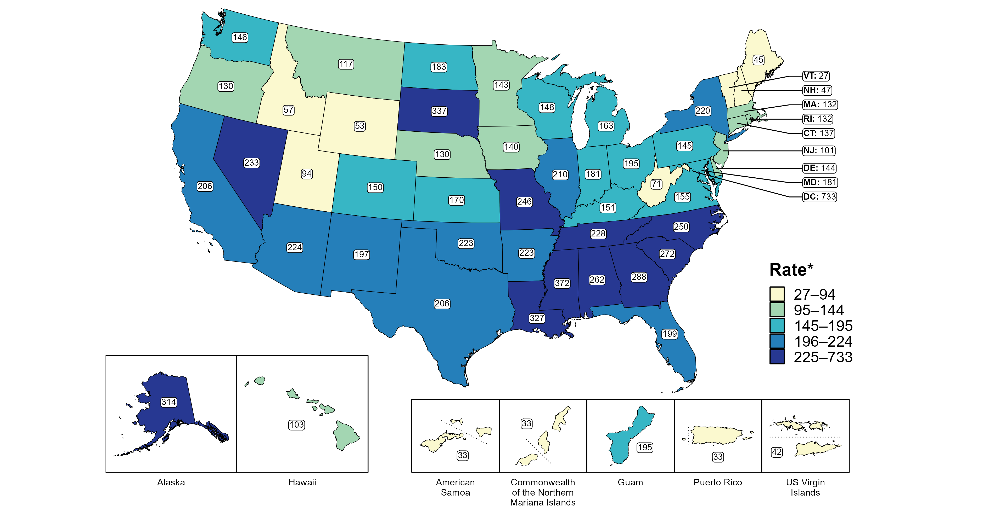
Gonorrhea — Rates of Reported Cases by Jurisdiction, United States and Territories, 2022
* Per 100,000
Notes:
In 2022, rates of reported gonorrhea ranged by state from 27 cases per 100,000 population in Vermont to 372 cases per 100,000 population in Mississippi. The rate of reported gonorrhea in the District of Columbia was 733 per 100,000 population.
Among US territories, rates of reported gonorrhea ranged from 33 cases per 100,000 population in American Samoa, the Commonwealth of the Northern Mariana Islands, and Puerto Rico to 195 cases per 100,000 population in Guam.
This report includes data from years that coincide with the COVID-19 pandemic, which introduced uncertainty and difficulty in interpreting STI surveillance data. See Impact of COVID-19 on STIs for more information.
See Technical Notes (https://www.cdc.gov/std/statistics/2022/technical-notes.htm) for information on gonorrhea case reporting and on interpreting reported rates in US territories.
Data for all figures are available at https://www.cdc.gov/std/statistics/2022/data.zip. The file “GC - Rates by Jurisdiction (US and Terr 2022).xlsx” contains the data for the figure presented on this slide.

Slide 13
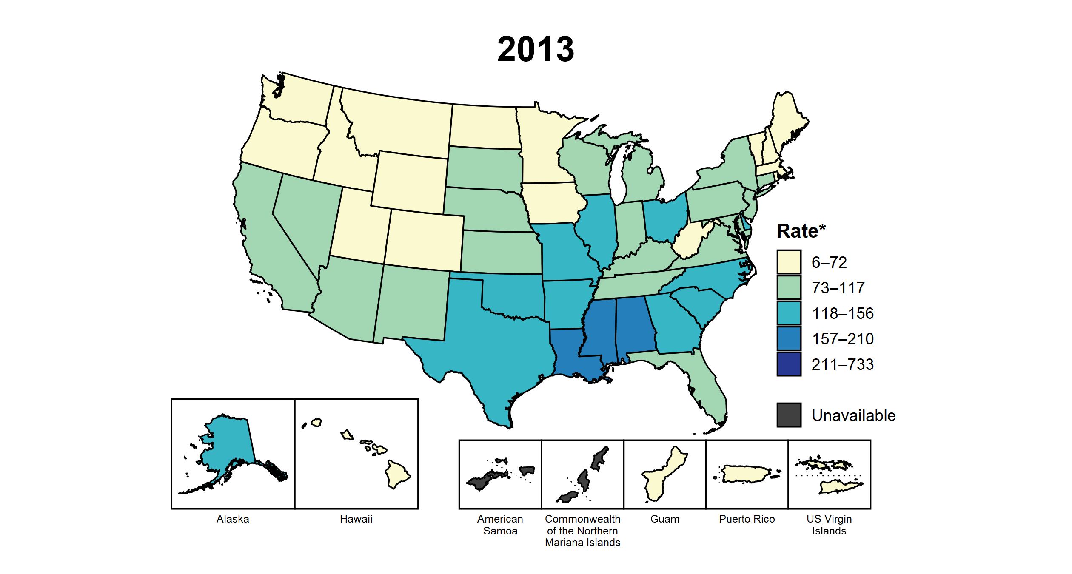
Gonorrhea — Rates of Reported Cases by Jurisdiction, United States and Territories, 2013–2022
* Per 100,000
Notes:
This slide contains an animated figure that will play when the slide is in presentation mode. A static version of the figure that displays maps from the first and last years of the range is available as a separate slide.
In 2013, three states and the District of Columbia (DC; 7.4% of areas with available data) had a rate of reported gonorrhea greater than or equal to 157 cases per 100,000 population. This increased to 26 states, DC, and one US territory (50.0% of areas with available data) in 2022. During 2021 to 2022, rates of reported gonorrhea increased in eight states, DC, and three territories.
American Samoa and the Commonwealth of the Northern Mariana Islands began reporting data on gonorrhea cases to CDC in 2018; data are not available for those areas prior to that year. In addition, data on reported gonorrhea cases in 2018 are not available for the US Virgin Islands. Due to a network security incident in December 2021, the Maryland Department of Health could not finalize their 2021 STI case notification data. Data for 2021 from Maryland have been suppressed for this figure; however, they are included in national and regional case counts and rates displayed in other figures.
This report includes data from years that coincide with the COVID-19 pandemic, which introduced uncertainty and difficulty in interpreting STI surveillance data. See Impact of COVID-19 on STIs for more information.
See Technical Notes (https://www.cdc.gov/std/statistics/2022/technical-notes.htm) for information on gonorrhea case reporting and on interpreting reported rates in US territories.
Data for all figures are available at https://www.cdc.gov/std/statistics/2022/data.zip. The file “GC - Rates by Jurisdiction (US and Terr 2013-2022).xlsx” contains the data for the figure presented on this slide.

Slide 14
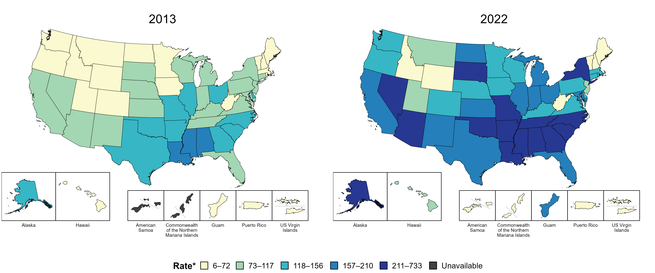
Gonorrhea — Rates of Reported Cases by Jurisdiction, United States and Territories, 2013 and 2022
* Per 100,000
Notes:
In 2013, three states and the District of Columbia (DC; 7.4% of areas with available data) had a rate of reported gonorrhea greater than or equal to 157 cases per 100,000 population. This increased to 26 states, DC, and one US territory (50.0% of areas with available data) in 2022.
American Samoa and the Commonwealth of the Northern Mariana Islands began reporting data on gonorrhea cases to CDC in 2018; data are not available for those areas prior to that year.
This report includes data from years that coincide with the COVID-19 pandemic, which introduced uncertainty and difficulty in interpreting STI surveillance data. See Impact of COVID-19 on STIs for more information.
See Technical Notes (https://www.cdc.gov/std/statistics/2022/technical-notes.htm) for information on gonorrhea case reporting and on interpreting reported rates in US territories.
Data for all figures are available at https://www.cdc.gov/std/statistics/2022/data.zip. The file “GC - Rates by Jurisdiction (US and Terr 2013 and 2022).xlsx” contains the data for the figure presented on this slide.

Slide 15
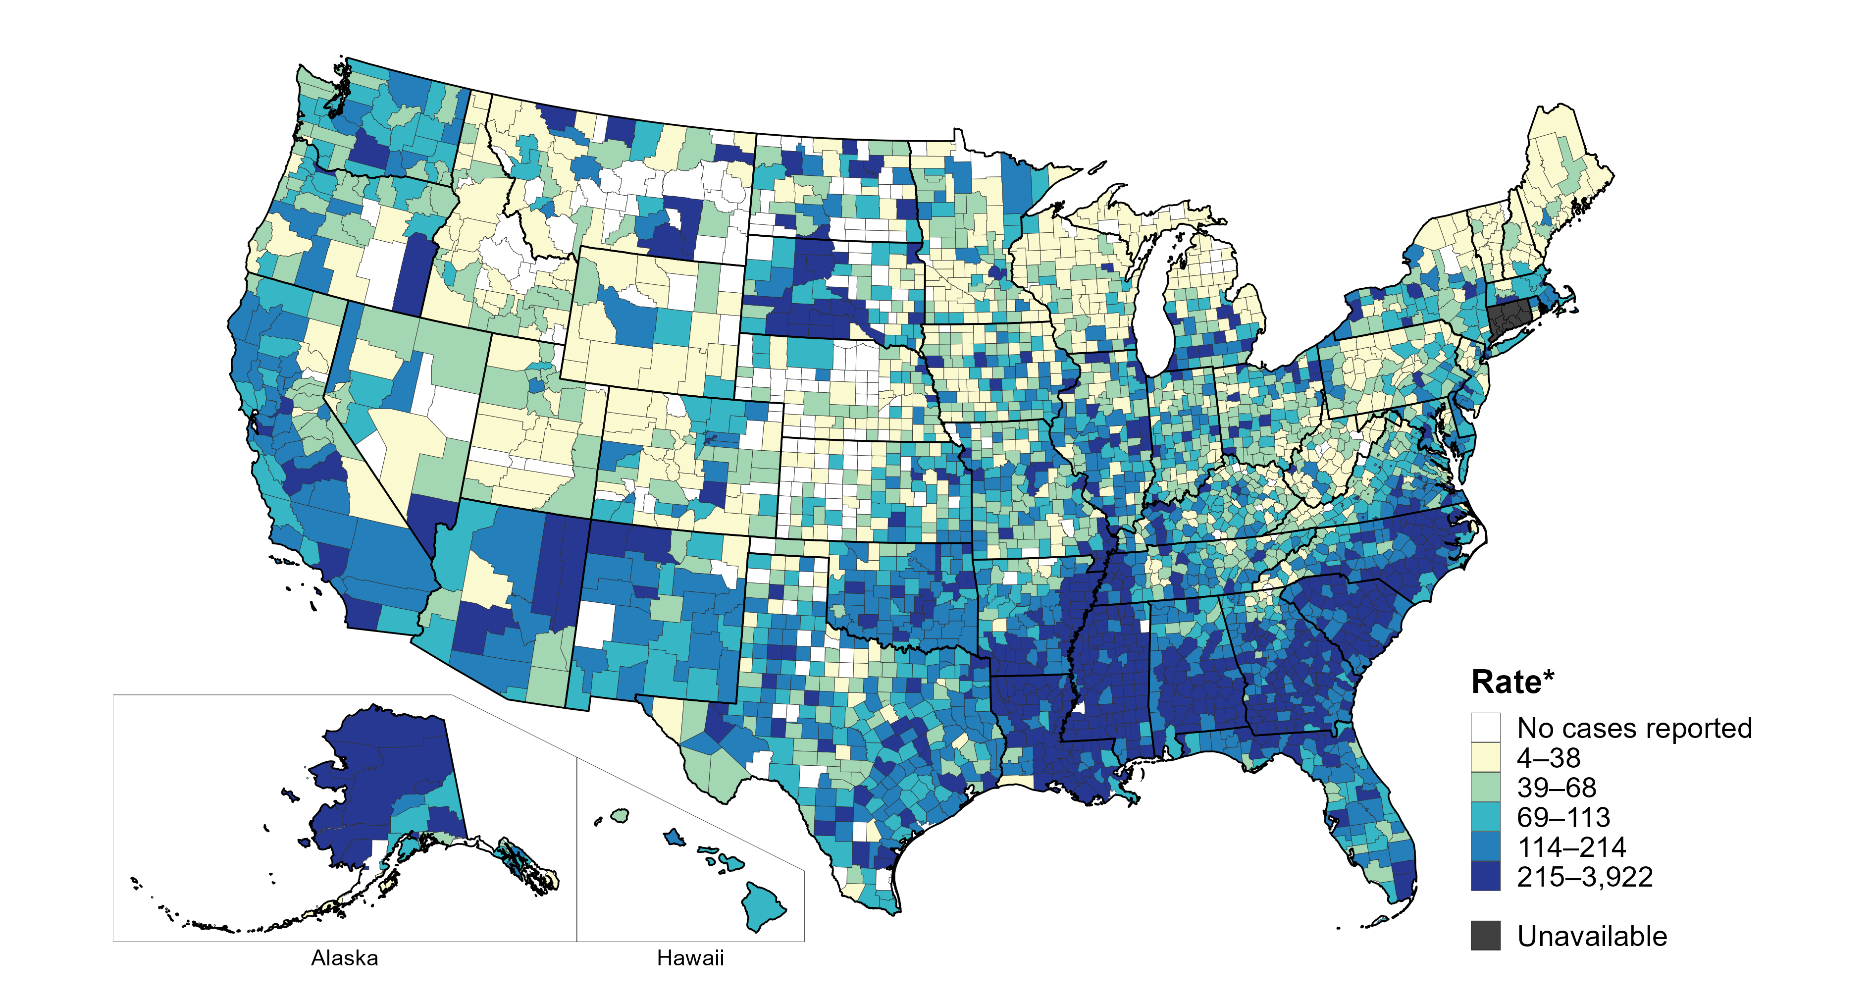
Gonorrhea — Rates of Reported Cases by County, United States, 2022
* Per 100,000
Notes:
In 2022, 93% of counties and county equivalents with available data in the United States reported at least one case of gonorrhea. Out of 3,135 counties and county equivalents with available data, 66 (2%) reported half of all cases of gonorrhea.
In 2022, Connecticut adopted nine planning regions as county-equivalent geographic units; as STI case notification data were not available in the new county-equivalent units for 2022, data for Connecticut have been suppressed for this figure.
This report includes data from years that coincide with the COVID-19 pandemic, which introduced uncertainty and difficulty in interpreting STI surveillance data. See Impact of COVID-19 on STIs for more information.
See Technical Notes (https://www.cdc.gov/std/statistics/2022/technical-notes.htm) for information on gonorrhea case reporting.
Data for all figures are available at https://www.cdc.gov/std/statistics/2022/data.zip. The file “GC - Rates by County (US 2022).xlsx” contains the data for the figure presented on this slide.

Slide 16
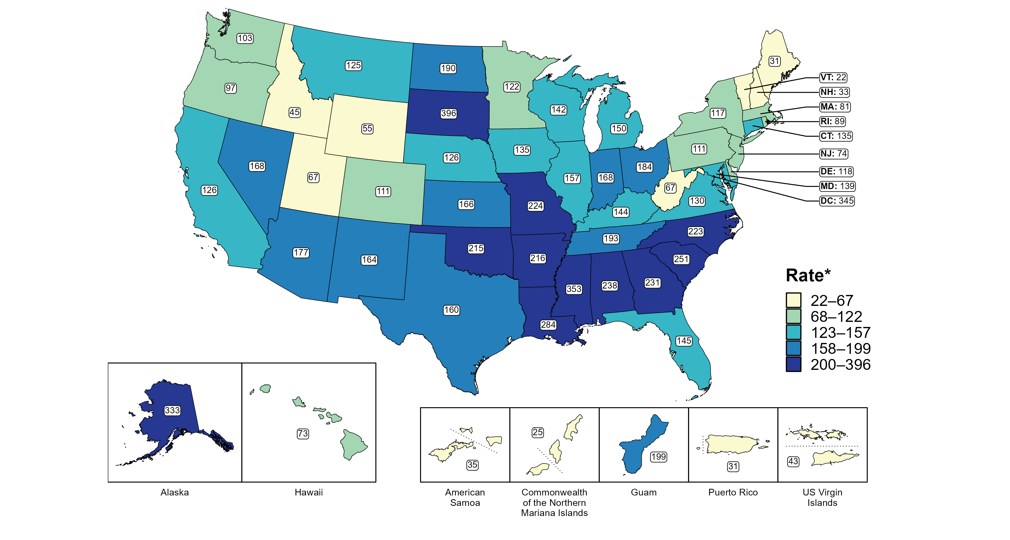
Gonorrhea — Rates of Reported Cases Among Women by Jurisdiction, United States and Territories, 2022
* Per 100,000
Notes:
In 2022, rates of reported gonorrhea among women ranged by state from 22 cases per 100,000 women in Vermont to 396 cases per 100,000 women in South Dakota. The rate of reported gonorrhea in the District of Columbia was 345 per 100,000 women.
Among US territories, rates of reported gonorrhea ranged from 25 cases per 100,000 women in the Commonwealth of the Northern Mariana Islands to 199 cases per 100,000 women in Guam.
This report includes data from years that coincide with the COVID-19 pandemic, which introduced uncertainty and difficulty in interpreting STI surveillance data. See Impact of COVID-19 on STIs for more information.
See Technical Notes (https://www.cdc.gov/std/statistics/2022/technical-notes.htm) for information on gonorrhea case reporting and on interpreting reported rates in US territories. Table A1 (https://www.cdc.gov/std/statistics/2022/tables/a1.htm) provides information on unknown, missing, or invalid values of select variables.
Data for all figures are available at https://www.cdc.gov/std/statistics/2022/data.zip. The file “GC - Rates Women by Jurisdiction (US and Terr 2022).xlsx” contains the data for the figure presented on this slide.

Slide 17
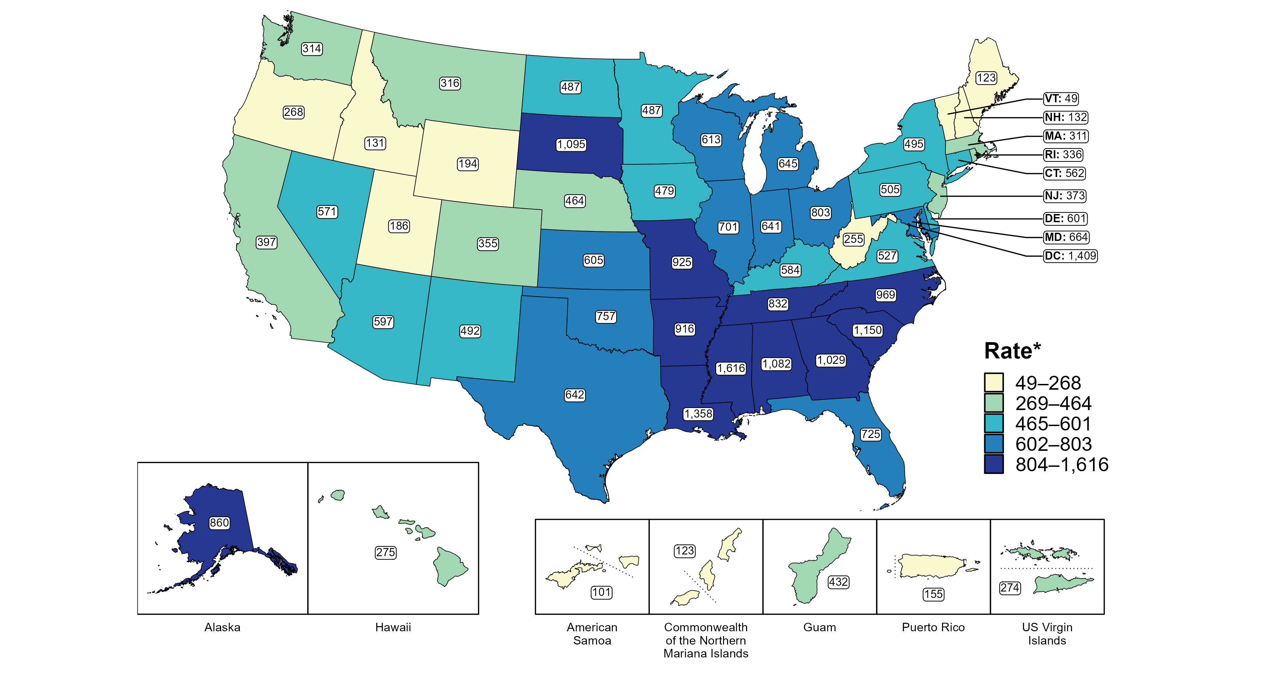
Gonorrhea — Rates of Reported Cases Among Women Aged 15–24 Years by Jurisdiction, United States and Territories, 2022
* Per 100,000
Notes:
In 2022, rates of reported gonorrhea among women aged 15 to 24 years ranged by state from 49 cases per 100,000 women aged 15 to 24 years in Vermont to 1,616 cases per 100,000 women aged 15 to 24 years in Mississippi. The rate of reported gonorrhea in the District of Columbia was 1,409 per 100,000 women aged 15 to 24 years.
Among US territories, rates of reported gonorrhea ranged from 101 cases per 100,000 women aged 15 to 24 years in American Samoa to 432 cases per 100,000 women aged 15 to 24 years in Guam.
This report includes data from years that coincide with the COVID-19 pandemic, which introduced uncertainty and difficulty in interpreting STI surveillance data. See Impact of COVID-19 on STIs for more information.
See Technical Notes (https://www.cdc.gov/std/statistics/2022/technical-notes.htm) for information on gonorrhea case reporting and on interpreting reported rates in US territories. Table A1 (https://www.cdc.gov/std/statistics/2022/tables/a1.htm) provides information on unknown, missing, or invalid values of select variables.
Data for all figures are available at https://www.cdc.gov/std/statistics/2022/data.zip. The file “GC - Rates Women 15-24 Years by Jurisdiction (US and Terr 2022).xlsx” contains the data for the figure presented on this slide.

Slide 18
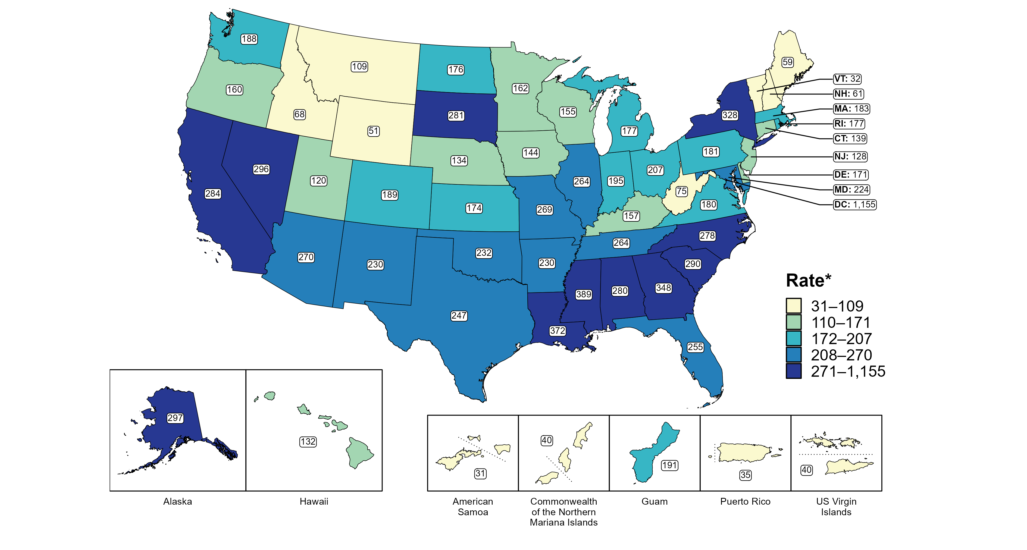
Gonorrhea — Rates of Reported Cases Among Men by State, United States and Territories, 2022
* Per 100,000
Notes:
In 2022, rates of reported gonorrhea among men ranged by state from 32 cases per 100,000 men in Vermont to 389 cases per 100,000 men in Mississippi. The rate of reported gonorrhea in the District of Columbia was 1,155 per 100,000 men.
Among US territories, rates of reported gonorrhea ranged from 31 cases per 100,000 men in American Samoa to 191 cases per 100,000 men in Guam.
This report includes data from years that coincide with the COVID-19 pandemic, which introduced uncertainty and difficulty in interpreting STI surveillance data. See Impact of COVID-19 on STIs for more information.
See Technical Notes (https://www.cdc.gov/std/statistics/2022/technical-notes.htm) for information on gonorrhea case reporting and on interpreting reported rates in US territories. Table A1 (https://www.cdc.gov/std/statistics/2022/tables/a1.htm) provides information on unknown, missing, or invalid values of select variables.
Data for all figures are available at https://www.cdc.gov/std/statistics/2022/data.zip. The file “GC - Rates Men by Jurisdiction (US and Terr 2022).xlsx” contains the data for the figure presented on this slide.

Slide 19
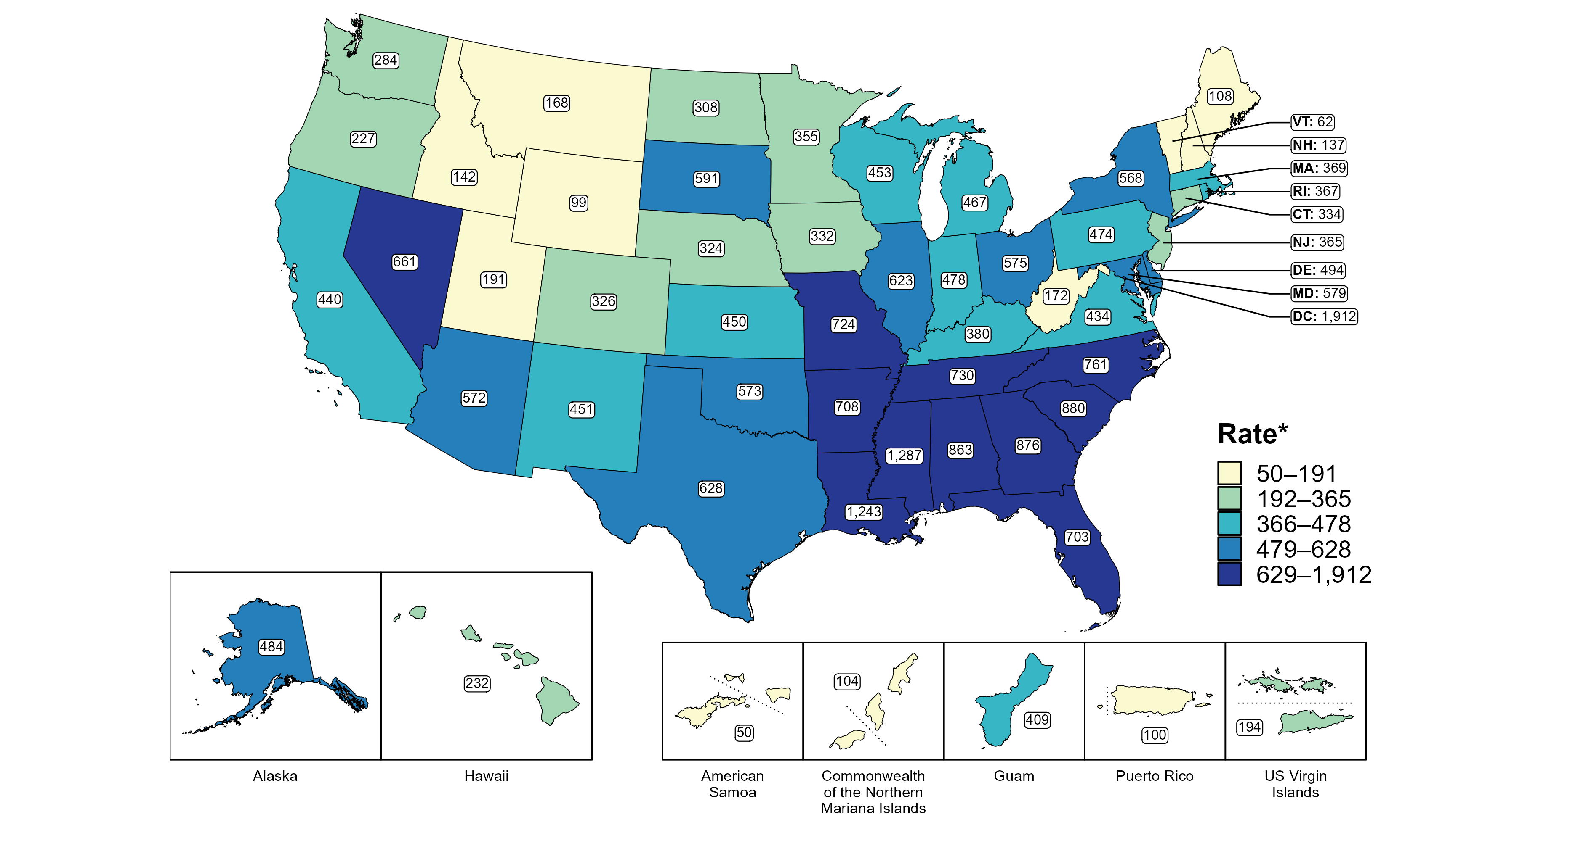
Gonorrhea — Rates of Reported Cases Among Men Aged 15–24 Years by Jurisdiction, United States and Territories, 2022
* Per 100,000
Notes:
In 2022, rates of reported gonorrhea among men aged 15 to 24 years ranged by state from 62 cases per 100,000 men aged 15 to 24 years in Vermont to 1,287 cases per 100,000 men aged 15 to 24 years in Mississippi. The rate of reported gonorrhea in the District of Columbia was 1,912 per 100,000 men aged 15 to 24 years.
Among US territories, rates of reported gonorrhea ranged from 50 cases per 100,000 men aged 15 to 24 years in American Samoa to 409 cases per 100,000 men aged 15 to 24 years in Guam.
This report includes data from years that coincide with the COVID-19 pandemic, which introduced uncertainty and difficulty in interpreting STI surveillance data. See Impact of COVID-19 on STIs for more information.
See Technical Notes (https://www.cdc.gov/std/statistics/2022/technical-notes.htm) for information on gonorrhea case reporting and on interpreting reported rates in US territories. Table A1 (https://www.cdc.gov/std/statistics/2022/tables/a1.htm) provides information on unknown, missing, or invalid values of select variables.
Data for all figures are available at https://www.cdc.gov/std/statistics/2022/data.zip. The file “GC - Rates Men 15-24 Years by Jurisdiction (US and Terr 2022).xlsx” contains the data for the figure presented on this slide.

Slide 20
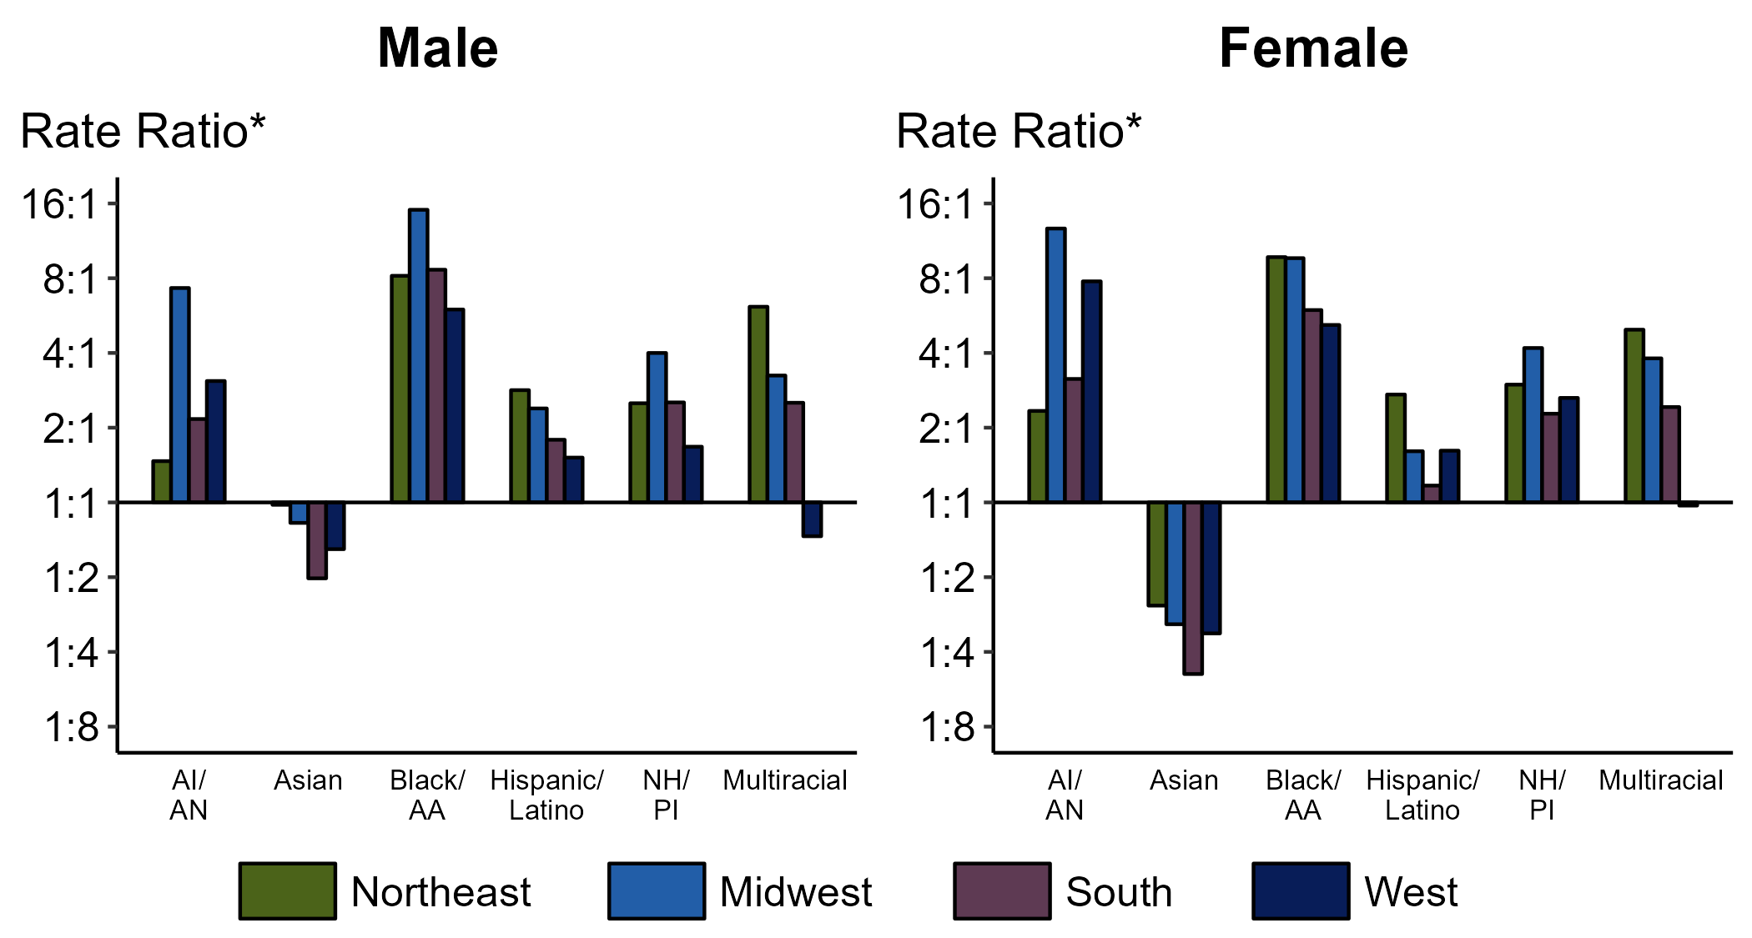
Gonorrhea — Ratios of Rates of Reported Cases by Sex, Race/Hispanic Ethnicity, and Region, United States, 2022
* For the rate ratios, non-Hispanic White persons are the referent population. Y-axis is log scale.
ACRONYMS: AI/AN = American Indian or Alaska Native; Black/AA = Black or African American; NH/PI = Native Hawaiian or other Pacific Islander
Notes:
Among men and women, rate ratios of rates of reported gonorrhea by race/Hispanic ethnicity (using non-Hispanic White persons as the referent population) varied by region in 2022. Among men, the greatest rate ratio was in the Midwest where the rate of gonorrhea among non-Hispanic Black men was 15.1 times the rate among non-Hispanic White men. Among women, the greatest rate ratio was in the Midwest where the rate of gonorrhea among non-Hispanic American Indian or Alaska Native women was 12.7 times the rate among non-Hispanic White women.
This report includes data from years that coincide with the COVID-19 pandemic, which introduced uncertainty and difficulty in interpreting STI surveillance data. See Impact of COVID-19 on STIs for more information.
See Technical Notes (https://www.cdc.gov/std/statistics/2022/technical-notes.htm) for information on gonorrhea case reporting and reporting of race/Hispanic ethnicity for STI cases. Table A1 (https://www.cdc.gov/std/statistics/2022/tables/a1.htm) provides information on unknown, missing, or invalid values of select variables.

Slide 21
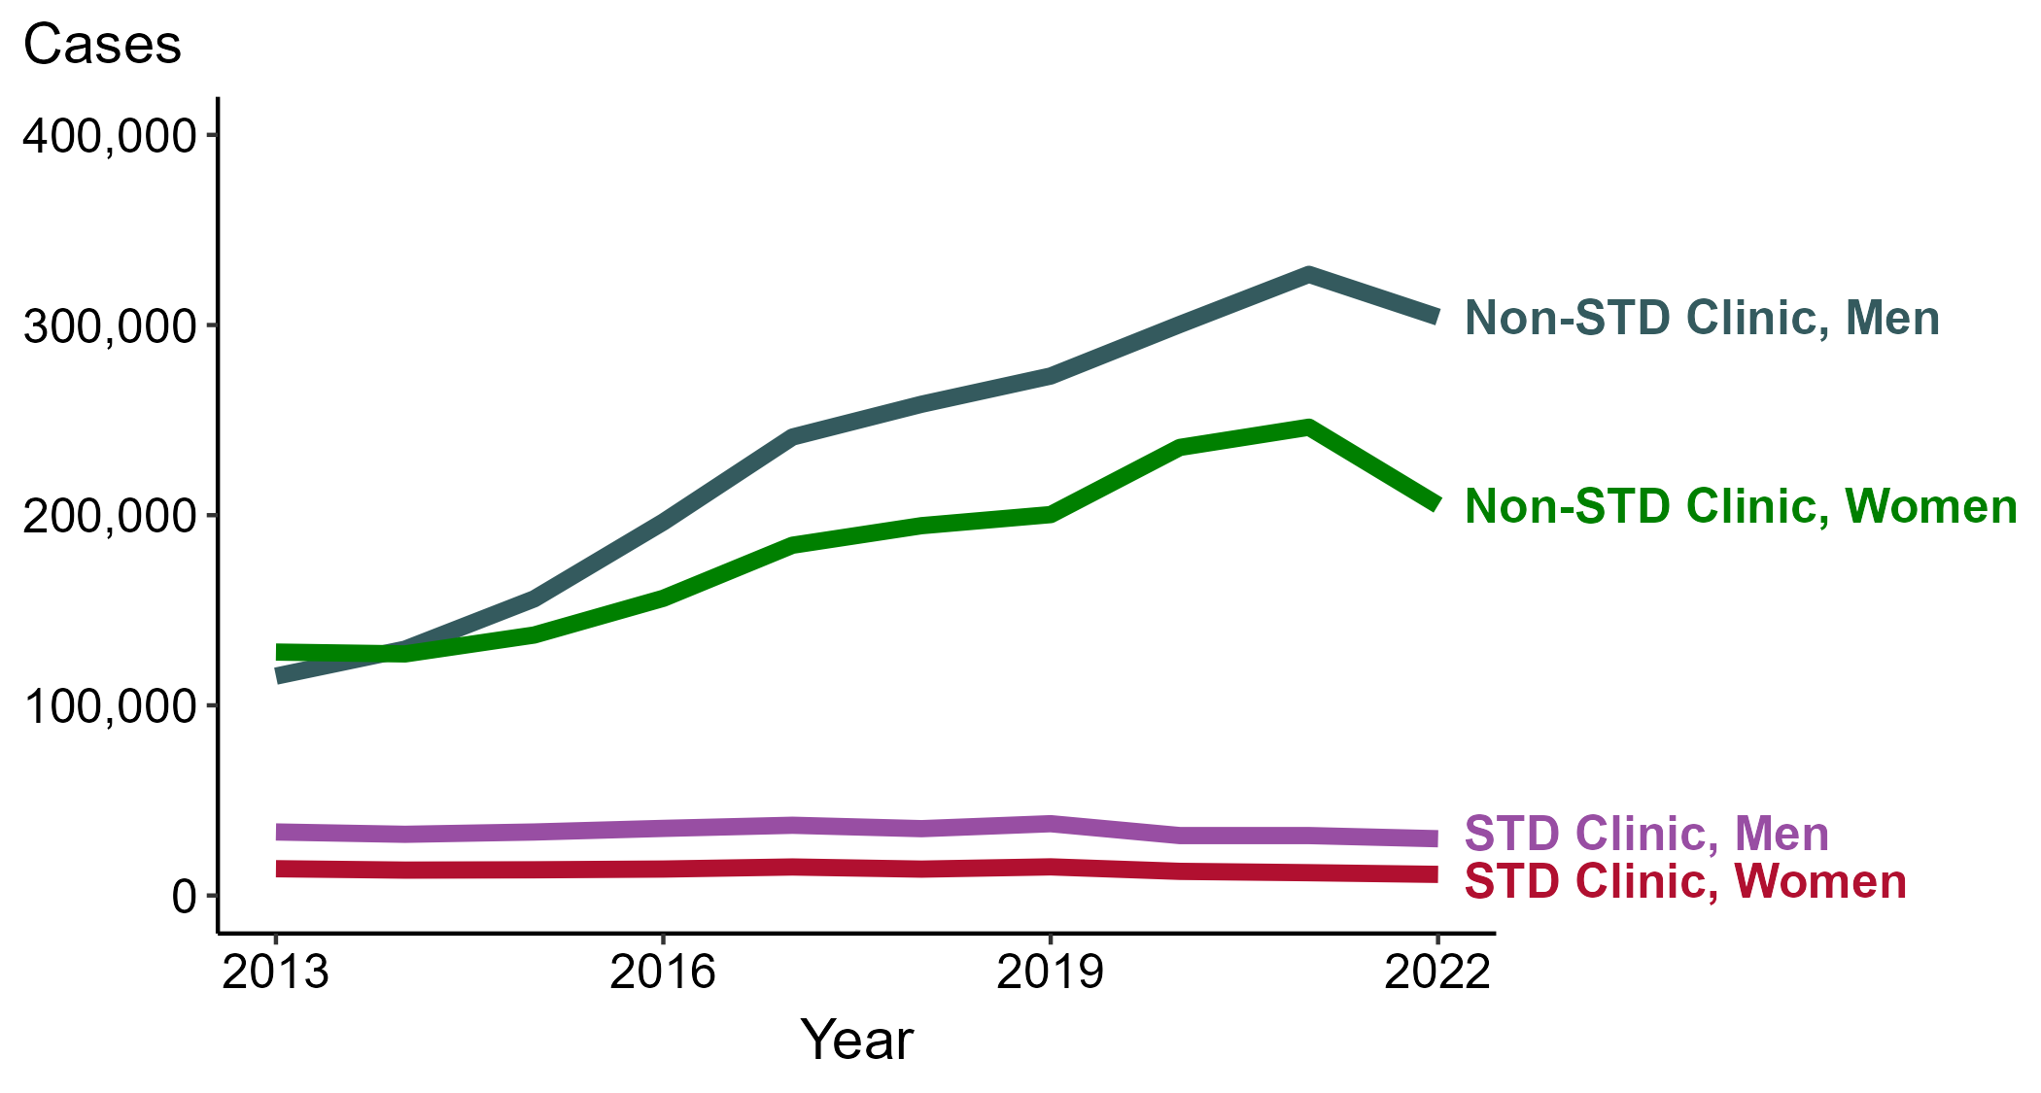
Gonorrhea — Reported Cases by Reporting Source and Sex, United States, 2013–2022
NOTE: During 2013 to 2022, the proportion of all cases with unknown reporting source was 13.9%, from a low of 12.5% (n = 41,579) in 2013 to a high of 14.8% (n = 96,035) in 2022.
Notes:
During 2021 to 2022, the number of gonorrhea cases reported from STD clinics decreased 5.3% among men (31,512 to 29,849 cases) and decreased 7.4% among women (11,990 to 11,104 cases), while the number of cases reported from non-STD clinics decreased 6.9% among men (326,647 to 304,166 cases) and decreased 16.7% among women (246,270 to 205,253 cases).
During a ten-year period (2013 to 2022), the number of gonorrhea cases reported from STD clinics decreased 10.7% among men (33,408 to 29,849 cases) and decreased 21.1% among women (14,076 to 11,104 cases), while the number of cases reported from non-STD clinics increased 163.7% among men (115,359 to 304,166 cases) and increased 60.3% among women (128,016 to 205,253 cases).
This report includes data from years that coincide with the COVID-19 pandemic, which introduced uncertainty and difficulty in interpreting STI surveillance data. See Impact of COVID-19 on STIs for more information.
See Technical Notes (https://www.cdc.gov/std/statistics/2022/technical-notes.htm) for information on gonorrhea case reporting. Table A1 (https://www.cdc.gov/std/statistics/2022/tables/a1.htm) provides information on unknown, missing, or invalid values of select variables.
Data for all figures are available at https://www.cdc.gov/std/statistics/2022/data.zip. The file “GC - Cases by Reporting Source and Sex (US 2013-2022).xlsx” contains the data for the figure presented on this slide.

Slide 22
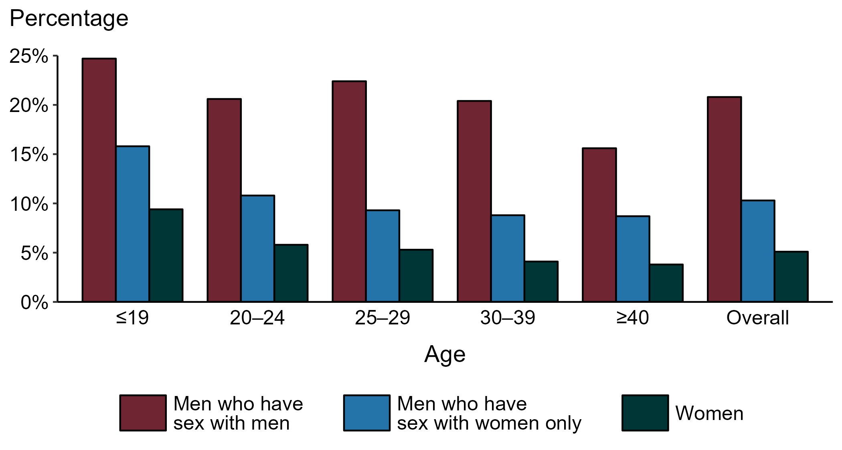
Gonorrhea — Proportion of STD Clinic Patients Testing Positive by Age Group, Sex, and Sex of Sex Partners, STD Surveillance Network (SSuN), 2022
NOTE: Results are based on 49,726 unique patients in 10 participating jurisdictions (Baltimore City, California [excluding San Francisco], Columbus, Florida, Indiana, Multnomah County, New York City, Philadelphia, San Francisco, and Washington) with known sex of sex partners attending SSuN STD clinics who were tested ≥1 times for gonorrhea in 2022.
Notes:
Among patients accessing care in participating STD clinics in the STD Surveillance Network (SSuN) who were tested for gonorrhea in 2022, 20.8% of gay, bisexual, and other men who have sex with men (MSM), 10.3% of men who have sex with women only (MSW), and 5.1% of women were positive. The proportion of STD clinic patients who tested positive for gonorrhea varied by sex and sex of sex partners, as well as by age group. MSM were noted to have higher proportions of testing positive in all age groups when compared to women and MSW. Of note, adolescent patients represent a relatively small subgroup of the clinic population and changes in the number of events in the numerator or a small denominator may lead to substantial fluctuations from year to year. Hence, data should be interpreted with caution.
This report includes data from years that coincide with the COVID-19 pandemic, which introduced uncertainty and difficulty in interpreting STI surveillance data. See Impact of COVID-19 on STIs for more information.
See Technical Notes (https://www.cdc.gov/std/statistics/2022/technical-notes.htm) for information on SSuN methodology.

Slide 23
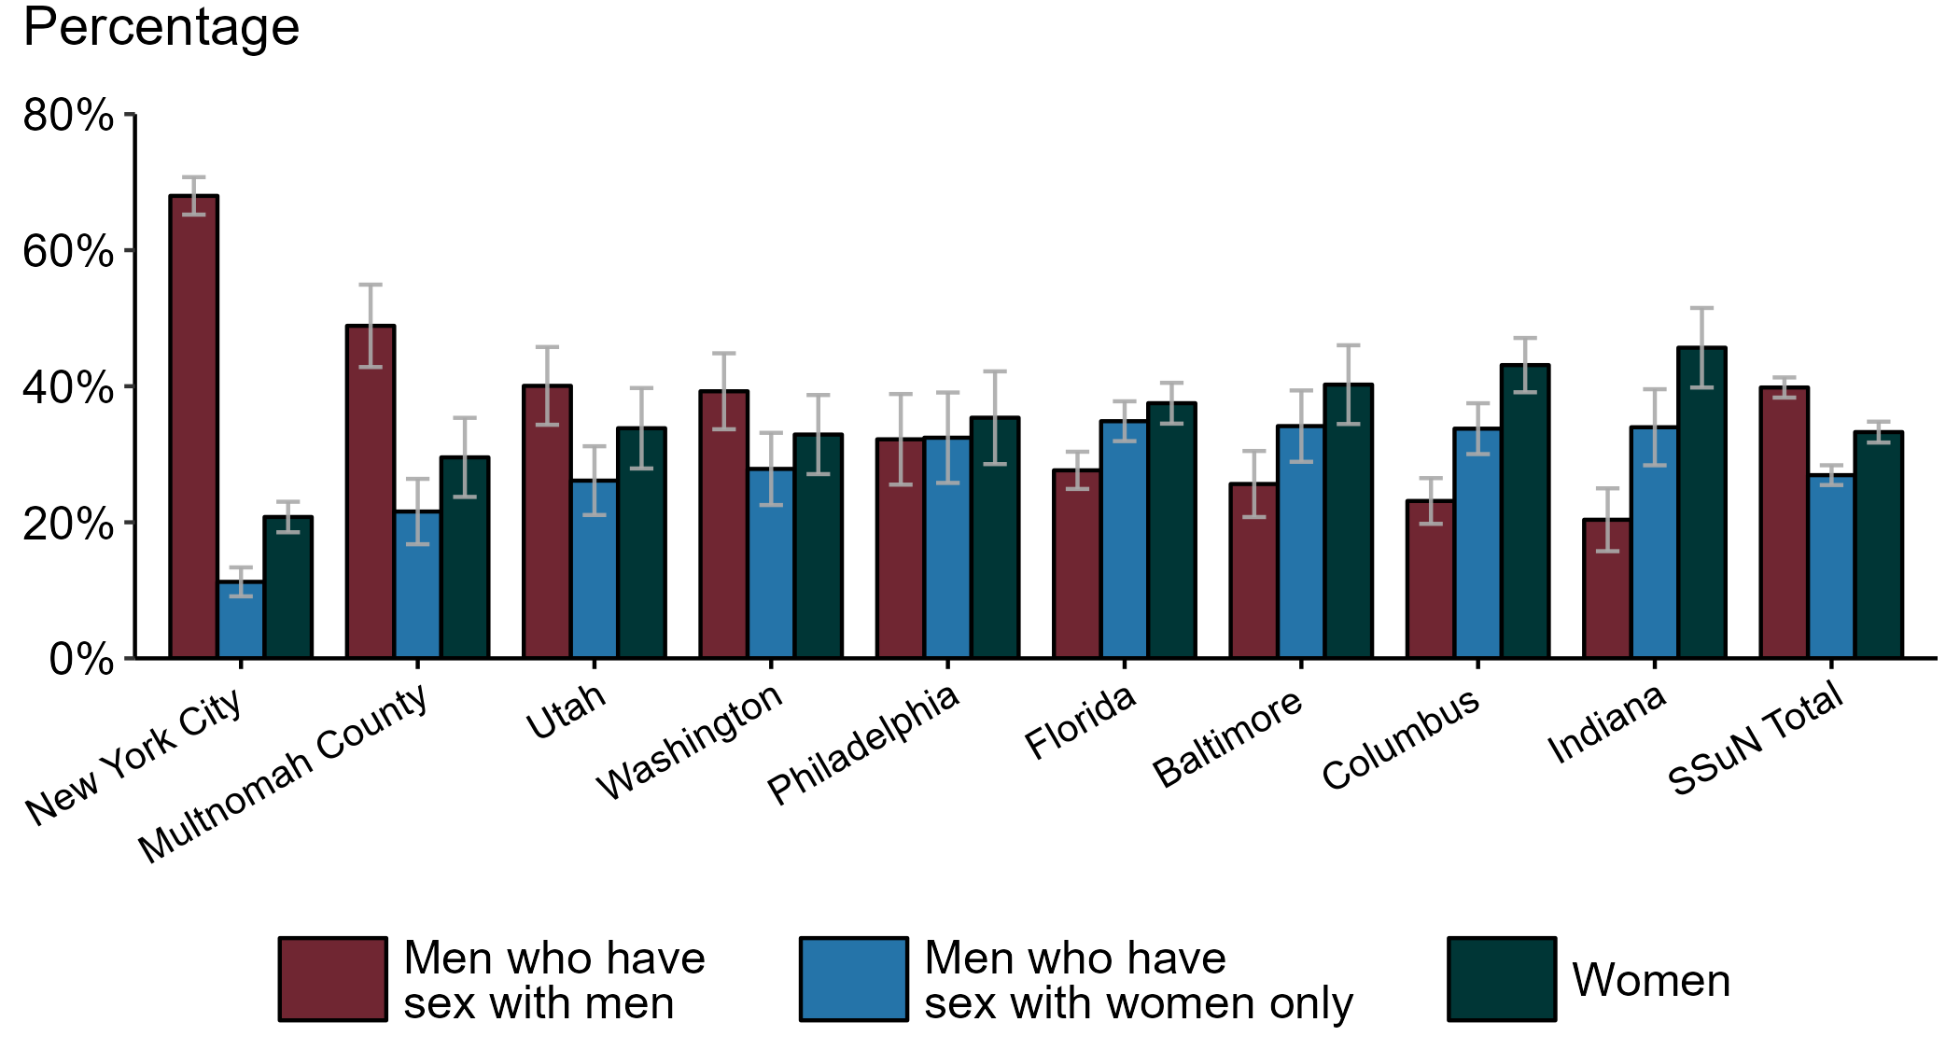
Gonorrhea — Estimated Proportion of Cases by Sex and Sex of Sex Partners and Jurisdiction, STD Surveillance Network (SSuN), 2022
NOTE: Estimate based on weighted analysis of data on sex of sex partners obtained from interviews (n=4,992) conducted among a random sample of gonorrhea cases reported to participating SSuN jurisdictions during January to December 2022. Includes nine SSuN sites reporting completed case investigations in 2022 for at least 2% of all reported cases.
Notes:
In 2022, New York City had the highest proportion of gonorrhea cases reported among gay, bisexual, and other men who have sex with men (MSM) among SSuN jurisdictions meeting the inclusion threshold, Indiana had the highest proportion of gonorrhea cases reported among women, and Florida had the highest proportion of gonorrhea cases reported among men who have sex with women only. Overall, the proportion of gonorrhea estimated to be attributed to MSM was 39.8% in 2022.
This report includes data from years that coincide with the COVID-19 pandemic, which introduced uncertainty and difficulty in interpreting STI surveillance data. See Impact of COVID-19 on STIs for more information.
See Technical Notes (https://www.cdc.gov/std/statistics/2022/technical-notes.htm) for information on SSuN methodology.

Slide 24
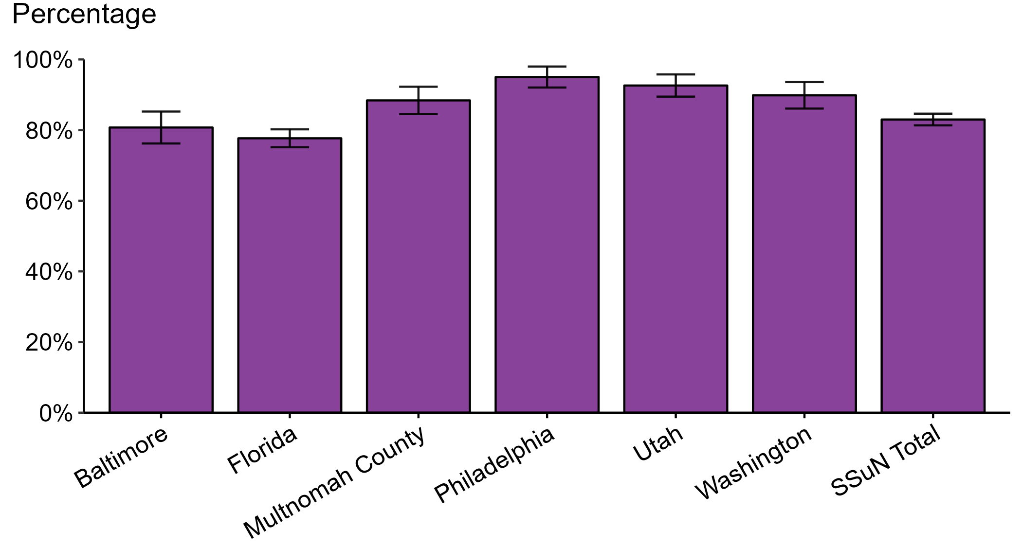
Gonorrhea — Estimated Proportion of Cases Treated with Recommended Regimen by Jurisdiction, STD Surveillance Network (SSuN), 2022
NOTE: Includes SSuN jurisdictions with treatment and dosage data ascertained for at least 80% of sampled, investigated cases. In 2022, the recommended treatment for uncomplicated gonorrhea was ceftriaxone 500 mg, intramuscular.
Notes:
In 2022, Philadelphia reported the highest estimated proportion of gonorrhea cases treated with the recommended regimen and Florida reported the lowest proportion of cases treated with the recommended regimen among jurisdictions participating in SSuN that met the inclusion criteria. Overall, the proportion of cases treated with the recommended regimen was 83.0% in 2022.
This report includes data from years that coincide with the COVID-19 pandemic, which introduced uncertainty and difficulty in interpreting STI surveillance data. See Impact of COVID-19 on STIs for more information.
See Technical Notes (https://www.cdc.gov/std/statistics/2022/technical-notes.htm) for information on SSuN methodology.

Slide 25
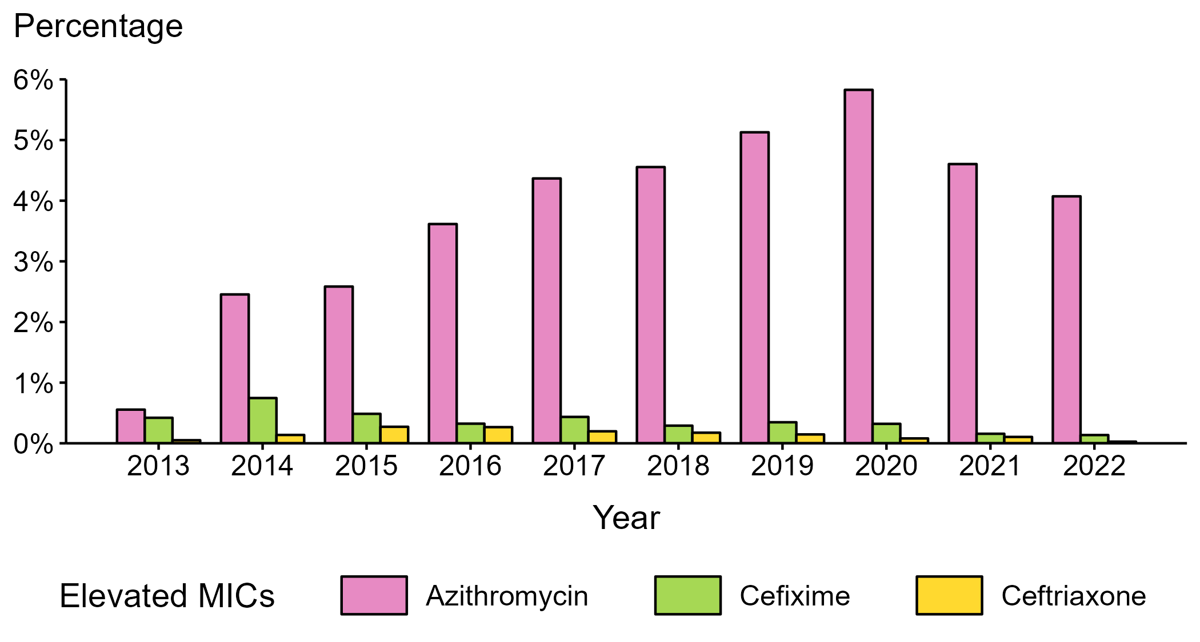
Neisseria gonorrhoeae — Percentage of Isolates with Elevated Minimum Inhibitory Concentrations (MICs) to Azithromycin, Cefixime, and Ceftriaxone, Gonococcal Isolate Surveillance Project (GISP), 2013–2022
NOTE: Elevated MICs = Azithromycin: ≥ 2.0 μg/mL; Cefixime: ≥ 0.25 μg/mL; Ceftriaxone: ≥ 0.125 μg/mL
Notes:
During 2013 to 2022, the percentage of Neisseria gonorrhoeae isolates collected in STD clinics participating in GISP that exhibited elevated ceftriaxone minimum inhibitory concentrations (MICs), defined as ≥ 0.125 µg/mL, ranged from <0.1% in 2022 to 0.3% in 2015. The percentage decreased over the period, from 0.1% in 2013 to <0.1% in 2022. The percentage of isolates with elevated cefixime MICs (≥ 0.25 µg/mL) ranged from 0.1% in 2022 to 0.7% in 2014, decreasing over the period from 0.4% in 2013 to 0.1% in 2022. In addition, the percentage of isolates with elevated azithromycin MICs (≥ 2.0 µg/mL) ranged from 0.6% in 2013 to 5.8% in 2020. Over the period, the percentage increased from 0.6% in 2013 to 4.1% in 2022.
This report includes data from years that coincide with the COVID-19 pandemic, which introduced uncertainty and difficulty in interpreting STI surveillance data. See Impact of COVID-19 on STIs for more information.
See Technical Notes (https://www.cdc.gov/std/statistics/2022/technical-notes.htm) for information on GISP methodology.
Data for all figures are available at https://www.cdc.gov/std/statistics/2022/data.zip. The file “NG - Percentage of Isolates with Elevated MICs (GISP 2013-2022) .xlsx” contains the data for the figure presented on this slide.

Slide 26
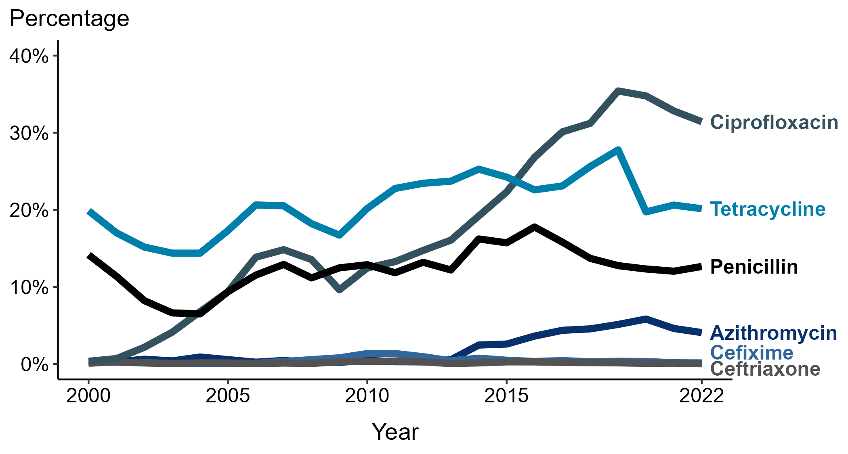
Neisseria gonorrhoeae — Prevalence of Tetracycline, Penicillin, or Ciprofloxacin Resistance* or Elevated Cefixime, Ceftriaxone, or Azithromycin Minimum Inhibitory Concentrations (MICs)†, by Year — Gonococcal Isolate Surveillance Project (GISP), 2000–2022
* Resistance: Ciprofloxacin: MIC ≥ 1.0 µg/mL; Penicillin: MIC ≥ 2.0 µg/mL or Beta-lactamase positive; Tetracycline: MIC ≥ 2.0 µg/mL
† Elevated MICs: Azithromycin: MIC ≥ 1.0 µg/mL (2000–2004); ≥ 2.0 µg/mL (2005–2022); Ceftriaxone: MIC ≥ 0.125 µg/mL; Cefixime: MIC ≥ 0.25 µg/mL
NOTE: Cefixime susceptibility was not tested in 2007 and 2008.
Notes:
In 2022, 31.4% of Neisseria gonorrhoeae isolates collected in STD clinics participating in GISP were resistant to ciprofloxacin, 20.1% to tetracycline, and 12.6% to penicillin.
This report includes data from years that coincide with the COVID-19 pandemic, which introduced uncertainty and difficulty in interpreting STI surveillance data. See Impact of COVID-19 on STIs for more information.
See Technical Notes (https://www.cdc.gov/std/statistics/2022/technical-notes.htm) for information on GISP methodology.
Data for all figures are available at https://www.cdc.gov/std/statistics/2022/data.zip. The file “NG - Prevalence of Resistance or Elevated MICs to Specific Antimicrobials by Year (GISP 2000-2022).xlsx” contains the data for the figure presented on this slide.

Slide 27
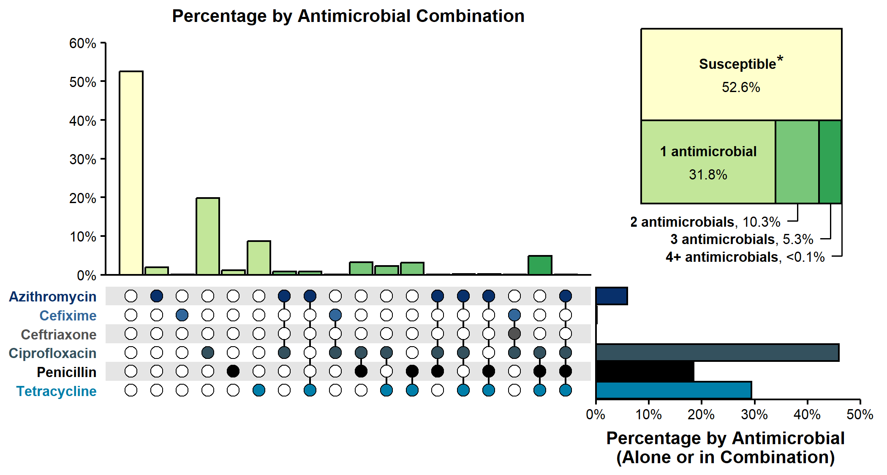
Resistance or Elevated Minimum Inhibitory Concentration (MIC) Patterns of Neisseria gonorrhoeae Isolates to Antimicrobials, Gonococcal Isolate Surveillance Project (GISP), 2022
* Susceptible category includes isolates with penicillin (or Beta-lactamase negative), tetracycline, and ciprofloxacin MIC values that are not considered resistant (i.e., susceptible and intermediate resistant) based on Clinical & Laboratory Standards Institute criteria and isolates with ceftriaxone, cefixime, and azithromycin MIC values that are not considered elevated based on GISP “alert” values.
NOTE: Elevated MIC = Ceftriaxone: MIC ≥ 0.125 μg/mL; Cefixime: MIC ≥ 0.25 μg/mL; Azithromycin: MIC ≥ 2.0 μg/mL. Resistance = Tetracycline: MIC ≥ 2.0 μg/mL; Ciprofloxacin: MIC ≥ 1.0 μg/mL; Penicillin: MIC ≥ 2.0 μg/mL or Beta-lactamase positive. In the figure, a filled circle reflects resistance or elevated MIC to a specific antimicrobial; only antimicrobial combinations with non-zero percentages are shown.
Notes:
In 2022, 52.6% of Neisseria gonorrhoeae isolates collected through GISP were susceptible to the six antimicrobials tested. Almost half (45.4%) were resistant to at least one of three antimicrobials (tetracycline, penicillin, or ciprofloxacin). An additional 2.0% of isolates were susceptible to those antimicrobials, but had elevated minimum inhibitory concentrations (MICs) to ceftriaxone, cefixime, or azithromycin. Overall, 10.3% of isolates demonstrated resistance or elevated MICs to two antimicrobials tested; 5.3% demonstrated resistance or elevated MICs to three antimicrobials tested; and <0.1% (one isolate) demonstrated resistance to four or more antimicrobials tested.
This report includes data from years that coincide with the COVID-19 pandemic, which introduced uncertainty and difficulty in interpreting STI surveillance data. See Impact of COVID-19 on STIs for more information.
See Technical Notes (https://www.cdc.gov/std/statistics/2022/technical-notes.htm) for information on GISP methodology.
Data for all figures are available at https://www.cdc.gov/std/statistics/2022/data.zip. The file “NG - Resistance or Elevated MIC Patterns of NG Isolates to Antimicrobials (GISP 2022).xlsx” contains the data for the figure presented on this slide.

Slide 28
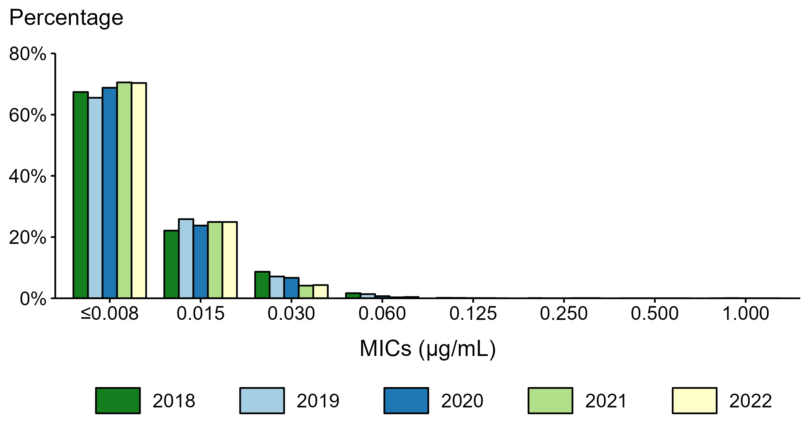
Neisseria gonorrhoeae — Distribution of Ceftriaxone Minimum Inhibitory Concentrations (MICs) by Year, Gonococcal Isolate Surveillance Project (GISP), 2018–2022
Notes:
During 2018 to 2022, 65.5–70.5% of all tested Neisseria gonorrhoeae isolates collected in STD clinics participating in GISP had a ceftriaxone minimum inhibitory concentration value ≤0.008 µg/mL, and 99.8–99.9+% had a minimum inhibitory concentration value <0.125 µg/mL.
This report includes data from years that coincide with the COVID-19 pandemic, which introduced uncertainty and difficulty in interpreting STI surveillance data. See Impact of COVID-19 on STIs for more information.
See Technical Notes (https://www.cdc.gov/std/statistics/2022/technical-notes.htm) for information on GISP methodology.
Data for all figures are available at https://www.cdc.gov/std/statistics/2022/data.zip. The file “NG - Distribution of Ceftriaxone MICs by Year (GISP 2018-2022).xlsx” contains the data for the figure presented on this slide.

Slide 29
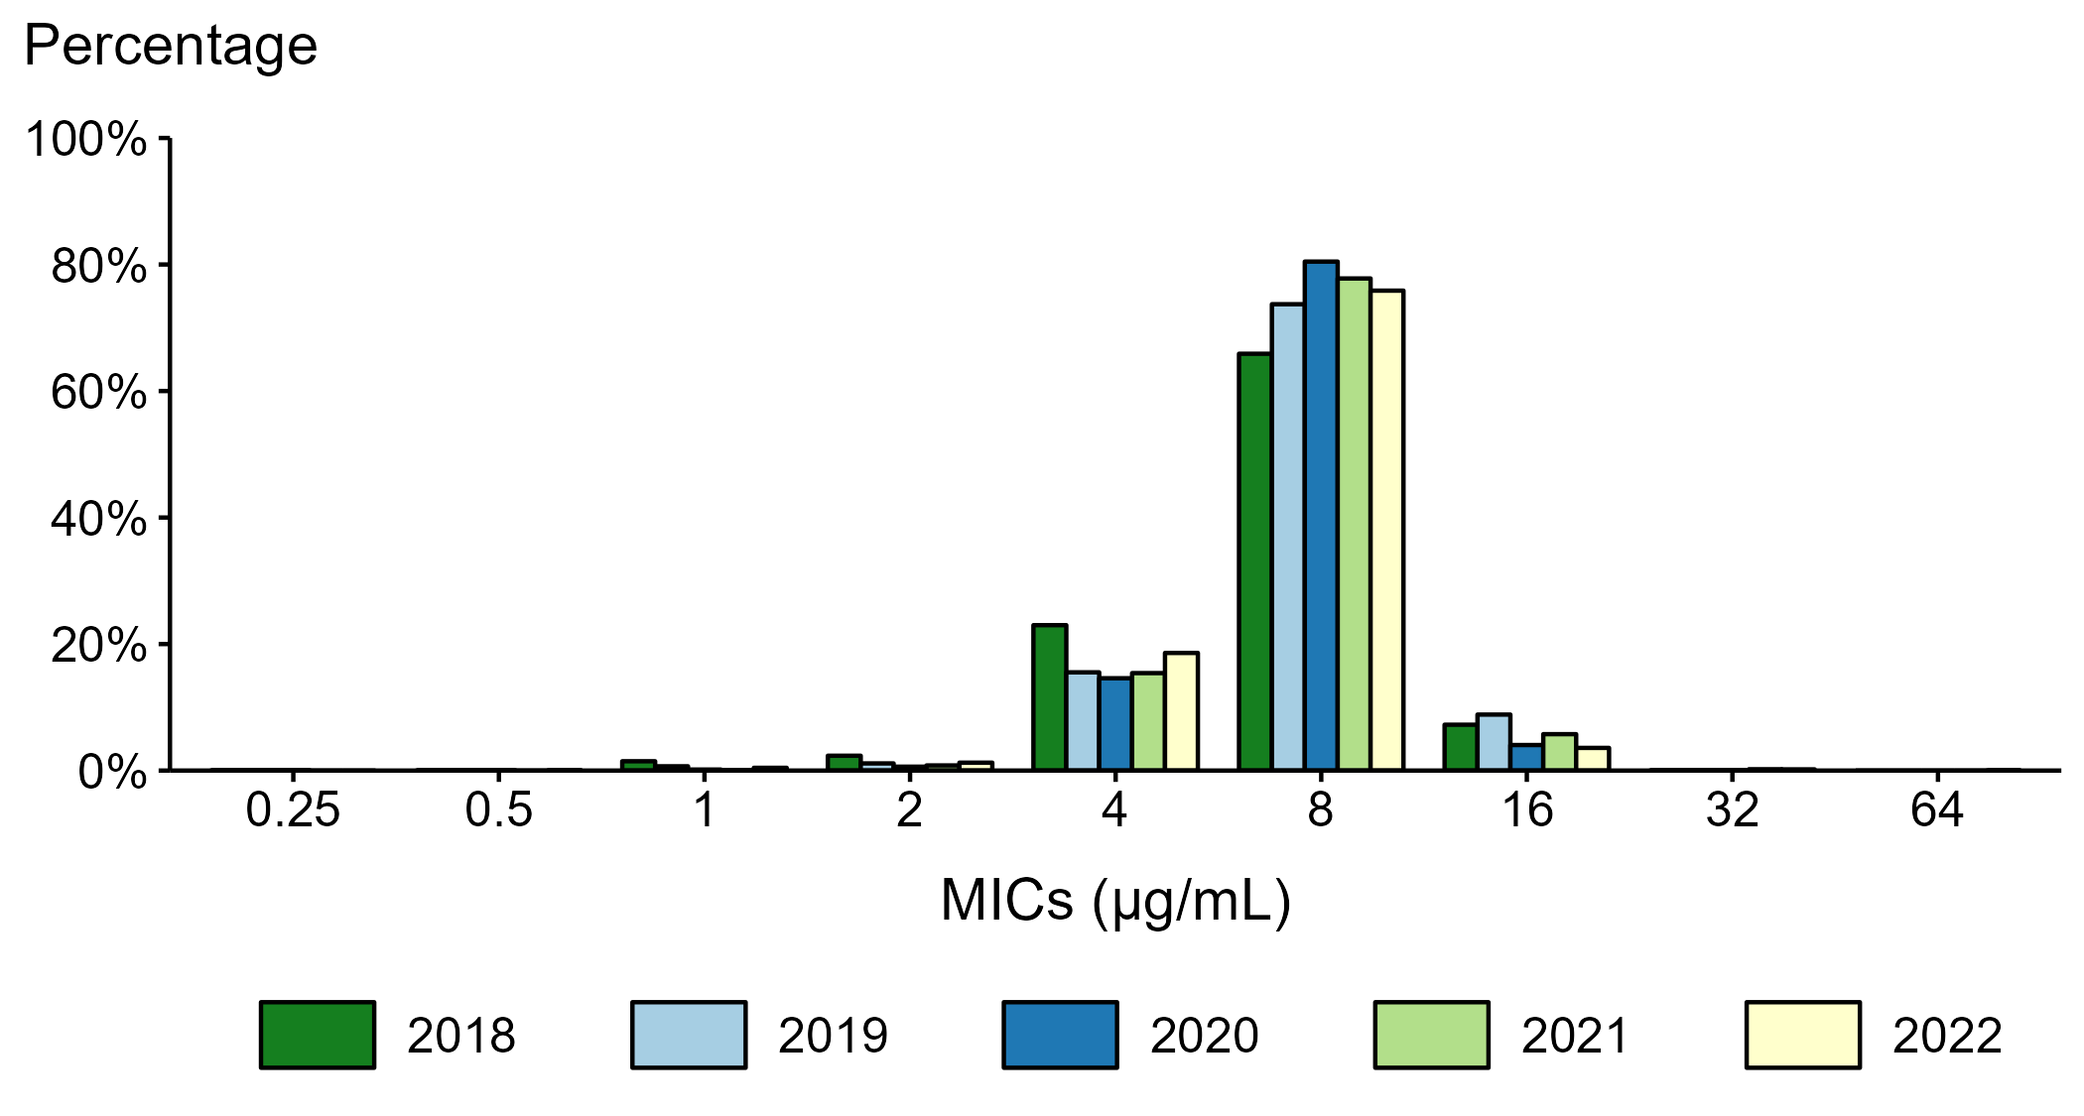
Neisseria gonorrhoeae — Distribution of Gentamicin Minimum Inhibitory Concentrations (MICs) by Year, Gonococcal Isolate Surveillance Project (GISP), 2018–2022
NOTE: Beginning in 2018, the antibiotic susceptibility testing range for gentamicin was expanded from MICs of 1 µg/mL–32 µg/mL in previous years to 0.25 µg/mL–64 µg/mL.
Notes:
During 2018 to 2022, 65.9–80.5% of all tested Neisseria gonorrhoeae isolates collected in STD clinics participating in GISP had a gentamicin minimum inhibitory concentration value of 8 µg/mL. In 2022, 0.2% of all tested Neisseria gonorrhoeae isolates had a gentamicin minimum inhibitory concentration above 16 µg/mL.
This report includes data from years that coincide with the COVID-19 pandemic, which introduced uncertainty and difficulty in interpreting STI surveillance data. See Impact of COVID-19 on STIs for more information.
See Technical Notes (https://www.cdc.gov/std/statistics/2022/technical-notes.htm) for information on GISP methodology.
Data for all figures are available at https://www.cdc.gov/std/statistics/2022/data.zip. The file “NG - Distribution of Gentamicin MICs by Year (GISP 2018-2022).xlsx” contains the data for the figure presented on this slide.

Slide 30
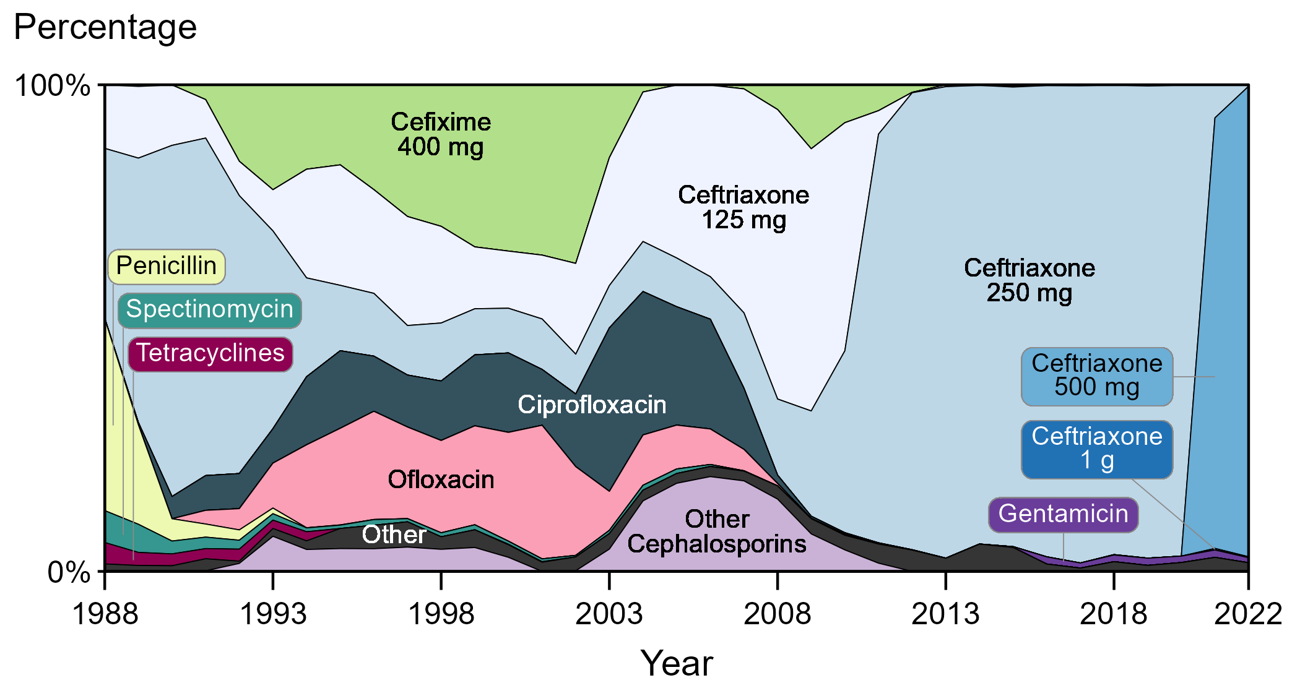
Distribution of Primary Antimicrobial Drugs Used to Treat Gonorrhea Among Participants, Gonococcal Isolate Surveillance Project (GISP), 1988–2022
NOTE: In 2022, Cefixime 800 mg (0.1%) and Ceftriaxone 1 g (0.2%) each represented less than one percent of primary antimicrobial drugs used to treat gonorrhea among GISP participants and may not be visible in this figure.
Notes:
In 2022, 97.0% of GISP participants were treated with ceftriaxone, 96.7% with 500 mg and 0.2% with 250 mg and 1 g, respectively. Participants treated with gentamicin 240 mg increased from 0.2% in 2015 to a maximum of 1.5% in 2016, 2019, and 2021, with 1.0% of patients treated with gentamicin in 2022. (Note that percentages in text may not sum as expected due to rounding.)
Results for 2022 are based on data obtained from participants in all participating GISP jurisdictions except for Pittsburgh due to missing data.
This report includes data from years that coincide with the COVID-19 pandemic, which introduced uncertainty and difficulty in interpreting STI surveillance data. See Impact of COVID-19 on STIs for more information.
See Technical Notes (https://www.cdc.gov/std/statistics/2022/technical-notes.htm) for information on GISP methodology.
Data for all figures are available at https://www.cdc.gov/std/statistics/2022/data.zip. The file “GC - Distribution of Primary Antimicrobial Drugs Used to Treat GC (GISP, 1988-2022).xlsx” contains the data for the figure presented on this slide.

Slide 31
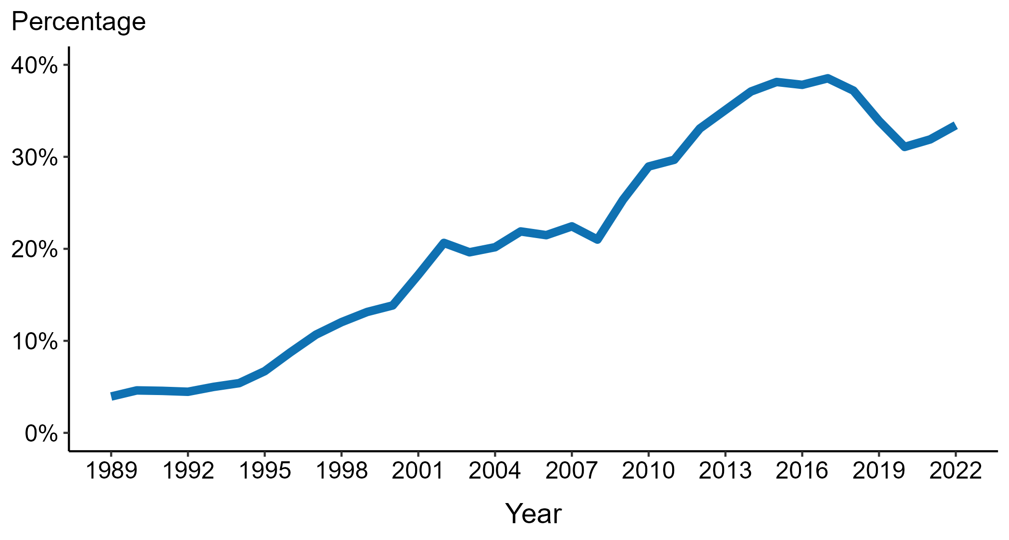
Neisseria gonorrhoeae — Percentage of Urethral Isolates Obtained from MSM Attending STD Clinics, Gonococcal Isolate Surveillance Project (GISP), 1989–2022
ACRONYMS: MSM = Gay, bisexual, and other men who have sex with men
Notes:
Overall, the proportion of Neisseria gonorrhoeae isolates collected in selected STD clinics participating in GISP that were from gay, bisexual and other men who have sex with men increased steadily from 3.9% in 1989 to a high of 38.5% in 2017. In 2022, this proportion was 33.4%.
Results for 2022 are based on data obtained from participants in all participating GISP jurisdictions except for Pittsburgh due to missing data.
This report includes data from years that coincide with the COVID-19 pandemic, which introduced uncertainty and difficulty in interpreting STI surveillance data. See Impact of COVID-19 on STIs for more information.
See Technical Notes (https://www.cdc.gov/std/statistics/2022/technical-notes.htm) for information on GISP methodology.
Data for all figures are available at https://www.cdc.gov/std/statistics/2022/data.zip. The file “NG - Percentage of Urethral Isolates from MSM Attending STD Clinics (GISP, 1989-2022).xlsx” contains the data for the figure presented on this slide.

Slide 32
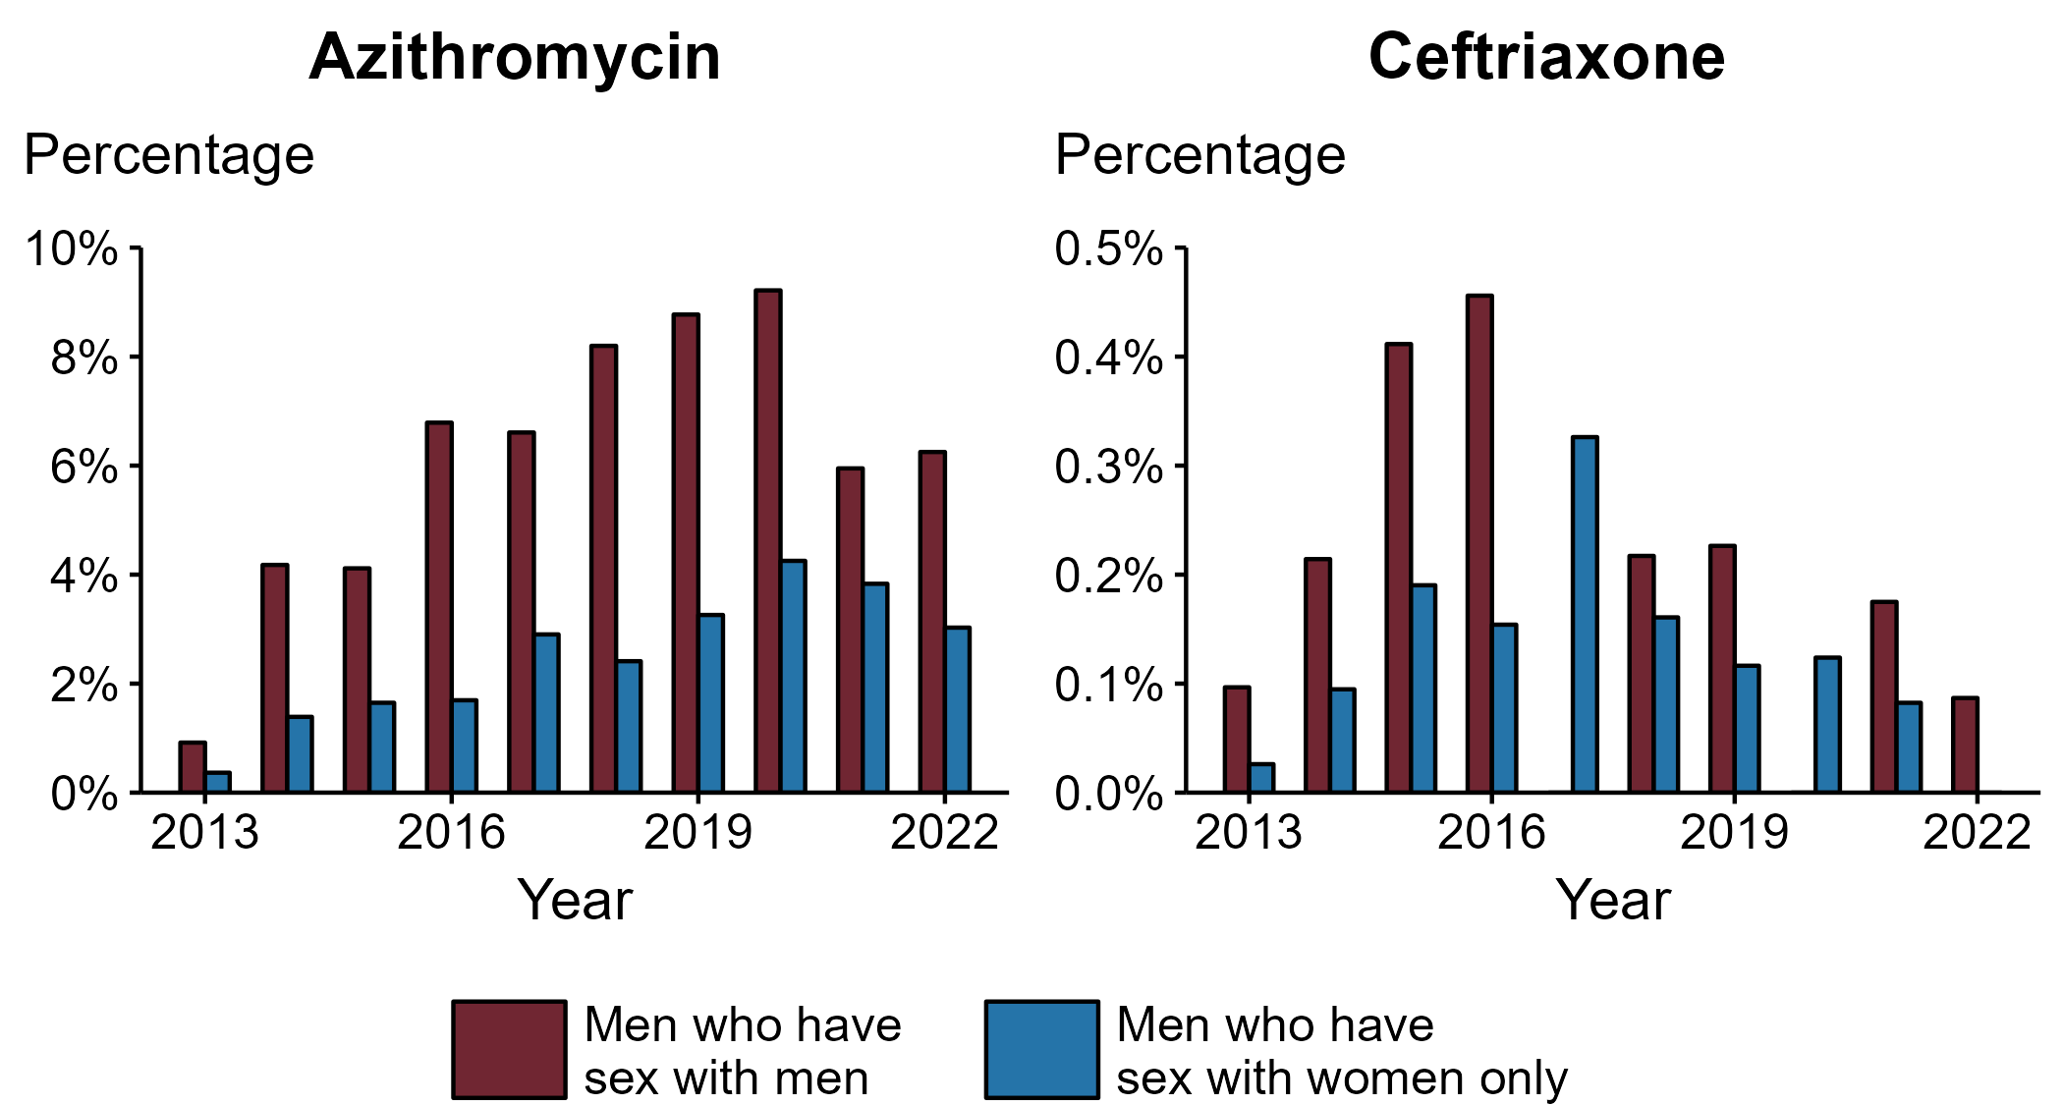
Neisseria gonorrhoeae — Percentage of Urethral Isolates with Elevated Minimum Inhibitory Concentrations (MICs) to Azithromycin* and Ceftriaxone† by Sex and Sex of Sex Partners, Gonococcal Isolate Surveillance Project (GISP), 2013–2022
* Elevated Azithromycin MIC: ≥ 2.0 µg/mL
† Elevated Ceftriaxone MIC: ≥ 0.125 μg/mL
Notes:
In 2022, the proportion of Neisseria gonorrhoeae isolates collected in GISP with elevated azithromycin minimum inhibitory concentrations (MICs) (≥ 2.0 µg/mL) was higher in isolates from gay, bisexual and other men who have sex with men (MSM) than from men who have sex with women only (MSW). For azithromycin, 6.2% of isolates from MSM had elevated MICs compared to 3.0% in MSW. For ceftriaxone, the proportion of isolates with elevated ceftriaxone MICs (≥ 0.125 µg/mL) was higher at 0.1% in MSM compared to 0.0% in MSW.
Results for 2022 are based on data obtained from participants in all participating GISP jurisdictions except for Pittsburgh due to missing data.
This report includes data from years that coincide with the COVID-19 pandemic, which introduced uncertainty and difficulty in interpreting STI surveillance data. See Impact of COVID-19 on STIs for more information.
See Technical Notes (https://www.cdc.gov/std/statistics/2022/technical-notes.htm) for information on GISP methodology.
Data for all figures are available at https://www.cdc.gov/std/statistics/2022/data.zip. The file “NG - Percentage of Urethral Isolates with Elevated MICs to AZM and CRO by Sex and Sex of Sex Partners (GISP 2013-2022).xlsx” contains the data for the figure presented on this slide.

Slide 33
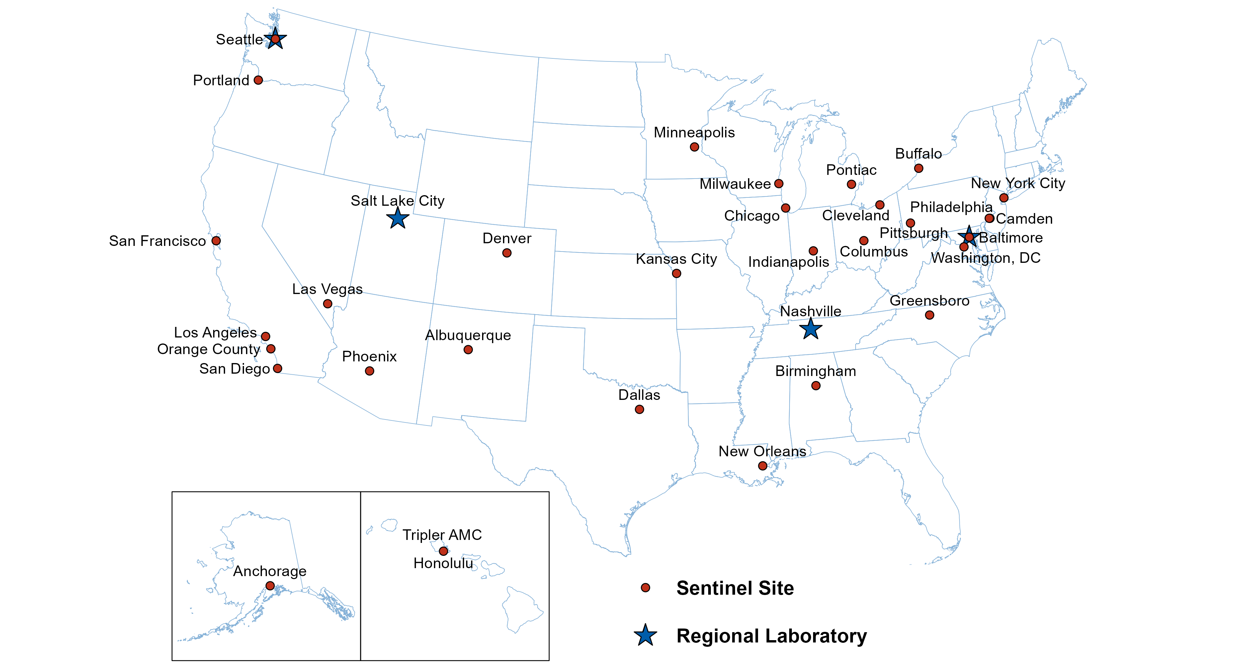
Location of Participating Sentinel Sites and Regional Laboratories, Gonococcal Isolate Surveillance Project (GISP), 2022
NOTE: Baltimore and Seattle are both sentinel sites and regional laboratories.
Notes:
See Technical Notes (https://www.cdc.gov/std/statistics/2022/technical-notes.htm) for information on GISP methodology.

Slide 34
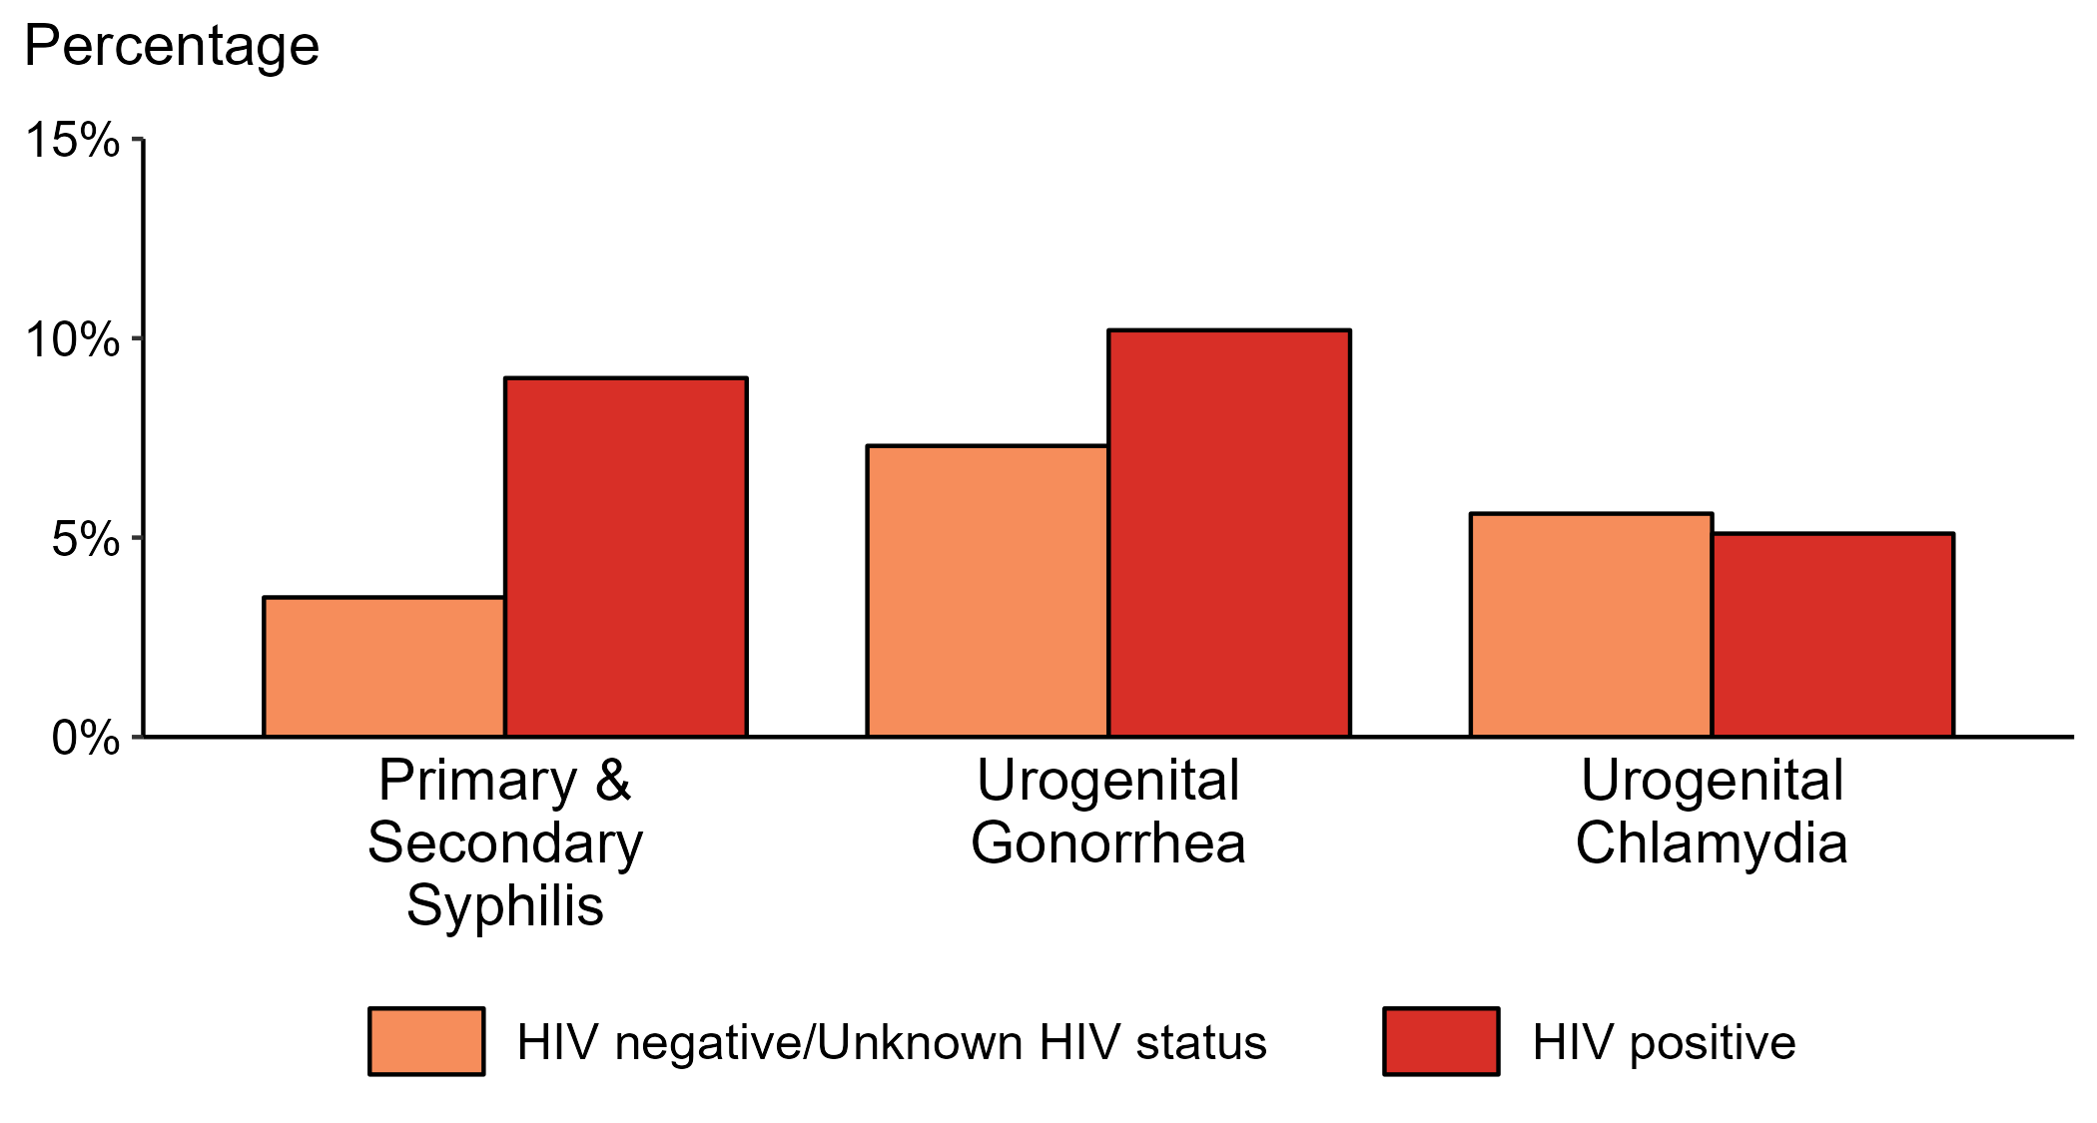
Proportion of MSM with Primary and Secondary Syphilis, Urogenital Gonorrhea, or Urogenital Chlamydia by HIV Status, STD Surveillance Network (SSuN), 2022
NOTE: Results are based on data obtained from patients attending a participating STD clinic in 10 jurisdictions (Baltimore City, California [excluding San Francisco], Columbus, Florida, Indiana, Multnomah County, New York City, Philadelphia, San Francisco, and Washington).
ACRONYMS: MSM = Gay, bisexual, and other men who have sex with men
Notes:
Among gay, bisexual, and other men who have sex with men (MSM) attending participating STD clinics in the STD Surveillance Network in 2022, the portion diagnosed with primary and secondary syphilis was higher for those that were HIV positive compared with those not known to be HIV positive (9.0% versus 3.5%). The pattern was similar for urogenital gonorrhea, with the proportion of testing positive higher among HIV-positive MSM compared with MSM not known to be HIV positive (10.2% versus 7.3%); however, the proportion testing positive for urogenital chlamydia was similar (5.1% among HIV-positive MSM and 5.6% among MSM not known to be HIV positive).
For this figure, HIV status is categorized using documented in the clinic records (based on self-report or most recent HIV test result) or matched information documented in the jurisdiction’s HIV registry.
This report includes data from years that coincide with the COVID-19 pandemic, which introduced uncertainty and difficulty in interpreting STI surveillance data. See Impact of COVID-19 on STIs for more information.
See Technical Notes (https://www.cdc.gov/std/statistics/2022/technical-notes.htm) for information on SSuN methodology.

Slide 35
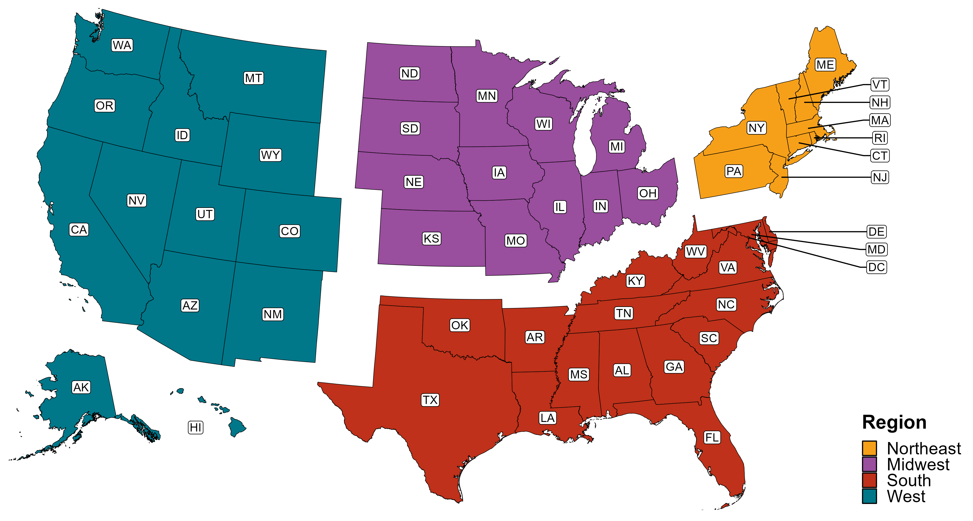
Reference Map of US Census Regions

