Slide 1
Prevalence of Obesity Based on Self-Reported Weight and Height Among US Adults by Race/Ethnicity, State and Territory, BRFSS, 2020–2022
Definitions
Obesity: Body mass index (BMI) of 30 kg/m² or higher.
Body mass index (BMI): A calculated measure of weight relative to height, defined as body weight in kilograms divided by height in meters squared.

Slide 2
Prevalence of Obesity Based on Self-Reported Weight and Height Among US Adults by Race/Ethnicity, State and Territory, BRFSS, 2020–2022
Method
The data were collected through the Behavioral Risk Factor Surveillance System (BRFSS), an ongoing, state-based, telephone interview survey conducted by state health departments with assistance from CDC.
Height and weight data used in the BMI calculations were self-reported.
Three years of data were combined to ensure sufficient sample size.

Slide 3
Prevalence of Obesity Based on Self-Reported Weight and Height Among US Adults by Race/Ethnicity, State and Territory, BRFSS, 2020–2022
Exclusion Criteria
Records with the following were excluded:
Height: <3 feet or ≥8 feet
Weight: <50 pounds or ≥650 pounds
BMI: <12 kg/m² or ≥100 kg/m²
Pregnant women

Slide 4
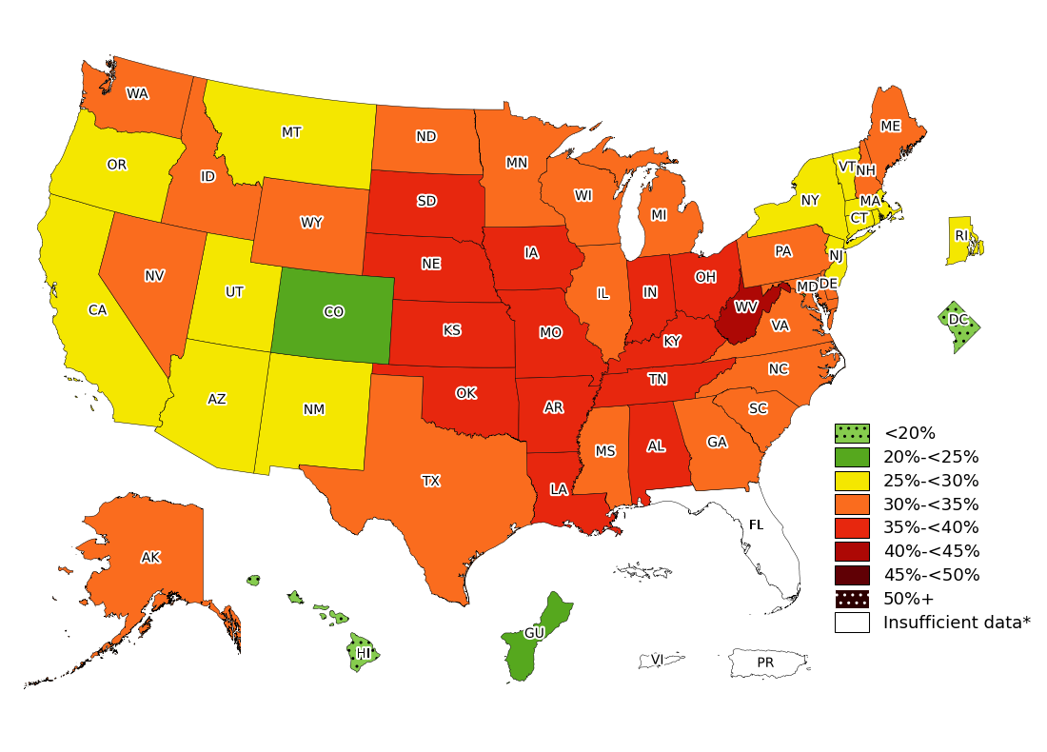
Prevalence of Obesity Based on Self-Reported Weight and Height Among Non-Hispanic White Adults, by State and Territory, BRFSS, 2020–2022
*Sample size <50, the relative standard error (dividing the standard error by the prevalence) ≥30%, or no data in a specific year.

Slide 5
Prevalence of Obesity Based on Self-Reported Weight and Height Among Non-Hispanic White Adults, by State and Territory, BRFSS, 2020–2022
State | Prevalence | 95% Confidence Interval
Alabama | 36.0 | (34.8, 37.3)
Alaska | 30.6 | (29.3, 32.0)
Arizona | 27.9 | (27.0, 28.9)
Arkansas | 36.6 | (35.4, 37.8)
California | 25.8 | (24.6, 27.1)
Colorado | 23.2 | (22.5, 24.0)
Connecticut | 28.3 | (27.2, 29.3)
Delaware | 33.5 | (32.0, 34.9)
District of Columbia | 12.9 | (11.6, 14.3)
Florida | Insufficient data* | Insufficient data*
Georgia | 32.6 | (31.5, 33.8)
Guam | 20.1 | (15.9, 25.1)
Hawaii | 19.7 | (18.4, 21.2)
Idaho | 31.4 | (30.5, 32.4)
Illinois | 31.8 | (30.4, 33.3)
Indiana | 36.7 | (35.9, 37.5)
Iowa | 37.1 | (36.3, 37.9)
Kansas | 35.2 | (34.5, 35.9)
Kentucky | 38.0 | (36.8, 39.2)
Louisiana | 36.1 | (34.9, 37.4)
Maine | 31.9 | (31.1, 32.7)
Maryland | 30.2 | (29.4, 31.1)
Massachusetts | 26.1 | (25.2, 27.0)
Michigan | 34.3 | (33.4, 35.1)
Minnesota | 32.2 | (31.6, 32.8)
Mississippi | 34.8 | (33.5, 36.2)
Missouri | 35.5 | (34.6, 36.4)
State | Prevalence | 95% Confidence Interval
Montana | 29.3 | (28.4, 30.2)
Nebraska | 35.2 | (34.4, 36.0)
Nevada | 31.3 | (29.5, 33.1)
New Hampshire | 30.5 | (29.5, 31.5)
New Jersey | 27.6 | (26.6, 28.6)
New Mexico | 25.7 | (24.3, 27.1)
New York | 27.9 | (27.2, 28.6)
North Carolina | 31.3 | (30.1, 32.5)
North Dakota | 34.3 | (33.2, 35.4)
Ohio | 36.7 | (36.0, 37.5)
Oklahoma | 37.4 | (36.2, 38.5)
Oregon | 29.3 | (28.4, 30.3)
Pennsylvania | 32.8 | (31.6, 34.1)
Puerto Rico | Insufficient data* | Insufficient data*
Rhode Island | 29.5 | (28.3, 30.8)
South Carolina | 32.6 | (31.6, 33.7)
South Dakota | 35.2 | (33.4, 37.0)
Tennessee | 35.0 | (33.8, 36.2)
Texas | 32.2 | (30.9, 33.4)
Utah | 29.6 | (28.8, 30.3)
Vermont | 27.5 | (26.5, 28.4)
Virgin Islands | Insufficient data* | Insufficient data*
Virginia | 32.8 | (31.9, 33.7)
Washington | 30.3 | (29.7, 31.0)
West Virginia | 40.3 | (39.3, 41.3)
Wisconsin | 33.8 | (32.8, 34.8)
Wyoming | 31.5 | (30.3, 32.7)
*Sample size <50, the relative standard error (dividing the standard error by the prevalence) ≥30%, or no data in a specific year.
Source: Behavioral Risk Factor Surveillance System, CDC.

Slide 6
Prevalence of Obesity Based on Self-Reported Weight and Height Among Non-Hispanic White Adults, by State and Territory, BRFSS, 2020–2022
Summary
The District of Columbia and Hawaii had a prevalence of obesity less than 20%.
Colorado and Guam had a prevalence of obesity between 20% and <25%.
12 states had a prevalence of obesity between 25% and <30%.
21 states had a prevalence of obesity between 30% and <35%.
13 states (Alabama, Arkansas, Indiana, Iowa, Kansas, Kentucky, Louisiana, Missouri, Nebraska, Ohio, Oklahoma, South Dakota and Tennessee) had a prevalence of obesity between 35% and <40%.
West Virginia had a prevalence of obesity 40% or greater.
http://www.cdc.gov/obesity/data/adult.html

Slide 7
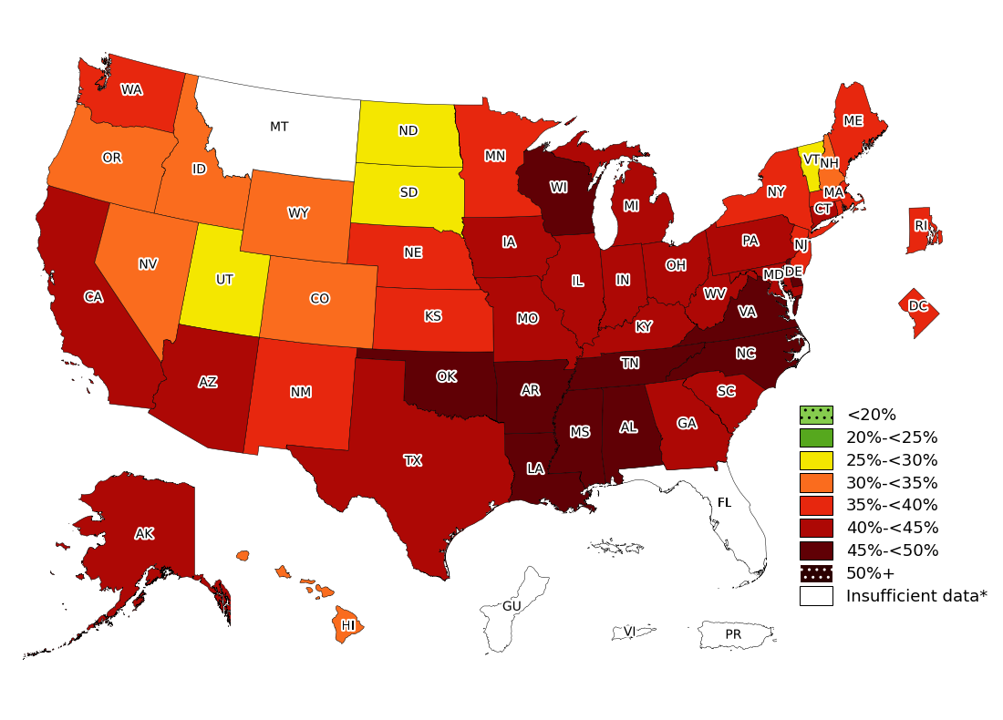
Prevalence of Obesity Based on Self-Reported Weight and Height Among Non-Hispanic Black Adults, by State and Territory, BRFSS, 2020–2022
*Sample size <50, the relative standard error (dividing the standard error by the prevalence) ≥30%, or no data in a specific year.

Slide 8
Prevalence of Obesity Based on Self-Reported Weight and Height Among Non-Hispanic Black Adults, by State and Territory, BRFSS, 2020–2022
State | Prevalence | 95% Confidence Interval
Alabama | 49.3 | (47.1, 51.6)
Alaska | 41.8 | (32.9, 51.4)
Arizona | 40.9 | (36.3, 45.7)
Arkansas | 46.6 | (42.8, 50.5)
California | 42.5 | (38.1, 47.1)
Colorado | 31.3 | (27.7, 35.3)
Connecticut | 41.1 | (37.7, 44.6)
Delaware | 46.3 | (43.0, 49.7)
District of Columbia | 38.3 | (36.0, 40.5)
Florida | Insufficient data* | Insufficient data*
Georgia | 42.8 | (40.7, 44.9)
Guam | Insufficient data* | Insufficient data*
Hawaii | 31.2 | (23.8, 39.6)
Idaho | 30.5 | (19.6, 44.2)
Illinois | 41.0 | (37.5, 44.6)
Indiana | 44.0 | (41.3, 46.8)
Iowa | 41.9 | (36.8, 47.3)
Kansas | 39.6 | (36.2, 43.1)
Kentucky | 44.7 | (39.6, 49.9)
Louisiana | 46.5 | (44.1, 48.8)
Maine | 36.9 | (26.8, 48.2)
Maryland | 41.6 | (40.1, 43.1)
Massachusetts | 36.0 | (32.3, 39.8)
Michigan | 42.1 | (39.5, 44.7)
Minnesota | 36.0 | (33.3, 38.8)
Mississippi | 47.5 | (45.7, 49.4)
Missouri | 42.6 | (39.7, 45.5)
State | Prevalence | 95% Confidence Interval
Montana | Insufficient data* | Insufficient data*
Nebraska | 37.5 | (32.9, 42.3)
Nevada | 33.4 | (28.3, 38.9)
New Hampshire | 33.7 | (22.9, 46.5)
New Jersey | 37.3 | (34.8, 39.9)
New Mexico | 37.5 | (29.2, 46.6)
New York | 36.3 | (34.5, 38.1)
North Carolina | 48.2 | (45.7, 50.7)
North Dakota | 25.0 | (18.6, 32.8)
Ohio | 43.9 | (41.4, 46.4)
Oklahoma | 46.1 | (41.9, 50.4)
Oregon | 31.0 | (24.2, 38.8)
Pennsylvania | 40.8 | (37.7, 44.1)
Puerto Rico | Insufficient data* | Insufficient data*
Rhode Island | 38.5 | (33.5, 43.8)
South Carolina | 44.9 | (42.6, 47.2)
South Dakota | 28.9 | (18.4, 42.2)
Tennessee | 46.4 | (43.0, 49.9)
Texas | 43.5 | (40.3, 46.8)
Utah | 28.1 | (20.4, 37.5)
Vermont | 28.6 | (20.2, 38.9)
Virgin Islands | Insufficient data* | Insufficient data*
Virginia | 46.7 | (44.6, 48.8)
Washington | 36.1 | (32.5, 39.9)
West Virginia | 42.0 | (36.0, 48.1)
Wisconsin | 49.8 | (44.0, 55.6)
Wyoming | 30.7 | (17.2, 48.7)
*Sample size <50, the relative standard error (dividing the standard error by the prevalence) ≥30%, or no data in a specific year.
Source: Behavioral Risk Factor Surveillance System, CDC.

Slide 9
Prevalence of Obesity Based on Self-Reported Weight and Height Among Non-Hispanic Black Adults, by State and Territory, BRFSS, 2020–2022
Summary
No state or territory had a prevalence of obesity less than 25%.
4 states had a prevalence of obesity between 25% and <30%.
7 states had a prevalence of obesity between 30% and <35%.
10 states and the District of Columbia had a prevalence of obesity between 35% and <40%.
17 states had a prevalence of obesity between 40% and <45%.
10 states had a prevalence of obesity between 45% and <50%.
No state or territory had a prevalence of obesity 50% or greater.
http://www.cdc.gov/obesity/data/adult.html

Slide 10
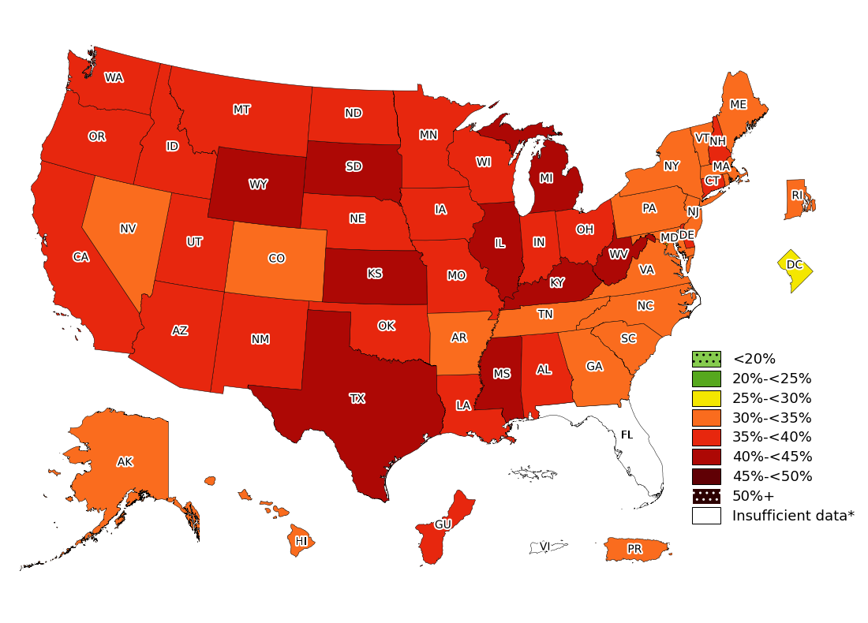
Prevalence of Obesity Based on Self-Reported Weight and Height Among Hispanic Adults, by State and Territory, BRFSS, 2020–2022
*Sample size <50, the relative standard error (dividing the standard error by the prevalence) ≥30%,
or no data in a specific year.

Slide 11
Prevalence of Obesity Based on Self-Reported Weight and Height Among Hispanic Adults, by State and Territory, BRFSS, 2020–2022
State | Prevalence | 95% Confidence Interval
Alabama | 36.8 | (29.0, 45.3)
Alaska | 33.4 | (27.8, 39.4)
Arizona | 38.2 | (36.4, 40.1)
Arkansas | 33.5 | (28.0, 39.4)
California | 37.8 | (36.1, 39.6)
Colorado | 31.0 | (29.4, 32.6)
Connecticut | 36.0 | (33.5, 38.5)
Delaware | 35.9 | (31.4, 40.6)
District of Columbia | 27.0 | (22.5, 32.1)
Florida | Insufficient data* | Insufficient data*
Georgia | 33.4 | (29.7, 37.2)
Guam | 38.5 | (30.4, 47.4)
Hawaii | 31.4 | (28.4, 34.5)
Idaho | 36.7 | (33.3, 40.2)
Illinois | 40.5 | (36.4, 44.7)
Indiana | 39.2 | (35.9, 42.7)
Iowa | 37.1 | (34.0, 40.2)
Kansas | 40.6 | (37.6, 43.6)
Kentucky | 40.2 | (32.4, 48.4)
Louisiana | 35.4 | (29.6, 41.6)
Maine | 34.6 | (28.2, 41.7)
Maryland | 33.5 | (31.1, 36.0)
Massachusetts | 33.0 | (30.4, 35.7)
Michigan | 40.3 | (35.6, 45.3)
Minnesota | 35.5 | (32.8, 38.3)
Mississippi | 44.7 | (34.5, 55.4)
Missouri | 36.5 | (31.8, 41.5)
State | Prevalence | 95% Confidence Interval
Montana | 36.5 | (30.9, 42.5)
Nebraska | 36.9 | (34.2, 39.8)
Nevada | 34.8 | (31.6, 38.2)
New Hampshire | 36.7 | (30.1, 43.9)
New Jersey | 33.4 | (31.4, 35.4)
New Mexico | 36.4 | (34.6, 38.1)
New York | 33.0 | (31.5, 34.5)
North Carolina | 32.9 | (29.6, 36.3)
North Dakota | 35.0 | (28.4, 42.3)
Ohio | 36.3 | (32.3, 40.4)
Oklahoma | 39.7 | (36.0, 43.6)
Oregon | 36.9 | (33.9, 40.1)
Pennsylvania | 33.9 | (29.3, 38.8)
Puerto Rico | 33.9 | (32.8, 35.1)
Rhode Island | 33.9 | (31.0, 36.9)
South Carolina | 32.7 | (27.4, 38.4)
South Dakota | 41.2 | (31.5, 51.5)
Tennessee | 34.8 | (28.8, 41.4)
Texas | 40.8 | (38.9, 42.8)
Utah | 35.5 | (33.3, 37.8)
Vermont | 31.5 | (24.1, 40.0)
Virgin Islands | Insufficient data* | Insufficient data*
Virginia | 32.5 | (29.3, 35.9)
Washington | 35.8 | (33.7, 37.9)
West Virginia | 41.1 | (32.5, 50.2)
Wisconsin | 35.5 | (30.8, 40.5)
Wyoming | 40.2 | (35.3, 45.3)
*Sample size <50, the relative standard error (dividing the standard error by the prevalence) ≥30%, or no data in a specific year.
Source: Behavioral Risk Factor Surveillance System, CDC.

Slide 12
Prevalence of Obesity Based on Self-Reported Weight and Height Among Hispanic Adults, by State and Territory, BRFSS, 2020–2022
Summary
No state or territory had a prevalence of obesity less than 25%.
The District of Columbia had a prevalence of obesity between 25% and <30%.
18 states and Puerto Rico, had a prevalence of obesity between 30% and <35%.
22 states and Guam had a prevalence of obesity between 35% and <40%.
9 states had a prevalence of obesity between 40% and <45%.
No state or territory had a prevalence of obesity 45% or greater.
http://www.cdc.gov/obesity/data/adult.html

Slide 13
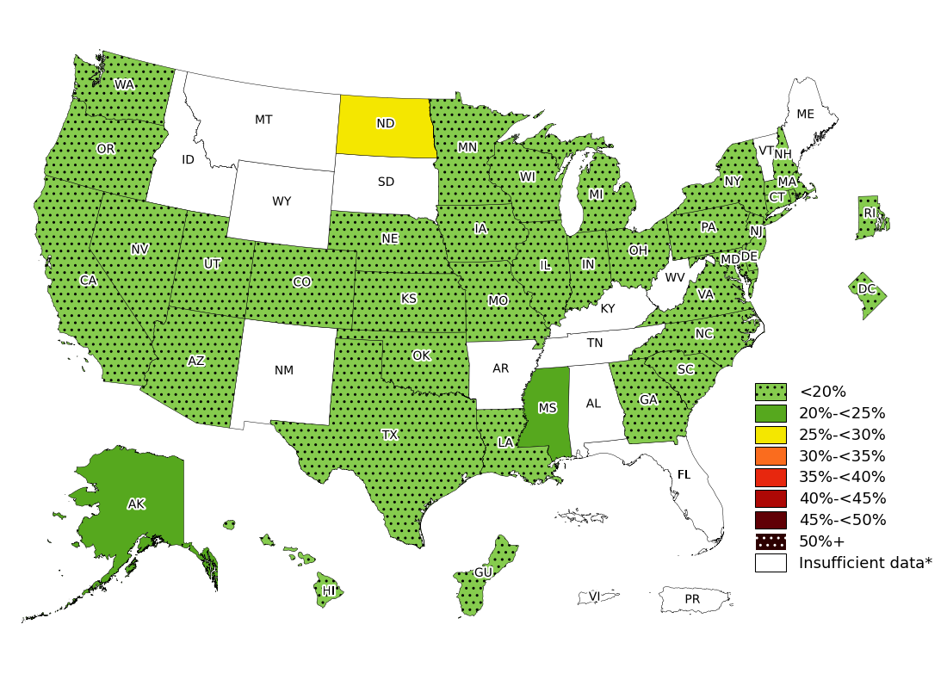
Prevalence of Obesity Based on Self-Reported Weight and Height Among Non-Hispanic Asian Adults, by State and Territory, BRFSS, 2020–2022
*Sample size <50, the relative standard error (dividing the standard error by the prevalence) ≥30%,
or no data in a specific year.

Slide 14
Prevalence of Obesity Based on Self-Reported Weight and Height Among Non-Hispanic Asian Adults, by State and Territory, BRFSS, 2020–2022
State | Prevalence | 95% Confidence Interval
Alabama | Insufficient data* | Insufficient data*
Alaska | 24.8 | (18.4, 32.7)
Arizona | 13.5 | (9.7, 18.4)
Arkansas | Insufficient data* | Insufficient data*
California | 11.1 | (9.2, 13.3)
Colorado | 10.0 | (7.1, 13.9)
Connecticut | 13.2 | (9.9, 17.6)
Delaware | 18.3 | (11.9, 27.1)
District of Columbia | 10.2 | (6.5, 15.5)
Florida | Insufficient data* | Insufficient data*
Georgia | 14.7 | (10.2, 20.6)
Guam | 18.1 | (15.2, 21.3)
Hawaii | 17.3 | (16.1, 18.6)
Idaho | Insufficient data* | Insufficient data*
Illinois | 11.6 | (8.5, 15.7)
Indiana | 8.2 | (4.9, 13.2)
Iowa | 11.8 | (8.1, 16.8)
Kansas | 10.2 | (7.5, 13.9)
Kentucky | Insufficient data* | Insufficient data*
Louisiana | 19.9 | (12.9, 29.4)
Maine | Insufficient data* | Insufficient data*
Maryland | 13.4 | (11.0, 16.2)
Massachusetts | 10.6 | (8.3, 13.5)
Michigan | 9.2 | (6.6, 12.7)
Minnesota | 18.8 | (16.3, 21.6)
Mississippi | 23.3 | (13.7, 36.8)
Missouri | 12.4 | (8.2, 18.3)
State | Prevalence | 95% Confidence Interval
Montana | Insufficient data* | Insufficient data*
Nebraska | 12.6 | (8.2, 19.0)
Nevada | 15.8 | (10.4, 23.3)
New Hampshire | 10.9 | (6.9, 16.7)
New Jersey | 11.2 | (9.1, 13.6)
New Mexico | Insufficient data* | Insufficient data*
New York | 12.6 | (10.9, 14.6)
North Carolina | 15.5 | (10.7, 21.8)
North Dakota | 27.6 | (18.3, 39.3)
Ohio | 12.8 | (9.4, 17.2)
Oklahoma | 13.7 | (7.9, 22.5)
Oregon | 15.2 | (11.3, 20.1)
Pennsylvania | 10.7 | (7.3, 15.3)
Puerto Rico | Insufficient data* | Insufficient data*
Rhode Island | 12.0 | (8.0, 17.7)
South Carolina | 17.5 | (10.0, 28.7)
South Dakota | Insufficient data* | Insufficient data*
Tennessee | Insufficient data* | Insufficient data*
Texas | 13.5 | (9.8, 18.2)
Utah | 8.2 | (5.5, 12.1)
Vermont | Insufficient data* | Insufficient data*
Virgin Islands | Insufficient data* | Insufficient data*
Virginia | 12.6 | (9.9, 15.9)
Washington | 10.2 | (8.8, 11.9)
West Virginia | Insufficient data* | Insufficient data*
Wisconsin | 17.7 | (11.9, 25.5)
Wyoming | Insufficient data* | Insufficient data*
*Sample size <50, the relative standard error (dividing the standard error by the prevalence) ≥30%, or no data in a specific year.
Source: Behavioral Risk Factor Surveillance System, CDC.

Slide 15
Prevalence of Obesity Based on Self-Reported Weight and Height Among Non-Hispanic Asian Adults, by State and Territory, BRFSS, 2020–2022
Summary
34 states, the District of Columbia and Guam had a prevalence of obesity less than 20%.
2 states (Alaska and Mississippi) had a prevalence of obesity between 20% and <25%.
1 state (North Dakota) had a prevalence of obesity between 25% and <30%.
No state had a prevalence of obesity 30% or greater.
http://www.cdc.gov/obesity/data/adult.html

Slide 16
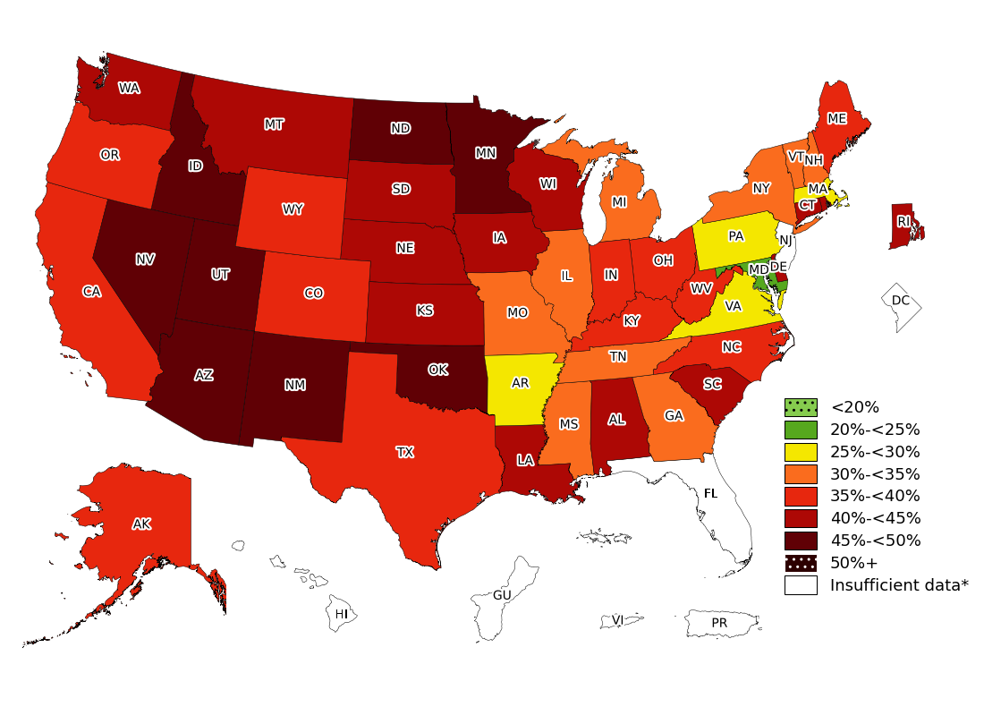
Prevalence of Obesity Based on Self-Reported Weight and Height Among Non-Hispanic American Indian or Alaska Native Adults, by State and Territory, BRFSS, 2020–2022
*Sample size <50, the relative standard error (dividing the standard error by the prevalence) ≥30%,
or no data in a specific year.

Slide 17
Prevalence of Obesity Based on Self-Reported Weight and Height Among Non-Hispanic American Indian or Alaska Native Adults, by State and Territory, BRFSS, 2020–2022
State | Prevalence | 95% Confidence Interval
Alabama | 42.6 | (31.8, 54.1)
Alaska | 37.1 | (33.7, 40.5)
Arizona | 47.0 | (42.8, 51.2)
Arkansas | 28.4 | (21.3, 36.9)
California | 37.0 | (27.2, 47.9)
Colorado | 37.1 | (30.1, 44.7)
Connecticut | 42.1 | (29.4, 56.0)
Delaware | 40.1 | (25.5, 56.7)
District of Columbia | Insufficient data* | Insufficient data*
Florida | Insufficient data* | Insufficient data*
Georgia | 32.9 | (21.8, 46.2)
Guam | Insufficient data* | Insufficient data*
Hawaii | Insufficient data* | Insufficient data*
Idaho | 45.2 | (36.2, 54.5)
Illinois | 32.0 | (19.0, 48.4)
Indiana | 36.6 | (28.0, 46.2)
Iowa | 44.8 | (34.2, 55.9)
Kansas | 42.9 | (36.3, 49.7)
Kentucky | 37.6 | (25.2, 51.9)
Louisiana | 43.7 | (34.1, 53.7)
Maine | 36.1 | (28.4, 44.6)
Maryland | 24.8 | (17.7, 33.7)
Massachusetts | 25.2 | (15.1, 38.9)
Michigan | 30.1 | (21.6, 40.2)
Minnesota | 45.9 | (40.1, 51.8)
Mississippi | 30.5 | (19.3, 44.6)
Missouri | 33.6 | (25.1, 43.2)
State | Prevalence | 95% Confidence Interval
Montana | 41.8 | (37.7, 45.9)
Nebraska | 43.3 | (35.7, 51.2)
Nevada | 45.4 | (31.3, 60.4)
New Hampshire | 34.9 | (22.8, 49.2)
New Jersey | Insufficient data* | Insufficient data*
New Mexico | 45.5 | (41.6, 49.5)
New York | 30.9 | (21.4, 42.4)
North Carolina | 38.3 | (31.7, 45.3)
North Dakota | 49.5 | (43.9, 55.1)
Ohio | 35.1 | (26.5, 44.7)
Oklahoma | 45.9 | (42.4, 49.5)
Oregon | 37.2 | (28.6, 46.7)
Pennsylvania | 28.3 | (15.5, 45.9)
Puerto Rico | Insufficient data* | Insufficient data*
Rhode Island | 42.2 | (30.7, 54.5)
South Carolina | 40.3 | (30.1, 51.5)
South Dakota | 44.1 | (37.1, 51.4)
Tennessee | 31.6 | (22.6, 42.2)
Texas | 36.6 | (23.7, 51.7)
Utah | 46.7 | (38.6, 55.1)
Vermont | 31.6 | (22.6, 42.1)
Virgin Islands | Insufficient data* | Insufficient data*
Virginia | 28.0 | (18.8, 39.4)
Washington | 42.7 | (37.0, 48.6)
West Virginia | 37.1 | (26.3, 49.5)
Wisconsin | 42.3 | (33.6, 51.4)
Wyoming | 37.2 | (28.0, 47.5)
*Sample size <50, the relative standard error (dividing the standard error by the prevalence) ≥30%, or no data in a specific year.
Source: Behavioral Risk Factor Surveillance System, CDC.

Slide 18
Prevalence of Obesity Based on Self-Reported Weight and Height Among Non-Hispanic American Indian or Alaska Native Adults, by State and Territory, BRFSS, 2020–2022
Summary
No state or territory had a prevalence of obesity less than 20%.
1 state (Maryland) had a prevalence of obesity between 20% and <25%.
4 states had a prevalence of obesity between 25% and <30%.
9 states had a prevalence of obesity between 30% and <35%.
12 states had a prevalence of obesity between 35% and <40%.
13 states had a prevalence of obesity between 40% and <45%.
8 states had a prevalence of obesity between 45% and <50%.
No state or territory had a prevalence of obesity 50% or greater.
http://www.cdc.gov/obesity/data/adult.html

