Slide 1
Long-Term Care Services Use-Rates in the United States--US Maps Supplement: National Study of Long-Term Care Providers, 2015-2016
This slide presentation includes 10 US maps for the use-rates among five long-term care sectors of the National Study of Long-Term Care Providers (NSLTCP). These maps are a companion to the national report, Long-Term Care Providers and Services Users in the United States: Data from the National Study of Long-Term Care Providers, 2015 – 2016, planned to be published in January 2019. That report includes descriptive information on the supply, organizational characteristics, staffing, and services offered by paid, regulated providers of long-term care services; and the demographic, health, and functional characteristics of users of these services. Please visit the NSLTCP website to access published reports of national estimates, tables and maps of state estimates, and to review the study’s methodology and documentation. All reports and products are easily accessible and can be downloaded at no cost.
Five of the 10 maps show the use rate of long-term care services by individuals aged 65 and over per the state population of 1,000 persons aged 65 and over for each of the five long-term care sectors (adult day, home health, hospice, nursing home, residential care). The last five maps show the use rate of long-term care services by individuals aged 85 and over per the state population of 1,000 persons aged 85 and over for each of the five sectors. The adult day, nursing home, and residential care maps present data for 2016 and the home health and hospice maps present data for 2015.
Each map includes a title, legend, and footnotes. This presentation is available in PDF and PowerPoint versions. The maps show states that are not statistically significantly different from the national estimate (white color), states that are statistically significantly lower than the national estimate (light gray blue), and states that are statistically significantly higher than the national estimate (bright blue). States where estimates cannot be reported based on NCHS’ reliability or confidentiality standards are shaded with hash marks.
All material appearing in this presentation is in the public domain and may be reproduced or copied without permission; citation, however, is appreciated.
Suggested citation
Lendon, J.P., Rome, V., Sengupta, M., and Harris-Kojetin, L. Long-Term Care Services Use-Rates in the United States--US Maps Supplement: National Study of Long-Term Care Providers, 2015-2016. National Center for Health Statistics. 2018.

Slide 2
Contents
1. Adult day service centers use-rate maps, 2016
  Figure 1. Use rate of adult day services center participants aged 65 and over: United States, 2016
  Figure 2. Use rate of adult day services center participants aged 85 and over: United States, 2016
2. Home health agency use-rate maps, 2015
  Figure 3. Use rate of home health patients aged 65 and over: United States, 2016
  Figure 4. Use rate of home health patients aged 85 and over: United States, 2016
3. Hospice use-rate maps, 2015
  Figure 5. Use rate of hospice patients aged 65 and over: United States, 2016
  Figure 6. Use rate of hospice patients aged 85 and over: United States, 2016
4. Nursing home use-rate maps, 2016
  Figure 7. Use rate of nursing home residents aged 65 and over: United States, 2016
  Figure 8. Use rate of nursing home residents aged 65 and over: United States, 2016
5. Residential care community use-rate maps, 2016
  Figure 9. Use rate of residential care community residents aged 65 and over: United States, 2016
  Figure 10. Use rate of residential care community residents aged 85 and over: United States, 2016

Slide 3
1. Adult day services centers use-rate maps, 2016

Slide 4
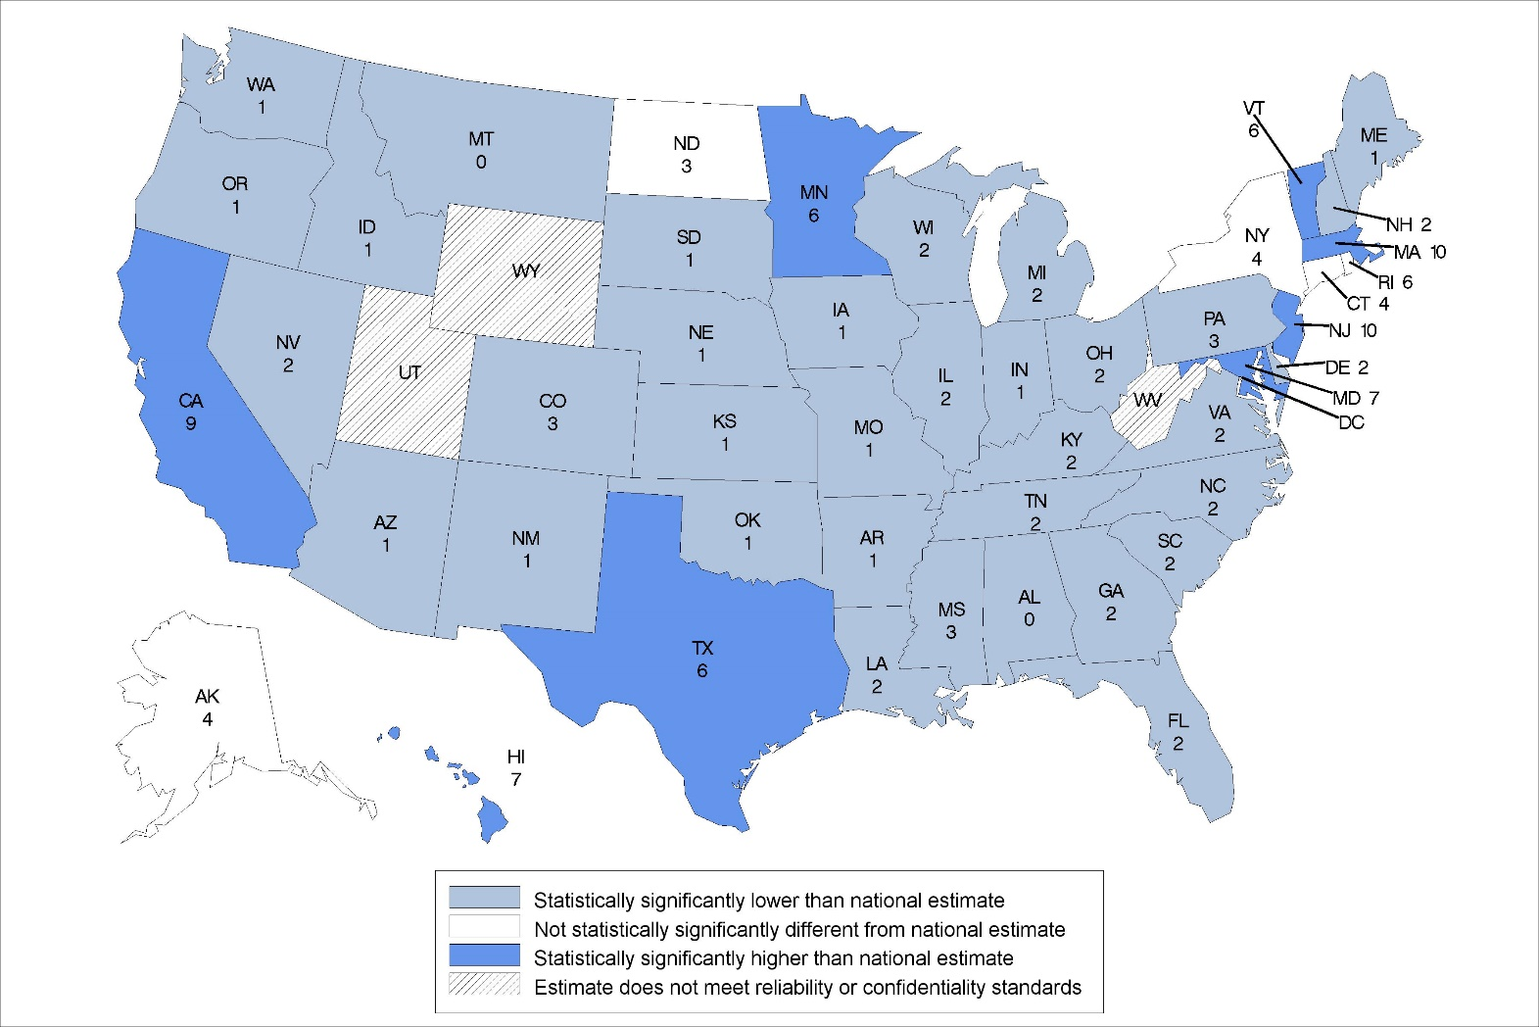
Figure 1. Use rate of adult day services center participants aged 65 and over: United States, 2016
The national rate is 4.
Note: Use rate is calculated as the number of participants aged 65 and over enrolled in adult day services centers on any given day in 2016 per 1,000 persons aged 65 and over. Statistical significance tested at p < .05.
Source: NCHS, National Study of Long-Term Care Providers, 2016

Slide 5
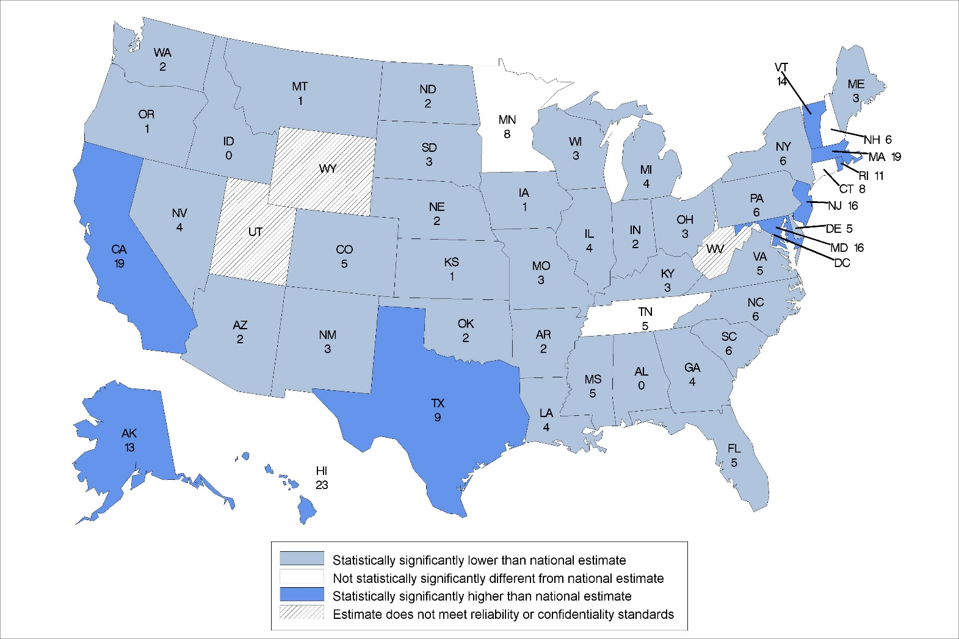
Figure 2. Use rate of adult day services center participants aged 85 and over: United States, 2016
.
Note: The national rate is 7.
Note: Use rate calculated as the number of participants aged 85 and over enrolled in adult day services centers on any given day in 2016 per 1,000 persons aged 85 and over. Statistical significance tested at p<0.05
Source: NCHS, National Study of Long-Term Care Providers, 2016

Slide 6
2. Home health agency use-rate maps, 2015

Slide 7
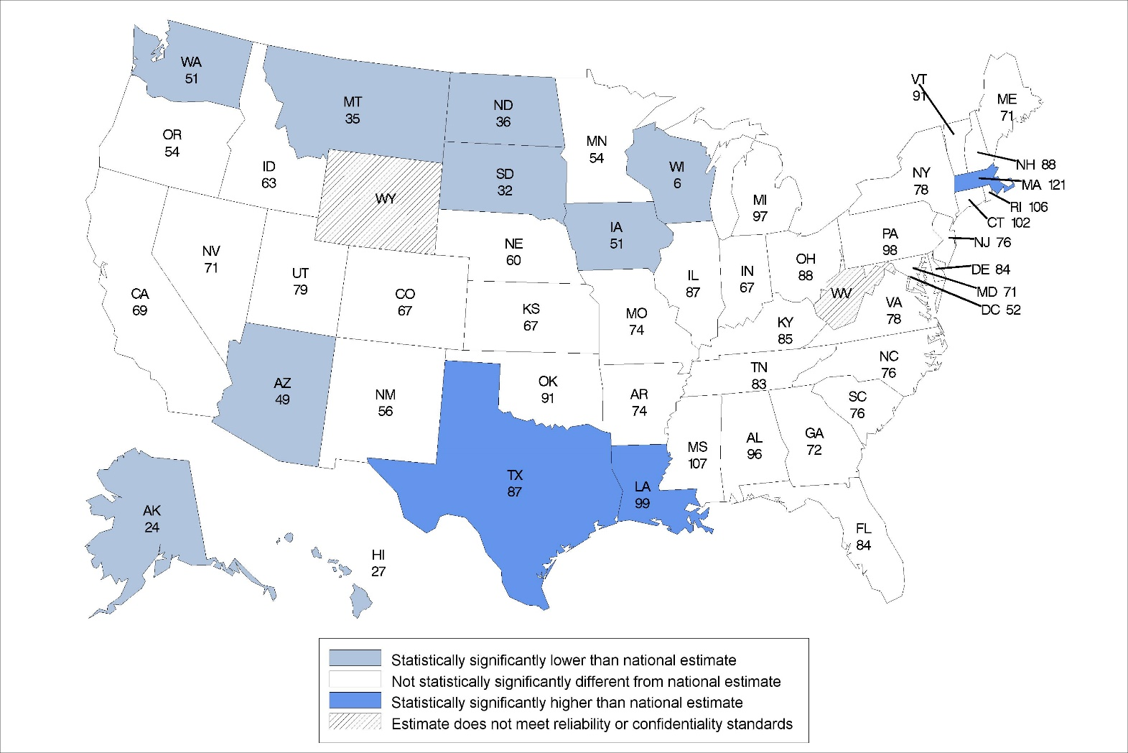
Figure 3. Use rate of home health patients aged 65 and over discharged in calendar year: United States, 2015
The national rate is 76.
Note: Use rate is calculated as the number of home health patients aged 65 and over whose episode of care ended anytime in 2015 per 1,000 persons aged 65 and over. Statistical significance tested at p<0.05.
Source: NCHS, National Study of Long-Term Care Providers, 2016

Slide 8
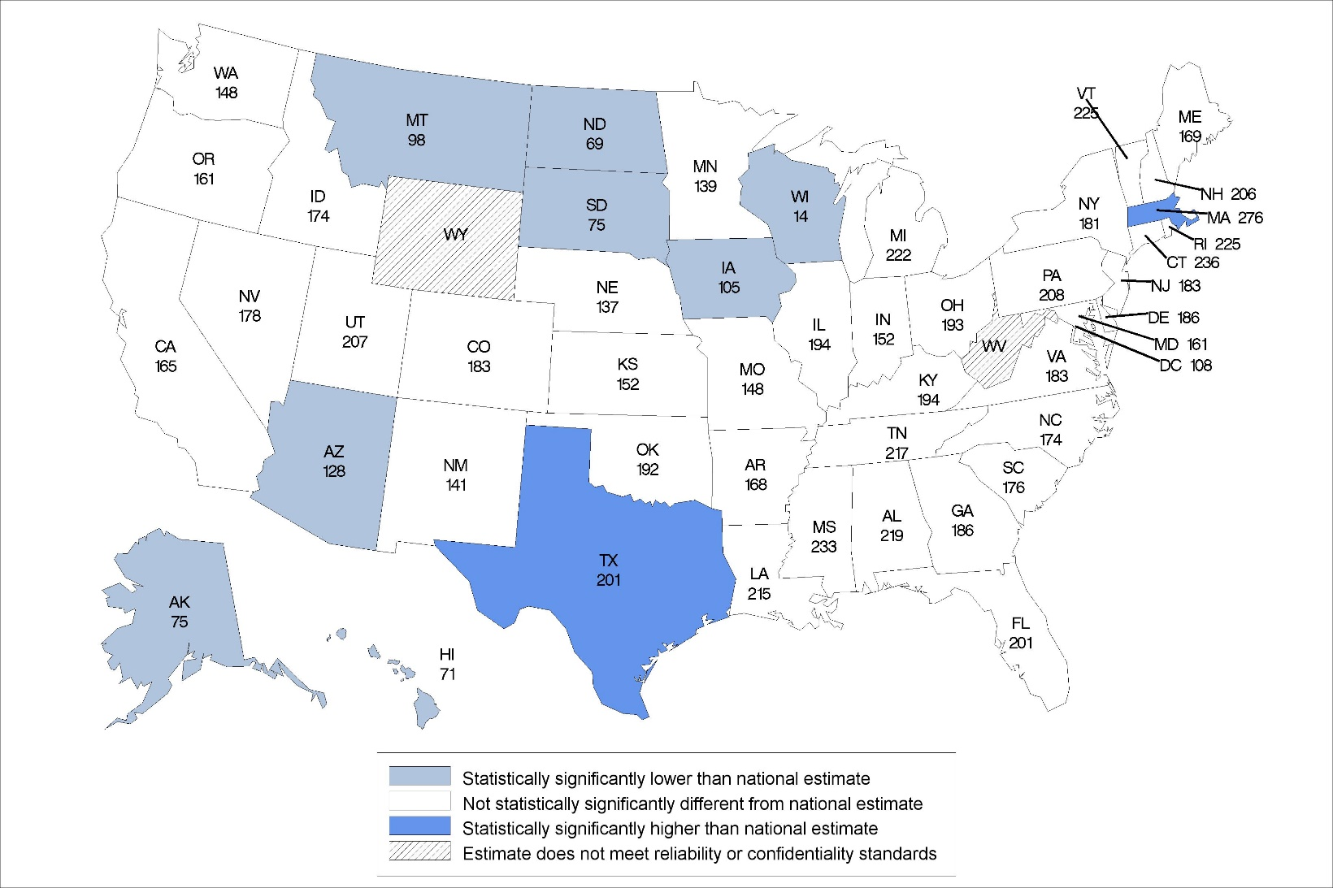
Figure 4. Use rate of home health patients aged 85 and over discharged in calendar year: United States, 2015
The national rate is 179.
Notes: Use rate is calculated as the number of home health patients aged 85 and over whose episode of care ended anytime in 2015 per 1,000 persons aged 85 and over. Statistical significance tested at p<0.05.
Source: NCHS, National Study of Long-Term Care Providers, 2016

Slide 9
3. Hospice use-rate maps, 2015

Slide 10
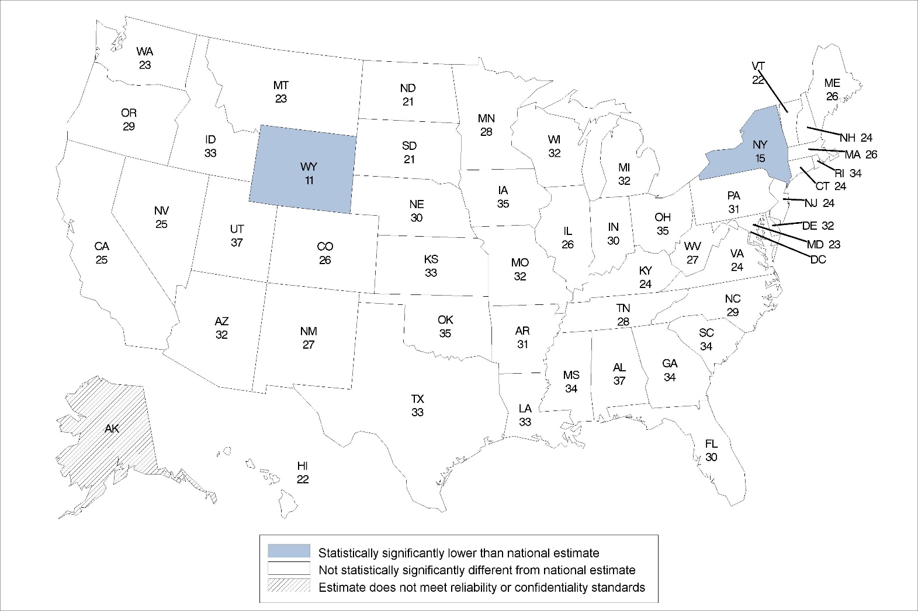
Figure 5. Use rate of hospice patients aged 65 and over: United States, 2015
The national rate is 28.
Notes: Use rate is calculated as the number of hospice patients aged 65 and over receiving care anytime in 2015 per 1,000 persons aged 65 and over. Statistical significance tested at p<0.05.
Source: NCHS, National Study of Long-Term Care Providers, 2016

Slide 11
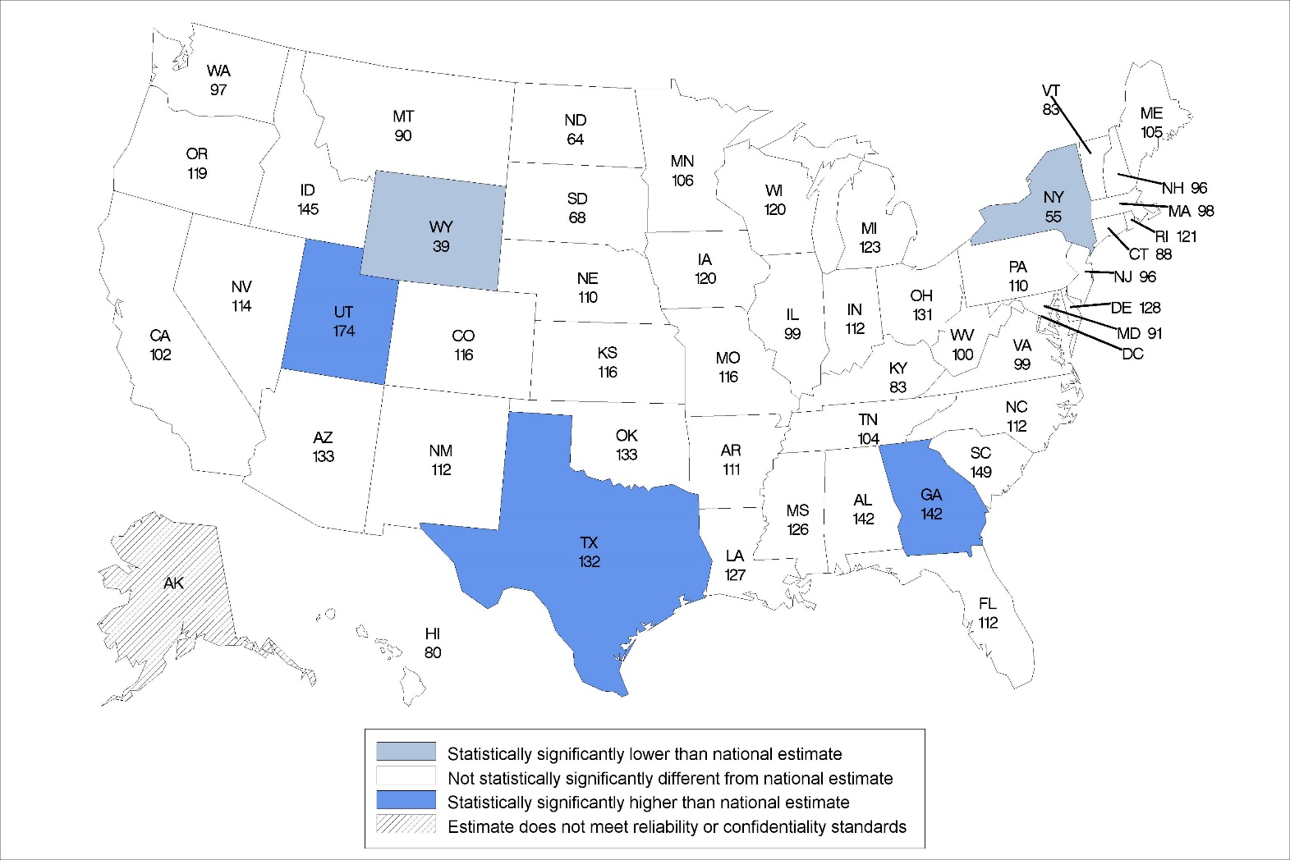
Figure 6. Use rate of hospice patients aged 85 and over: United States, 2015
The national rate is 108.
Note: Use rate is calculated as the number of hospice patients aged 85 and over receiving care anytime in 2015 per 1,000 persons aged 85 and over. Statistical significance tested at p<0.05.
Source: NCHS, National Study of Long-Term Care Providers, 2016

Slide 12
4. Nursing home use-rate maps, 2016

Slide 13
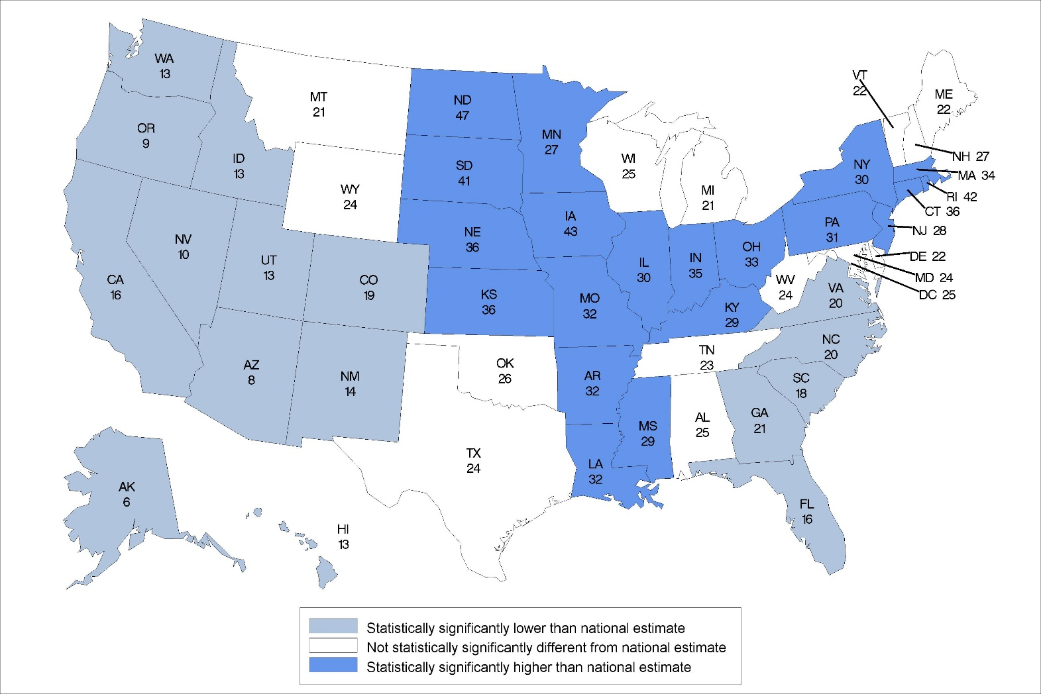
Figure 7. Use rate of nursing home residents aged 65 and over: United States, 2016
The national rate is 24.
Notes: Use rate is calculated as the number of nursing home residents aged 65 and over on any given day in 2016 per 1,000 persons aged 65 and over. Statistical significance tested at p<0.05.
Source: NCHS, National Study of Long-Term Care Providers, 2016

Slide 14
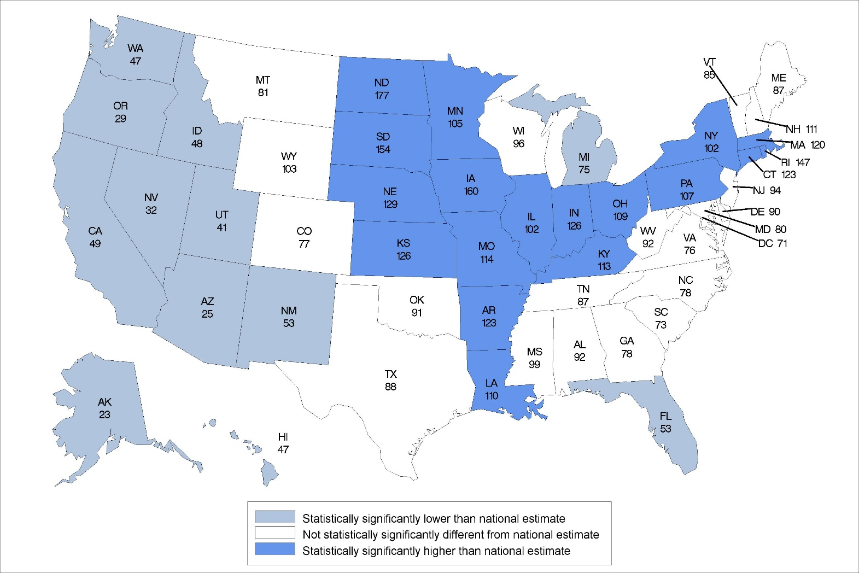
Figure 8. Use rate of nursing home residents aged 85 and over: United States, 2016
The national rate is 85.
Notes: Use rate is calculated as the number of nursing home residents aged 85 and over on any given day in 2016 per 1,000 persons aged 85 and over. Statistical significance tested at p<0.05.
Source: NCHS, National Study of Long-Term Care Providers, 2016

Slide 15
5. Residential care community use-rate maps, 2016

Slide 16
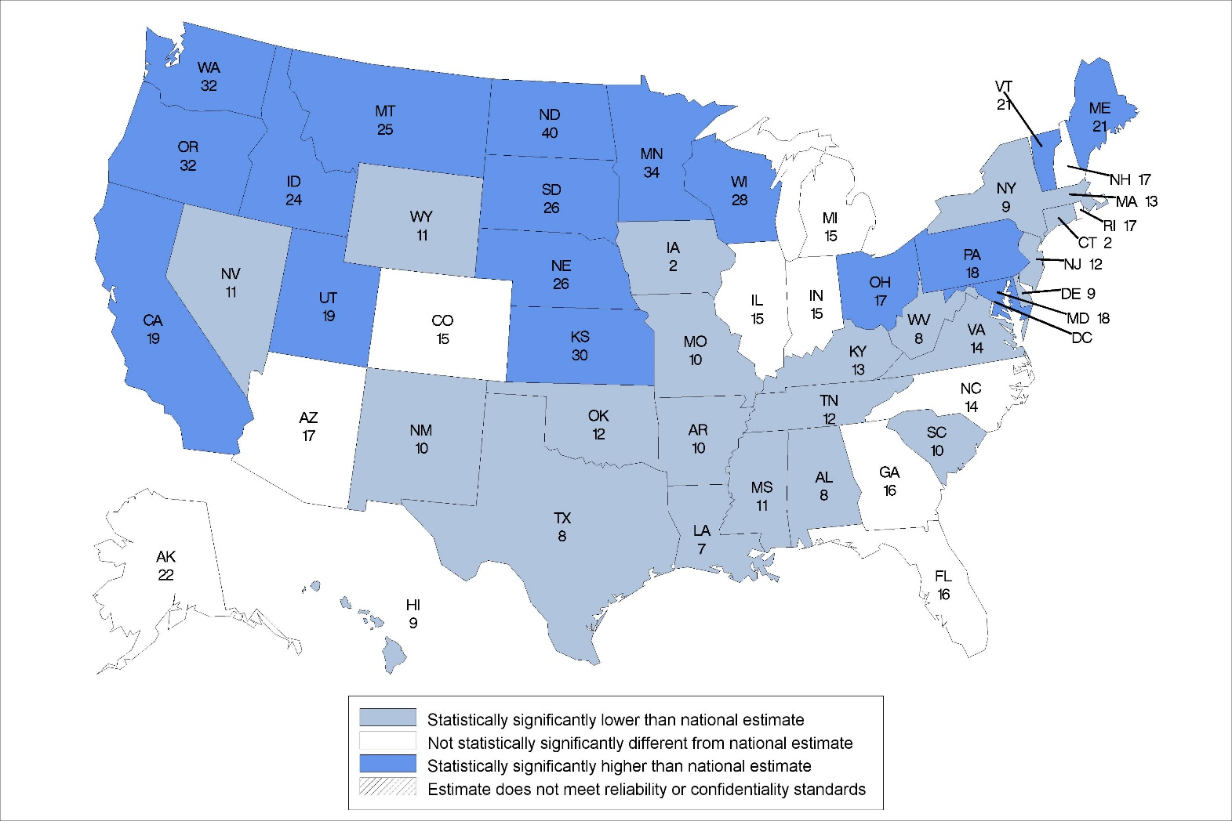
Figure 9. Use rate of residential care residents aged 65 and over: United States, 2016
The national rate is 15.
Notes: Use rate is calculated as the number of residents aged 65 and over in residential care communities on any given day in 2016 per 1,000 persons aged 65 and over. Statistical significance tested at p<0.05.
Source: NCHS, National Study of Long-Term Care Providers, 2016

Slide 17
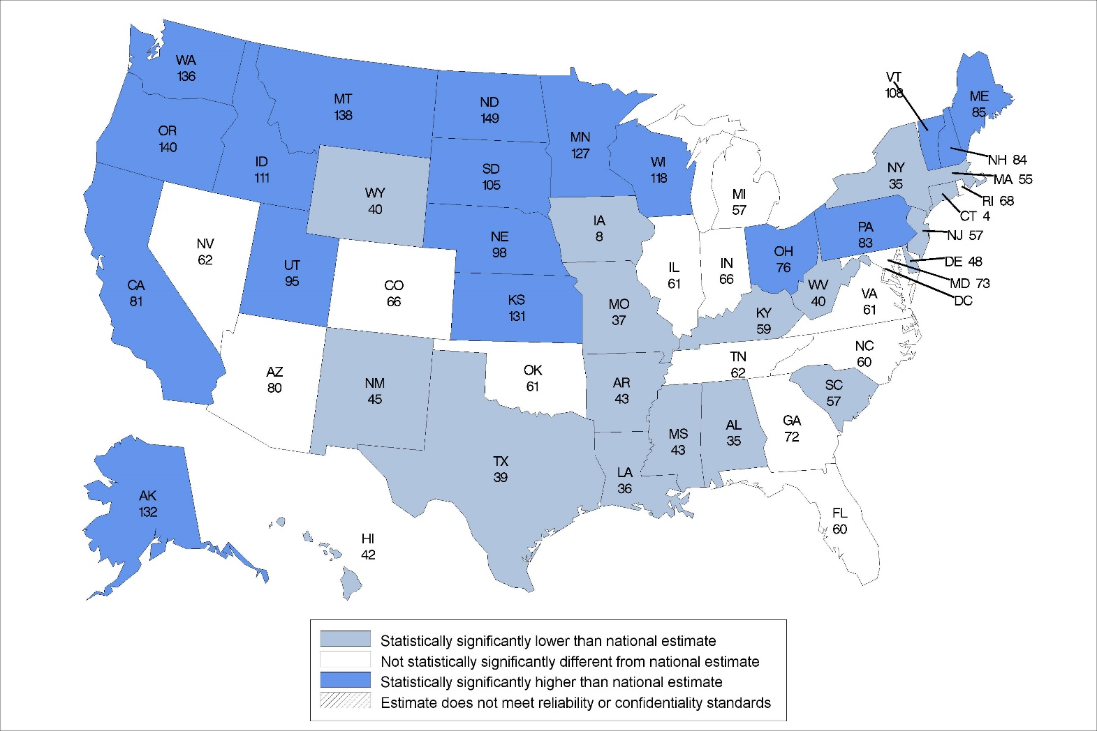
Figure 10. Use rate of residential care residents aged 85 and over: United States, 2016
The national rate is 66.
Notes: Use rate is calculated as the number of residents aged 85 and over in residential care communities on any given day in 2016 per 1,000 persons aged 85 and over. Statistical significance tested at p<0.05.
Source: NCHS, National Study of Long-Term Care Providers, 2016

