Slide 1

Learn to Live!
Managing Ongoing
Health Problems
Insert local program name and information here…
Notes:
Hello – My name is________________________.
I’m a volunteer with (insert the name of the program here).
I am here today to talk to you about having chronic, ongoing health problems.
I’d like to take you on my journey so you’ll know why I am here now and how I got here.

Slide 2

Did you wake up bright and ready to go?
Notes:
How did you feel when you got up this morning?
Did you jump out of bed ready to get rolling?

Slide 3

or were you a bit droopy?
Notes:
Or, were you a bit slow and not feeling like facing the day?

Slide 4
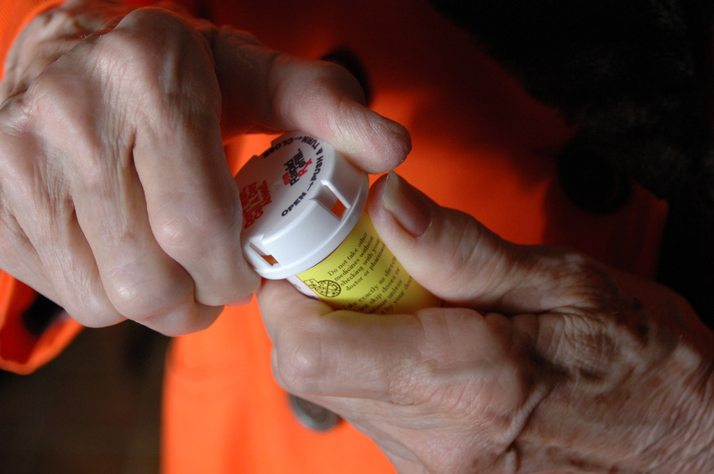
I know how you feel…
Notes:
I’m here talking with you because I’m probably like many of you here in this room. I have an ongoing (chronic) health condition that I live with every day.
I have (share your ongoing health problems…)
Before I attended a (insert the name of the program) workshop, I didn’t feel like jumping out of bed in the morning ready to get moving. I was pretty slow.
The workshop taught me how to manage my health problems and I feel so much better now. Now I can do the things I like to do and I’m much happier.
That’s why I am volunteering to share my experience with you today.

Slide 5
Let’s Talk About:
Chronic health problems
The symptom cycle
Self-management workshops
How to sign up
Notes:
Before I tell you about the workshop, you’ll need to understand where I’m coming from. This is what we’ll talk about today.
What a chronic health condition is.
What it means to get caught in the vicious cycle of chronic disease symptoms.
What we can do to break this cycle and learn to manage our health problems.
What a (insert name of program) Workshop is and the benefits of participating in a workshop.
And, I’ll tell you all you need to know to sign up for a workshop near you.

Slide 6
Chronic Health Problems
Diabetes
Heart disease
High blood pressure
Arthritis
Notes:
Chronic is another name for ongoing. What kind of health problems are considered chronic?
Some examples include:
Diabetes.
Heart disease.
High blood pressure.
Arthritis.
Why are these chronic or ongoing?
The doctor might give you medicine or other treatments but they don’t cure the problem.
The doctor gives you advice about how to manage the symptoms of your health problem.
It’s up to you to learn how to control or manage your symptoms so you can live a better life with the ongoing problem.

Slide 7
I wasn’t prepared to live with ongoing health problems.
Where are the directions?
Notes:
I don’t know about you, but when I found out I had (share your chronic health condition),
I was not prepared to live my life with (share your symptoms like pain, fatigue, limitations getting around and doing things, etc.).
So many things began to happen to me (share your own experience here):
Such as,
no longer having the energy I once had,
not being able to do the things I used to do,
not knowing how to take the correct medications for my many symptoms,
and not being able to sleep.
It was overwhelming for me.

Slide 8
The Symptom Cycle
Disease
Pain
Stress
Depression
Fatigue
Tense muscles
Notes:
When you have a health condition that is chronic or ongoing, you get caught in a cycle of symptoms that makes it hard to feel good and live your best life.
Let’s say you have diabetes.
The doctor tells you that you have high blood sugar.
You take your medicine but you need to lose weight too.
The extra weight on your body may cause your joints to hurt.
The pain may cause you to feel stress and worry.
If your stress continues over time, you may feel depressed and your mood may be very low.
Being overweight and stressed-out may make you very tired.
As you can see, having one symptom like pain or fatigue can lead to many other problems and this may lead to more symptoms. This becomes a vicious cycle that just makes you feel like sitting down, right?

Slide 9

The Symptom Cycle
Disease
Pain
Stress
Depression
Fatigue
Tense muscles
Notes:
Here is the good news: By learning techniques of self-management, I was able to break this vicious cycle of pain and stress.
Now, I’d like to share my journey to a better life through management of my health problems.
This is what is called “self-management.”

Slide 10
Insert name of your program here…
Developed by
Stanford University
Notes:
Lucky for us, scientists have studied this for many years and have developed what is called
Self-Management Education.
Self-management has been tested by Stanford University and has been found to work in treating people like us who have ongoing health problems.
People who participate and practice the techniques they have learned in self-management education workshops
Have been able to break the cycle of disease symptoms, and
Have learned to manage their health problems.
And we can too!

Slide 11
Research studies show
these benefits
of self-management:
  More confidence in managing your health problems.
  Improved ability to do household and social activities.
  Less fear and worry.
  Fewer symptoms like pain or shortness of breath.
Notes:
Some of the benefits of participating in a self-management education workshop include
Breaking the cycle of symptoms, including reducing pain and other symptoms that limit your activities.
Gaining more confidence in yourself and your ability to manage your symptoms.
Improving your mood and being happier.
Having more energy because you learn to manage your pain and to be more active.
As you become more confident, learning to communicate better with your doctor so that you can become an active partner in taking care of yourself and your health.

Slide 12
At a workshop, you can
Learn techniques that help you
  Do exercises that work for you.
  Move more easily.
  Take charge of your own health.
  Do the things you like to do.
  Be more independent.
Notes:
I participated in a self-management education workshop and this is what I learned:
I learned techniques that help me every day and they can also help you.
You will learn how to be physically active in ways that fit you and your lifestyle.
By learning new techniques for exercising, you will be able to move your body more easily.
You will learn how to talk to your doctor and how to take charge of your health and your life.
When you practice these techniques, you will be able to do more of the things that you like to do.
You will manage your ongoing health problems using practices in your everyday life that help you to be more independent.

Slide 13
Workshops
Are small groups of people like yourself.
Have experienced workshop leaders.
Take 2½ hours a week for 6 weeks.
Let you learn and practice problem-solving, goal-setting, and decision-making.
Are a way to share progress and get support from friends.
Notes:
What is a workshop like?
It is a small group of ten or fifteen people like yourself with different health concerns.
The leader is trained and has experience with his or her own chronic health problems.
Workshops are held each week for 6 weeks and are 2½ hours long, with a snack break and lots of time to talk.
There is no lecture—this is a time to discuss and practice making goals, solving problems, and making decisions to help you live better.
Workshops are set up so you can discuss how you are doing, share ideas, and get support from other people.

Slide 14
Take charge of your life!
Notes:
How many of you have ever felt like someone or something besides you is in control of your health?
I know I have felt like that sometimes.
At a self-management workshop, you will learn how to take charge of your own health instead of waiting for someone else to figure it out for you.
Would you like to be more independent and not have to depend on others to get around and do things?
By learning to manage the symptoms of your ongoing health condition, you will be more confident in your ability to do things yourself.
You can be a happier and more independent person.

Slide 15
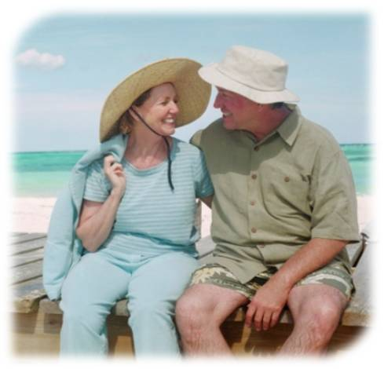


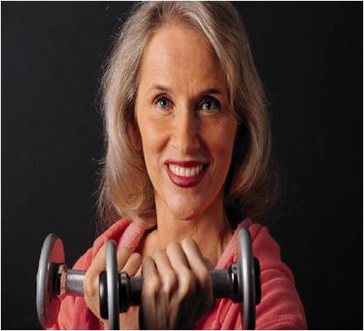
What would you like to do?
Notes:
Think about it—
What are some things you would like to do that you are not able to do now, because you just don’t feel that you can do them?
You might want to go swimming or do yoga or dance or play golf.
Don’t wait for others to do things for you. Now is your chance to live the life you want to live.

Slide 16
Sign Up for a Workshop
Where: insert location.
When: insert date and time.
How: insert information
telling how to sign up,
including contact information.
Notes:
I have shared my positive experience with you so you will take advantage of this opportunity to participate in a self-management workshop.
There is one starting soon.
Where:
When:
How to sign up:

