Slide 1
National Study of Long-Term Care Providers 2014
Slide 3 describes corrections made to the bullets for maps on slides 9, 14, and 19 on February 23, 2017.
State Maps
Adult Day Services Centers
Division of Health Care Statistics

Slide 2
NSLTCP 2014 Adult Day Services Center Maps Overview
This slide presentation (and accompanying presentation for residential care community sector) includes US maps for selected characteristics of adult day services centers and participants. Characteristics include center ownership and chain status, disease specific programming, center practices, and Medicaid utilization; and participant functioning, health conditions, and adverse events.
The data are from the National Center for Health Statistics’ (NCHS) 2013-2014 National Study of Long-Term Care Providers. Cases with missing data were excluded from the analyses on a variable by variable basis. Please visit the NSLTCP website to access published reports and state estimate tables and supplements, and to review the study’s methodology and documentation. All reports and products are easily accessible and can be downloaded at no cost.
Each map includes a title, legend, footnotes, and suggested talking points in the notes section. This presentation is available in PDF and PowerPoint versions. The maps show states that are not statistically significantly different from the national estimate (white color), states that are statistically significantly lower than the national estimate (light gray blue), and states that are statistically significantly higher than the national estimate (bright blue). States where estimates cannot be reported are shaded with hash marks.
All material appearing in this presentation is in the public domain and may be reproduced or copied without permission; citation as to source, however, is appreciated.
Suggested citation
Rome, V, Lendon, JP, and Sengupta, M. Maps of selected characteristics of adult day services centers and participants in the United States: Data from the National Study of Long-Term Care Providers, 2013–2014. National Center for Health Statistics. 2017.
Division of Health Care Statistics

Slide 3
Errata: State Maps Adult Day Services Centers
Revisions were made to the notes of the following maps on 2/23/2017.
On slide 9, Percentage of adult day services centers that offer disease-specific programs for Alzheimer’s disease: United States, 2014, the second bullet was revised to “The percentages ranged from 47% in Nebraska to 100% in Delaware and Oregon. “
On slide 14, Percentage of adult day services centers that screen for depression: United States, 2014, the first bullet was revised to “In 2014, the national percentage of adult day services centers that screened for depression was 82%.” The following bullets were dropped from the slide as they did not pertain to it: (1) “The location of states statistically significantly higher than the national percentage was varied across the United States.” (2) “States with a statistically significantly lower percentage of for-profit adult day services centers were located in the Midwest and Northeast regions.”
On slide 19, Medicaid as a percentage of adult day services centers’ revenue from paid participant fees: United States, 2014, the second bullet was revised to “The percentages ranged from 15% in Hawaii to 82% in Texas” and the last bullet was dropped “The location of states statistically significantly higher than the national percentage was spread throughout the Midwest, Northeast, and Southeastern regions.”

Slide 4
Links to NSLTCP Publications and Documentation
Study results and publications: https://www.cdc.gov/nchs/nsltcp/nsltcp_products.htm
Questionnaires, survey methodology, and related documentation: https://www.cdc.gov/nchs/nsltcp/nsltcp_questionnaires.htm
Division of Health Care Statistics

Slide 5
OWNERSHIP AND CHAIN STATUS
Division of Health Care Statistics

Slide 6
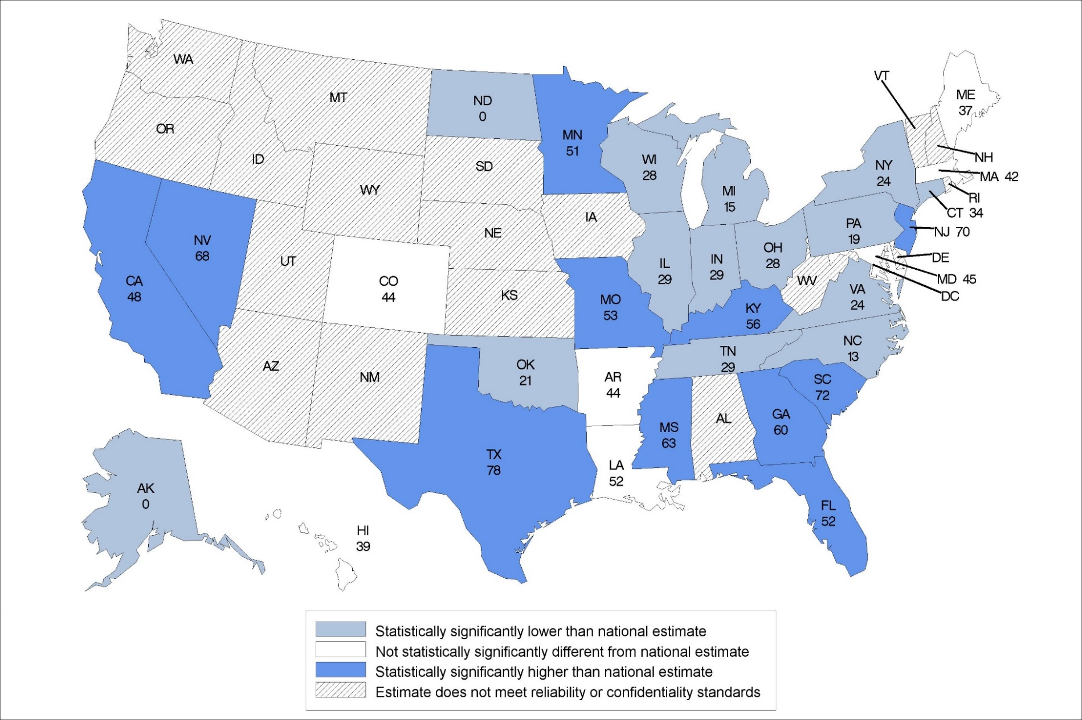
Percentage of adult day services centers that are for-profit: United States, 2014
Statistical significance tested at p<0.05.
Note: The national percentage is 44%.
Source: NCHS, National Study of Long-Term Care Providers, 2014
Notes:
In 2014, the national percentage of adult day services centers that were for-profit was 44%.
The percentages ranged from 0% in Alaska and North Dakota to 78% in Texas.
The location of states statistically significantly higher than the national percentage was varied across the United States.
States with a statistically significantly lower percentage of for-profit adult day services centers were located in the Midwest and Northeast regions.

Slide 7
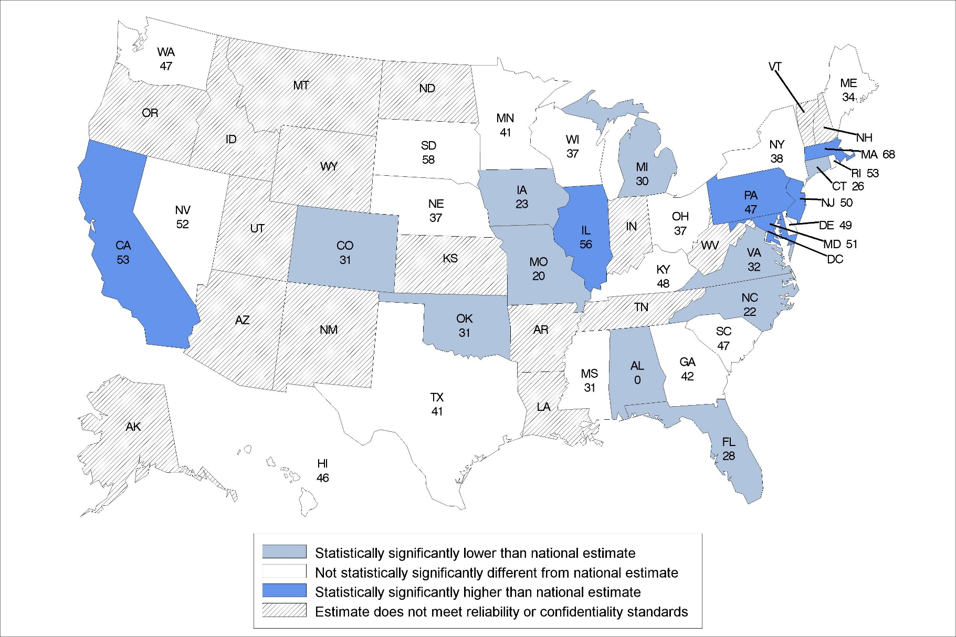
Percentage of adult day services centers that are chain-affiliated: United States, 2014
Statistical significance tested at p<0.05.
Note: The national percentage is 42%.
Source: NCHS, National Study of Long-Term Care Providers, 2014
Notes:
In 2014, the national percentage of adult day services centers that were affiliated with a chain was 42%.
The percentages ranged from 0% in Alabama to 68% in Massachusetts.
Four of the six states that had a statistically significantly higher percentage of chain-affiliated centers were located in the Northeast region of the country.
The majority of states were not statistically significantly different from the national percentage.

Slide 8
DISEASE-SPECIFIC PROGRAMS
Division of Health Care Statistics

Slide 9
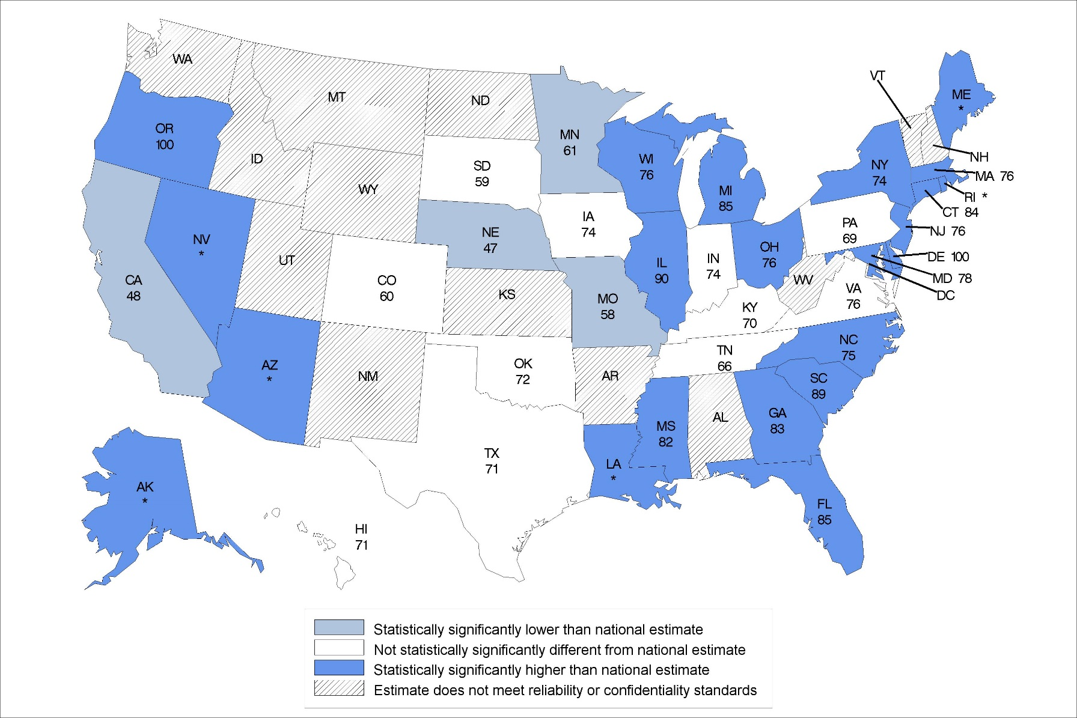
Percentage of adult day services centers that offer disease-specific programs for Alzheimer’s disease: United States, 2014
Statistical significance tested at p<0.05.
*Percentage is 90% or higher but estimate is not displayed as it may pose a disclosure risk.
Note: The national percentage is 69%.
Source: NCHS, National Study of Long-Term Care Providers, 2014
Notes:
In 2014, the national percentage of adult day services centers that offer disease-specific programs for Alzheimer’s disease was 69%.
The percentages ranged from 47% in Nebraska to 100% in Delaware and Oregon. [Bullet revised 9/23/2017.]
The majority of states were statistically significantly different from the national percentage.
The location of states statistically significantly different from the national percentage varied across the United States.

Slide 10
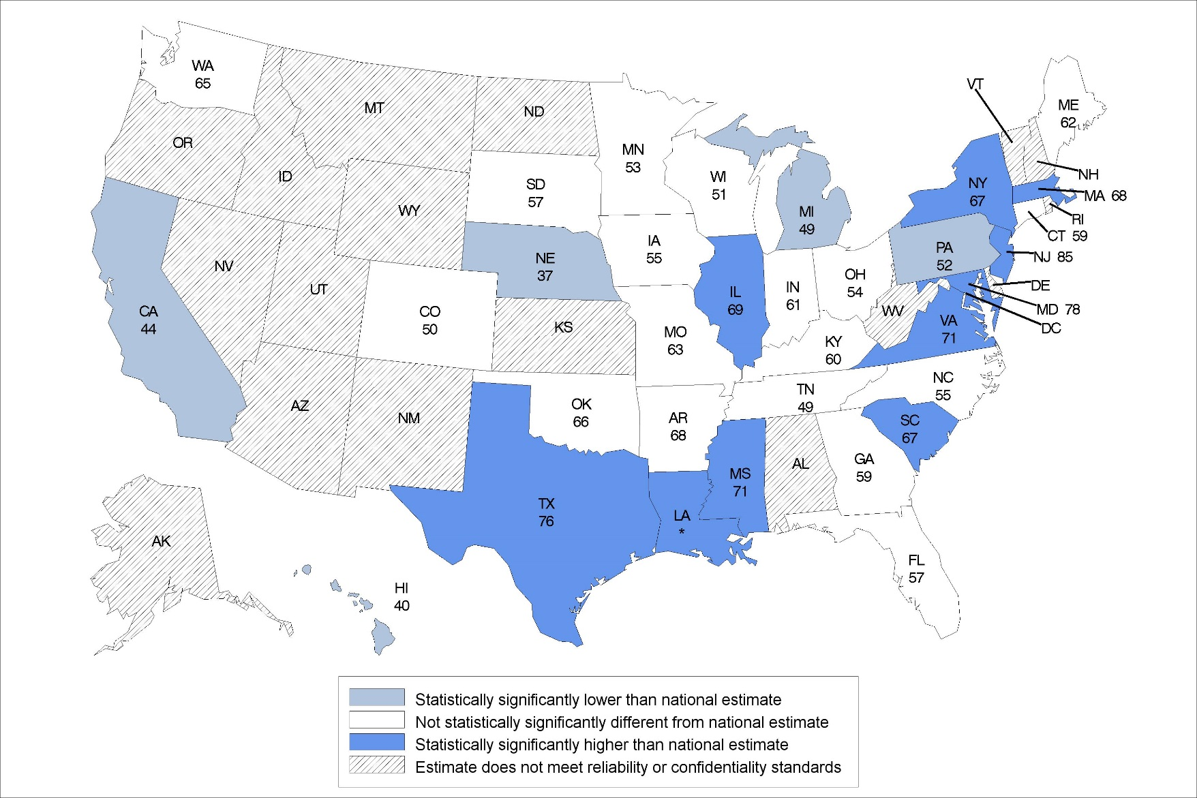
Percentage of adult day services centers that offer disease-specific programs for cardiovascular disease: United States, 2014
Statistical significance tested at p<0.05.
*Percentage is 90% or higher but estimate is not displayed as it may pose a disclosure risk.
Note: The national percentage is 59%.
Source: NCHS, National Study of Long-Term Care Providers, 2014
Notes:
In 2014, the national percentage of adult day services centers that offer disease-specific programs for cardiovascular disease was 59%.
The percentages ranged from 37% in Nebraska to 85% in New Jersey.
The location of states statistically significantly higher than the national percentage was concentrated in the Northeast and Southern regions of the United States.

Slide 11
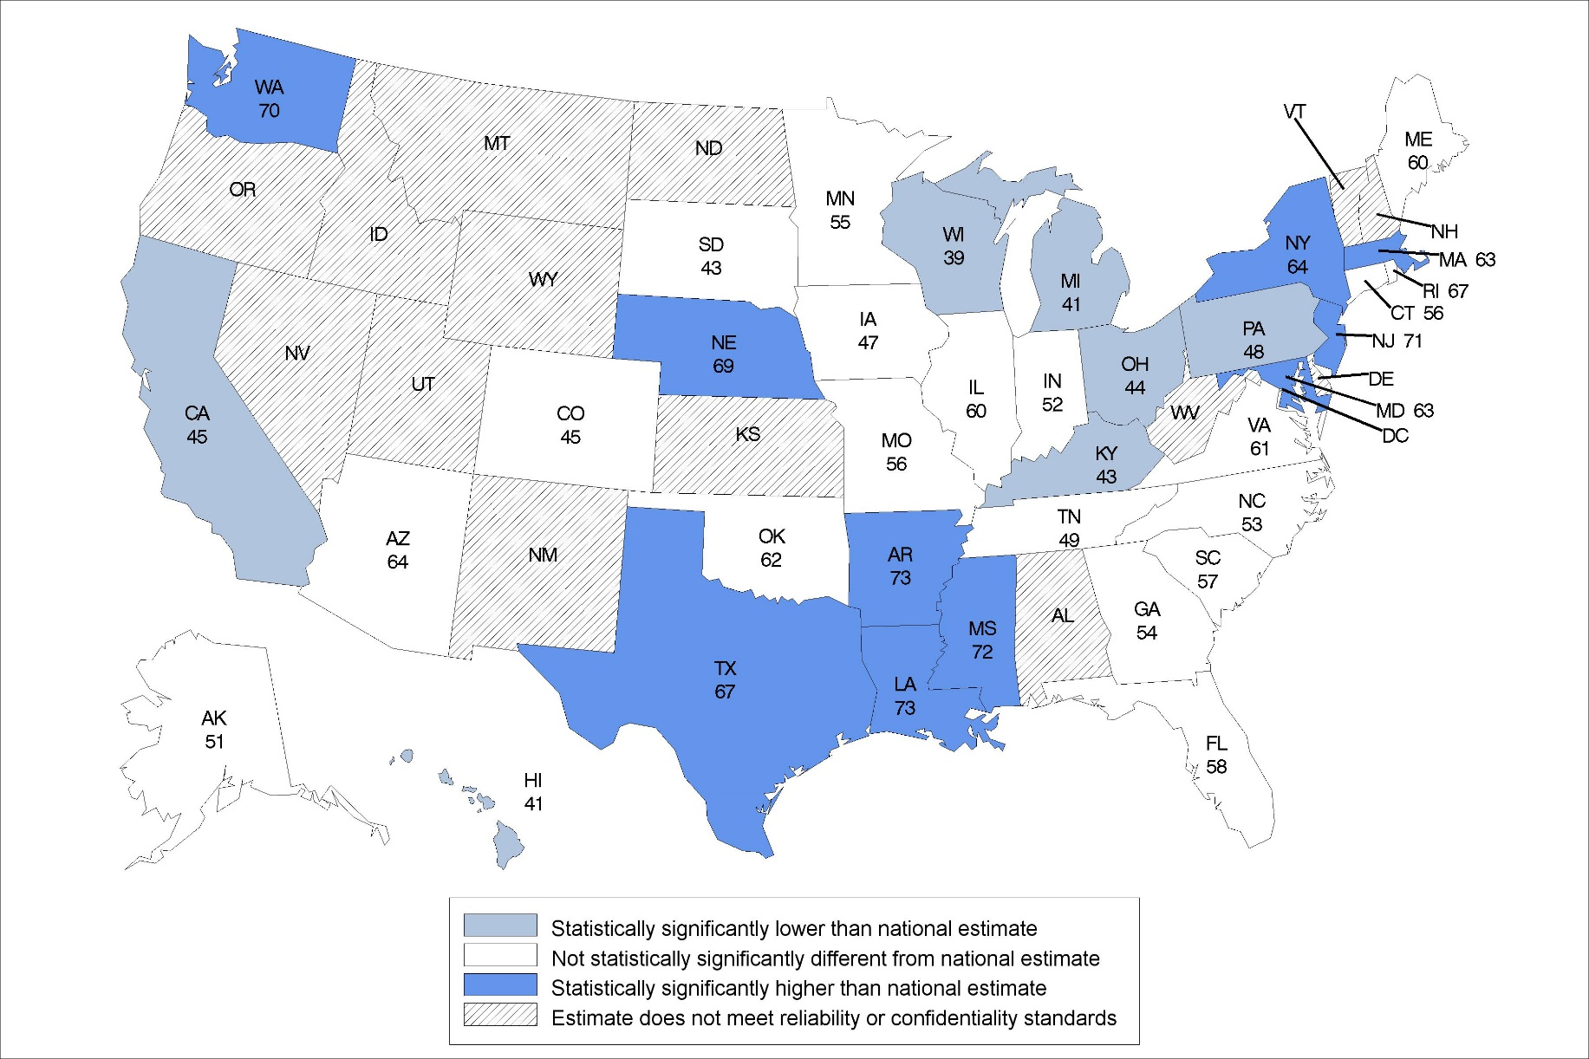
Percentage of adult day services centers that offer disease-specific programs for depression: United States, 2014
Statistical significance tested at p<0.05.
Note: The national percentage is 54%.
Source: NCHS, National Study of Long-Term Care Providers, 2014
Notes:
In 2014, the national percentage of adult day services centers that offer disease-specific programs for depression was 54%.
The percentages ranged from 39% in Wisconsin to 73% in Arkansas and Louisiana.
The location of states statistically significantly higher than the national percentage was concentrated in the Northeast and Southern regions of the United States, with the exception of Nebraska and Washington.
The majority of states were not statistically significantly different from the national percentage.

Slide 12
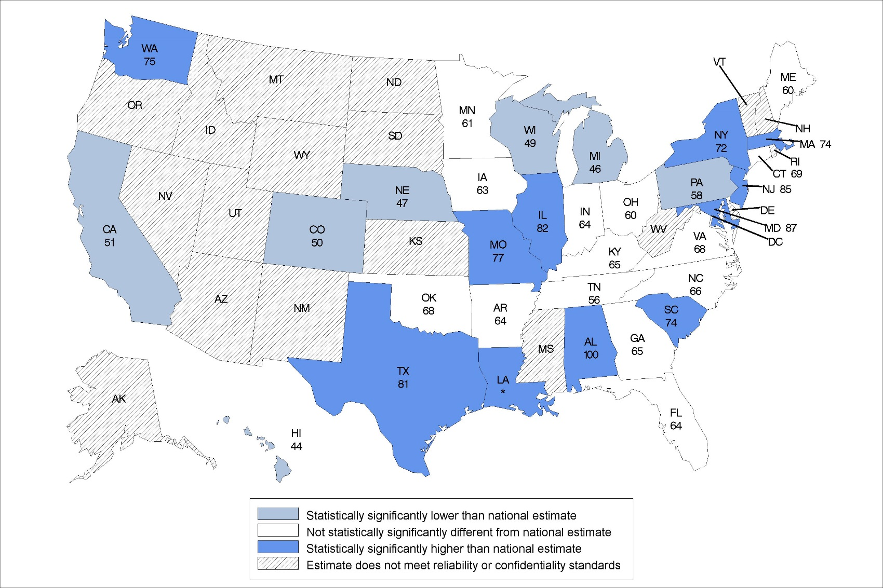
Percentage of adult day services centers that offer disease-specific programs for diabetes: United States, 2014
Significance tested at p<0.05.
*Percentage is 90% or higher but estimate is not displayed as it may pose a disclosure risk.
Note: The national percentage is 64%.
Source: NCHS, National Study of Long-Term Care Providers, 2014
Notes:
In 2014, the national percentage of adult day services centers that offer disease-specific programs for diabetes was 64%.
The percentages ranged from 44% in Hawaii to 100% in Alabama.
The location of states statistically significantly higher than the national percentage was concentrated in the Northeastern and Southern regions of the United States, with the exception of Washington, Missouri, and Illinois.

Slide 13
PRACTICES
Division of Health Care Statistics

Slide 14
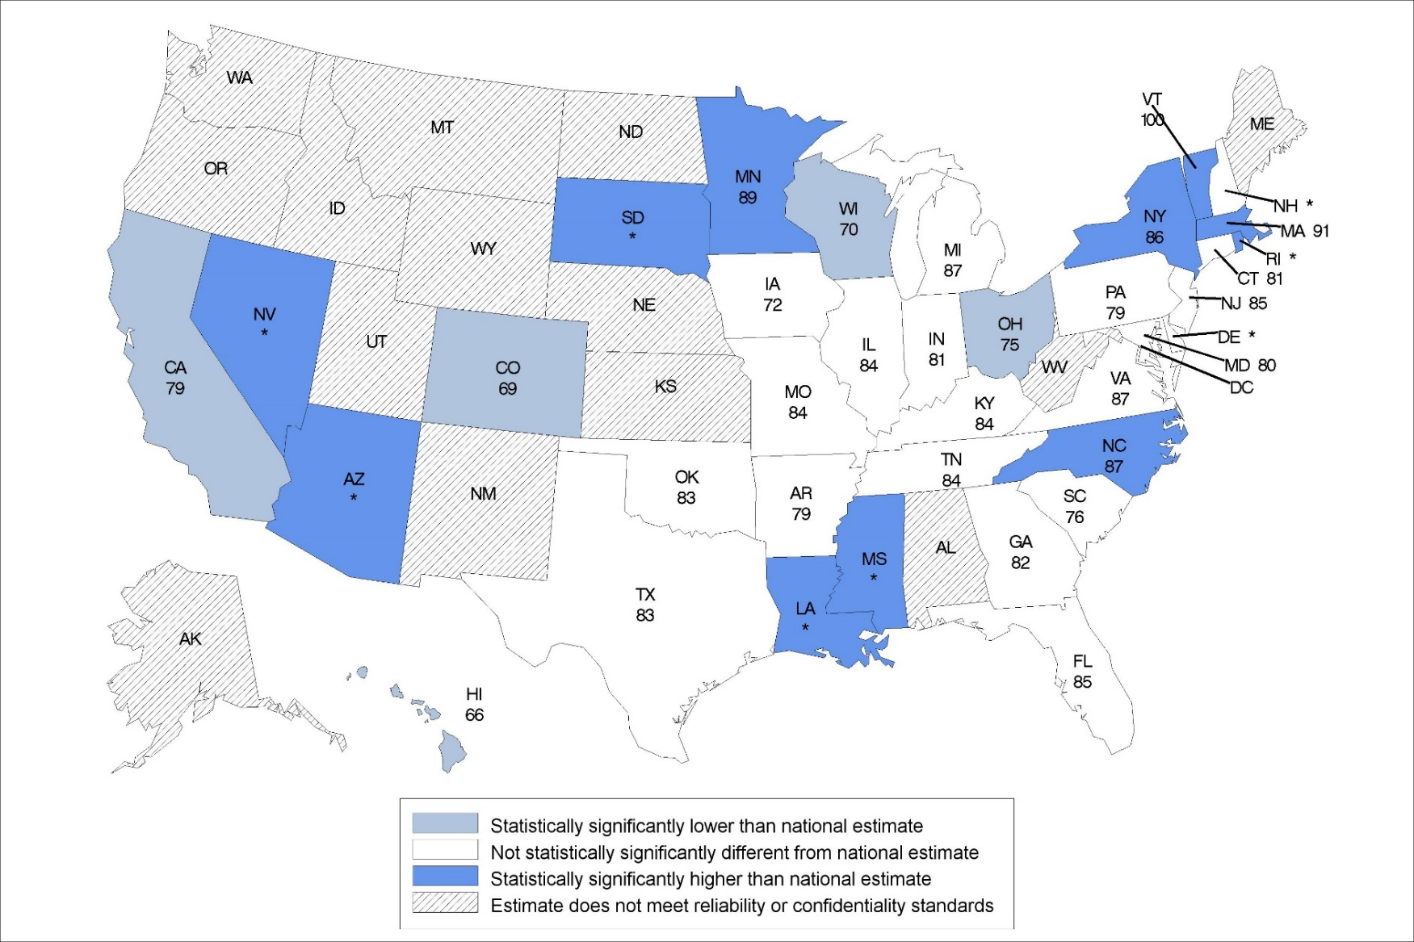
Percentage of adult day services centers that screen for depression: United States, 2014
Statistical significance tested at p<0.05.
*Percentage is 90% or higher but estimate is not displayed as it may pose a disclosure risk.
Note: The national percentage is 82%.
Source: NCHS, National Study of Long-Term Care Providers, 2014
Notes:
In 2014, the national percentage of adult day services centers that screened for depression was 82%. [Bullet revised 9/23/2017.]
The percentages ranged from 66% in Hawaii to 100% in Vermont.
The location of states statistically significantly higher than the national percentage was varied across the United States.

Slide 15
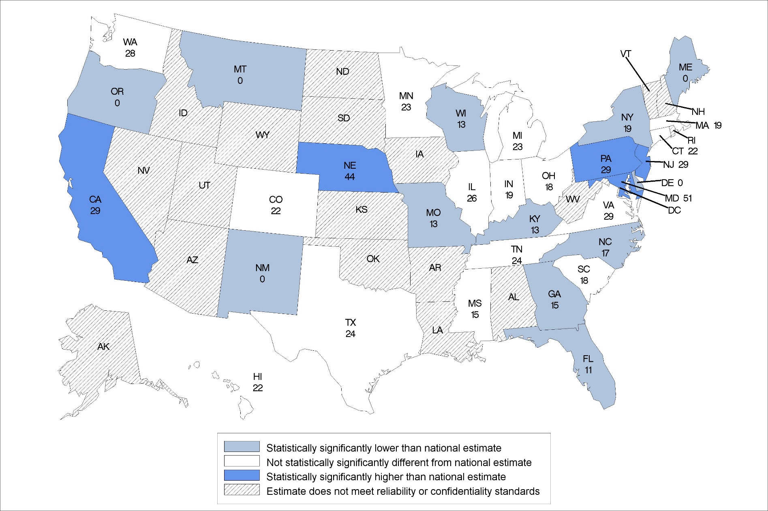
Percentage of adult day services centers that use electronic health records: United States, 2014
Statistical significance tested at p<0.05.
Note: The national percentage is 23%.
Source: NCHS, National Study of Long-Term Care Providers, 2014
Notes:
In 2014, the national percentage of adult day services centers that used electronic health records was 23%.
The percentages ranged from 0% in Delaware, Maine, Montana, New Mexico, and Oregon to 51% in Maryland.
The location of states statistically significantly different from the national percentage varied across the United States.
About 5 states were statistically significantly higher than the national percentage.

Slide 16
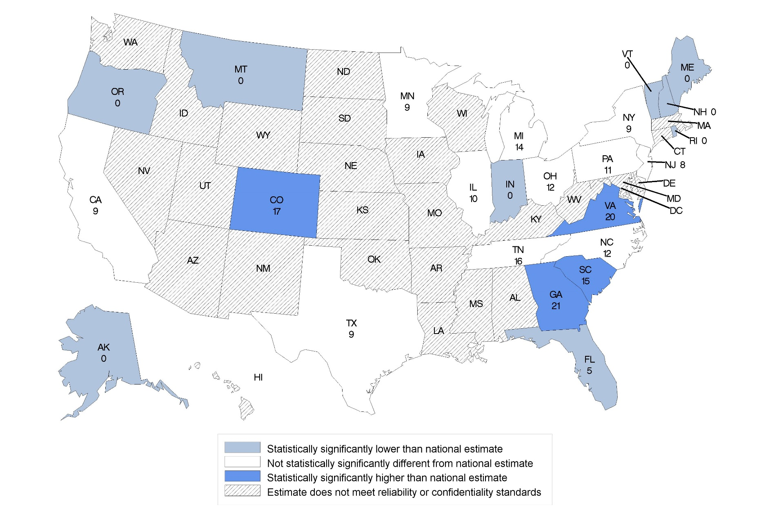
Percentage of adult day services centers that had computerized support for electronic health information exchange: United States, 2014
Statistical significance tested at p<0.05.
Note: The national percentage is 9%.
Source: NCHS, National Study of Long-Term Care Providers, 2014
Notes:
In 2014, the national percentage of adult day services centers that had computerized support for electronic health information exchange was 9%.
The percentages ranged from 0% in Alaska, Indiana, Maine, Montana, New Hampshire, Oregon, Rhode Island, and Vermont to 21% in Georgia.
Three of the four states statistically significantly higher than the national percentage were located in the Southeastern region.

Slide 17
MEDICAID

Slide 18
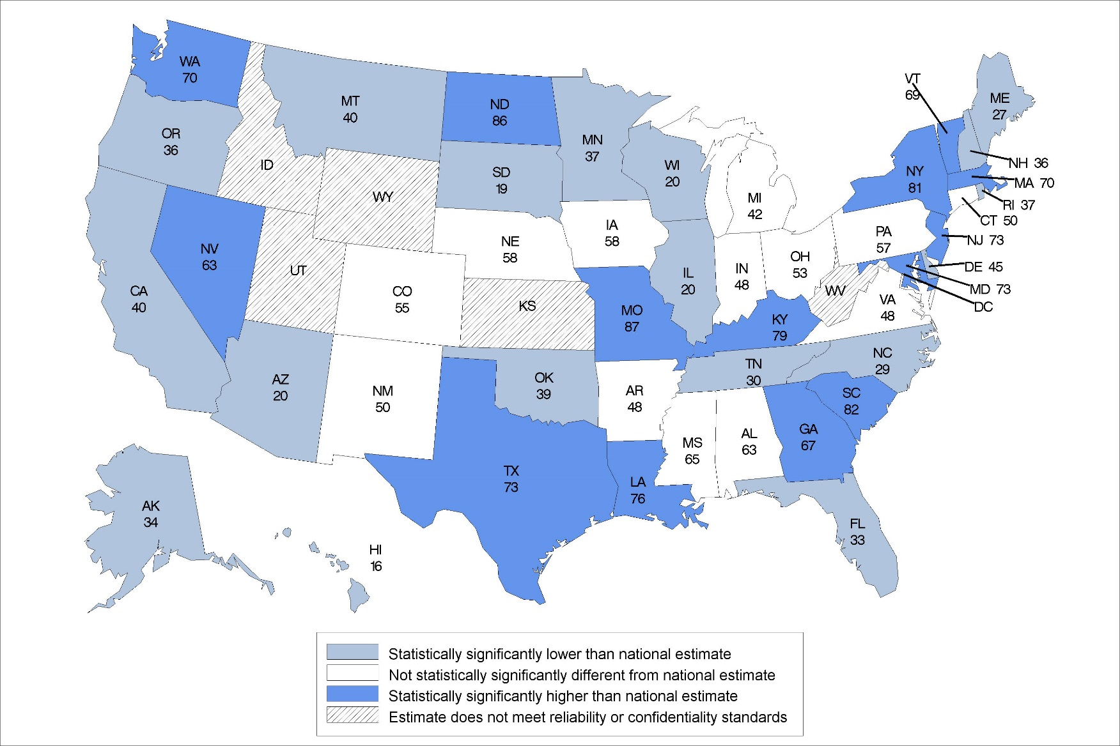
Percentage of adult day participants who used Medicaid for long-term care services in the past 30 days: United States, 2014
Statistical significance tested at p<0.05.
Note: The national percentage is 54%.
Source: CDC/NCHS, National Study of Long-Term Care Providers, 2014
Notes:
In 2014, the national percentage of adult day services center participants whose long-term care in the past 30 days was paid for by Medicaid was 54%.
The percentages ranged from 16% in Hawaii to 87% in Missouri.
The location of states statistically significantly different from the national percentage varied across the United States.

Slide 19
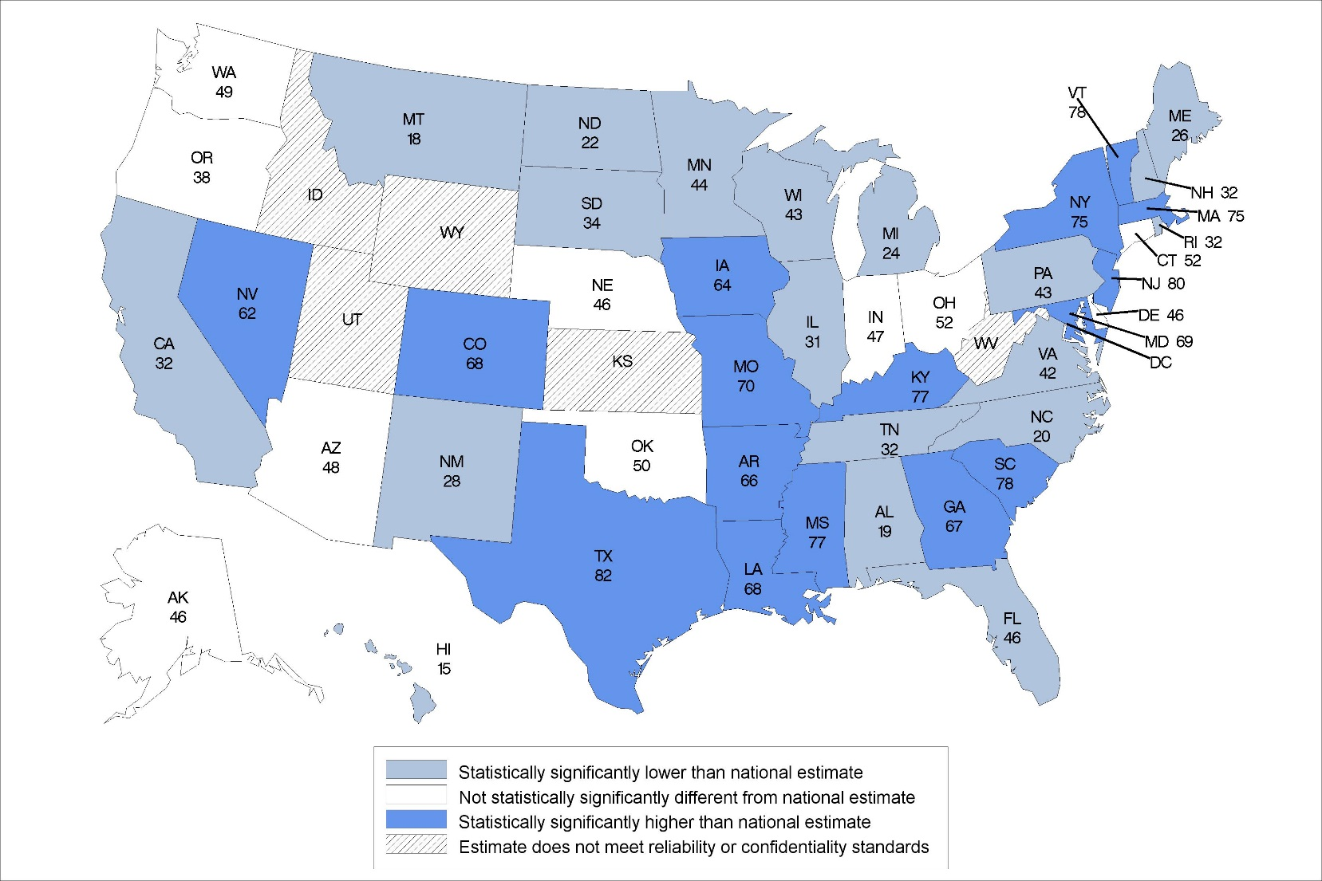
Medicaid as a percentage of adult day services centers’ revenue from paid participant fees: United States, 2014
Statistical significance tested at p<0.05.
Note: The national percentage is 54%.
Source: CDC/NCHS, National Study of Long-Term Care Providers, 2014
Notes:
In 2014, the percentage of Medicaid revenue from paid participant fees was 54%.
The percentages ranged from 15% in Hawaii to 82% in Texas. [Bullet revised 9/23/2017.]
The majority of states were statistically significantly different from the national percentage.

Slide 20
ACTIVITIES OF DAILY LIVING
Division of Health Care Statistics

Slide 21
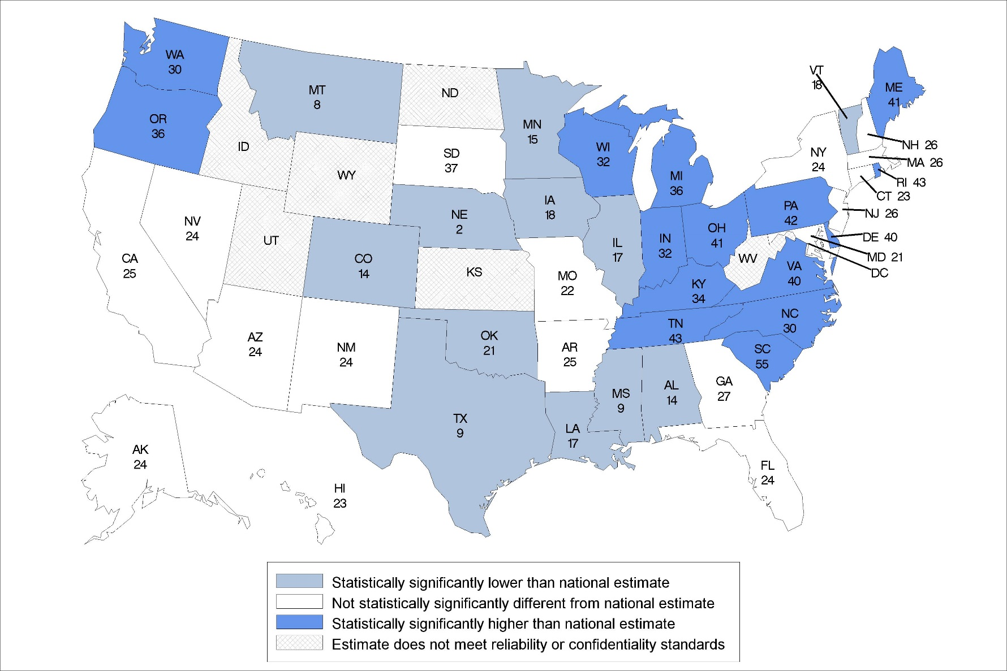
Percentage of adult day services center participants that need assistance with eating: United States, 2014
Statistical significance tested at p<0.05.
Note: The national percentage is 24%.
Source: NCHS, National Study of Long-Term Care Providers, 2014
Notes:
In 2014, the national percentage of adult day services center participants that needed assistance with eating was 24%.
The percentages ranged from 2% in Nebraska to 55% in South Carolina.
The location of states statistically significantly higher than the national percentage were concentrated in the Northeast and Southeast regions of the country.

Slide 22
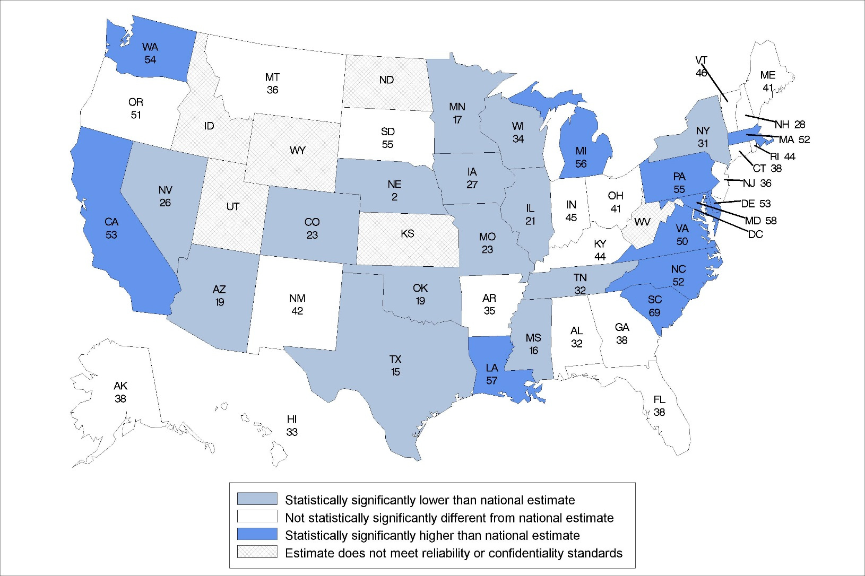
Percentage of adult day services center participants that need assistance with bathing: United States, 2014
Statistical significance tested at p<0.05.
Note: The national percentage is 41%.
Source: NCHS, National Study of Long-Term Care Providers, 2014
Notes:
In 2014, the national percentage of adult day services center participants that needed assistance with bathing was 41%.
The percentages ranged from 2% in Nebraska to 69% in South Carolina.
The location of states statistically significantly different from the national percentage varied across the United States.

Slide 23
MEDICATION USE

Slide 24
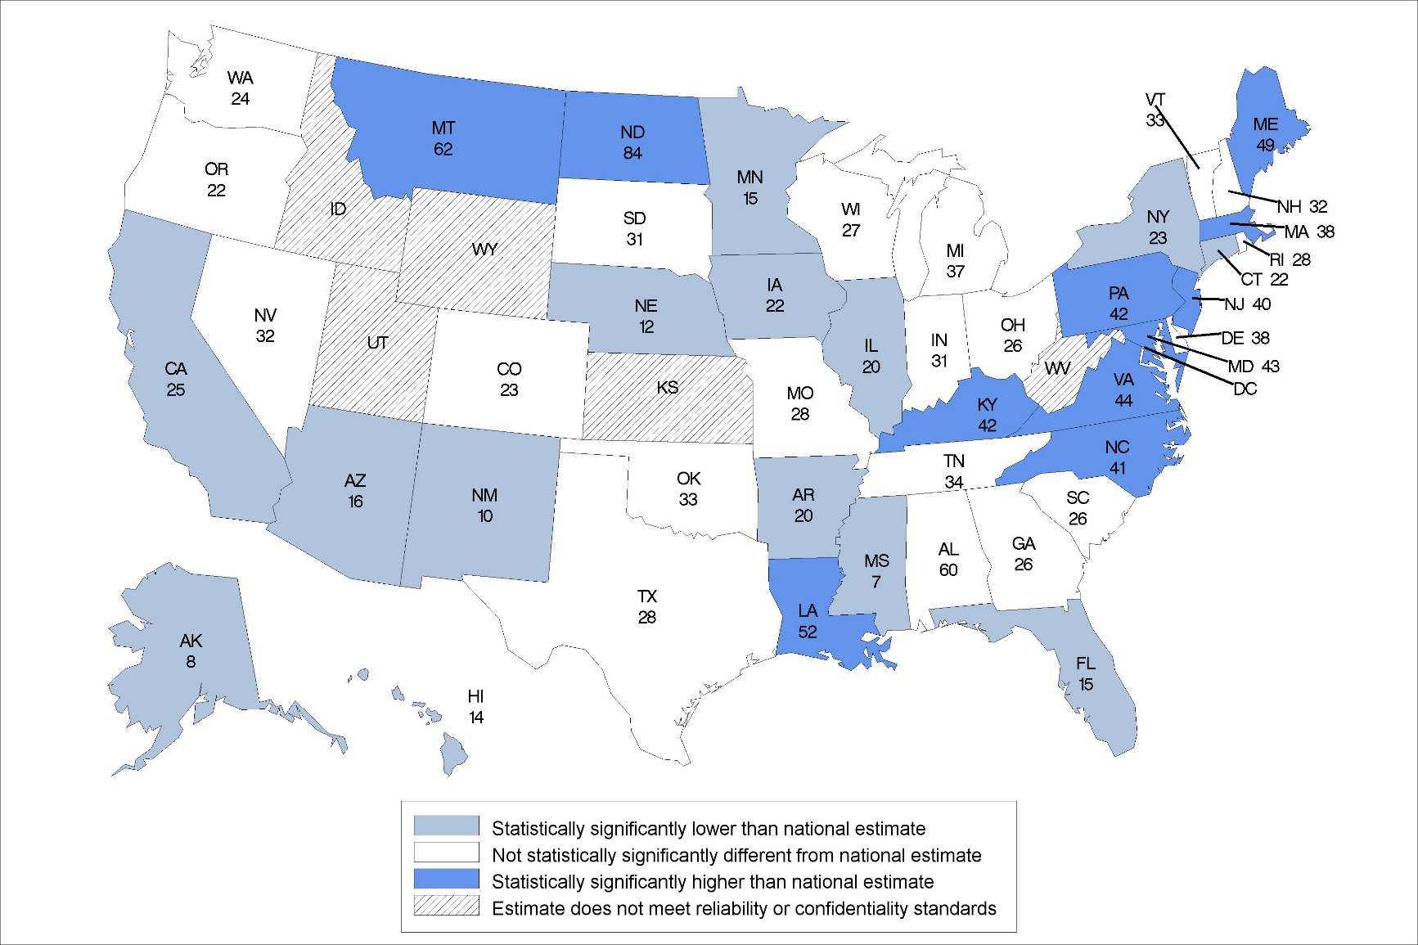
Percentage of adult day participants who received assistance with medication use: United States 2014
Statistical significance tested at p<0.05.
Note: The national percentage is 29%.
Source: NCHS, National Study of Long-Term Care Providers, 2014
Notes:
In 2014, the national percentage of adult day services center participants who received assistance with medication use was 29%.
The percentages ranged from 7% in Mississippi to 84% in North Dakota.
The location of states statistically significantly higher than national percentage were concentrated mostly in the Northeast region of the country.

Slide 25
HEALTH CONDITIONS
Division of Health Care Statistics

Slide 26
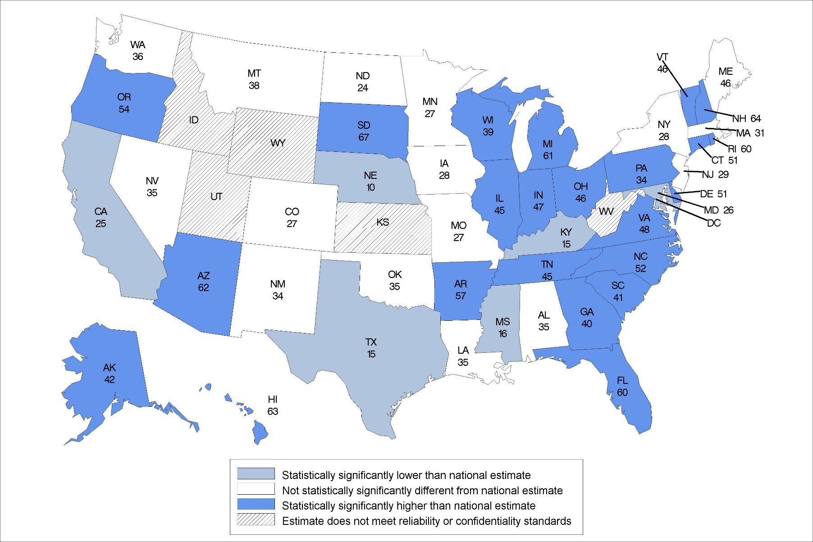
Percentage of adult day services center participants diagnosed with Alzheimer’s disease or other dementias: United States, 2014
Statistical significance tested at p<0.05.
Note: The national percentage is 30%.
Source: CDC/NCHS, National Study of Long-Term Care Providers, 2014
Notes:
In 2014, the national percentage of adult day services center participants diagnosed with Alzheimer’s disease or other dementias was 30%.
The percentages ranged from 10% in Nebraska to 67% in South Dakota.
The location of states statistically significantly higher than the national percentage was concentrated in the Eastern regions of the United States.
The majority of states were statistically significantly different from the national percentage.

Slide 27
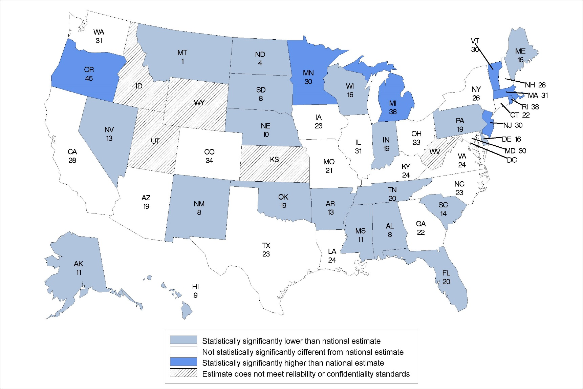
Percentage of adult day services center participants diagnosed with depression: United States, 2014
Statistical significance tested at p<0.05.
Note: The national percentage is 25%.
Source: NCHS, National Study of Long-Term Care Providers, 2014
Notes:
In 2014, the national percentage of adult day services center participants diagnosed with depression was 25%.
The percentages ranged from 1% in Montana to 45% in Oregon.
About 20 states were statistically significantly lower than the national percentage and 7 states were statistically significantly higher.
The location of states statistically significantly higher and lower varied through the United States.

Slide 28
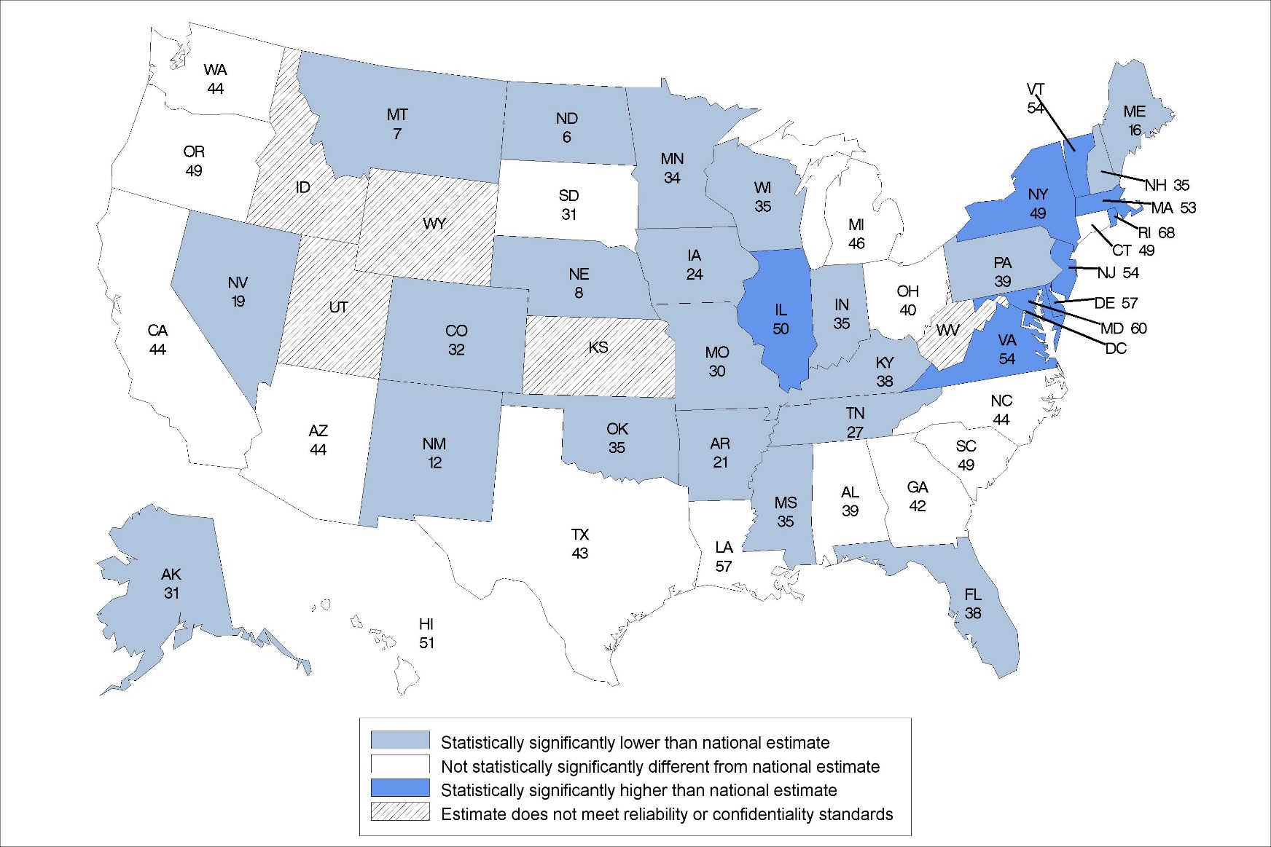
Percentage of adult day services center participants diagnosed with cardiovascular disease: United States, 2014
Statistical significance tested at p<0.05.
Note: The national percentage is 44%.
Source: NCHS, National Study of Long-Term Care Providers, 2014
Notes:
In 2014, the national percentage of adult day services center participants diagnosed with cardiovascular disease was 44%.
The percentages ranged from 6% in North Dakota to 68% in Rhode Island.
The majority of states were statistically significantly different from the national percentage.
The location of states statistically significantly different from the national percentage varied across the United States.

Slide 29
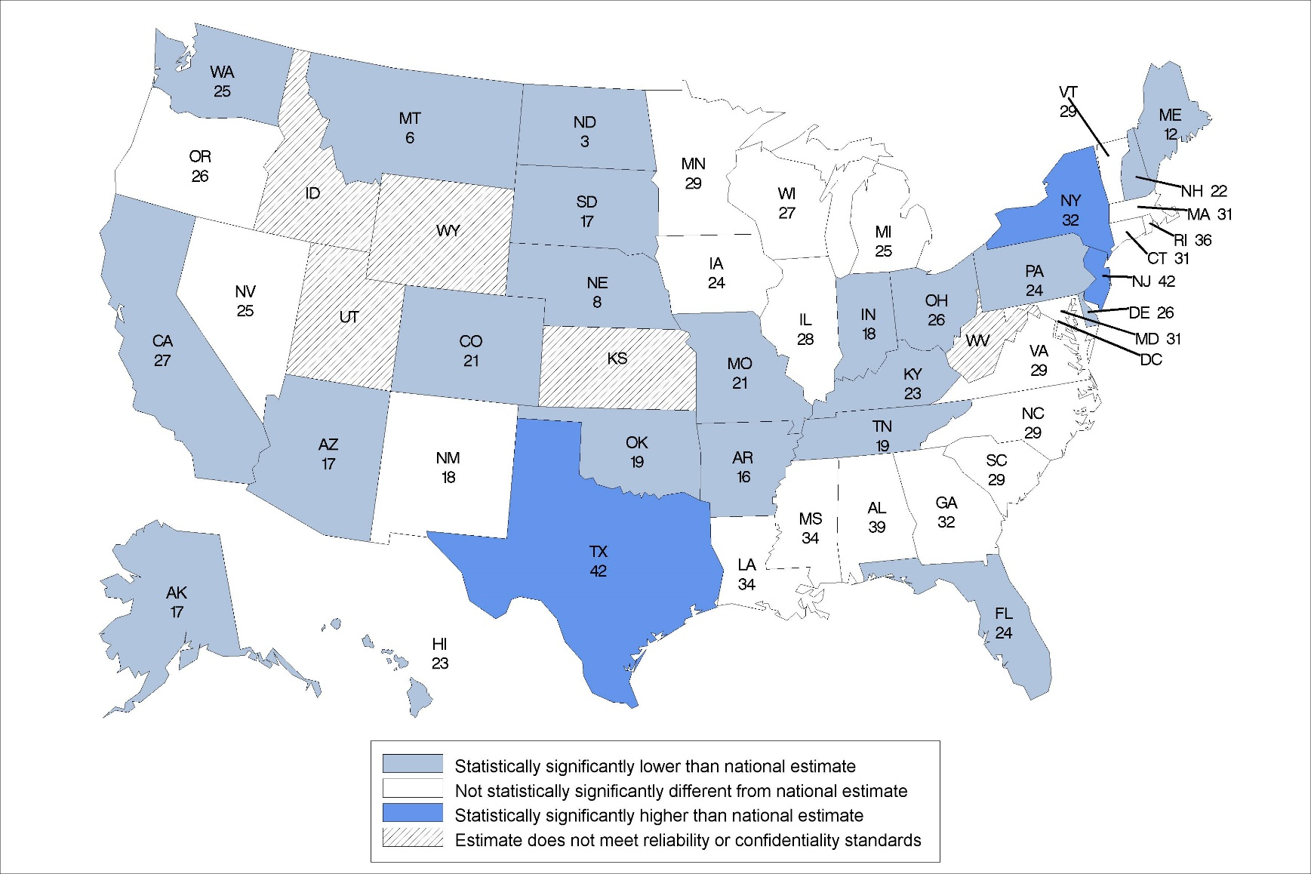
Percentage of adult day services center participants diagnosed with diabetes: United States, 2014
Statistical significance tested at p<0.05.
Note: The national percentage is 30%.
Source: /NCHS, National Study of Long-Term Care Providers, 2014
Notes:
In 2014, the national percentage of adult day services center participants diagnosed with diabetes was 30%.
The percentages ranged from 3% in North Dakota to 42% in Texas.
The location of states statistically significantly different from the national percentage varied across the United States.
Only New York, New Jersey, and Texas were statistically significantly higher than the national percentage.

Slide 30
ADVERSE EVENTS

Slide 31
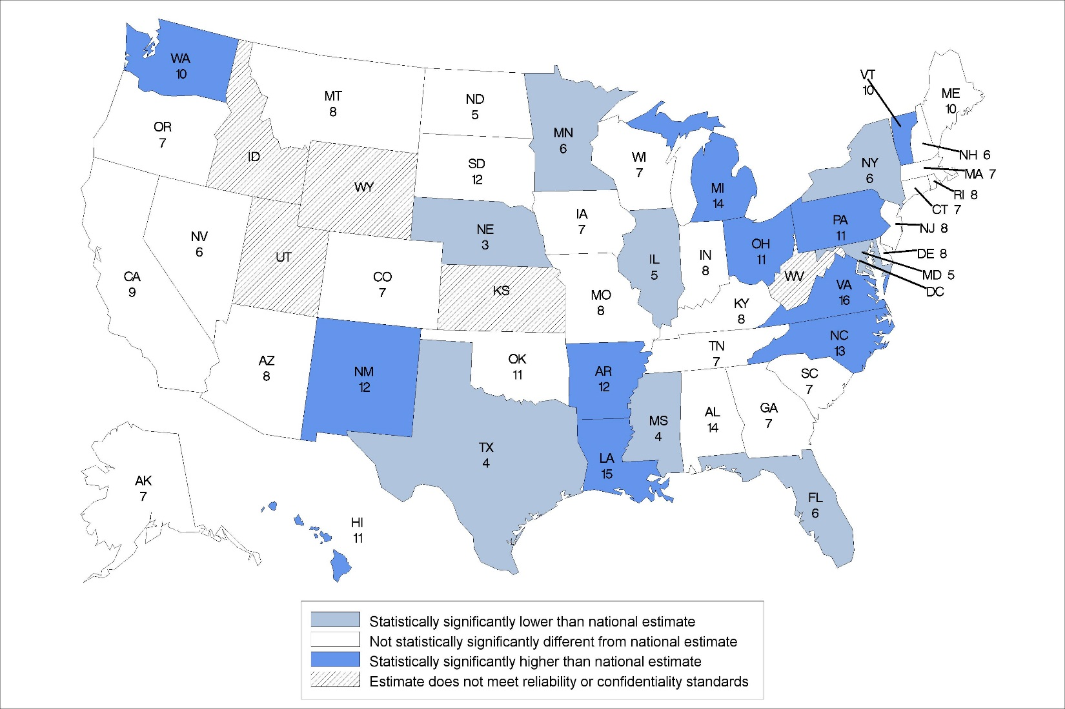
Percentage of adult day services center participants that had falls in the last 90 days: United States, 2014
Statistical significance tested at p<0.05.
Note: The national percentage is 8%.
Source: NCHS, National Study of Long-Term Care Providers, 2014
Notes:
In 2014, the national percentage of adult day services center participants that experienced a fall was 8%.
The percentages ranged from 3% in Nebraska to 16% in Virginia.
The location of states statistically significantly higher than national percentage were concentrated mostly in the Northeast region of the country.

Slide 32
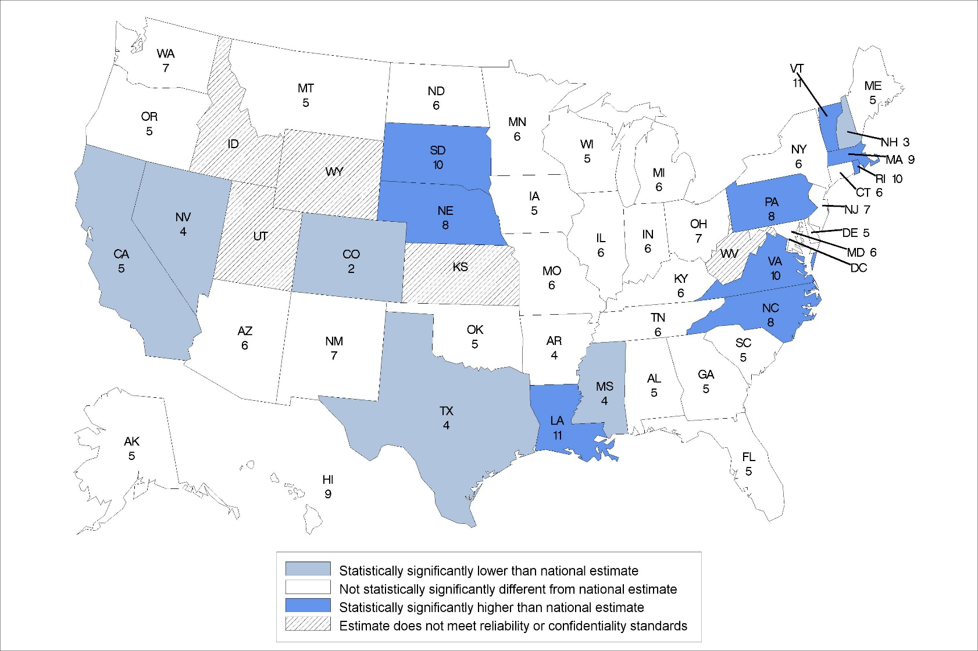
Percentage of adult day services center participants that had overnight hospitalizations in the last 90 days: United States, 2014
Statistical significance tested at p<0.05.
Note: The national percentage is 6%.
Source: NCHS, National Study of Long-Term Care Providers, 2014
Notes:
In 2014, the national percentage of adult day services center participants that had any hospitalizations was 6%.
The percentages ranged from 2% in Colorado to 11% in Louisiana and Vermont.
The location of states statistically significantly higher than national percentage were concentrated mostly in the Northeast region of the country.

Slide 33
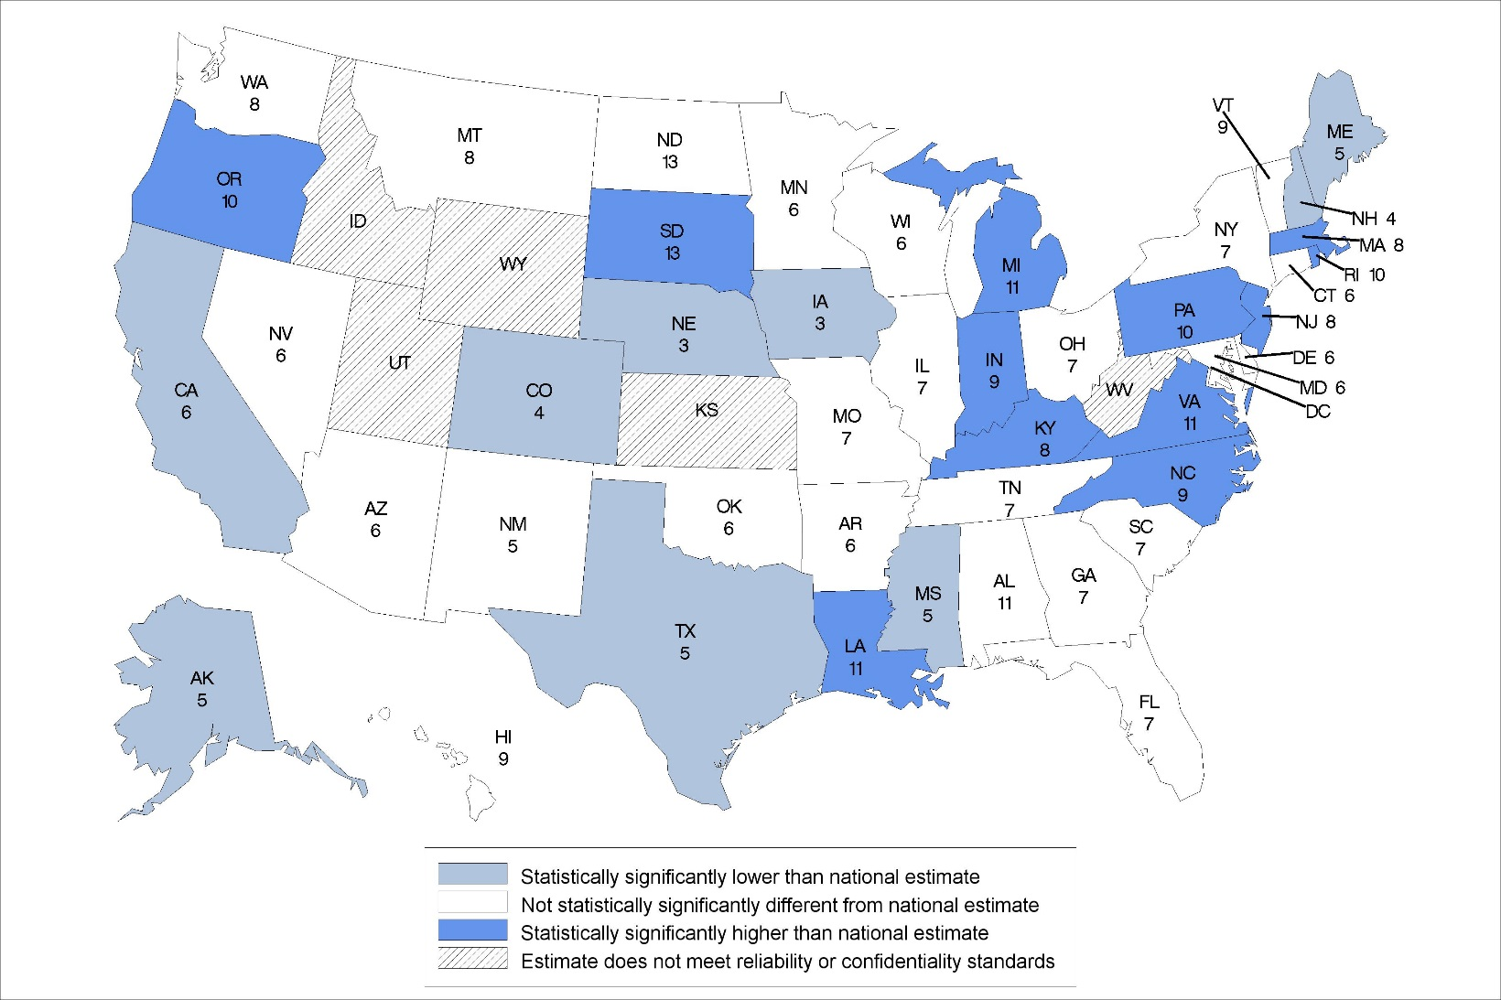
Percentage of adult day services center participants that had emergency room visits in the last 90 days: United States, 2014
Statistical significance tested at p<0.05.
Note: The national percentage is 7%.
Source: NCHS, National Study of Long-Term Care Providers, 2014
Notes:
In 2014, the national percentage of adult day services center participants that had any emergency room visits was 7%.
The percentages ranged from 3% in Iowa and Nebraska to 13% in South Dakota.
The location of states statistically significantly higher than national percentage were concentrated mostly in the Northeast region of the country.

