Slide 1
Behind International Rankings of Infant Mortality: How the United States Compares with Europe Marian MacDorman and T.J. Mathews Division of Vital Statistics National Center for Health Statistics Acknowledgements: Sam Notzon and Jennifer Madans, NCHS International Health Rankings: A Look Behind the Numbers National Conference on Health Statistics August 16-18, 2010

Slide 2
Infant mortality rate, United States, 2000-2007
Source: 2000-2006 data are from the linked birth/infant death data sets. 2007 data are from the main mortality file.

Slide 3
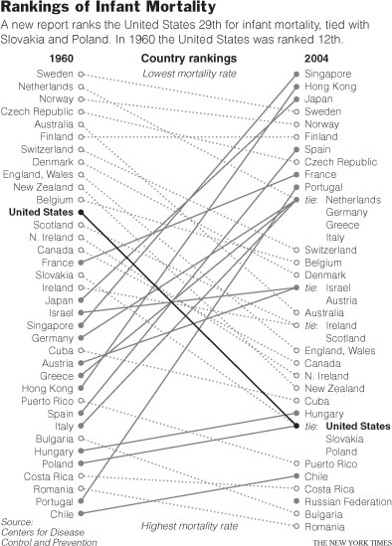

Slide 4
Infant mortality rates, selected countries, 2005
Source: Health, United States, 2008

Slide 6
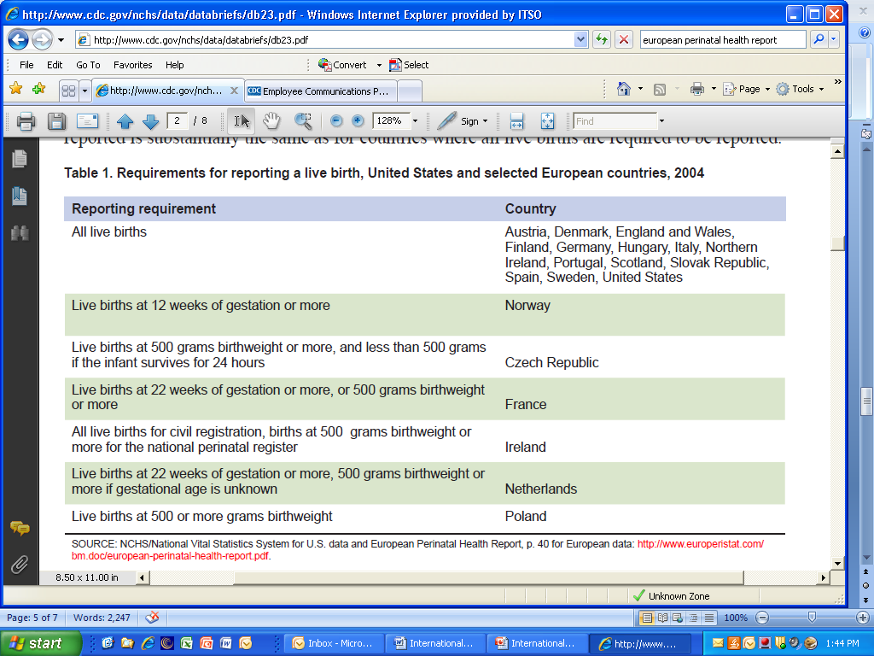

Slide 7
Infant mortality rates excluding births at <22 weeks of gestation, US and selected European countries, 2004

Slide 8
Infant mortality can be partitioned into two key components:
Gestational age-specific infant mortality rates (i.e. the mortality rate for infants at a given gestational age).
2. Distribution of births by gestational age.

Slide 10
Percentage of preterm births, United States and selected European countries, 2004
Note: Excludes births at <22 weeks of gestation to promote comparability between countries. Preterm births are those from 22 to 36 weeks of gestation. Source: NCHS linked birth/infant death data set (for US data), and European Perinatal Health Report (for European data).

Slide 11
Infant mortality rate for the US and Sweden, and the US infant mortality rate standardized for Sweden’s gestational age distribution, 2004
Note: Excludes births at <22 weeks of gestation

Slide 12
Conclusions
In 2005, the United States ranked 30th in the world in infant mortality.
Some differences exist in reporting of very small infants.
These reporting differences are not the primary explanation for the United States’ relatively low international ranking.
In 2005, 22 countries had infant mortality rates of 5.0 or below.
One would have to assume that these countries did not report more than 1/3 of their infant deaths for their infant mortality rates to equal or exceed the US rate.
This level of underreporting appears unlikely for most developed countries.

Slide 13
Conclusions (cont.)
Infant mortality rates for preterm infants are lower and rates for full-term infants are higher in the US than in Europe.
In 2004, 1 in 8 US infants were born preterm compared to 1 in 16 in France and Sweden and 1 in 18 in Ireland and Finland.
If the United States had Sweden’s distribution of births by gestational age, nearly 8,000 infant deaths in the US would be averted each year, and the US infant mortality rate would be 1/3 lower.
The main cause of the US’ high infant mortality rate when compared to Europe is the very high percentage of preterm births in the US, the period when infant mortality is greatest.

Slide 14
Full report available at:
http://www.cdc.gov/nchs/
data/databriefs/db23.pdf
Questions?
Marian MacDorman
mfm1@cdc.gov

