Slide 1
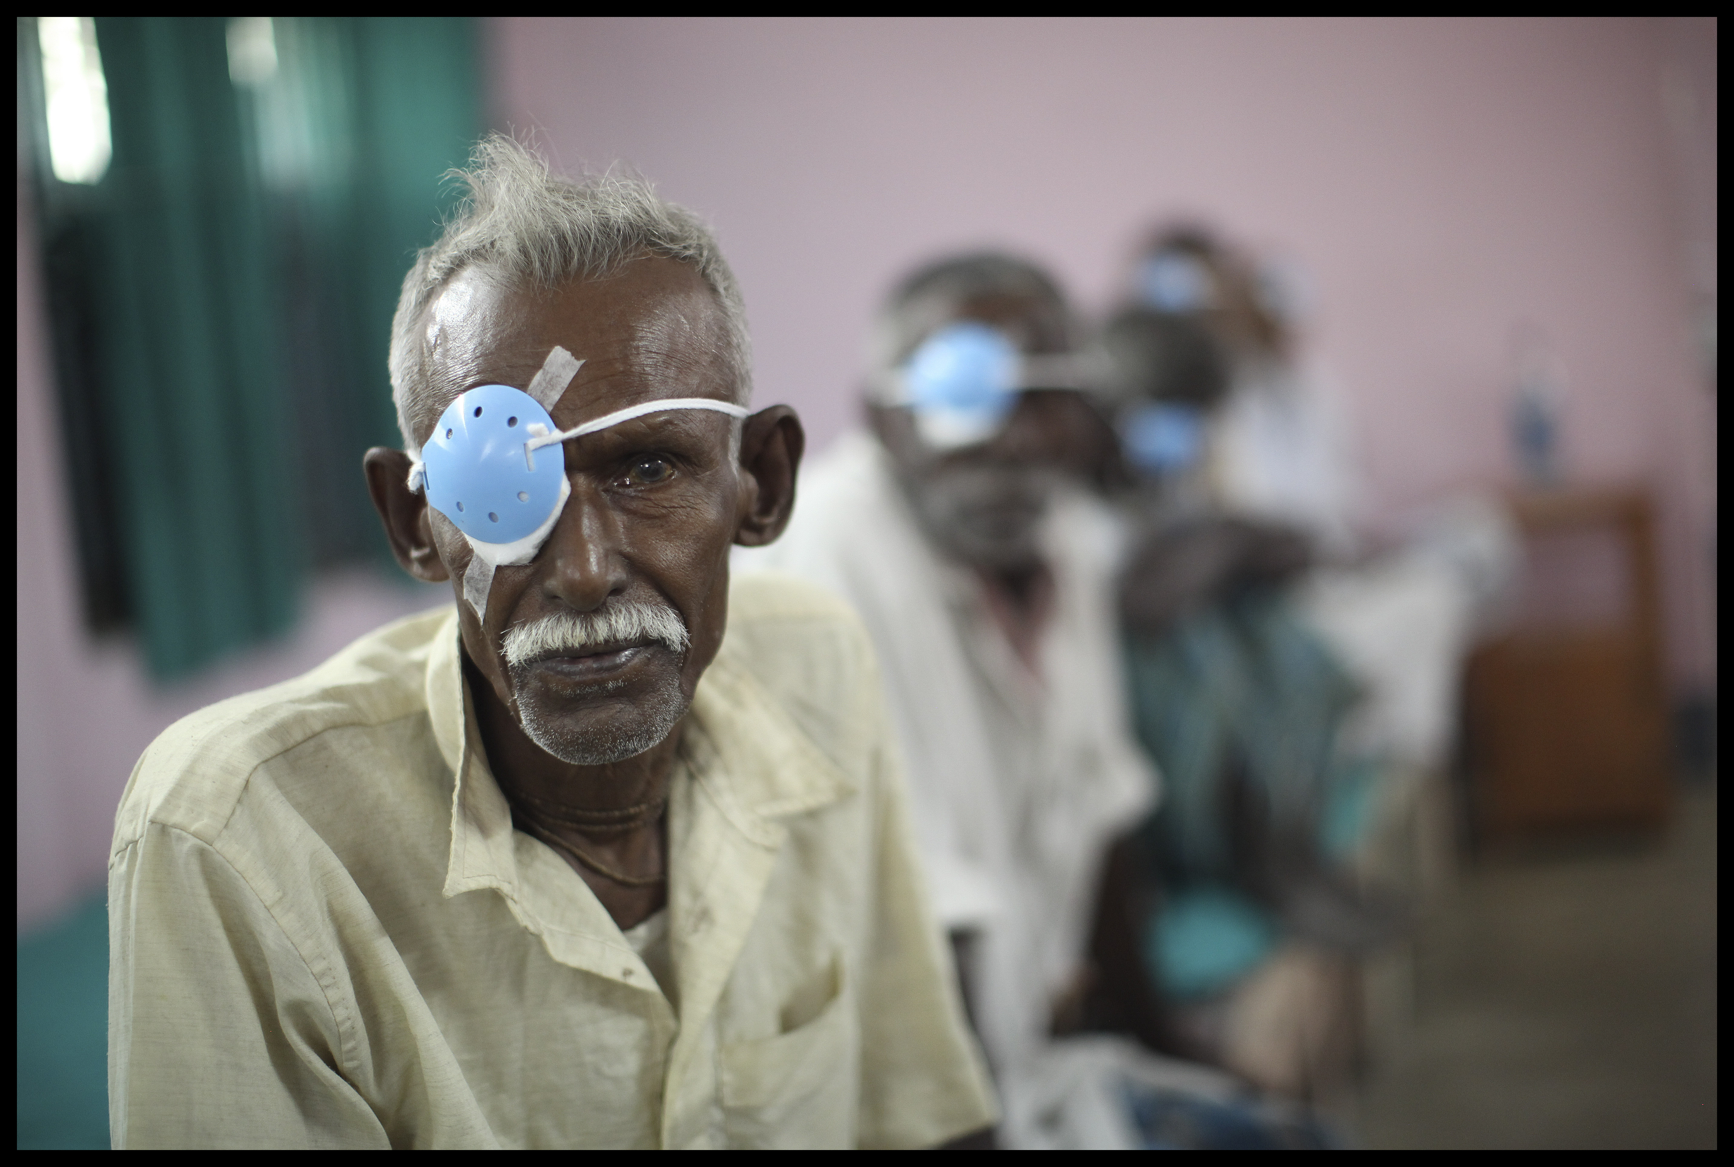
Piloting Disability Disaggregation in Routine Data Collection
-
A pilot in eye health

Slide 2
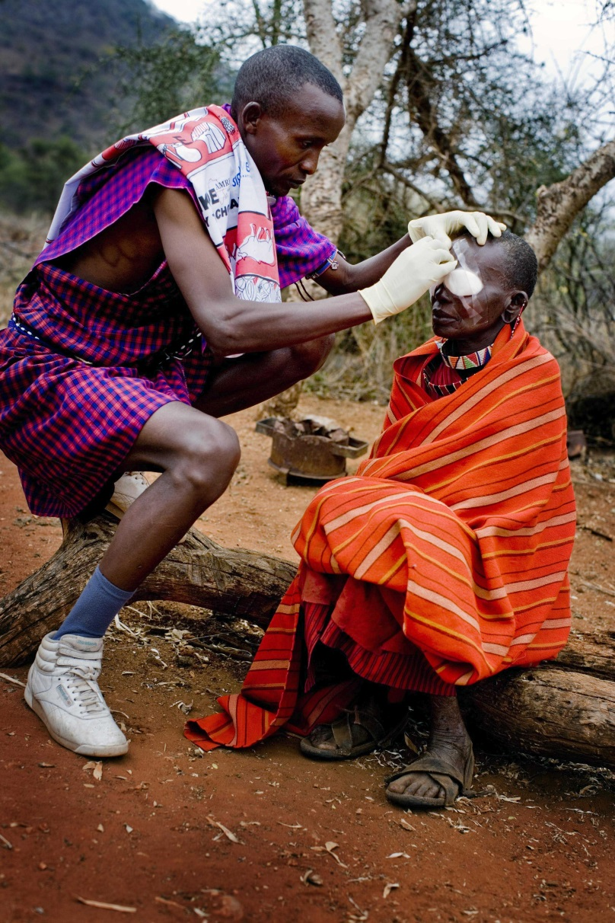
Sightsavers
NGO founded in 1950
Vision: a world where no one is blind from avoidable causes and where visually impaired people participate equally in society
Annual income of ~£50 million p.a. (£200 million including in-kind drug donations)
Employs >350 staff in > 30 countries

Slide 3
Disability Disaggregation pilot project
The objectives of this project are to:
Understand whether people with disabilities are accessing our services
Build the evidence base to inform our own work, share with others and demonstrate the clear case for collecting disability data
Ultimately make Sightsavers projects more inclusive of people with disabilities.
The two pilots are:
Eye Health Project in Bhopal, India
Neglected Tropical Disease (NTD) Project in Tanzania

Slide 4
Data Collection
Data on disability integrated in to routine data collection
Using the WG short set of questions
Integrated as a demographic variable in existing data collection tools
As this is a pilot we monitored:
Experiences of people involved in the project
Quality of the data collected
Evaluation questions: How can data disaggregated by disability be collected on a project level in a resource efficient way that is useful to policy and decision makers.

Slide 5
Process findings and challenges from Tanzania and India
Context: No single approach to data collection
Planning & flexibility: Data systems can be resistant to change
Ownership: Data collectors (& others) need to understand why data on disability is important
Expectations: Patients need to understand why we are collecting this data
Capacity: Analysing the data is necessary to initiate change
But … the process of engaging in the data collection has in itself a transformative effect.

Slide 6
Initial data from Bhopal, India
On the data: A basic analysis of the data collected on over 16,000 patients in India during the first 10 months of the pilot shows that:
Prevalence of disability varies greatly depending on the cut-off used.
Reporting disability is linked to the location of services.
Prevalence of disability varies by sex depending on the definition of disability used.

Slide 7
Initial data from Bhopal, India
What proportion of our clients have a disability?
15% of project clients report severe or completely limiting difficulties in at least one domain.
7% when we exclude the sight domain.
0.7% when we ask them directly if they are disabled (as in the national census).
*preliminary results subject to further data and analysis

Slide 8
Initial data from Bhopal, India
Prevalence among clients according to service location:
Clients are 6 times more likely to report a disability at the primary centre than the secondary centre
This rises to over 19 times when excluding the sight domain
Males are twice as likely to go to the tertiary centre than females.
Females are more likely to report functional difficulties
Males are more likely to respond positively to direct questioning.
*preliminary results subject to further data and analysis

Slide 9
WG Questions - lessons and challenges from Tanzania and India
Translate, translate, translate.
Qs 1 and 2 proved problematic in Hindi and were over complicated.
Several iterations of testing has improved the speed and ease of asking
Analysis can be tricky without statistical expertise
Technical skills mean a delay in programme staff accessing data
Develop a user friendly software package for auto-analyses

Slide 10
WG questions – lessons and challenges from Tanzania and India
Questions 5 and 6 (domains: self-care and communicating) cause issues:
Clients with no difficulties bored by this point
Some report finding the questions offensive
Staff feel clients answer ‘No difficulty’ repetitively just to finish quickly
Conducted a sensitivity analysis to understand how excluding these questions would change our results

Slide 11
WG questions – lessons and challenges from Tanzania and India
How does prevalence change when we remove the two domains?

Slide 12
What next?
India:
Created awareness and demand which did not exist
Partner organisations changed community communication practise and referrals
Confirmed plans for Sightsavers to pilot inclusive approaches to eye health to improve accessibility to services we support in 2016.
Tanzania: end of project evaluation November 2015
Ghana: new pilot, data collection taking place in 2016
Mass Drug Administration in general population for neglected tropical diseases.
Community data collectors

Slide 13
Lessons for replication?
Disaggregation requires commitment to include people with disabilities in services
It is only the beginning of a fundamental shift to inclusive services
The data collection process itself can awaken the need for inclusive services and stimulate the demand to provide them.
Before investing in data systems, it is imperative to ensure that the data can and will be used by people with power to implement change.

Slide 14
