Slide 1
ILO’s work and planned activities on the measurement of labour force characteristics of people with disability Valentina Stoevska, ILO Department of Statistics

Slide 2
Background Current national practices in the collection and compilation of statistics on labour force status of people with disabilities Questions covered in specialized disability surveys and modules Priority actions in 2016 and beyond Some statistics
Overview

Slide 3
Background
UNSC 2014: promote the collection of statistics on persons with disabilities (in line with the UN Convention on the Rights of Persons with Disabilities)
to understand the situation of people with disabilities
to inform disability policies , program development and service delivery
to report against national, regional and international conventions and strategies
to advocate for the rights of people with disabilities
SDG framework: need for more attention to persons with disabilities and more attention to statistics (disability as cross cutting issue)

Slide 4
Policy questions
How large is the disabled population and what is their social-demographic profile?
How many of these people are economically active/ employed?
Is there a difference between countries in the percentage of people with disabilities in employment and, if so, why?
How many people with disabilities could be integrated into the work force should the obstacles be removed?
What are the economic conse­quen­ces of ex­clu­ding people with di­sabilities from the labour market, as well as costs and be­ne­fits from in­clu­ding this group into the labour force?

Slide 5
ILO: Objectives improving employment opportunities for people with disabilities
Understanding the needs/ obstacles in the labor market
planning and designing
policies and interventions
monitoring the effect of different policies/legislation/services
Need for disability statistics cross-classified by various labour force characteristics

Slide 6
ILO objectives
Establishing guidelines, and developing survey instruments, to assist countries in setting or improving their statistics on the labour force characteristics of persons with disabilities (by analysing the methodologies currently used by countries to compile statistics)
Compilation of statistical information, and establishing a database

Slide 7
ILO’s compilation re sources of labour force characteristics of people with disabilities
Data were identified for 118 countries with data on labour force status of people with disabilities
Asia 39
Africa 33
Europe 44
America 20
Oceania 4
More than 140 data sources found (more than 80 data come from household surveys)
Most of the surveys conducted over last 10 years
Includes definitions, questionnaires, methodology used, and any other available supporting documentation
Statistical reports/publications for more than 60 countries

Slide 8
DESCRIPTIONS - structure
Source
- Organisation responsible
- Type of source
- Periodicity
- Reference period
Coverage
- Disabilities
- Persons
- Economic activities
- Sectors
- Employment situation
- Status in employment
- Geographic areas
- Establishments
Terms and Definitions
Term for disability
Definition of disability
Source of the definition
Questions used in the source
Minimum duration
Classifications
Dissemination
Publications
Website
Other (survey questionnaires)

Slide 9
Dissemination
ILO’s publication, Compendium of national methodologies: Statistics on the labour force characteristics of people with disabilities
It includes a synoptic tables summarizing the main characteristics of data sources
http://www.ilo.org/surveydata/index.php/catalog/DISABILITIES/about

Slide 10
Overall picture
Difficult to get timely, reliable, comparable statistics on labour force characteristics of people with disabilities
The quality and quantity of data available varies enormously across the world
Disability is not systematically monitored (variable covered but not processed against labour force characteristics)
Variety of sources (varying degree of limitations)
Censuses
Household surveys and specialized disability surveys
Various types of administrative data
Establishment surveys
Different classifications, concepts, definitions and questionnaires
Different indicators
Reported employment-to-population ratios vary from less than 10% to more than 60%

Slide 11
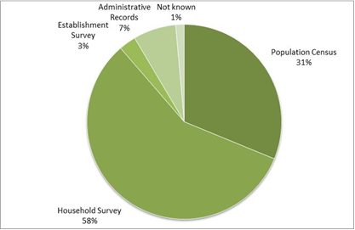
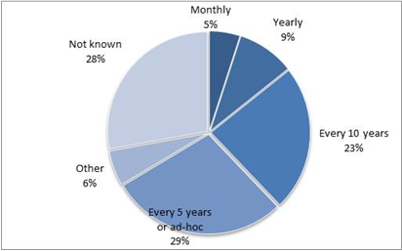
Type of sources (118 countries) Periodicity of data collection (118 countries)

Slide 12
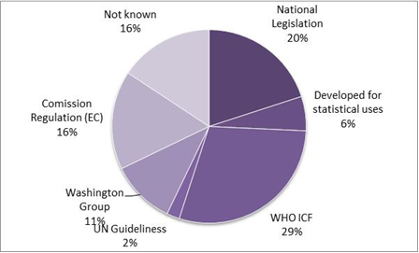
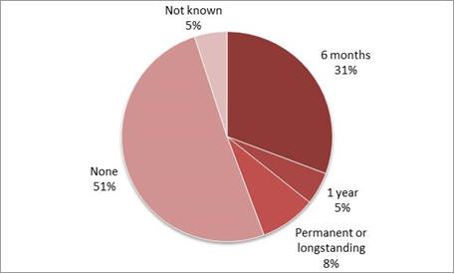

Slide 13
Questions used to identify persons with disabilities
Direct questions related to impairment/body functioning (but also registered work related disability)
The respondent is directly asked if she/he is disabled, or
The respondent is asked if she/he has physical impairment; visual impairment; deafness/hearing impairment; muteness/severe speech problem; deaf-mute; permanent disfigurement; psychiatric and intellectual disability; multiple disability; paralyzed;
Questions related to difficulties people face while performing daily activities
The respondent is asked if she/has difficulties in performing activities of daily living such as seeing, hearing, speaking, remembering, concentrating or communicating, mobility difficulties, etc.
Questions related to limitations/participation in the labour market (kind and amount of work they can do)

Slide 14
Specialized disability surveys and modules Type of questions asked
type of disability,
degree of disability,
duration of disability,
origin of disability,
age at the beginning of the disability,
use of support equipment, technology,
obstacles faced,
need for support/assistance and amount of assistance,
need for special equipment/adaptation of workplace,
transport means used, access to housing and public buildings,
perception of discrimination against people with disability,
membership in institutions related to disability,
use of special programs,
registration/medical certification.
EU Member States, Australia, Bangladesh, Canada, Chile, Ethiopia, Hong Kong, Hungary, India, Israel, Jordan, Lao, Malawi, Myanmar, Namibia, New Zealand, Peru, Spain, Swaziland, Tanzania, Thailand, Togo, Turkey, Uruguay, US, Vietnam, Zambia

Slide 15
ILO’ s priority actions in 2016 and beyond
Close the data gap - assemble, evaluate and organize available data and metadata on the labour force status of people with disabilities
The dataset would cover, wherever available employment, unemployment not in the labour force, by sex, age, type of disability, severity of disability employment in private/public sector, hours worked
Enhance the knowledge-base by releasing labour market indicators for people with/without disabilities and analysis.
Support countries to develop their own capacity for monitoring disability (minimum set) in censuses and household surveys (e.g. labour force surveys) and strengthen countries’ capacity to gather and disseminate sound, relevant and comparable data on labour force status of people with disability
Develop specialized module on the labour force characteristics of persons with disabilities (and obstacles they face in the labour market) in consultations with Washington group, other international/regional fora, countries and interest groups

Slide 16
LFS and other HH-based surveys
Include the minimum set of disability questions (developed by WG) in regular survey(s)
Cross-tabulate labour force characteristics against disability status
Disseminate and analyse the data

Slide 17
LFS specialized module (1)
Draft module is being developed in partnership with the Washington Group on Disability Statistics
The primary purpose of the module is to collect information on the barriers people with disabilities face in the labour market and their needs/use of workplace accommodations, but also attitudes at the labour market
Module can be included in any data collection that covers labour force, at least every 3-5 years (but need for an appropriate sampling design to capture these small populations)

Slide 18
LFS Module (2)
Short set of questions
Barriers in law
Barriers in inaccessible built environment
Barriers in transportation
Attitudes
Access to information
Onset of disability (from birth/childhood/adulthood)

Slide 19
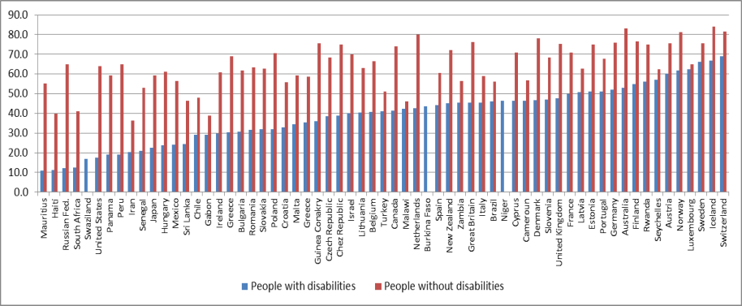
Employment-to-population ratio

Slide 20
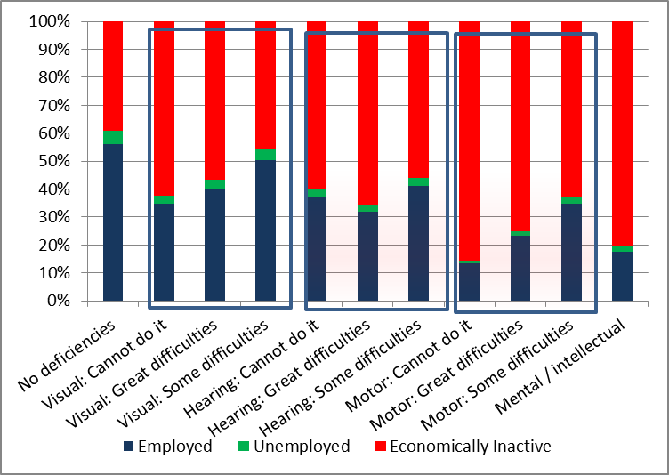
Brazil, PC 2010, Labour force status of persons aged 10+, by type of deficiency, %

Slide 21
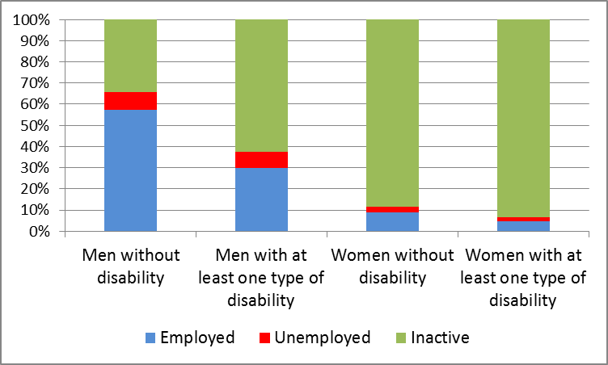
Iran, Population aged 10+, by disability status, sex and activity status, 2011

Slide 22
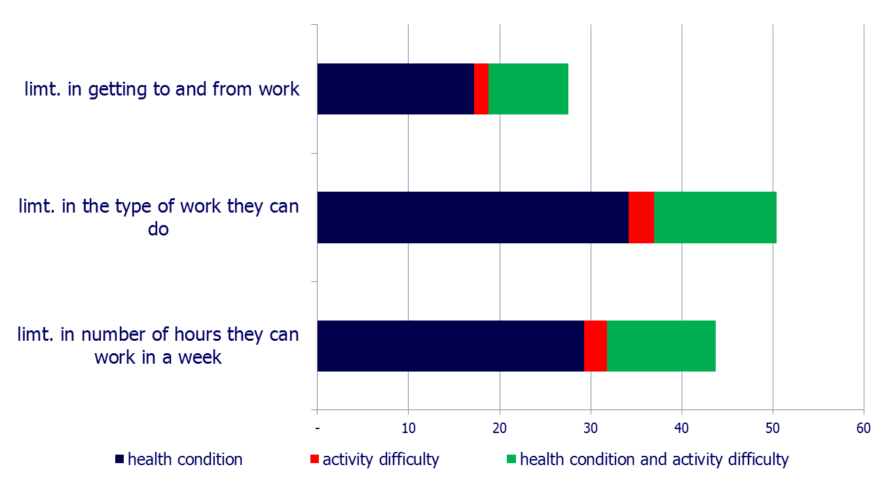
Poland, LFS 2011 , % of persons indicating longstanding health conditions, or difficulties in basic activities by type of limitations in performing work

Slide 23
Thank you!

